Slide 1


Transitioning to Adulthood with Ataxia
A Virtual Event
March 17-19, 2022

Slide 2




DISCLAIMER
The information provided by speakers in any presentation made as part of the 2022 NAF Annual Ataxia Conference is for informational use only.
Products or series mentioned during these presentations does not imply endorsement by NAF
NAF encourages all attendees to consult with their primary care provider, neurologist, or other healthcare provider about any advice, exercise, therapies, medication, treatment, nutritional supplement, or regimen that may have been mentioned as part of any presentation.
2022 AAC
A Virtual Event
March 17-19

Slide 3
Our speakers
Dr. Kristin Barañano
Cindy De Mint
Courtney Ng
2022 AAC
A Virtual Event
March 17-19

Slide 4
PRESENTER DISCLOSURES
Dr. Kristin Barañano
Cindy De Mint
Courtney Ng
No relationships to disclose or list
2022 AAC
A Virtual Event
March 17-19

Slide 5
Top questions for your neurologist during adolescence into adulthood
Dr. Kristin Barañano
A Virtual Event
March 17-19, 2022

Slide 6
Top questions and how your neurologist can help
Do we need to find a new neurologist?
What should we expect to change during our visits?
How can our neurologist help with school?
What about driving?
What happens after high school?
What happens at age 18 with decision making?
What about health insurance?
What about disability?
2022 AAC
A Virtual Event
March 17-19

Slide 7
Do we need to find a new neurologist?
2022 AAC
A Virtual Event
March 17-19

Slide 8
What should we expect to change during our visits?
Introduction of individual time during visits
Exploring adolescent’s understanding of their disorder
Promote adolescent responsibility for self-care and self-advocacy
2022 AAC
A Virtual Event
March 17-19

Slide 9
What should we expect to change during our visits?
Introduction of individual time during visits
Exploring adolescent’s understanding of their disorder
Promote adolescent responsibility for self-care and self-advocacy
This transition takes place even if the provider doesn’t change!
2022 AAC
A Virtual Event
March 17-19

Slide 10
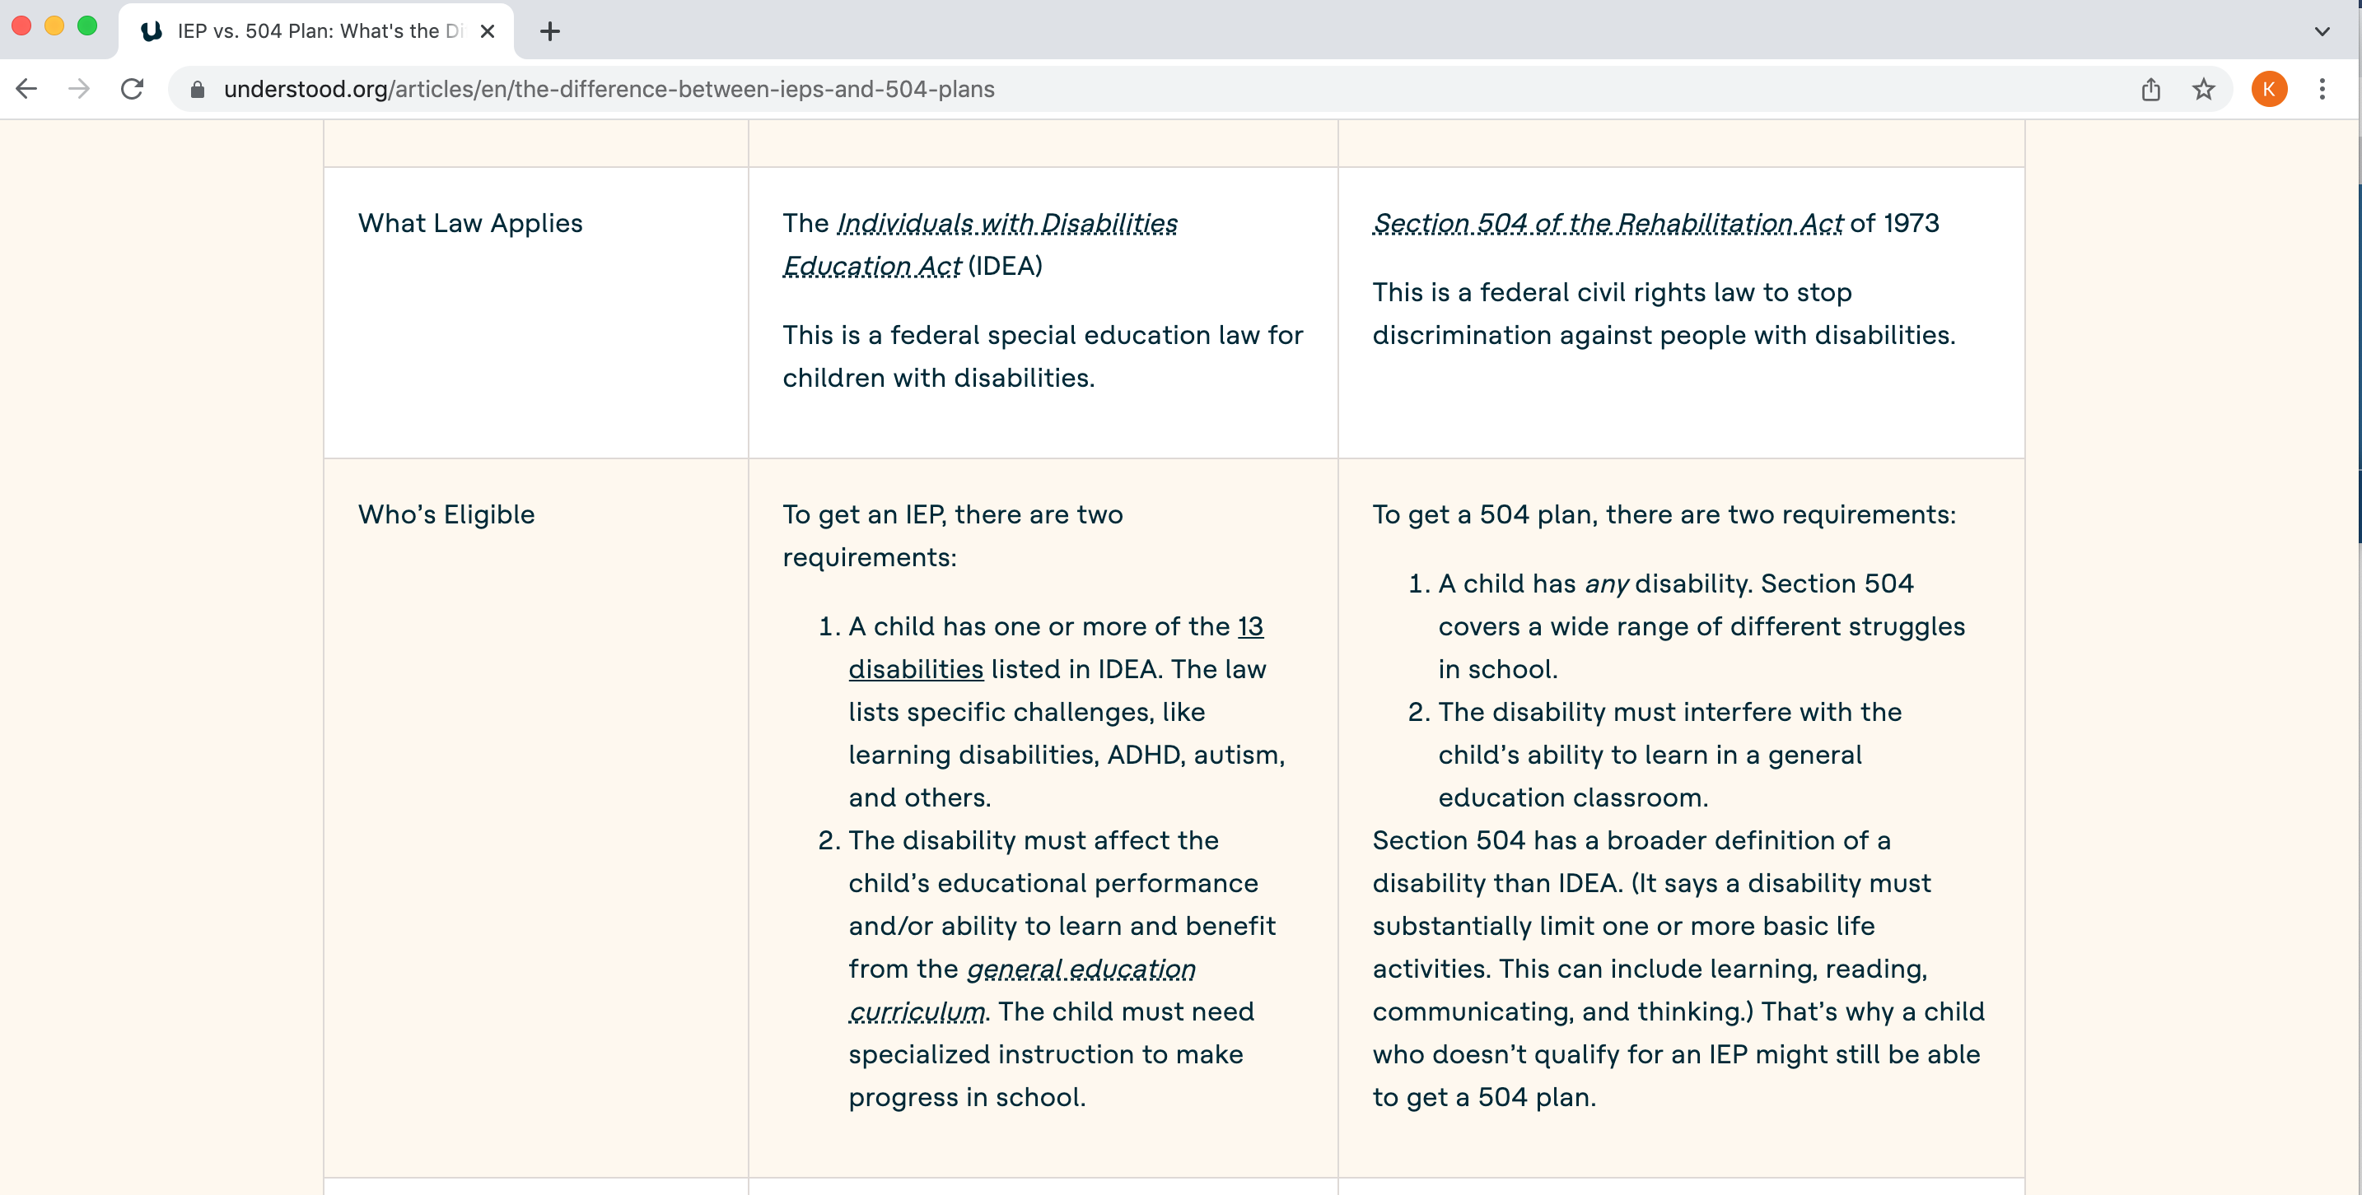
How can our neurologist help with school?
2022 AAC
A Virtual Event
March 17-19

Slide 11
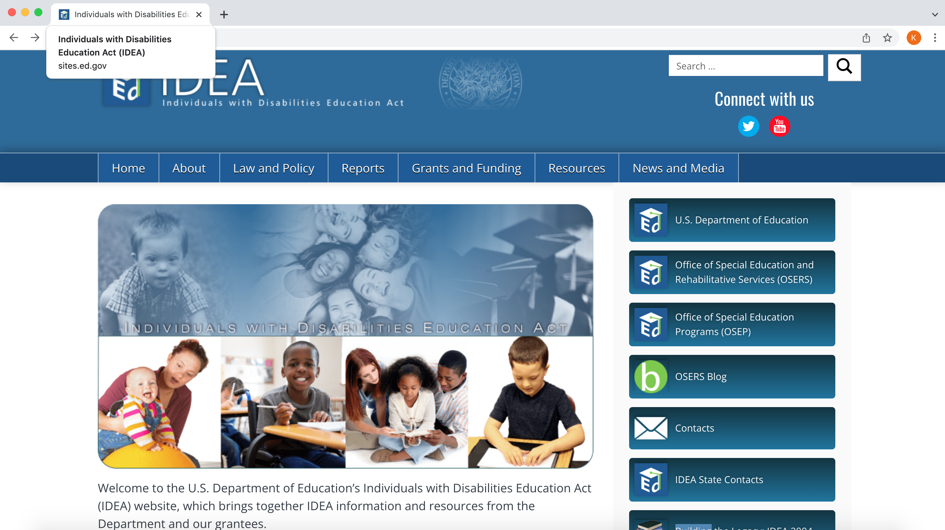
2022 AAC
A Virtual Event
March 17-19

Slide 12
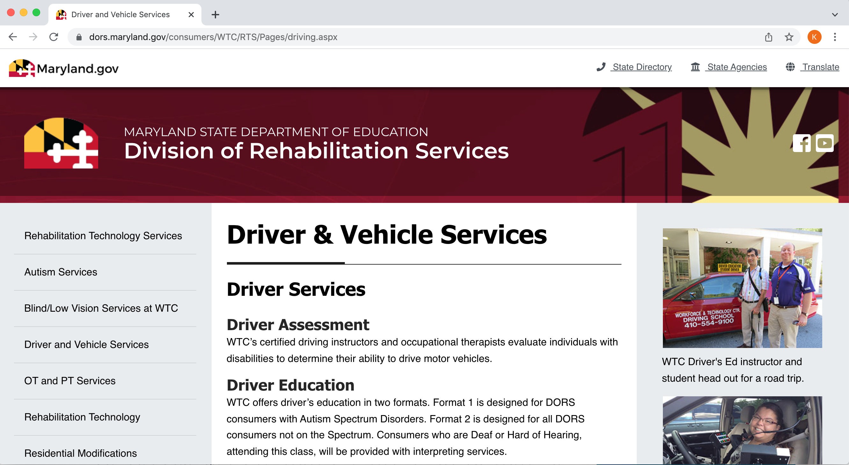
What about driving?
2022 AAC
A Virtual Event
March 17-19

Slide 13
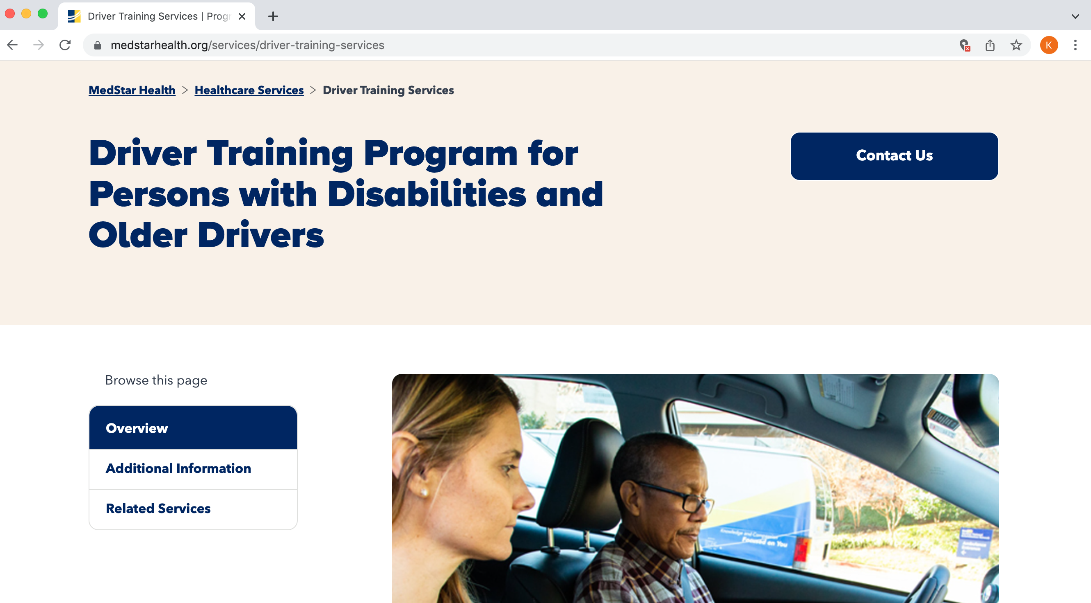
2022 AAC
A Virtual Event
March 17-19

Slide 14
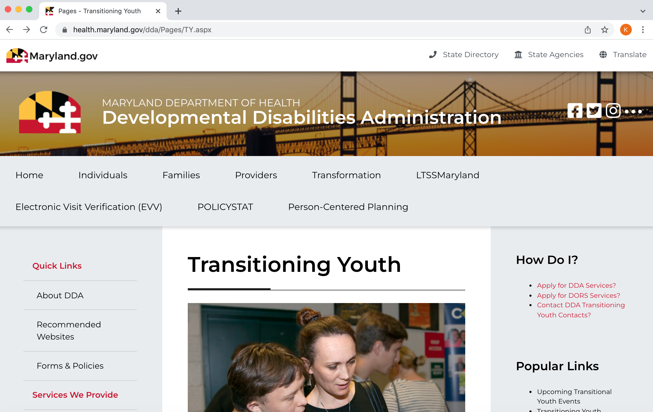
What happens after high school?
2022 AAC
A Virtual Event
March 17-19

Slide 15
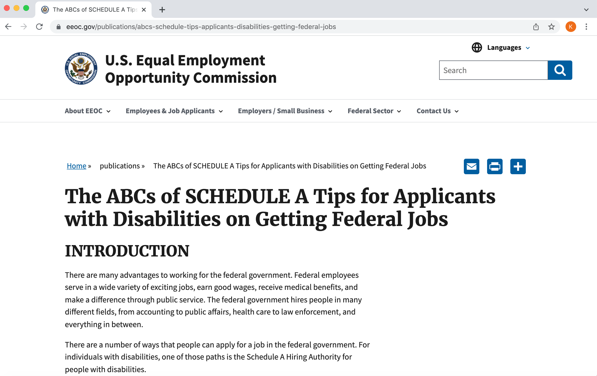
2022 AAC
A Virtual Event
March 17-19

Slide 16
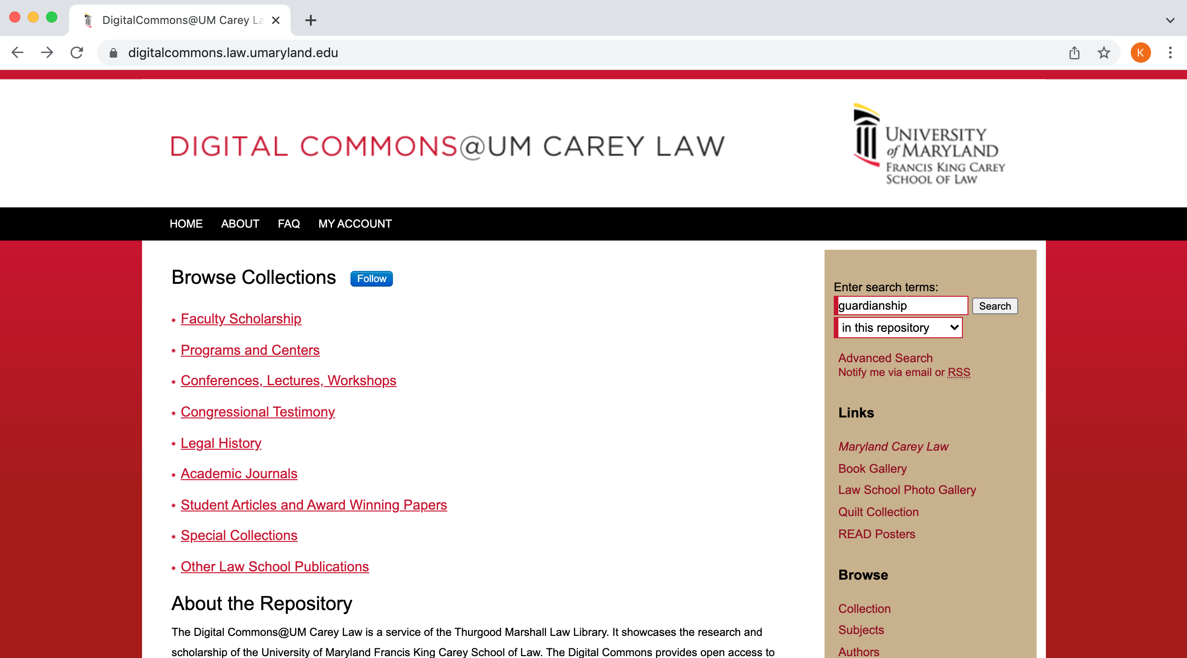
What happens at age 18 with decision making?
2022 AAC
A Virtual Event
March 17-19

Slide 17

2022 AAC
A Virtual Event
March 17-19

Slide 18
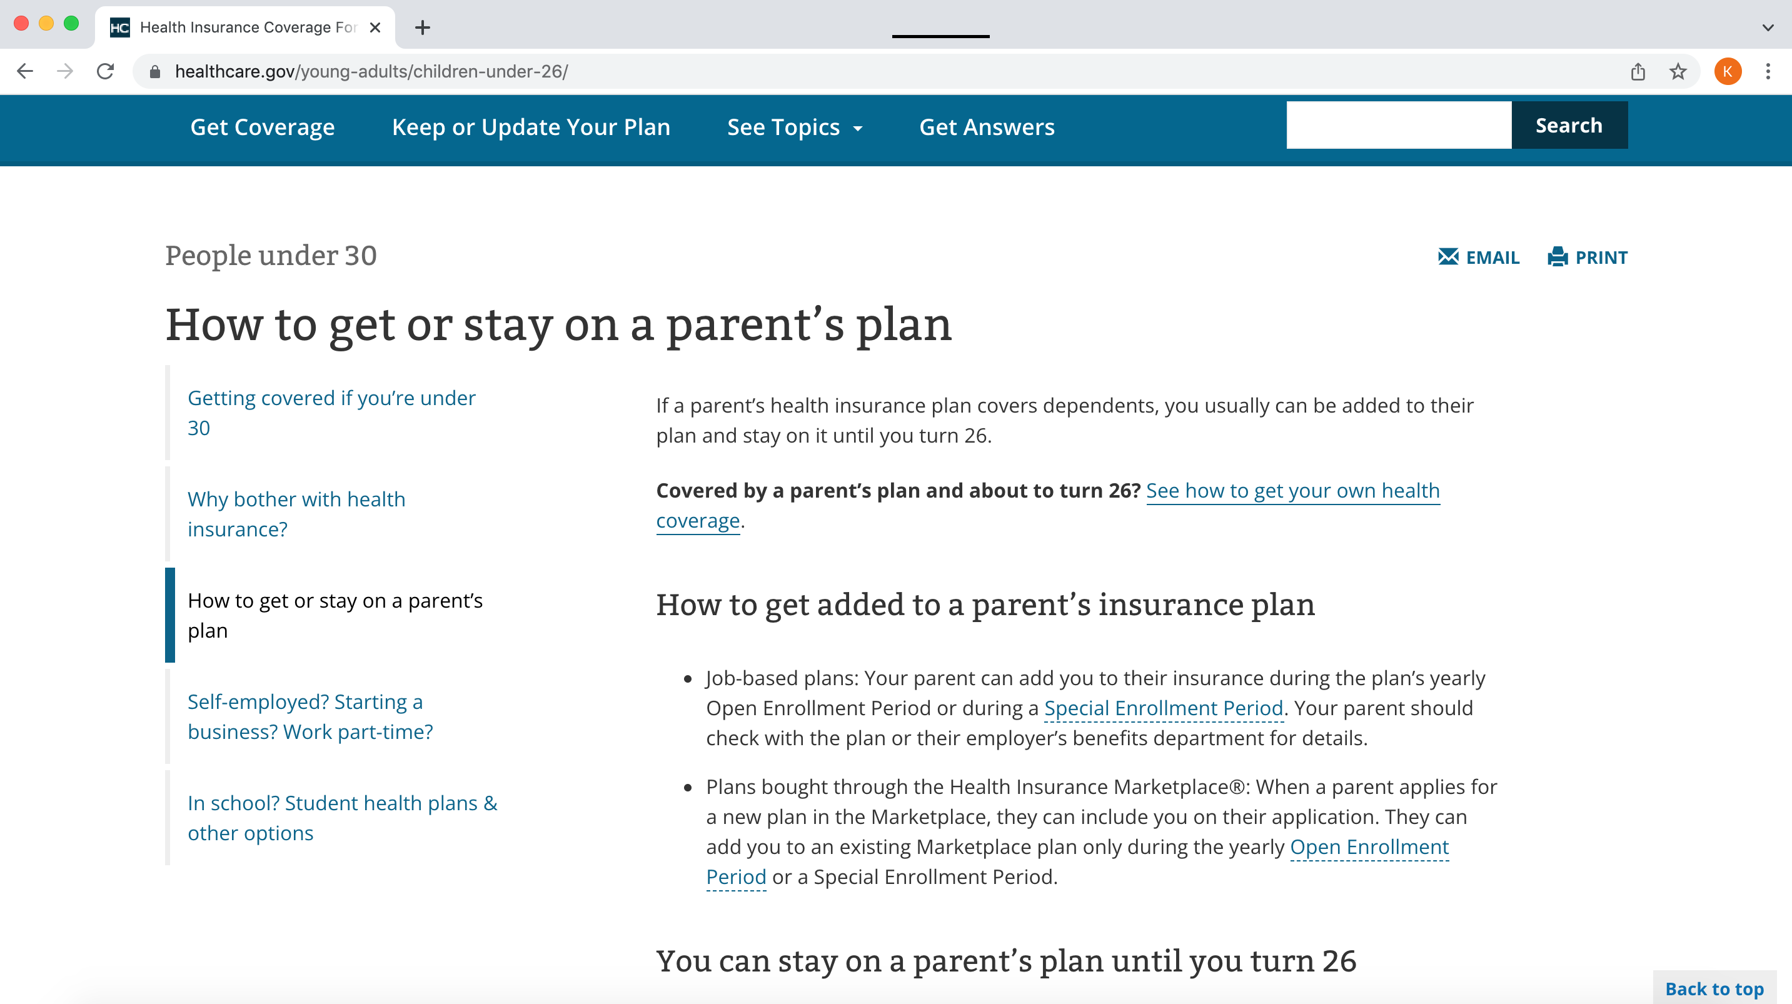
What about health insurance?
2022 AAC
A Virtual Event
March 17-19

Slide 19
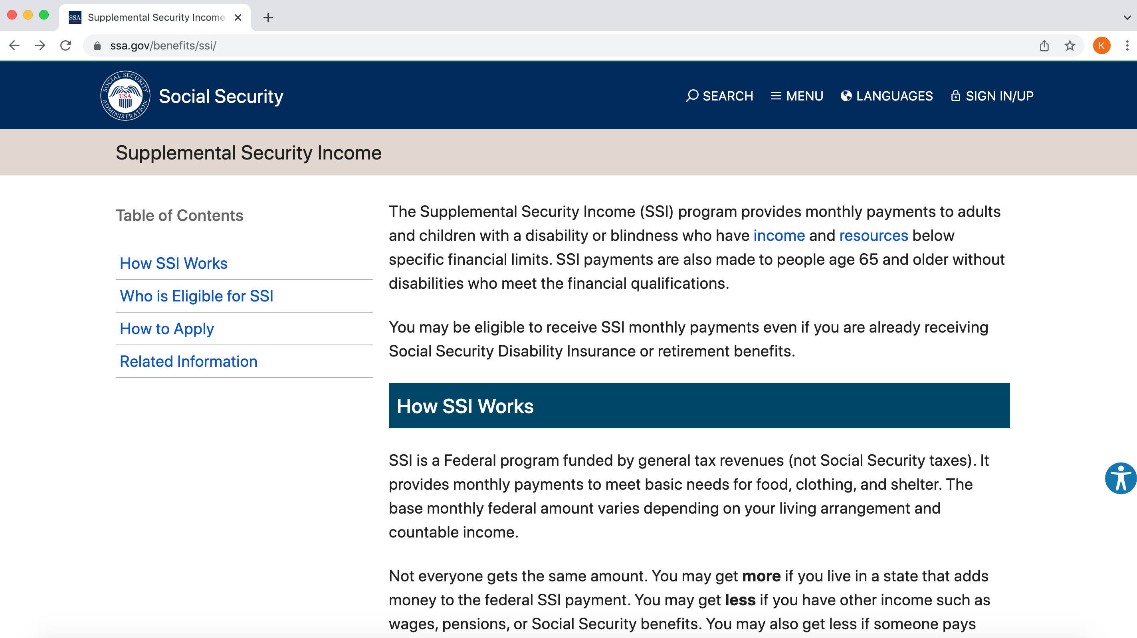
What about disability?
2022 AAC
A Virtual Event
March 17-19

Slide 20
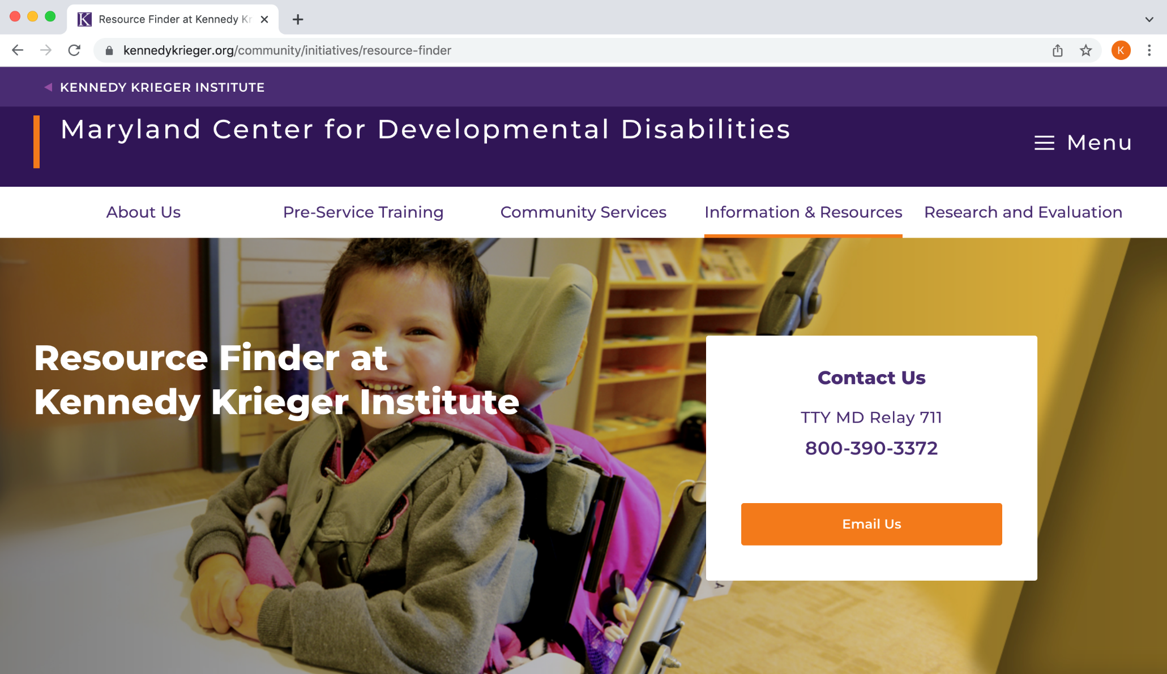
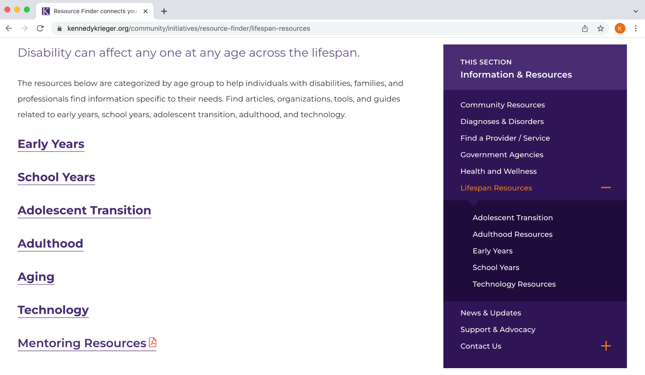
2022 AAC
A Virtual Event
March 17-19

Slide 21
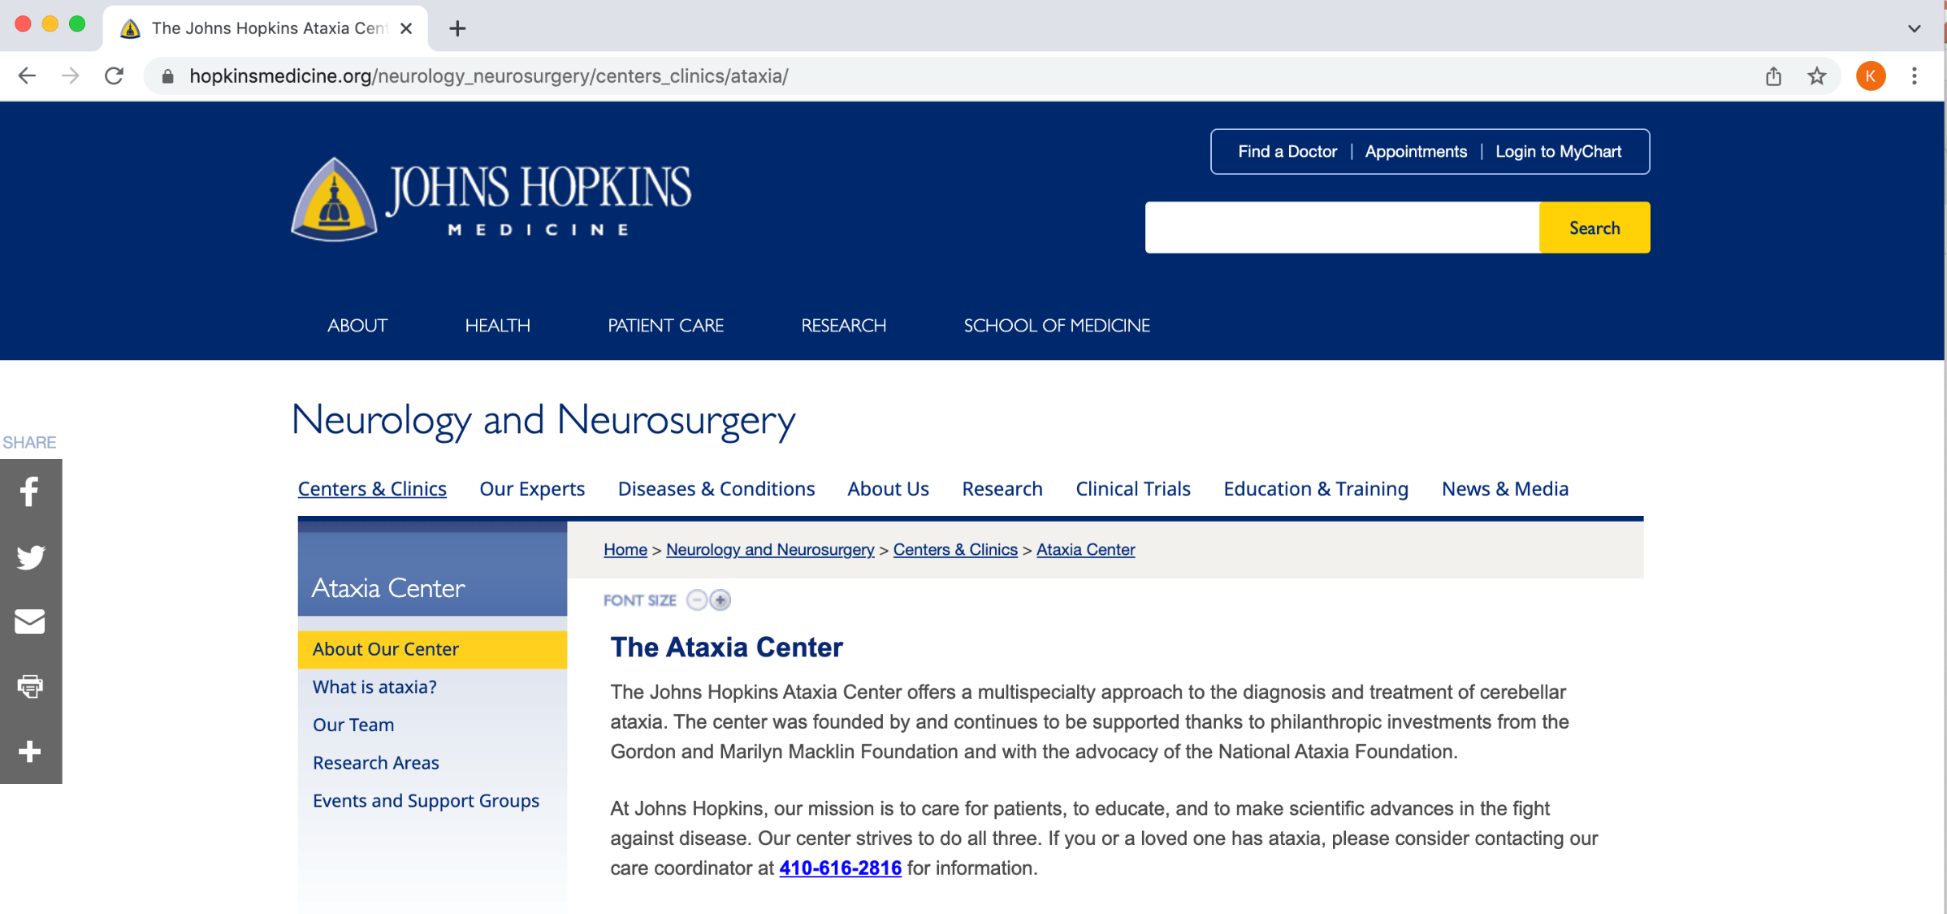
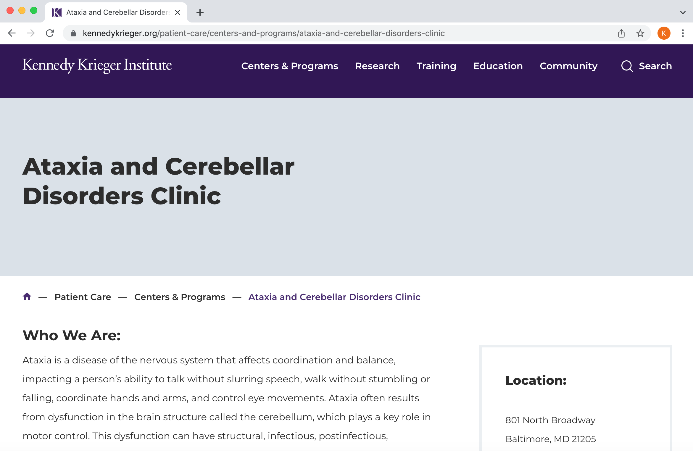
kwb@jhmi.edu
2022 AAC
A Virtual Event
March 17-19

