Slide 1
Ataxia Drug Treatments: Targets and Pipeline
Susan L. Perlman M.D.
Clinical Professor of Neurology at UCLA

Slide 2
DISCLAIMER
The information provided by speakers in any presentation made as part of the 2021 NAF Annual Ataxia Conference is for informational use only.
NAF encourages all attendees to consult with their primary care provider, neurologist, or other healthcare provider about any advice, exercise, therapies, medication, treatment, nutritional supplement, or regimen that may have been mentioned as part of any presentation.
Products or series mentioned during these presentations does not imply endorsement by the NAF.

Slide 3
PRESENTER DISCLOSURES
Susan L. Perlman M.D.
The following personal financial relationships with commercial interests relevant to this presentation existed during the past 12 months:
Member of Advisory Board or Consultant for Biogen, Biohaven, Chondrial, Eydel, Exicure, PTC, Reata, Seelos, Steminent.

Slide 4
Paradigm Shifts and Medical Progress
The birth of modern computing in the 1970’s served as a foundation for this all.
Infectious Disease | First Described | First Approved Drug | “Cure” | What new knowledge helped
HIV-AIDS | 1981 | 1987 Preventative 2014 | No vaccine. | Understanding how retroviruses hijack the cell.
Hepatitis C | 1989 | 1991 | 2014 No vaccine. | Understanding how the virus replicates. But public health crisis remains.
Prion disease | 1983 |  |  | Understanding how prions replicate
Genetic Disease
Duchenne Dystrophy | Gene discovered 1986 | Steroids--2017 | 2016 | Exon-skipping
Spinal Muscular Atrophy | Gene discovered 1995 | 2016 | DMT | Splicing repair of alternative gene
Friedreichs ataxia | Gene discovered 1996 |  |  | Understanding mitochondria Understanding gene regulation
Spinocerebellar ataxia | SCA1 gene in 1993 |  |  | Understanding gain of function
Non-genetic Ataxia
Multiple system atrophy | 1996 |  |  | Understanding synuclein

Slide 5
Resources for Ataxia Progress
Public-Private-Patient Partnership
NIH, FDA
National Ataxia Foundation, Friedreich’s Ataxia Research Alliance
NAF Drug Development Collaborative to bring Industry closer
Ataxia Global Initiative
MSA Coalition
Patients and Families like you, who are willing to step up

Slide 6
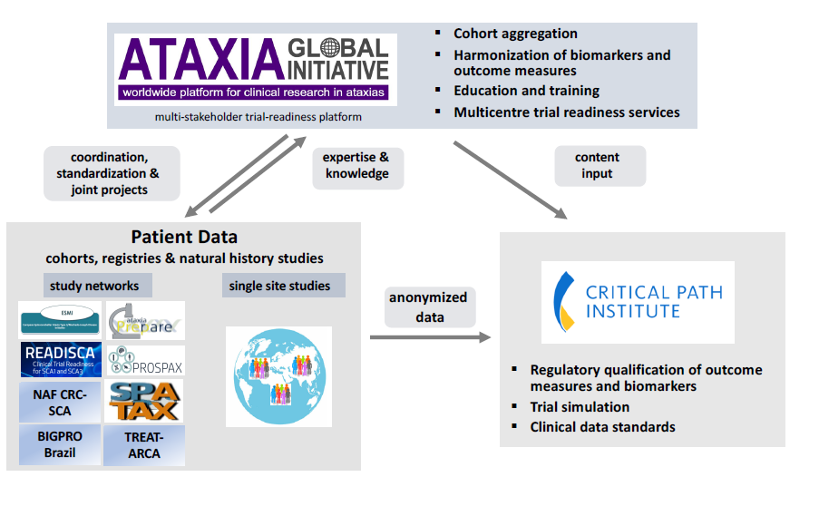
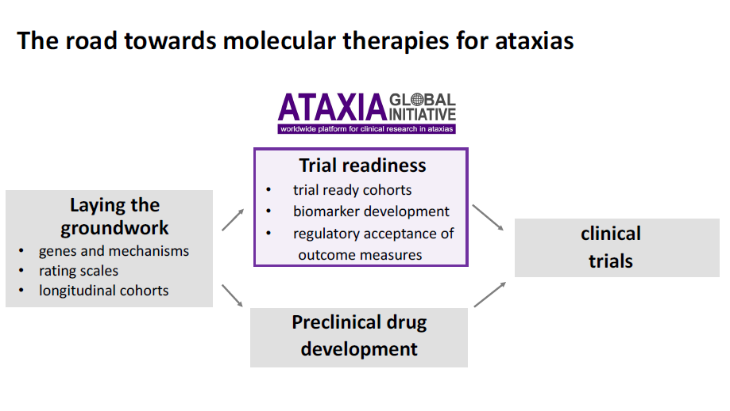
From the Ataxia Global Initiative
Thomas Klockgether, Matthis Synofzik, Holm Graessner

Slide 7
Targets for Ataxia Treatment
Nat Rev Neurol . 2018 Oct;14(10):590-605. Review
Spinocerebellar ataxias: prospects and challenges for therapy development
Tetsuo Ashizawa , Gülin Öz , Henry L Paulson

Slide 8
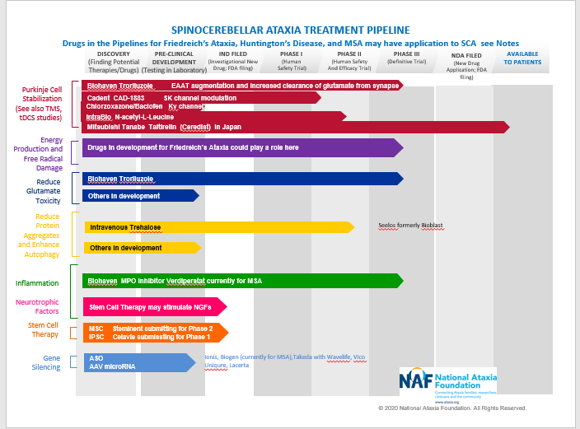
Ataxia Pipeline Today (updated August 2020)

Slide 9
Friedreich’s Ataxia Pipeline (FARA 2021)

Slide 10
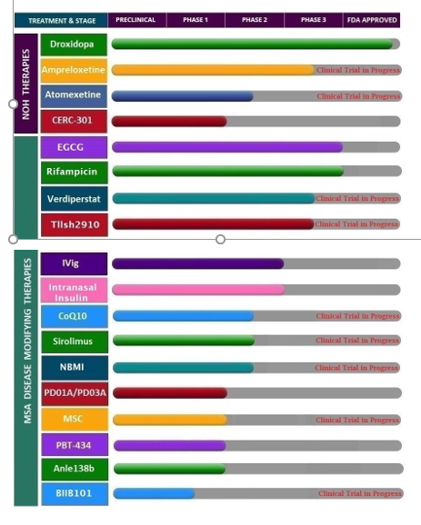
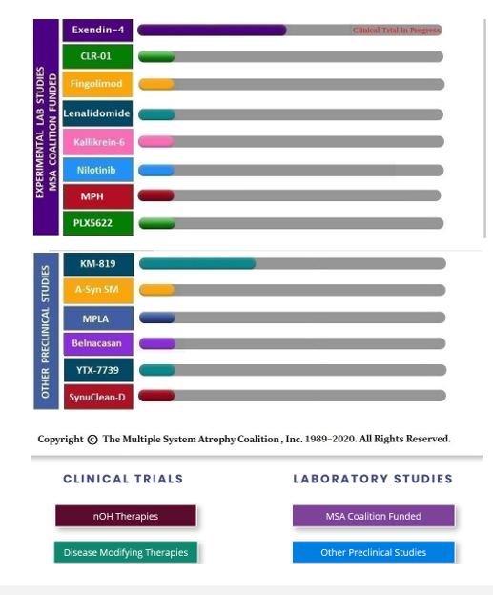
MSA Pipeline (MSA Coalition 2020)

Slide 11
What we are relying on you to do
Network with your support organizations here and abroad.
Join registries.
Participate in clinical trials, biomarker studies, natural history studies
Ask questions of your peers, your doctors, your researchers.
If you are frustrated or angry—use that energy to help shorten that historical 15 years that it takes to bring a good idea to an approved drug. We’ve already cut that in half.
Speak up to the FDA and to the drug companies about your goals.
Let’s make this the last generation of ataxia.

Slide 12
THANK YOU
STAY HEALTHY
STAY SAFE

