Slide 1
Physical Therapy Strategies Jennifer Millar and Jennifer Keller
A Virtual Event
March 17-19, 2022

Slide 2
DISCLAIMER
The information provided by speakers in any presentation made as part of the 2022 NAF Annual Ataxia Conference is for informational use only.
Products or series mentioned during these presentations does not imply endorsement by NAF
NAF encourages all attendees to consult with their primary care provider, neurologist, or other healthcare provider about any advice, exercise, therapies, medication, treatment, nutritional supplement, or regimen that may have been mentioned as part of any presentation.
2022 AAC
A Virtual Event
March 17-19

Slide 3
PRESENTER DISCLOSURES
Jennifer Keller, MS, PT
Kennedy Krieger Institute
Center for Movement Studies
Jennifer Millar, MS, PT
Johns Hopkins Ataxia Center
No relationships to disclose or list
2022 AAC
A Virtual Event
March 17-19

Slide 4
Outline
How does the cerebellum work?
Identify common impairments in people living with ataxia.
Imbalance
Limb ataxia
Dynamic oculomotor impairments
Identify motor learning strategies.
Discuss current rehab evidence in the literature.
Identify rehab evaluation tools and treatment principles.
Discuss safe mobility strategies.
Why seek rehabilitation?
2022 AAC
A Virtual Event
March 17-19

Slide 5
Outline
How does the cerebellum work?
Identify common impairments in people living with ataxia.
Imbalance
Limb ataxia
Dynamic oculomotor impairments
Identify motor learning strategies.
2022 AAC
A Virtual Event
March 17-19

Slide 6
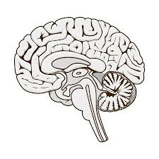
Basic neural pathway: Sensory input provides feedback to cerebellum contributing to motor output.
Symptoms
Vision
Oculomotor function
Bouncy vision
(oscillopsia)
Vestibular
Balance
Postural instability
Sensation
Coordination
Over/under shoot intended target
Cerebellum
Cerebellum is where movement coordination and motor learning occurs.

Slide 7
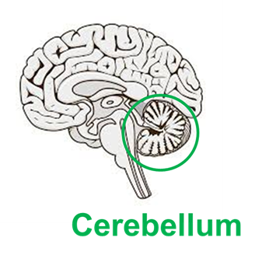
More on the role of the cerebellum Current evidence in motor learning research:
“It is thought that the brain does not simply react to sensory feedback, but rather uses an internal model of the body to predict the consequences of motor commands before sensory feedback arrives.
Zimmet A et al DOI: 10.7554/eLife.53246
Notes:
The cerebellum participates in an internal sensory prediction loop.
Predictions are compared with peripheral feedback to adapt (or learn) in response to changing environments.

Slide 8
Ataxia: Movement Incoordination
Main focus of this presentation:
Optimizing movement.
Different diagnoses may cause ataxia symptoms of varying severity:
Neurodegenerative (hereditary or unknown)
Autoimmune
Cerebrovascular accident
Trauma
Multiple Sclerosis

Slide 9
International Classification of Functioning (ICF) A model used by your rehab/medical team (and you) to optimize your function/participation in life:
Impairments
Oculomotor dysfunction
Vestibular dysfunction
Incoordination
Weakness, sensory loss
Limitations
Oscillopsia (bouncy vision)
Imbalance
Inability to pick up an object
Unsteady, veering gait
Deconditioning
Restrictions
Falls
Fatigue
Limited household, community, life activities
ATAXIA

Slide 10
Evaluation tools:
Clinical Activity Outcomes:
ARAT (Action Research Arm Test)
Dynamic Gait Index (DGI)
Timed Up and Go (TUG)
–TUG with dual task
Gait velocity
Five time sit to stand
Clinical neurological scores:
ICARS: International Cooperative Ataxia Rating Scale
SARA: Scale for Assessment and Rating of Ataxia
BARS: Brief Assessment and Rating of Ataxia

Slide 11
Outline
Discuss current rehab evidence in the literature.
Identify rehab evaluation tools and treatment principles.
2022 AAC
A Virtual Event
March 17-19

Slide 13
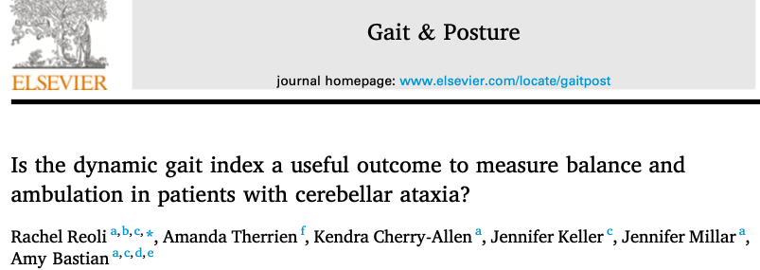
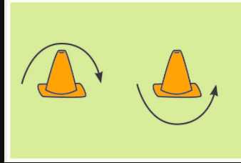
Dynamic Gait Index: recently validated in Ataxia Reoli, et al, 2021
High inter-rater reliability
(ICC = 0.98)
High test-retest reliability
(ICC = 0.98)
Excellent Construct validity:
(r=-0.81 SARA; r = -0.88 ICARS)
DGI is a fall risk measure
Best possible score= 24/24
Fall risk scores: 19/24 or less

Slide 14
Report of oscillopsia in ataxia patients correlates with activity,
not vestibular ocular reflex gain. Millar, Schubert, 2021 J. Vestibular Research DOI:10.3233/VES-210106
*People with ataxia and oscillopsia (bouncy vision) have symptom severity scores comparable to those of bilateral vestibulopathy (BVH).
*Higher oscillopsia symptoms correlated with slower gait velocity. (r=-0.56, p<0.05).
Oscillopsia Functional Index (OFI) scores:
(mean ± 1 standard deviation)
Ataxia (68.4± 28.7) (red line)
Bilateral vestibulopathy (65.9 ± 7.7) (green line)
Healthy controls (12.0 ± 1.6) (blue line)
OFI BVH and healthy control data per Anson et al, 2018.

Slide 15
Vestibular ocular reflex gains with passive head rotation are impaired in ataxia patients versus healthy controls: Millar, Schubert, 2021
*Symptoms of oscillopsia (bouncy vision) in ataxia patients correlates with walking speed, yet not eye-head coordination.
The Box and whiskers plot indicate a range of VOR gain values of all 6 semicircular canal (SCC) planes.
White boxes = 40 healthy controls.
Gray boxes = 19 ataxia patients.
Left (L), Right (R) Horizontal (H)
Anterior (A) Posterior(P) canal planes

Slide 16
Question: Does balance or leg placement ability predict walking?
A: Balance
B: Walking
Answer: Balance
Balance ability predicts walking speed better than leg placement (Morton and Bastian, 2003)

Slide 17
Is Intensive PT beneficial?
BALANCE CONTROL
Participants who rated their home balance exercises more challenging demonstrated more improvements in walking speed.
-Keller & Bastian 2014

Slide 18
What do PTs mean by Intensity? Dosing?
FREQUENCY = number of sessions a week and number of weeks
INTENSITY = how strenuous is the exercise each session
TIME = the length of time per session
TYPE = the type of exercise that is performed.
IS an intense bout of PT indicated?
WHEN in might an intense bout be indicated?

Slide 19
Balance exercise guidelines:
Recommended intensity/frequency:
Balance training:
A minimum of
20 minutes, 4 times per week
(Keller, Bastian 2014)
…....At a level that is challenging, yet do-able/safe.
Challenging yourself matters!

Slide 20
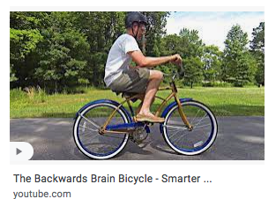
Motor learning principles and cerebellar control
?

Slide 21
How do individuals with ataxia (re)learn motor tasks?
Therrien, Wolpert, and Bastian, 2016

Slide 22
People with ataxia show retention of learning under the reinforcement feedback condition.
Therrien, Wolpert, and Bastian, 2016

Slide 23
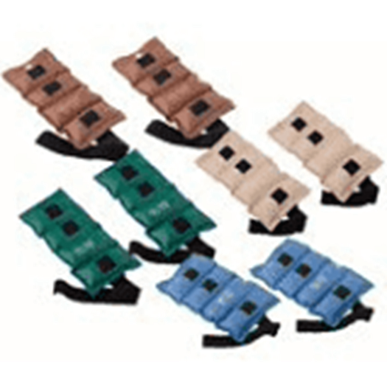
What we now know doesn’t work:
Use of external limb weights to control acceleration/ inertial forces has been proven ineffective in people with degenerative cerebellar ataxias. (Bastian et al, 2018)
Use of limb weights for strength training is fine!

Slide 24
Endurance training:
Intervention: Stationary biking
Frequency: 5 days per week for 4 weeks
Intensity: > 60-65 rpms
Duration: > 30 minutes
Results: SARA scores improved 2.1 points

Slide 25
Outline
Discuss safe mobility strategies.
2022 AAC
A Virtual Event
March 17-19

Slide 26
What Strategy can be changed? Tips for navigating safely:
Simplify movements. – stabilize elbow on table when drinking
Move slowly. Take your time.
–Upon standing, wait a few seconds to ensure stability
–Once stable, then take a step.
• Do one thing at a time.
–Avoid multi-tasking.
• Give oneself permission to accept help.
–Let someone else take a hot dish out of the oven or carry laundry on stairs.

Slide 27
Fall history predicts future falls: Be careful!
Fall status and frequency could be reliably predicted (accuracy of 78 and 91%, respectively) primarily based on number of falls a person has experienced in the past.

Slide 28
Assistive device considerations:

Slide 29
Track your Activity

Slide 30
Outline
Why seek rehabilitation?
2022 AAC
A Virtual Event
March 17-19

Slide 31
What PT interventions are indicated?
–Postural control / balance
•Optimizing sensorial and motor experiences
•Facilitating righting and equilibrium reactions
–Motor learning
•Varied tasks – within abilities
•Reinforce movements that yield success
–Endurance training

Slide 32
Thoughts to Guide Us: Is a Bout of Intense PT Indicated?
What is your functional goal?
What is the impairment(s) constraining function?
Is this impairment(s) within PT scope of practice to address?
If yes, is this impairment amenable to change?
Is there a concern about development of secondary complications (musculoskeletal, muscle weakness)?
Do the other functional domains (cognition, language, behavioral) support motor learning?
Is the PT provider skilled in neuro-rehabilitation?

Slide 33
Thoughts to Guide Us: Why consider a bout of intensive PT?
Gain capacity to take an emerging skill to a “safely” independent skill that can then be practiced, practiced, practiced outside of PT in the home and community setting.
Learn a new skill, by practicing the components of which are present but not yet integrated.
"Get unstuck", if stalled in learning a new skill beyond what the tested impairments can explain.
Seek PT intervention to manage complex impairments and activities most meaningful to you.

Slide 34
Thoughts to Guide Us: Why not consider a bout of intensive PT?
Time, energy, financial costs.
Does insurance cover rehabilitation?
Know your insurance benefits and consider how to use your visits.
If you are making progress between PT sessions, maybe less frequent visits are appropriate:
to modify your home program
to make gains at your own pace
Notes:
In the bigger picture, if intensive PT achieves an important milestone such as walking earlier than without intensive – is this important?

Slide 35
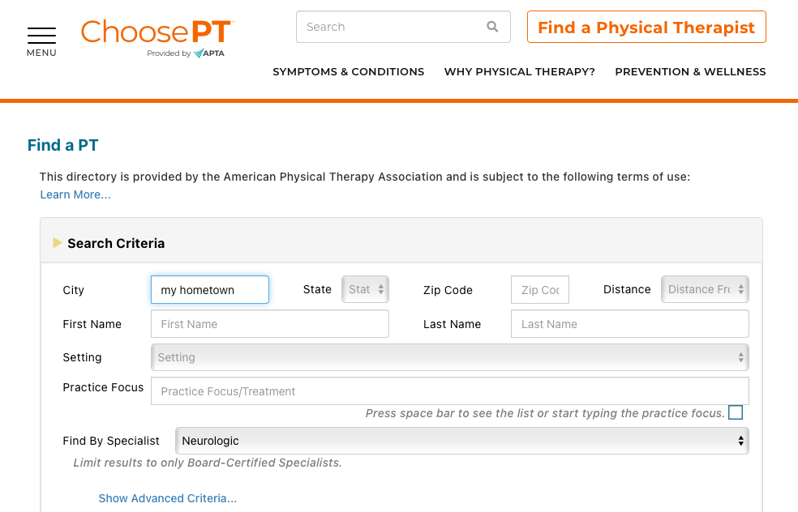
https://aptaapps.apta.org/APTAPTDirectory/FindAPTDirectory.aspx
Browser search:
APTA
Find a PT

Slide 36
When visiting PT: Be ready to address YOUR goals...
Break down your goals to smaller goals
Example: Set a goal of increasing walking distance ability by 10%
Be mentally okay with modifying expectations and give oneself permission to do tasks slightly differently
Acknowledge and address your safety concerns

Slide 37
Key Takeaways: What is cerebellar ataxia?
The movement disorder that results from damage to the cerebellum.
Presents as poorly coordinated movement without weakness or sensory loss.
Rehabilitation therapy is the main course for symptom management

Slide 38
Key Takeaways
Keep moving: Evidence in the literature has shown exercise and activity in ataxia IS beneficial!
Consider seeking a neurological specialized therapist for exercise/strategies specific for your situation.
Communicate to your therapist the activities most meaningful to you.
Set realistic goals and modify expectations as needed.
Utilize safe strategies: set yourself up for success and prevent falls.
You're not alone on this journey!

Slide 39
Thank You!
Participants
Conference organizers, Lori Shogren
Johns Hopkins Ataxia Center funders/supporters
Kennedy Krieger Center of Movement Studies and Pediatric Ataxia Clinic

Slide 40
References
Bastian AJ. Learning to predict the future: the cerebellum adapts feedforward movement control. Curr Opin Neurobiol 2006, 16(6): 645-649.
Barbuto S, Martelli D, Omofuma IB, et al. Phase I randomized single-blinded controlled study investigating the potential benefit of aerobic exercise in degenerative cerebellar disease. Clinical Rehabilitation. 2020;34(5):584-594. doi:10.1177/0269215520905073
Chang YJ, Chou CC, Huang WT, Lu CS, Wong AM, HsuMJ. Cycling regimen induces spinal circuitry plasticity and improves leg muscle coordination in individuals with spinocerebellar ataxia. Arch Phys Med Rehabil. 2015;96:1006-1013.
De Silva, R., Greenfield, J., Cook, A., Bonney, H., Vallortigara, J., Hunt, B., and Giunti, P. Guidelines on the diagnosis and management of the progressive ataxias. Orphanet Journal of Rare Diseases 2019 (14); 51.
Ilg W, Synofzik M, Brotz D, Burkard S, Giese MA, Schols L. Intensive coordinative training improves motor performance in degenerative cerebellar disease. Neurol 2009; 79 (20):2056-2060.
Keller JL, Bastian AJ. A home balance exercise program improves walking in people with cerebellar ataxia. Neurorehabilitation and Neural Repair. 2014; 28(8): 770-778.
Milne et al Rehabilitation for Individuals With Genetic Degenerative Ataxia: A Systematic Review Rehabilitation for Individuals With Genetic Degenerative Ataxia: A Systematic Review. Neurorehabilitation and Neural Repair 31(7) 609-629.
Millar JL, Schubert, Report of oscillopsia in ataxia patients correlates with activity, not vestibular ocular reflex gain, Journal of Vestibular Research, Accepted for publication, November 18, 2021.
Morton SM, Bastian AJ. Relative contributions of balance and voluntary leg-coordination deficits to cerebellar gait ataxia. J Neurophysiol 2003; 89(4): 1844-1856.
Morton SM, Bastian AJ. Cerebellar control of balance and locomotion. Neuroscientist 2004; June (10): 247-59.

Slide 41
References
Miyai, I., Ito, M., Hattori, N., Mihara, M., Hatakenaka, M., Yagura, H., … Nishizawa, M. (2012). Cerebellar Ataxia Rehabilitation Trial in Degenerative Cerebellar Diseases. Neurorehabilitation and Neural Repair, 26(5), 515- 522. https://doi.org/10.1177/1545968311425918
Reoli R, Therrien A, Cherry-Allen K, Keller J, Millar J, Bastian A, Is the dynamic gait index a useful outcome to measure balance and ambulation in patients with cerebellar ataxia?, Gait & Posture, Volume 89, 2021, Pages 200-205, ISSN 0966-6362, https://doi.org/10.1016/j.gaitpost.2021.07.011.
Reoli R, Cherry-Allen K, Therrien A, Keller J, Leech K, Whitt AL, Bastian A. Can the ARAT Be Used to Measure Arm Function in People With Cerebellar Ataxia? Phys Ther. 2021 Feb 4;101(2):pzaa203. doi: 10.1093/ptj/pzaa203. PMID: 33336704; PMCID: PMC7899061.
Schmitz-Hübsch T, du Montcel ST, Baliko L, Berciano J, Boesch S, Depondt C, Giunti P, Globas C, Infante J, Kang JS, et al. Scale for the assessment and rating of ataxia: development of a new clinical scale. Neurology. 2006; 66:1717–1720.
Schmitz-Hübsch T, Tezenas du Montcel S, Baliko L, Boesch S, Bonato S, Fancellu R, Giunti P, Globas C, Kang JS, Kremer B, Mariotti C, Melegh B, Rakowicz M, Rola R, Romano S, Schöls L, Szymanski S, van de Warrenburg BP, Zdzienicka E, Dürr A, Klockgether T. Reliability and validity of the International Cooperative Ataxia Rating Scale: a study in 156 spinocerebellar ataxia patients. Mov Disord. 2006 May;21(5):699-704. doi: 10.1002/mds.20781. PMID: 16450347.
Therrien AS, Wolpert DM, Bastian AJ. Effective reinforcement learning following cerebellar damage requires a balance between exploration and motor noise. Brain 2016, 139(1):101-14.
Trouillas P, Takayanagi T, Hallett M, Currier RD, Subramony SH, Wessel K, Bryer A, Diener HC, Massaquoi S, Gomez CM, Coutinho P, Ben Hamida M, Campanella G, Filla A, Schut L, Timann D, Honnorat J, Nighoghossian N, Manyam B. International Cooperative Ataxia Rating Scale for pharmacological assessment of the cerebellar syndrome. The Ataxia Neuropharmacology Committee of the World Federation of Neurology. J Neurol Sci. 1997 Feb 12;145(2):205-11. doi: 10.1016/s0022-510x(96)00231-6. PMID: 9094050.
Zimmet AM, Cowan NJ, Bastian AJ. Patients with Cerebellar Ataxia Do Not Benefit from Limb Weights The Cerebellum 2019, 18:128–136. https://doi.org/10.1007/s12311-018-0962-1

