Slide 1
Ataxia Hacks Tips from an Occupational Therapist
By: Elizabeth Foss OTR/L
Notes:
Good Afternoon! My name is Elizabeth Foss and I am an Occupational Therapist
Thank you so much for the opportunity to be here as I feel blessed to both learn from and give to the ataxia community
In this presentation, we're going to talk about some hacks to improve everyday functional independence and safety.... and while I will be moving fast, you will have the slides to review

Slide 2
What is Occupational Therapy?
Roles:
#1: Functional Independence
Reduce Risk for Falls
Balance Training
Strength Training
Coordination Training
Home Safety Modifications
Adapted Equipment Training
Improve functional upper extremity use – including use of hands

Slide 3
A Walk Through Life

Slide 4
Disclaimer
The products in this presentation include NO paid promotions
This presentation is for educational purposes only and should not be taken as medical advice.

Slide 5
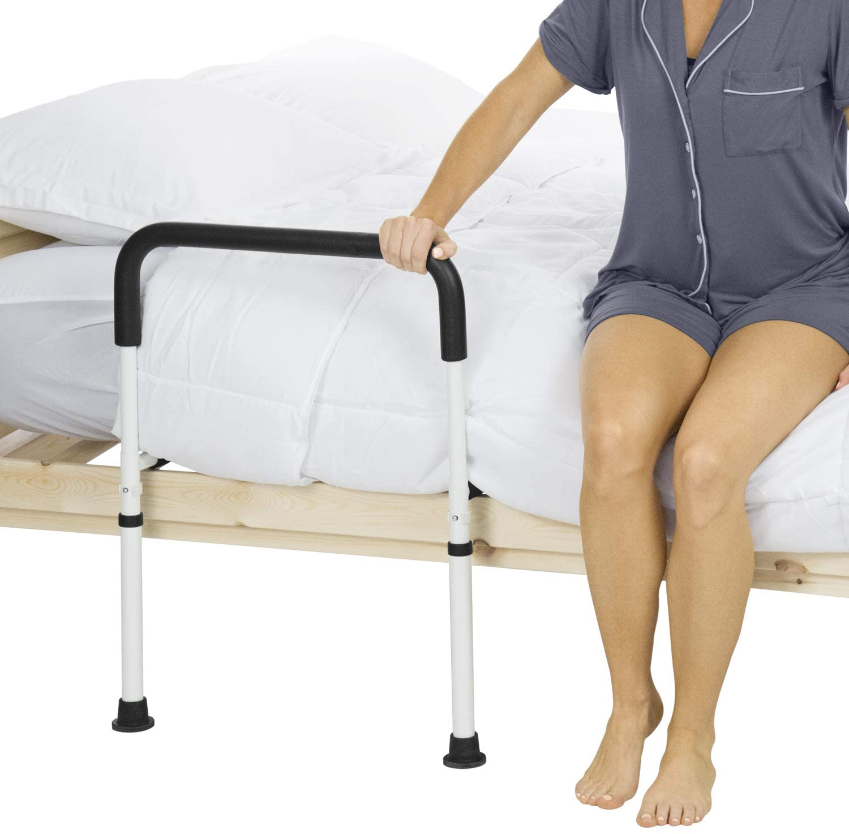
Starting the Day
Bed Railings
Stander Poles

Slide 6
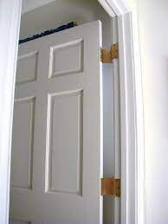
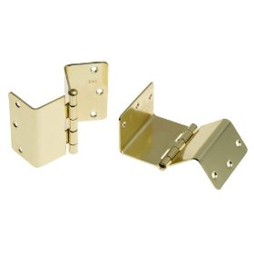
Bathroom Access
Swing Away Hinges

Slide 7
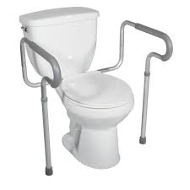
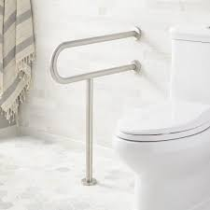
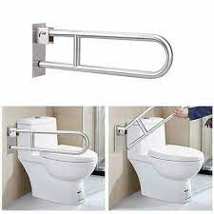
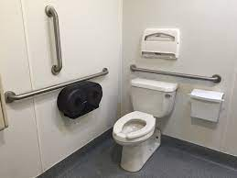
Toileting
Toilet Safety Frame
Grab bars
Flip up Grab Bars

Slide 8
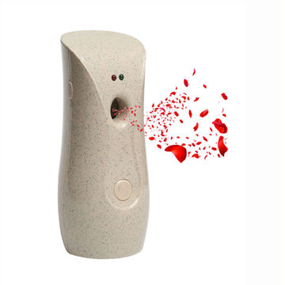
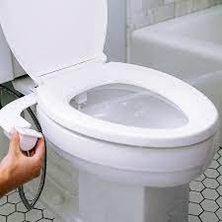
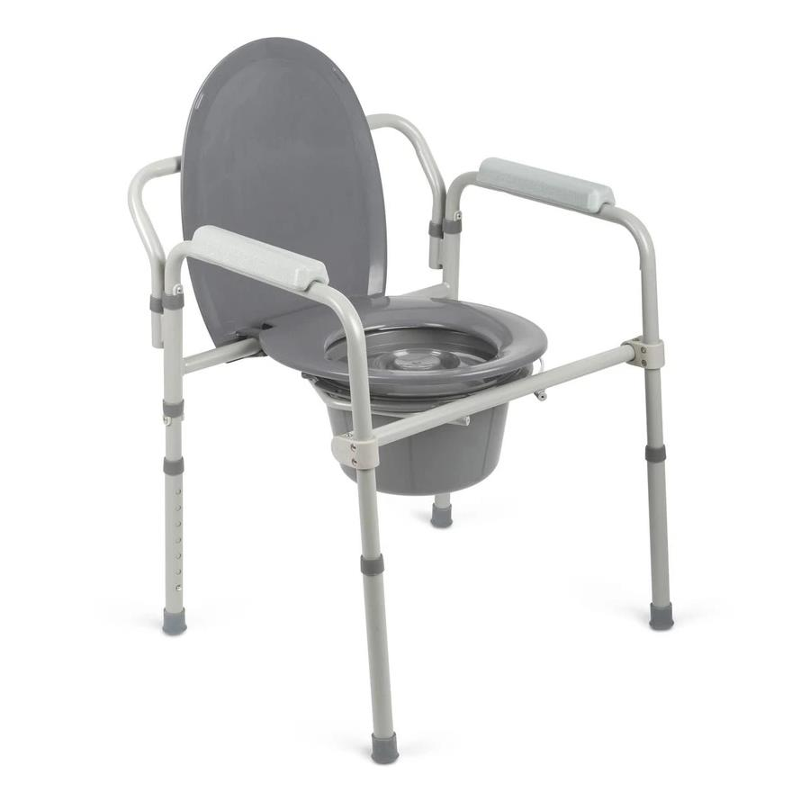
Toileting
Automatic
Air Freshener
Bidet- Pericare
Bedside Commode

Slide 9
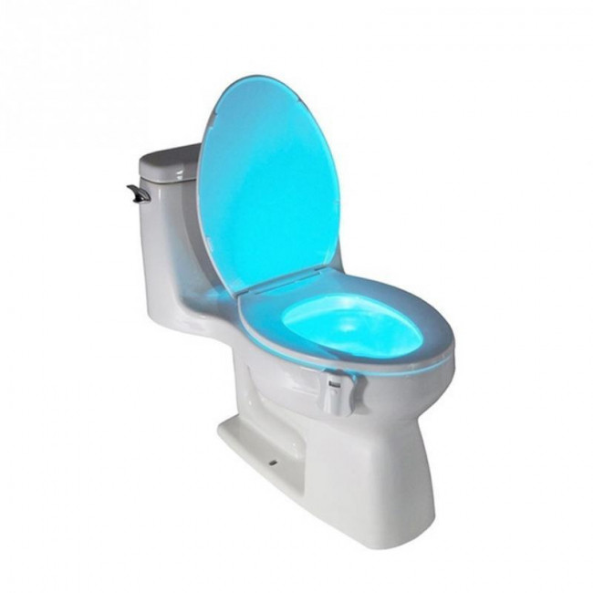
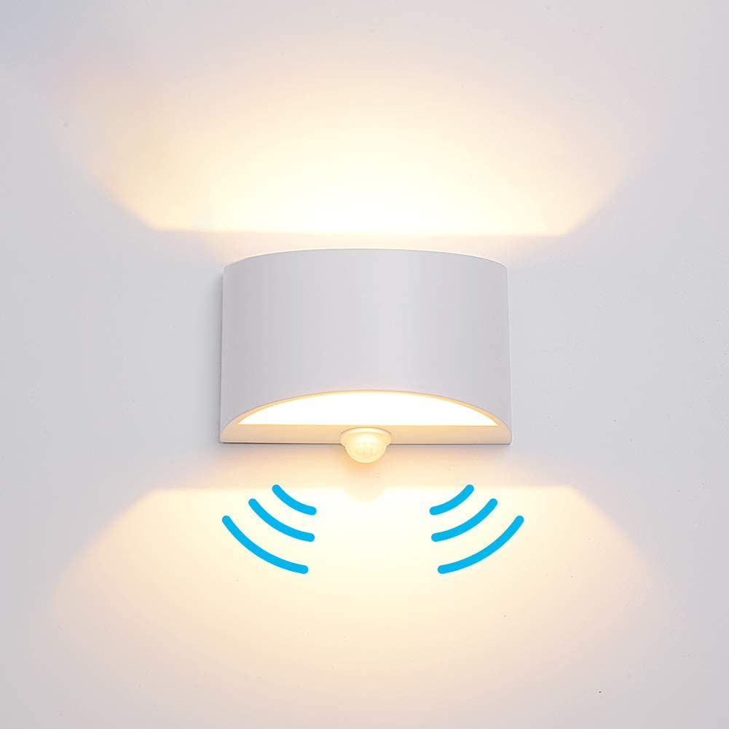
Night Time Lighting
Timers
Clapper Lights
Voice Activated
Motion Sensored
Strip Lighting
Toilet-Bowl Light

Slide 10
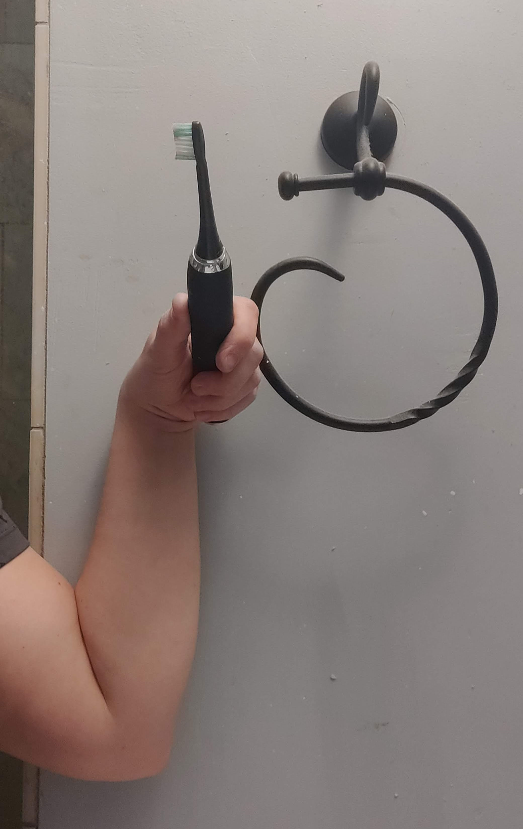
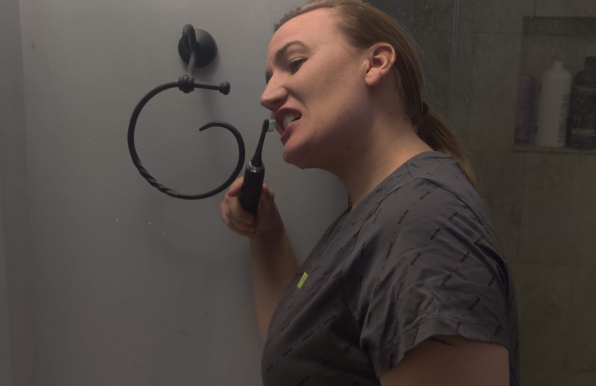
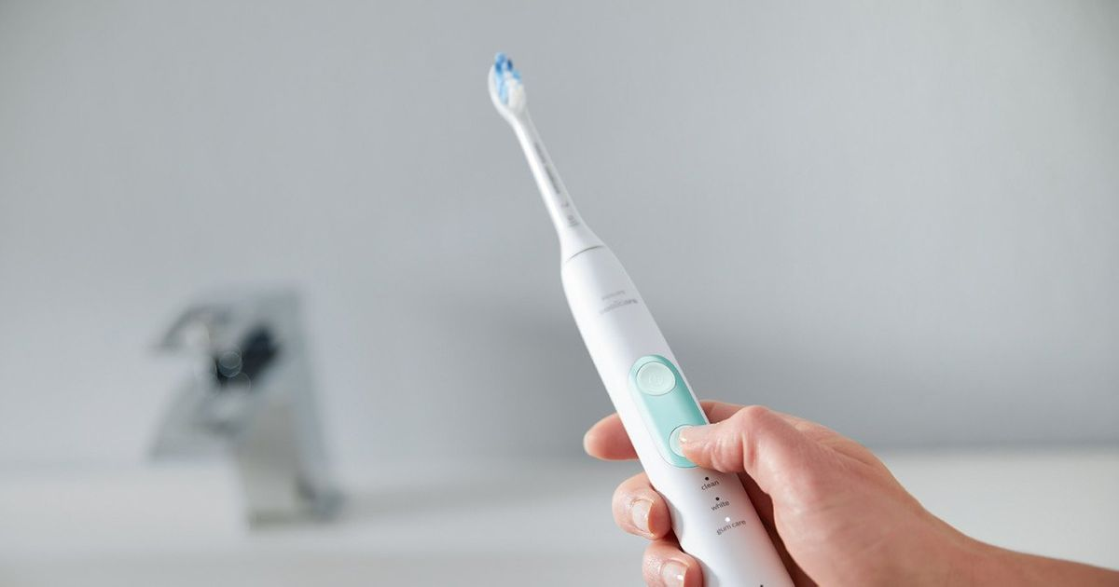
Oral Hygiene
Toothpaste-to-Mouth
Technique
Tremor Management
Electric Toothbrush

Slide 11
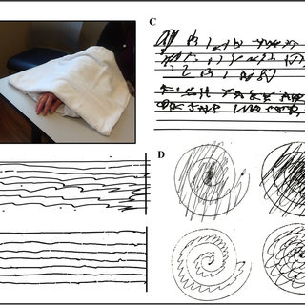
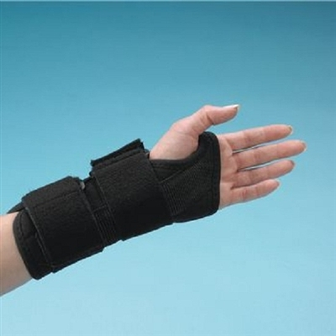
Tremor Reduction
Hand-over-Hand
Splinting
Proprioceptive-Loading Exercises
Forearm Cooling-Induced
Tremor Reduction

Slide 12
YouTube Channel: "Little Steps, Big Gains"

Slide 13
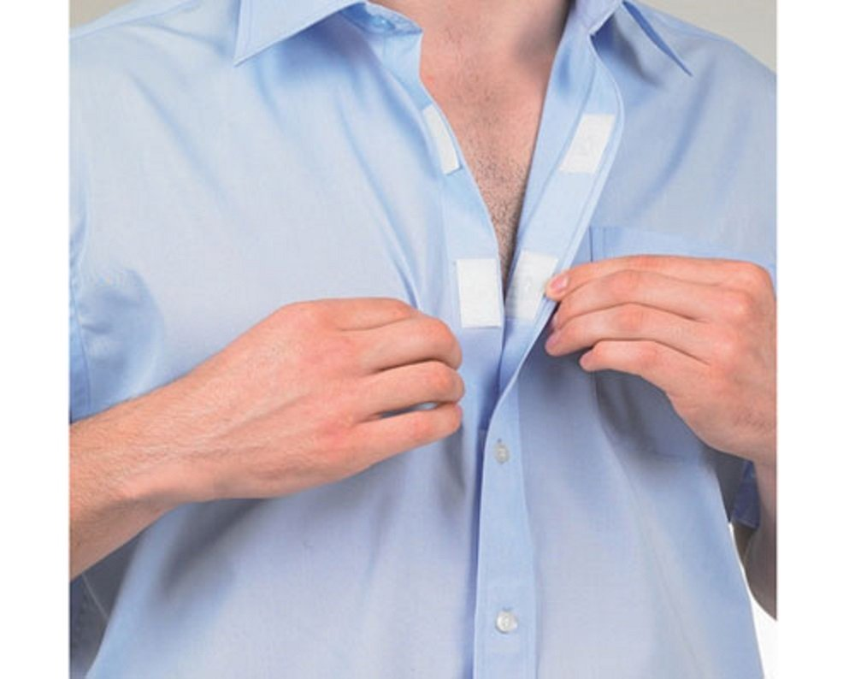
Upper Body Dressing
"Pull-Over Technique"
for Buttons
Sports Bras
Velcro Button Conversion

Slide 14
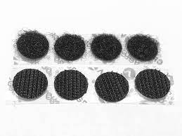
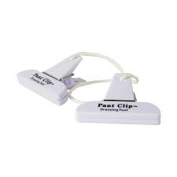
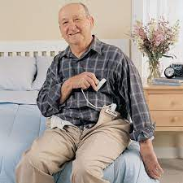
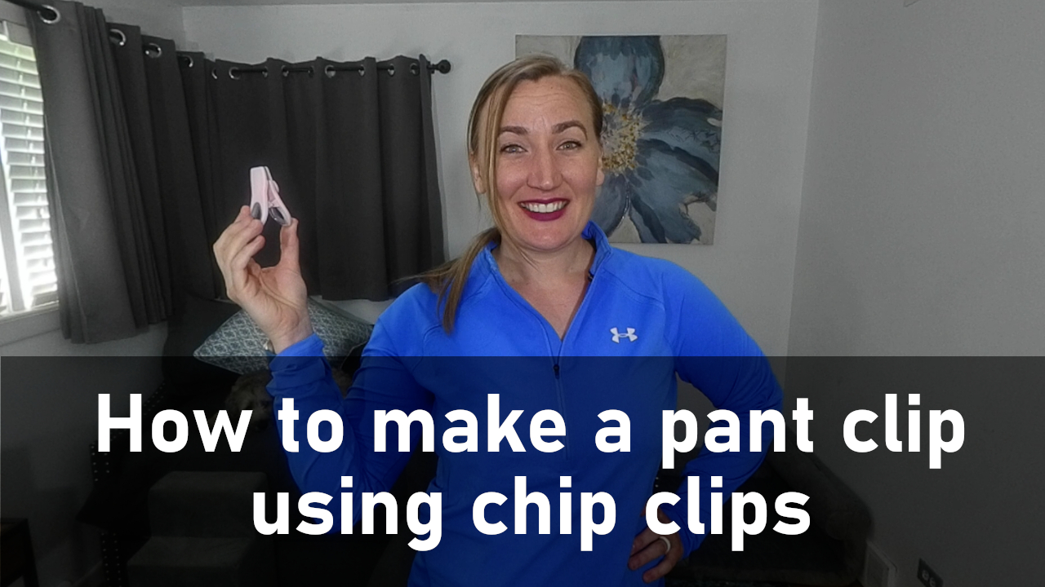
Lower Body Dressing- Pants
Pant Clip/Chip-Clip
Velcro Button Conversion

Slide 15
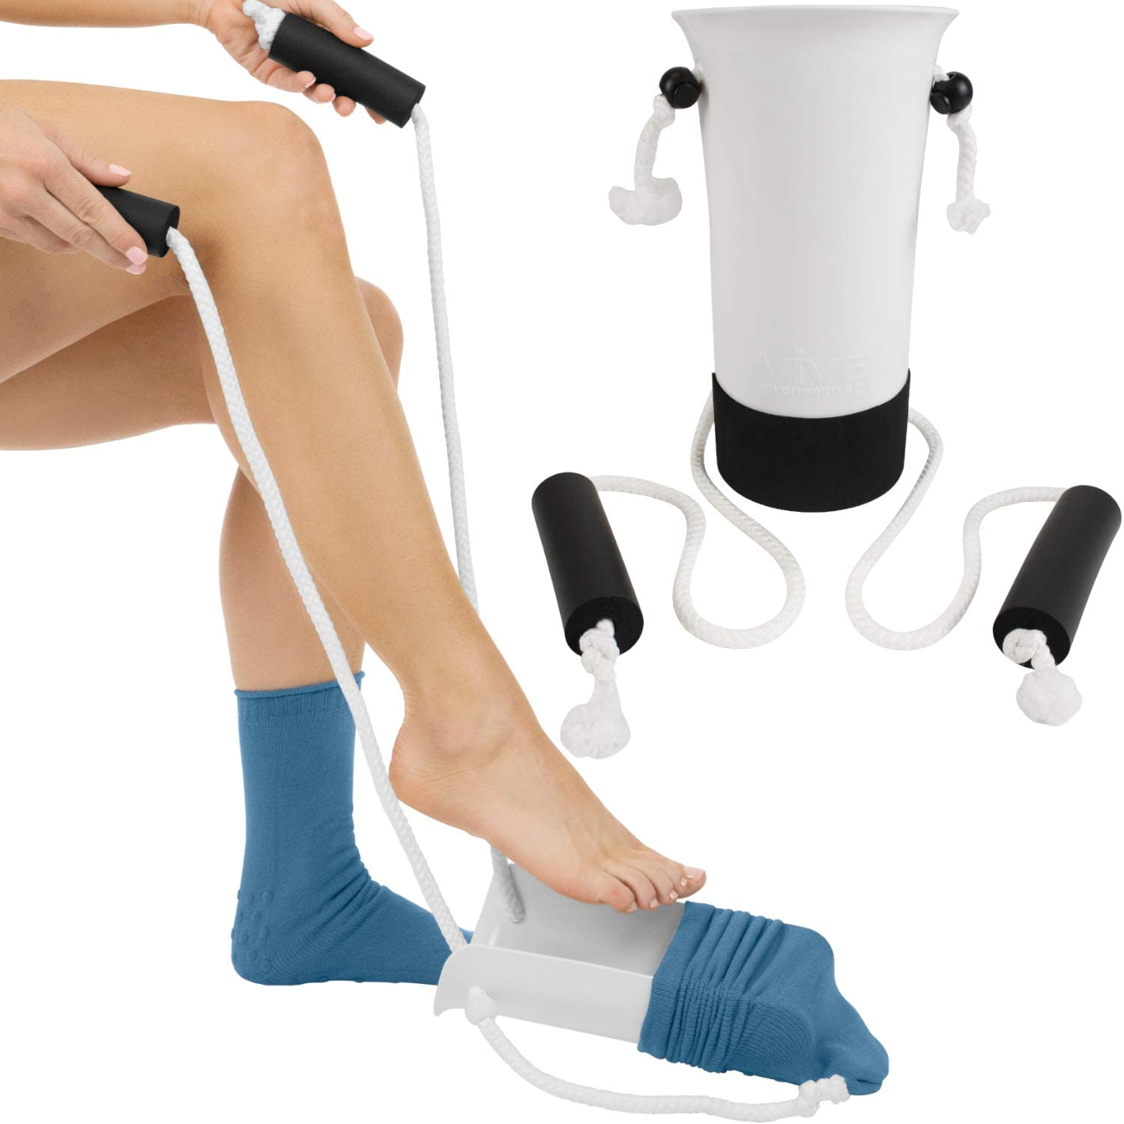
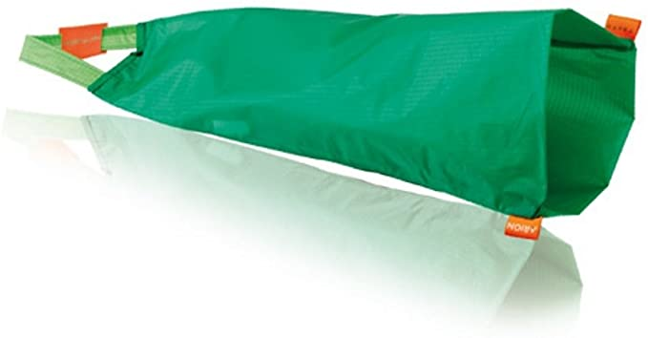
Lower Body Dressing- Socks
Compression Stockings
Sock-Aid
Socks

Slide 16
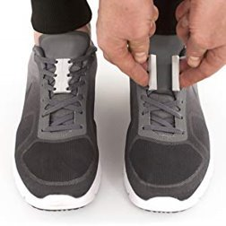
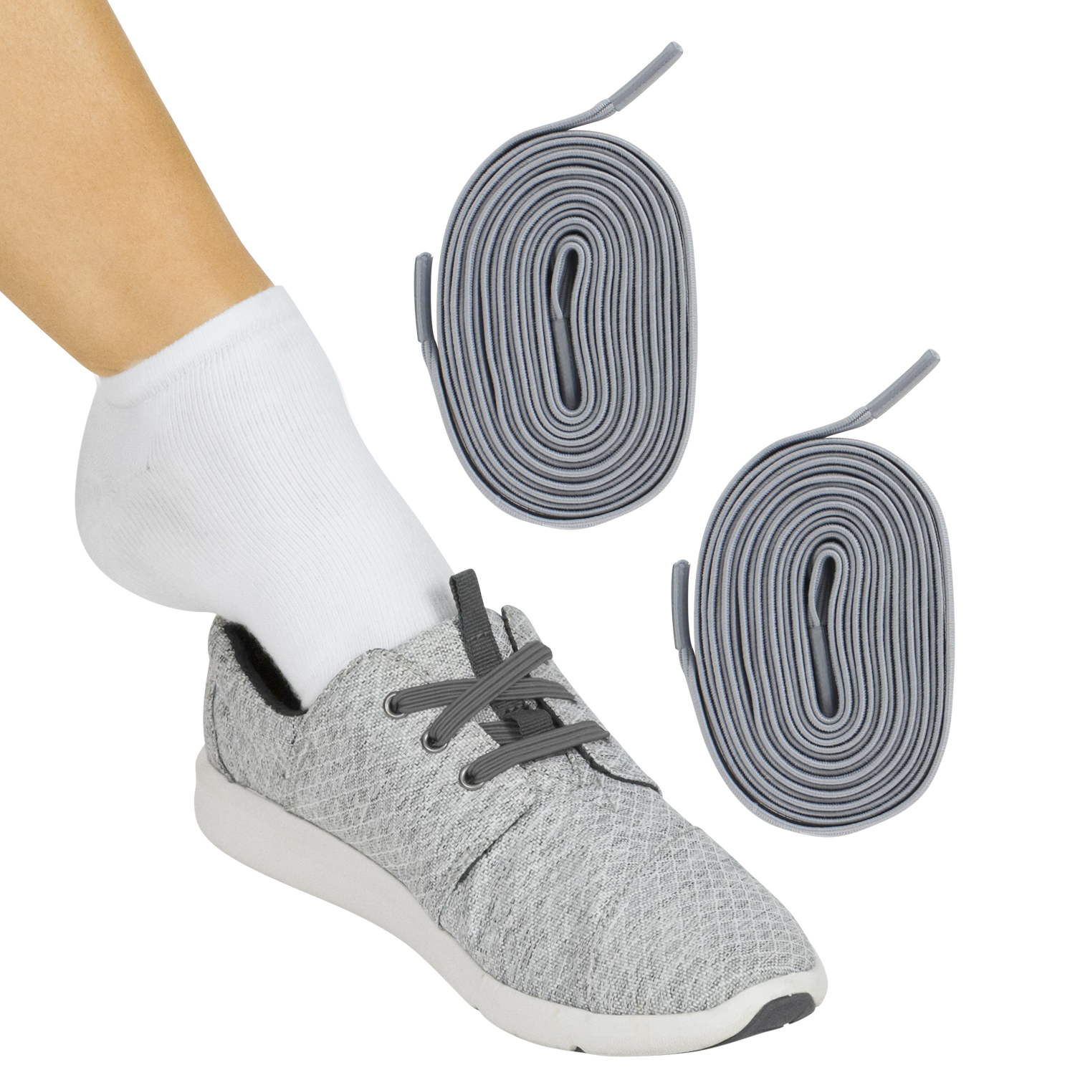
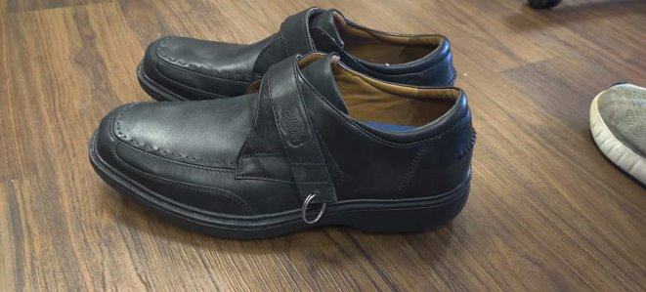
Lower Body Dressing- Shoes
Key Rings onto Velcro
Shoe Straps
Magnetic
Shoe Laces
Elastic Shoe Laces

Slide 17
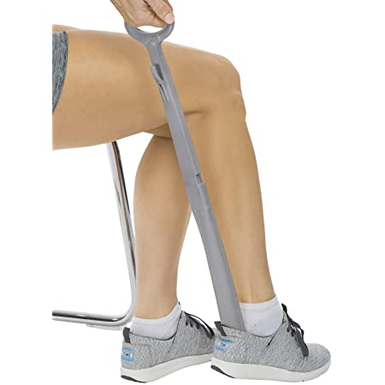
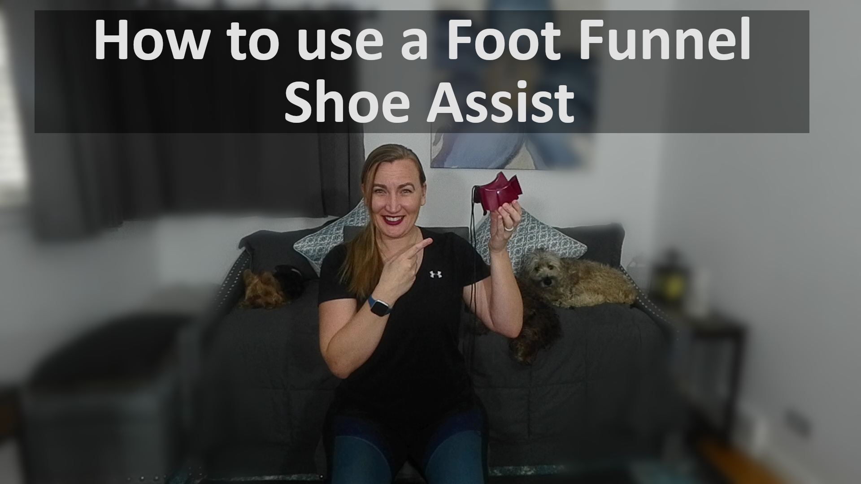
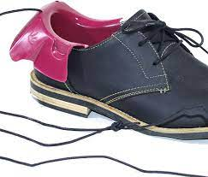
Lower Body Dressing- Shoes
Foot Funnel- Shoe Assist
Long Handled
Shoe Horn

Slide 18
Lower Body Dressing- Socks/Shoes
YouTube: "Little Steps Big Gains"

Slide 19
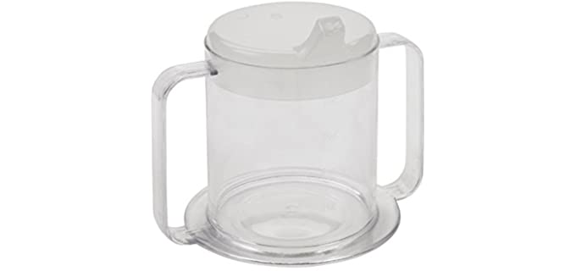
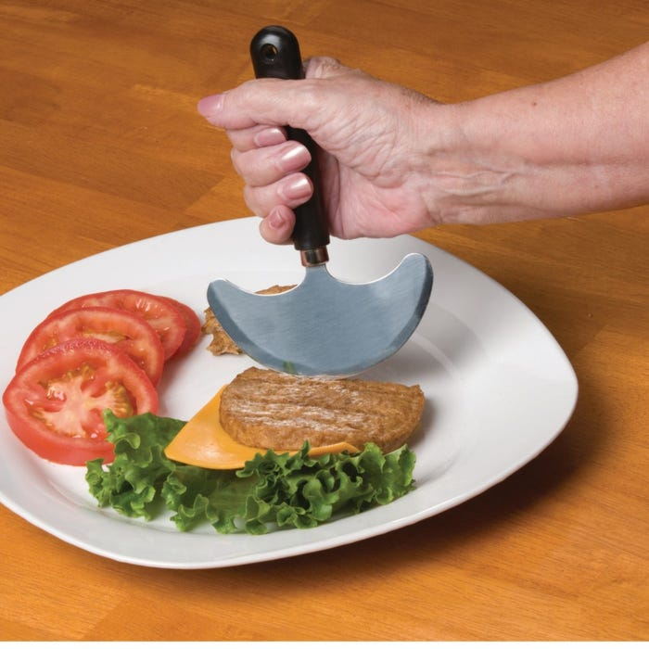
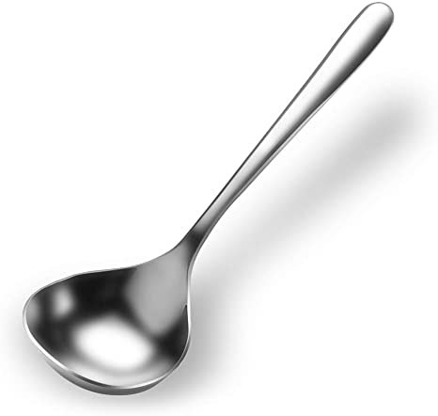
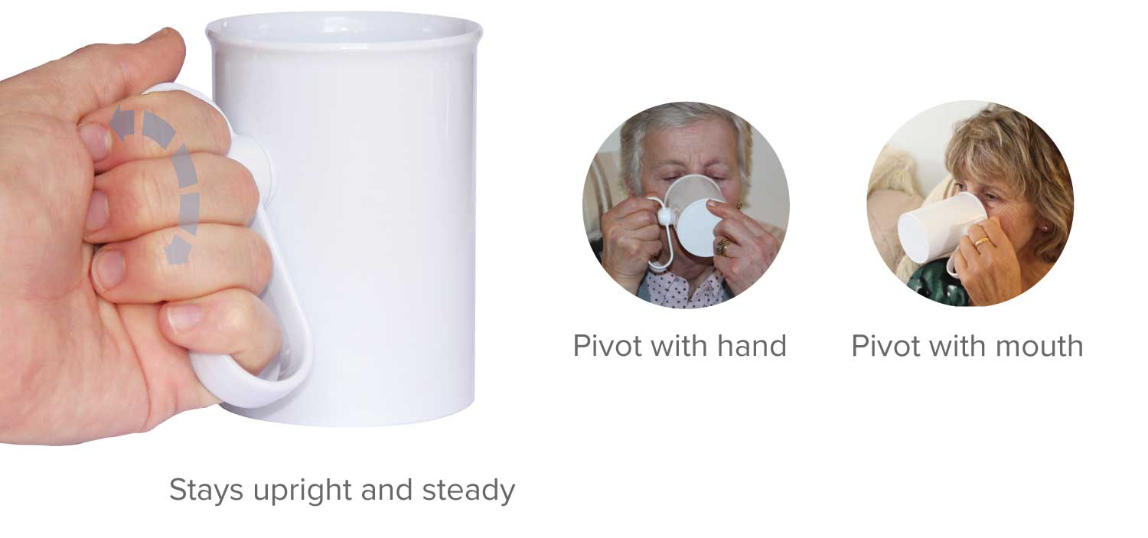
Eating
Two-Handed Cups
Non-Spill Lids
Rocker Knife
Large Ladle Soup
or Serving Spoon
HandSteady Drinking Aid

Slide 20
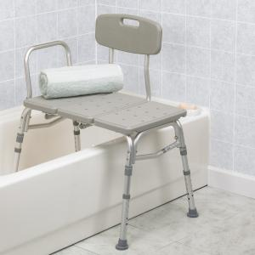
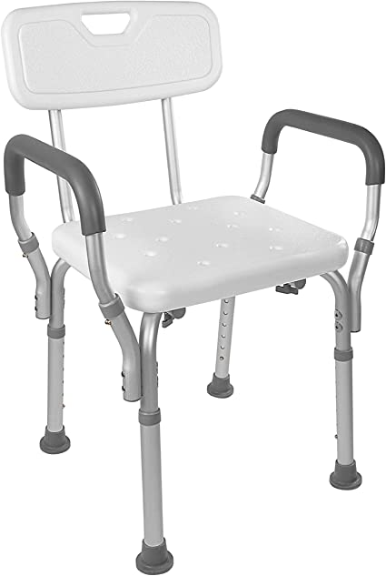
Bathing
Shower Chair
Double Shower Chair
Method Transfers
Bathtub Transfer Bench

Slide 21
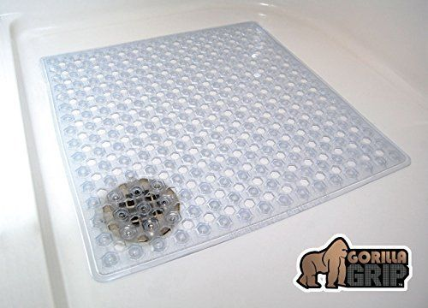
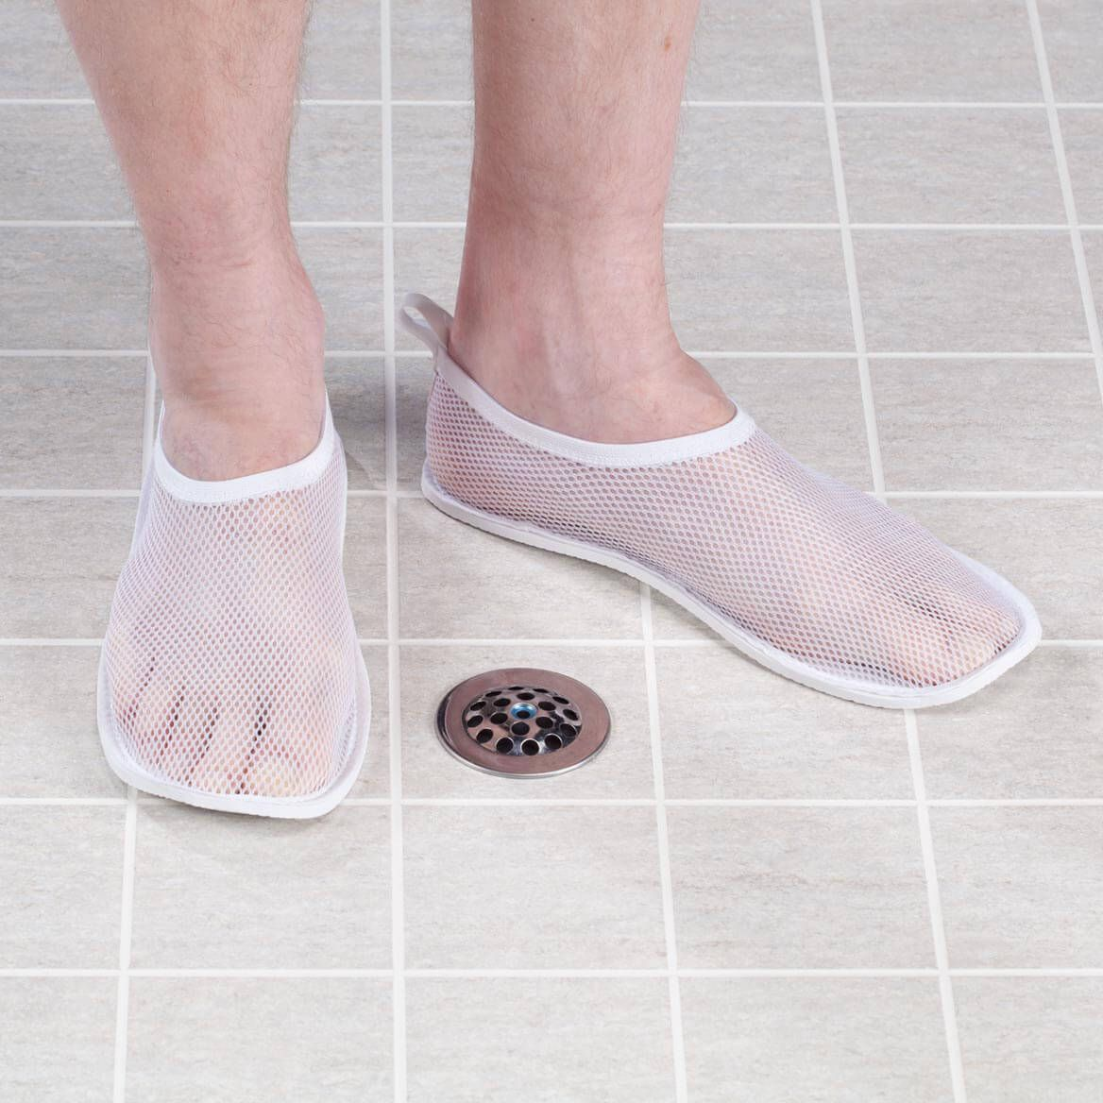
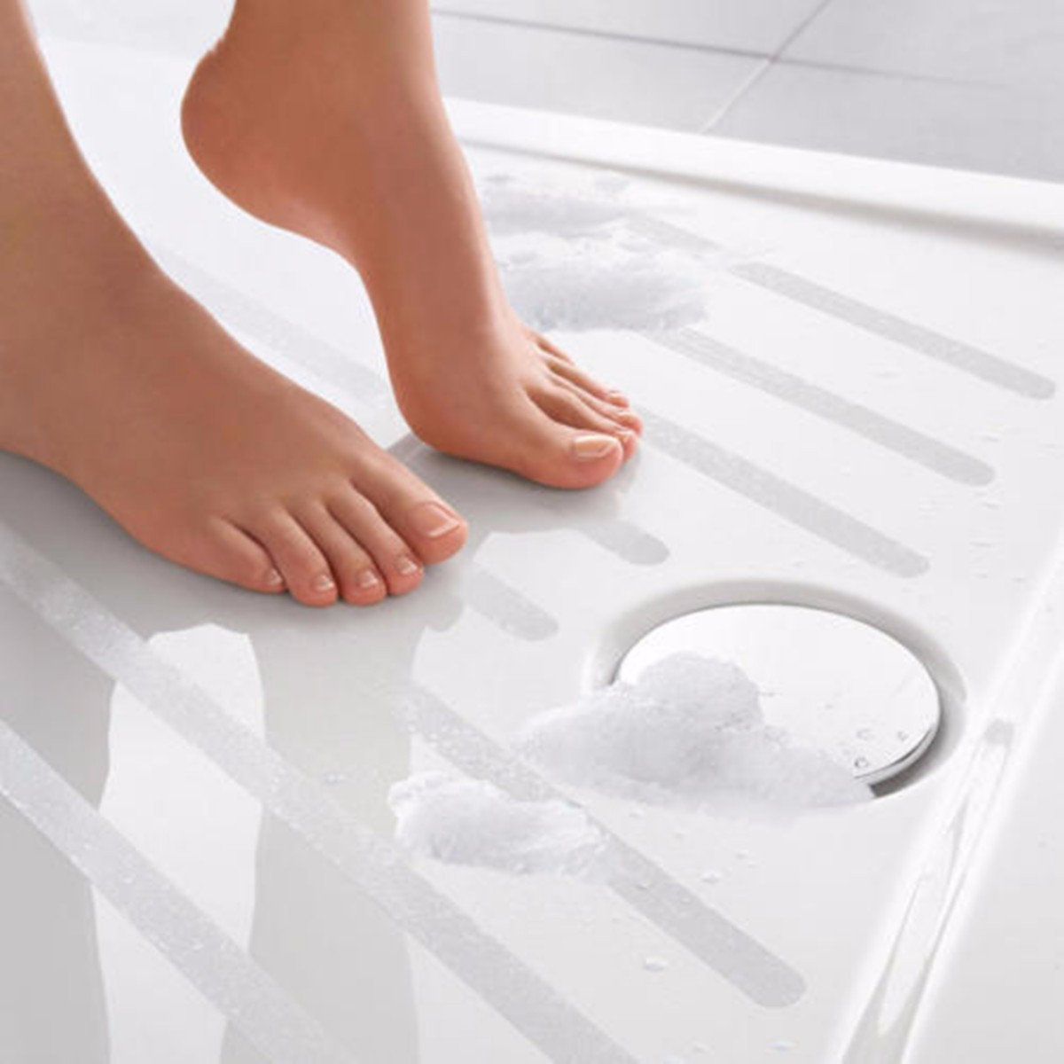
Bathing
Gorilla Grip
Shower or Water
Shoes
Non-Slip Shower Strips

Slide 22
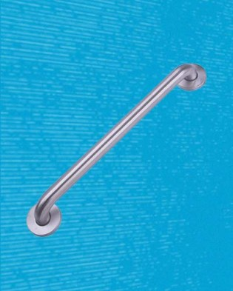
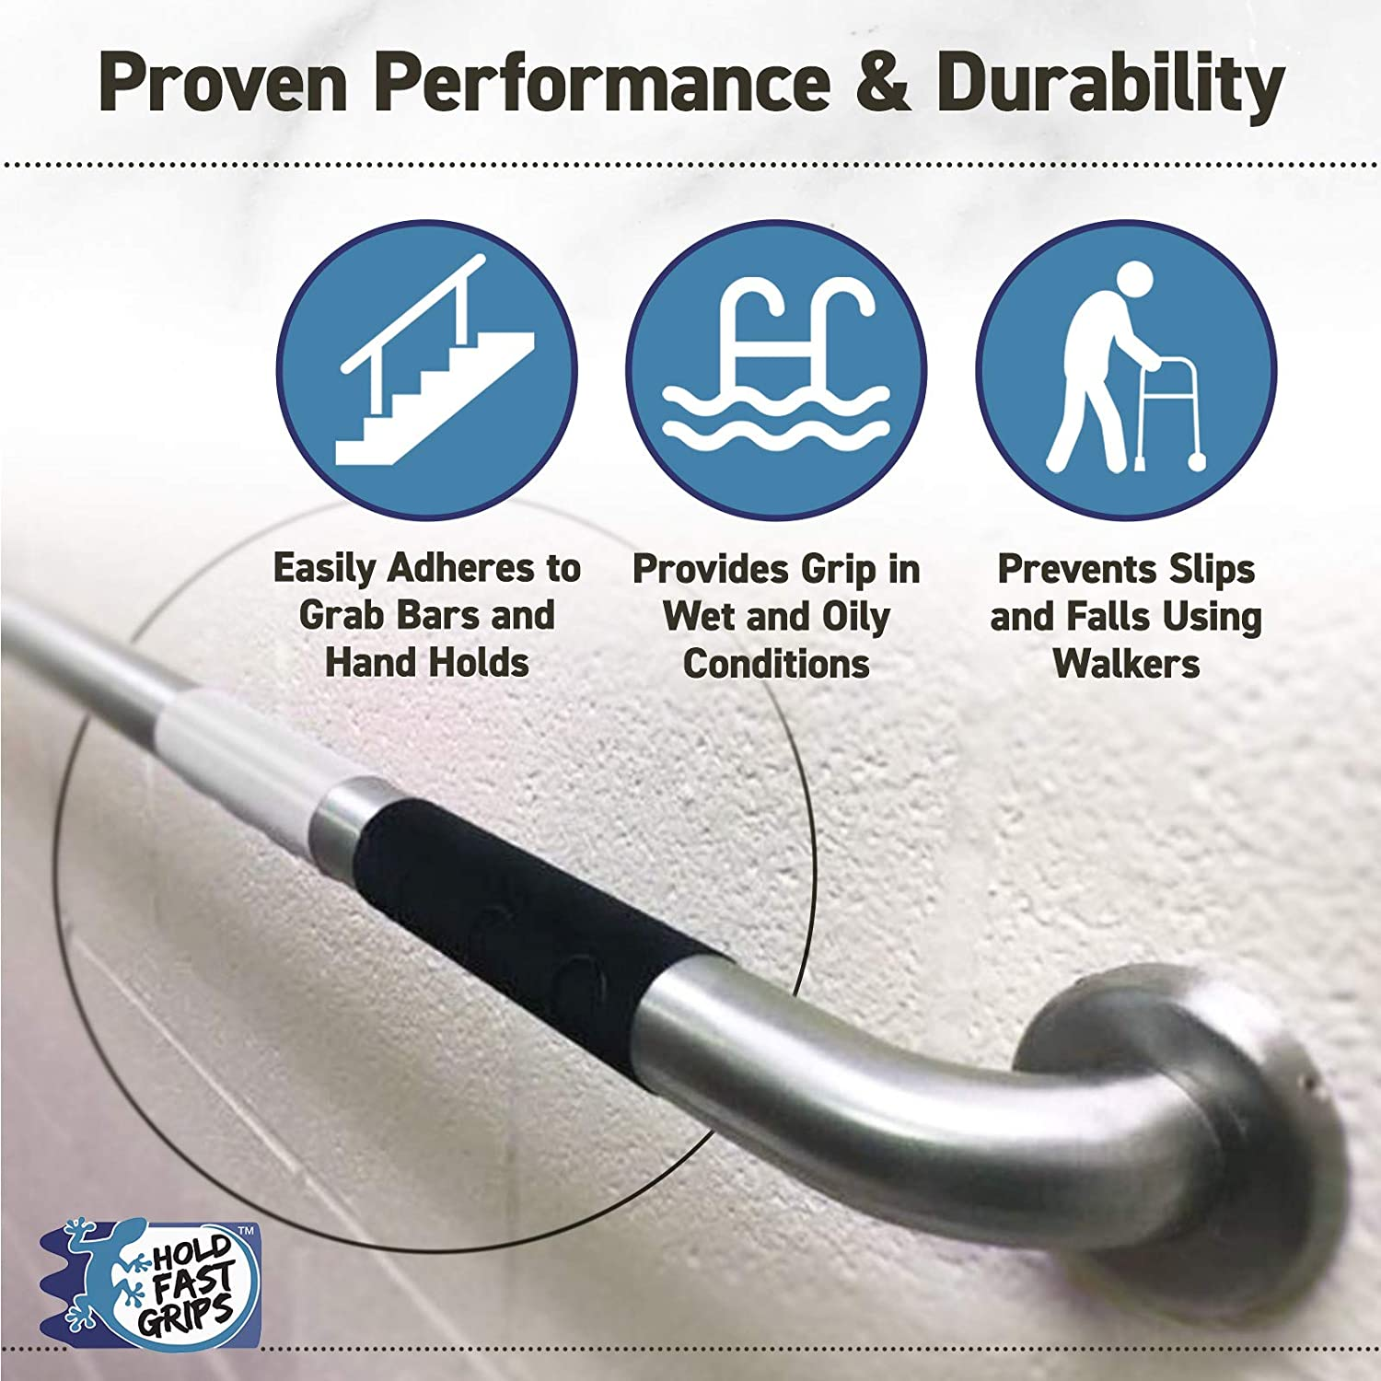
Bathing
Avoid Suction Cup
Grab Bars
Grab Bars
Grip Strips

Slide 23
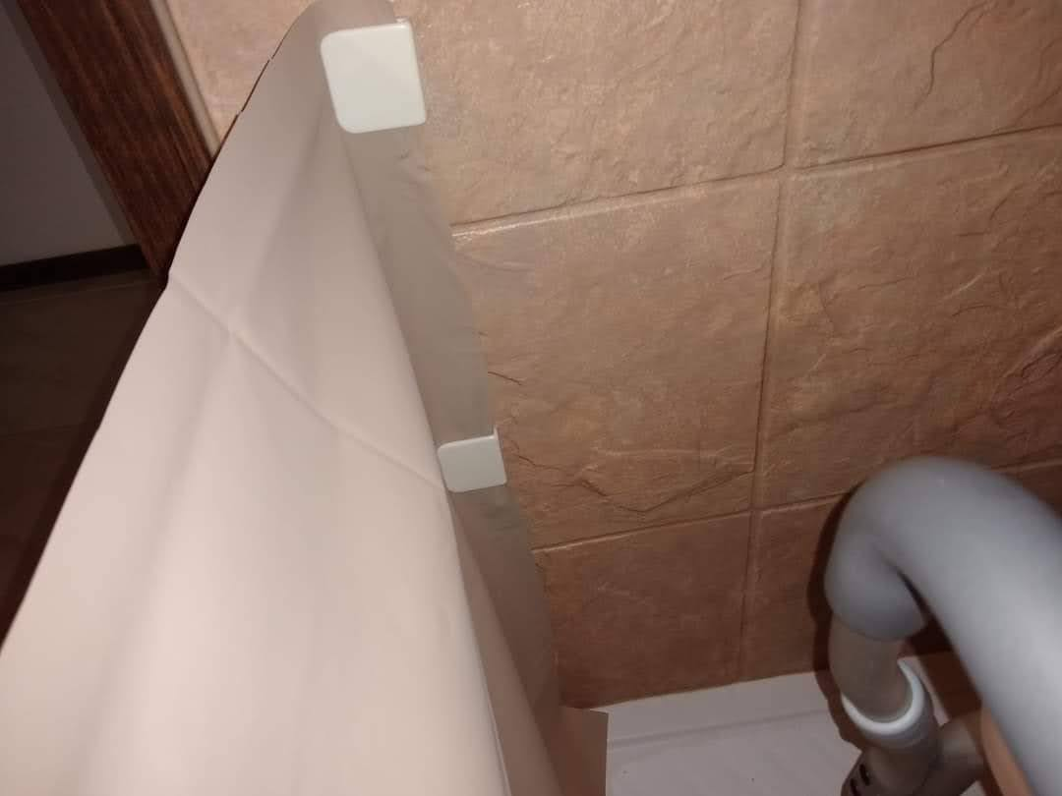
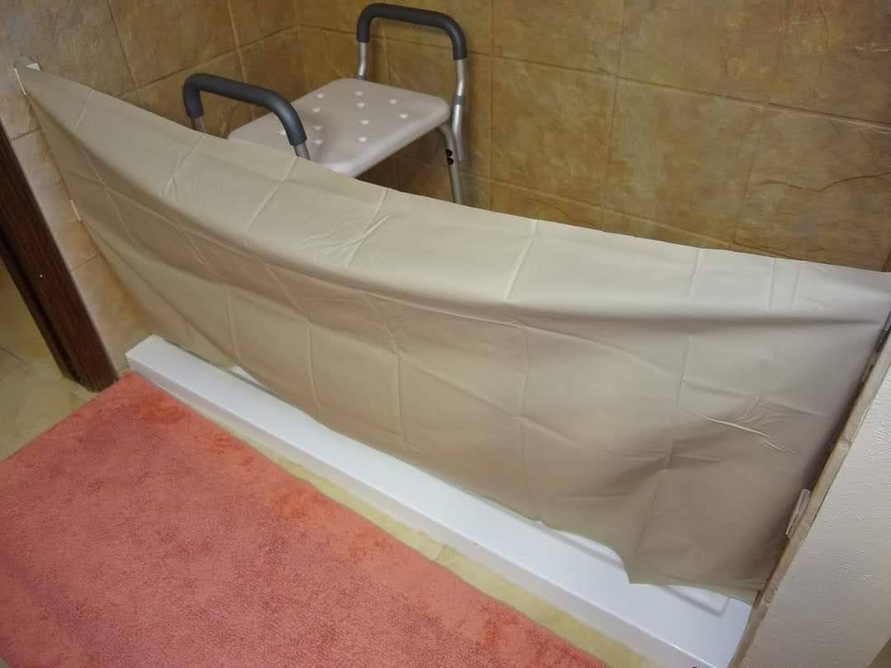
Bathing
Magnetic Shower Curtain Clips

Slide 24
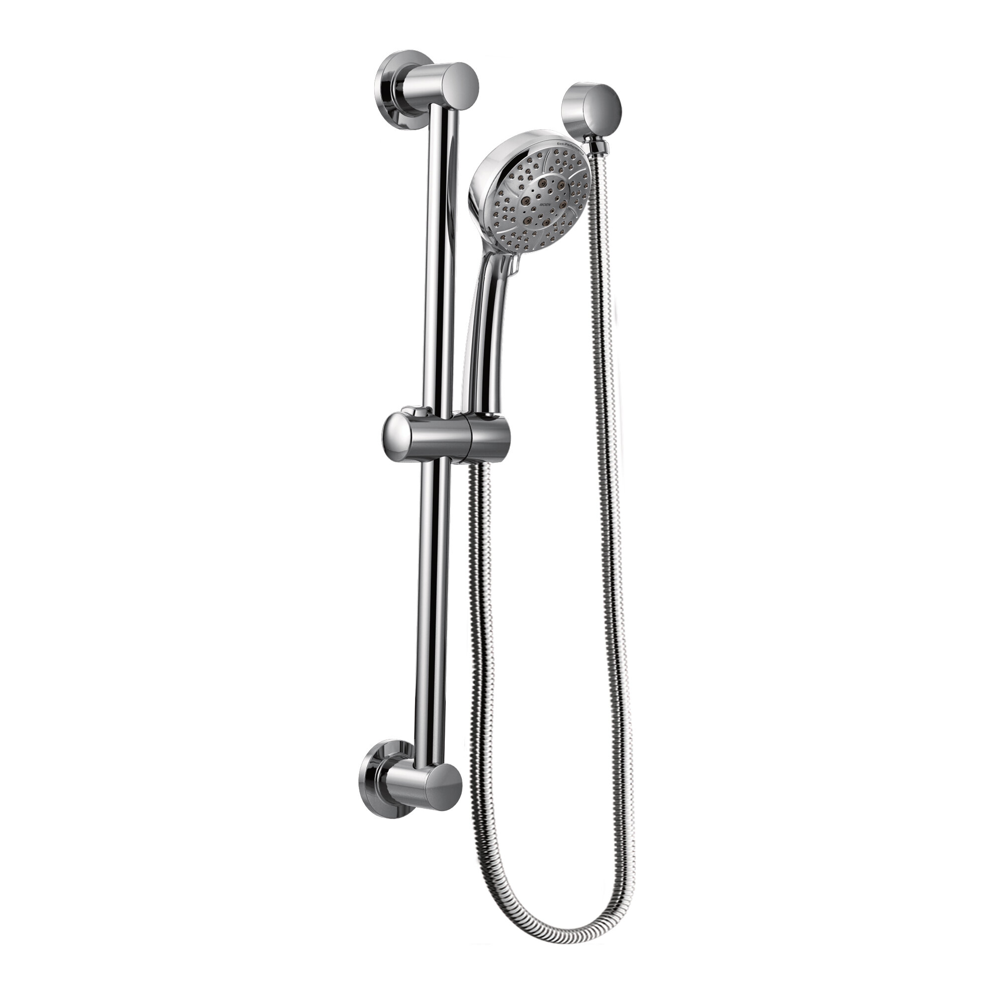
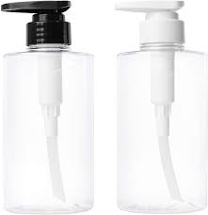
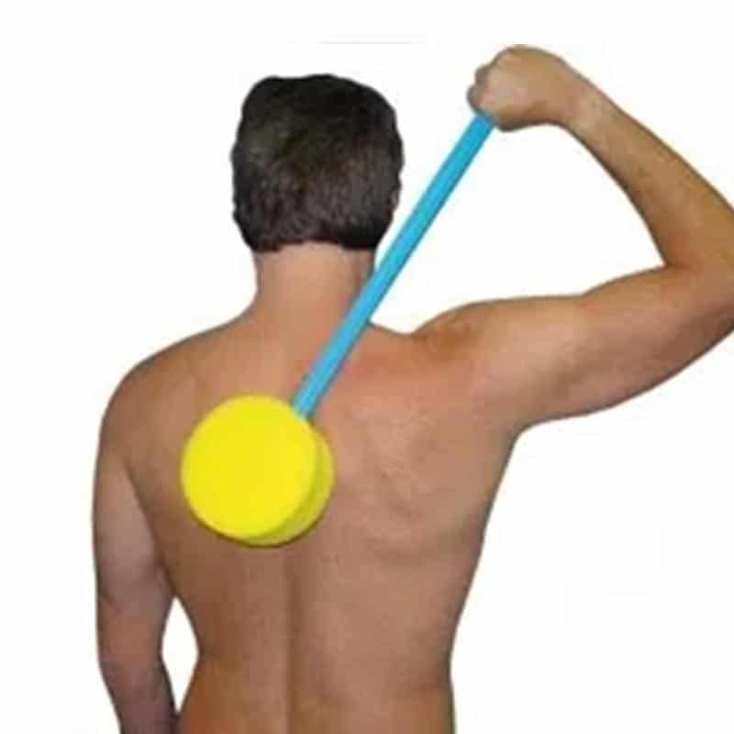
Bathing
Hand-Held
Shower Head
No-Rinse
Shampoo Cap
Pump Bottles
Long Handled Sponge

Slide 25
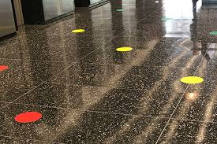
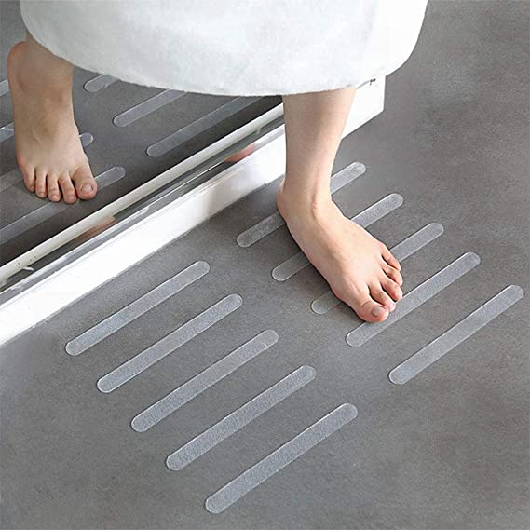
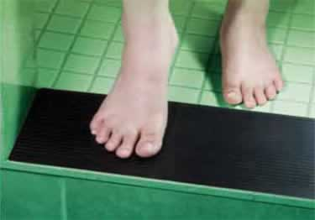
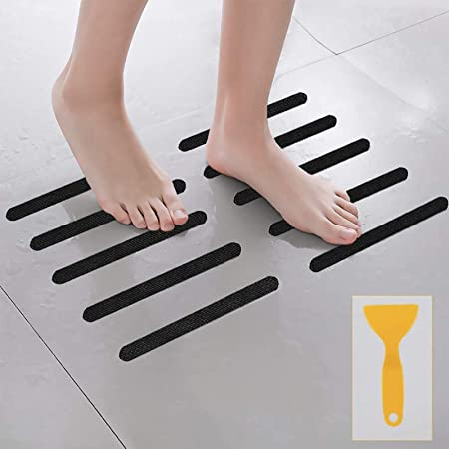
Safety
Freezing- Floor Targets
Non-Slip Floor Adhesives
Remove Clutter

Slide 26
Walker Accessories
Non-Slip
Grip Mat
Cup Holders
Walker Glides
Walker Tray

Slide 27
Walker Tips
"Walker-Smart"
PT Referral
Add Weight

Slide 28
References
"Effect of stretching and proprioceptive loading in hand function among patients with cerebellar tremor"
https://www.amhsjournal.org/article.asp?issn=2321-4848;year=2016;volume=4;issue=2;spage=185;epage=188;aulast=Ravichandran#:~:text=Statistical%20analysis%20showed%20that%20the,effective%20in%20cerebellar%20tremor%20patients.
Effects of peripheral cooling on intention tremor in multiple sclerosis
https://pubmed.ncbi.nlm.nih.gov/15716530/#:~:text=Conclusions%3A%20Cooling%20induced%20tremor%20reduction,and%20reduced%20muscle%20spindle%20activity.
"Little Steps, Big Gains" YouTube Channel

Slide 29
Resources
YouTube "Little Steps, Big Gains"
"Tips for Tremors in Life"
"Tips for Tremors with Eating"
"Tips for Compression Stocking, Socks, and Shoes"
"How to make a Pant Clip using Chip Clips"
"How to use a Foot Funnel Shoe Assist"
"Compression Stockings- The Inside Out and Scoop Methods"
"Navigate Shower Thresholds. The Double Shower Chair Method"

Slide 30
Resources
YouTube "Little Steps, Big Gains"
"Ataxia- what we need to know and who we need to listen to"
"Let's Talk Urinary Incontinence"
"Let's Talk Bowel Incontinence"
"Let's Talk Ataxia"
Free Home Exercise Programs

Slide 31
Thank you!

