Slide 1
ATAXIA HACKS
By Charlotte DePew

Slide 2
My Story
Diagnosed 1998
Friedreich’s ataxia (recessive)
Feared loss of retirement
Afraid to share with anyone

Slide 3
Grieving Stages
Shock, denial, anger, bargaining, depression, resolution
Significant others grieve w you
Resolution:
Accepting that ataxia is progressive
It is what it is
You can still live life

Slide 4
DIALOG IN YOUR HEAD
Distorted, Negative
“I can’t”
Can change over time
Ignore “What others may think”; you do not know others’ thoughts
Others admire your courage

Slide 5
TOOLS for HEALING
Talk to someone about your loss, pain
Never hesitate to ask for help; MAKES OTHERS FEEL GOOD
Ataxia Support Group, new friend(s)
Learn about ataxia, e.g., www.ataxia.org/what-is/ataxia
Podcasts, self-help books, etc.
www.hiddenbrain.org
Handicapped aides
Be proactive
Safety is priority

Slide 6
FEEL-GOOD ACTIVITIES & DO THEM
in the morning, plan a “feel-good” activity
Get out of the house
Tackle a procrastinated something
Call someone
Tidy up: makeup, shave, dress for going out
TV: watch comedy over negative talk shows
Bedtime:
Focus on what you do not want to loose
What went well for the day; list them in prayer as thank you items

Slide 7
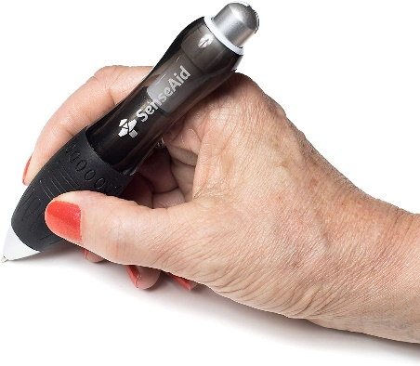

Slide 8
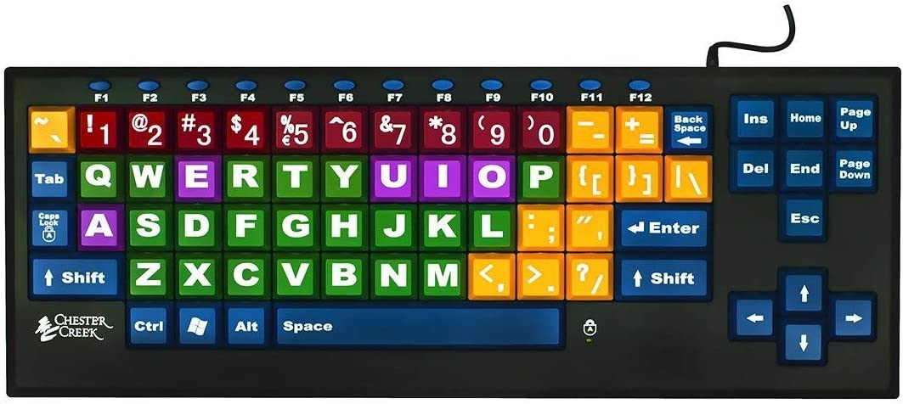

Slide 9
Odor-Lock Bags
Amazon.com
Notes:
Ataxians often have incontinence issues. These bags come in different sizes. After a week in my trash, there is still no odor, even during hot summer days.

Slide 10
EATING OUT?
Ask kitchen to cut into bite-sized pieces
Ask to fill cups 1/2 to 2/3
Wine glass issues
Bring your accessories

Slide 11
REMEMBER
Safety #1 goal
Be proactive
Life is not what happens to you,
but how you react to it
Notes:
I prepared this primarily for those who are new to ataxia.
And I hope I answer questions submitted by you to NAF via email a few weeks back
Goal: no falls, no injury, make ataxia life less frustrating
Take action before you need an assistive device, it will be there when you need it
Accidents happen, you may need a W?C if you sprain your ankle, have

Slide 12
