Slide 1


Letter of Intent
Kelly Piacenti, ChSNC®, Head of SpecialCare
Jerry Hulick, ChSNC®, Special Care Planner
A Virtual Event
March 17-19, 2022
Notes:
SpecialCare is a program exclusive to Massachusetts Mutual Life Insurance Company (MassMutual) that provides access to information and resources to families with dependents, of any age, who have a disability.
Through SpecialCare, you will learn valuable financial strategies, identify financial strategy solutions, access vital information and resources, and meet specialists who will work with families of dependents with special needs and their professional advisors – such as their banker, accountant or financial professional, lawyer, social workers and health care providers – to review their financial picture and offer options to fit the needs of each situation.
Our mission is to help educate families and caregivers of people with special needs about the importance and steps in creating a life care plan to help provide a secure financial future.

Slide 2



DISCLAIMER
The information provided by speakers in any presentation made as part of the 2022 NAF Annual Ataxia Conference is for informational use only.
Products or series mentioned during these presentations does not imply endorsement by NAF
NAF encourages all attendees to consult with their primary care provider, neurologist, or other healthcare provider about any advice, exercise, therapies, medication, treatment, nutritional supplement, or regimen that may have been mentioned as part of any presentation.
2022 AAC
A Virtual Event
March 17-19
Notes:
[Read slide]

Slide 3
PRESENTER DISCLOSURES
Kelly Piacenti
Jerry Hulick
The following personal financial relationships with commercial interests' relevant to this presentation existed during the past 12 months:
No relationships to disclose or list
2022 AAC
A Virtual Event
March 17-19
Notes:
[Read slide]

Slide 4
MASSMUTUAL DISCLOSURES
The information provided is not written or intended as specific tax or legal advice. MassMutual, its subsidiaries, employees and representatives are not authorized to give tax or legal advice. Individuals are encouraged to seek advice from their own tax or legal counsel. Individuals involved in the estate planning process should work with an estate planning team, including their own personal legal or tax counsel.
2022 AAC
A Virtual Event
March 17-19
Notes:
[Read slide]

Slide 5
Agenda
Person Centered Planning
Importance of Integrated Planning
Comprehensive life care planning steps
Letter of Intent
Letter of Intent examples and importance of communication
Additional Resource Support
2022 AAC
A Virtual Event
March 17-19
Notes:
[Read slide]

Slide 6
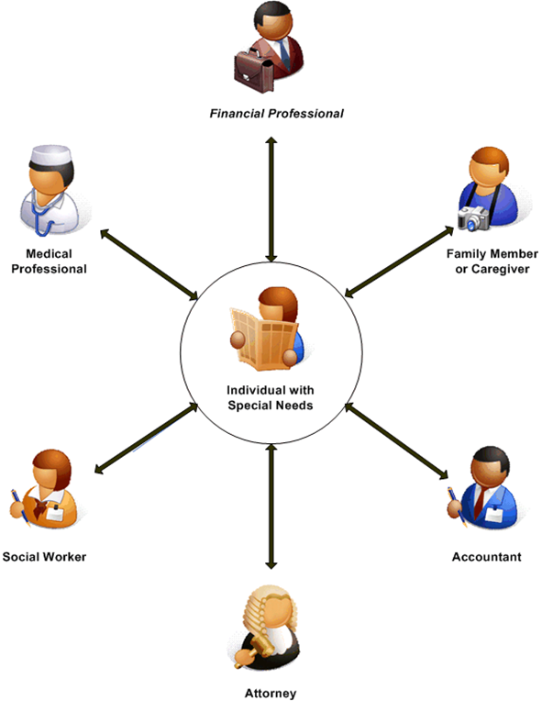
Person Centered Planning Process
Primary focus is on the person with special needs
Develop a Life Care Plan that enables that person to obtain the BEST possible quality of life in ALL areas of life
A Life Care Plan incorporates basic needs, goals, and strategies
2022 AAC
A Virtual Event
March 17-19
Notes:
The Person Centered Life Care Planning Process focuses on the development of a Life Care Plan that will enable the person with a disability to obtain the best quality of life possible. Your financial professional’s role is to work with you and your team of experts – doctors, specialists, social workers, attorney’s, bankers – to help develop a life care plan that best suits the needs of a person with a disability – now and far into the future.
This model supports our relationship building and needs based analysis approach employed by our agent or financial professional and it has been applauded by family support groups and non-profit organizations as an effective approach to reach these families.

Slide 7
The Importance of Integrated Planning
“Creating a life care plan that provides for both your own needs and those of your child’s can feel overwhelming, making it all the more important to assemble a team of trusted advisors”, such as…
Financial Professionals with special needs training
Attorneys with special needs planning experience
Accountants
Bankers
Social Workers and Advocates
Medical Providers
2022 AAC
A Virtual Event
March 17-19
Notes:
[read slide]

Slide 8
10 Comprehensive Life Care Planning Steps*
(1–5)
Address primary issues
Create Life Care Plan vision
Guardianship / alternatives to guardianship
Identify financial resources
Prepare Life Care Plan costs
2022 AAC
A Virtual Event
March 17-19
*You will need to work with your team of specialists and advisors – attorneys, medical specialists and financial professionals to help you create a life care plan that meets your needs.
Notes:
Our holistic approach involves a person with special needs’ network of advisors in the development of a life care plan that can help the individual maintain the lifestyle that he or she needs.
These are ten primary steps that should be considered and will help you develop an agenda to stay on track as you consider what’s right for your situation. Here we’ll go through steps 1 through 5 and continue with the rest of the steps on the next slide.
Step 1 is to Address Primary Issues. In other words, it’s a look at what is currently happening in your loved one’s life.
Step 2 is to Create a Life Care Plan Vision. Let us help you and your other advisors as you define your dreams, goals and wishes for the future care of your loved one. We can provide protection strategies to help ensure the quality of life is retained.
Step 3 is to Guardianship & Alternatives. Guardianship is a personal issue and unique to each family. Involve your loved one with special needs in the decision making process, if applicable.
Step 4 is to Identify Financial Resources; What assets are available today? Or, where will the money come from ?
Step 5 is to Determine Life Care Plan Costs. How much will it cost to address your primary issues?

Slide 9
10 Comprehensive Life Care Planning Steps
(6–10)
6. Prepare Letter of Intent
7. Prepared legal instruments
8. Review need for special needs trust/ ABLE account
9. Hold family/friend meeting
10. Review Life Care Plan annually
2022 AAC
A Virtual Event
March 17-19
Notes:
Step 6 is to Prepare Letter of Intent. We’ll review a Letter of Intent in more detail in the next slide.
Step 7 is to Prepare Legal Instruments. Work with an attorney to ensure that your desires are carried out whether you are here or not. Be sure you have all the appropriate legal documents in place in case of a need or emergency, such as wills, trusts, medical directives, health care proxies, power of attorney.
Step 8 Speak with your attorney and financial professionals to see if a Special Needs Trust and/or ABLE Account is applicable.
Step 9 Involves holding a Family/Friend Meeting to make sure that everyone is informed and involved (if applicable).
Step 10 is to Review your Life Care Plan Annually. This is to ensure that your plan is always up-to-date with potential changes in benefits, trustees, family members, insurance and other Life Care plan components. Consider using a birthday or holiday as a reminder to update.

Slide 10
Letter of Intent
Not a legal document, but considered by the court (Wills, Trusts and other legal documents take precedence)
Captures current situation, as well as hopes and dreams
Helps to ensure future caregivers understand your wishes for your loved one with special needs
Updated regularly and stored in a readily available location
2022 AAC
A Virtual Event
March 17-19
Notes:
A great way to share information is through use of a Letter of Intent.
A Letter of Intent is not a legal document (it is not binding) however it conveys the thoughts, dreams, and feelings regarding the care of a loved one with special needs.
It describes a day in the life of the dependent; such as likes, dislikes routines, favorite foods, thoughts on religion, dating, medical routines and history, doctors, etc.
It can help future caregivers continue caring for your loved one.
It’s important to keep it updated regularly and stored in a readily available location.

Slide 11
Letter of Intent – The Why’s and How’s
WHY? – To leave explicit and specific instructions that would familiarize anyone with the individual
WHEN? – This is a working document; it should be completed as soon as possible and updated regularly – at least once per year or as needed
HOW? – Templates are available online which are downloadable and fillable, but don’t be afraid to go beyond what is asked and provide more information
WHO? – Input from everyone, especially the caregivers, and the dependent, if applicable
2022 AAC
A Virtual Event
March 17-19
Notes:
[read slide]

Slide 12
Letter of Intent Examples
Describe your child’s current diagnosis and medical condition, medications, doctors, allergies, hospitalizations, etc.
Does your child currently live with you? Where do you see your child living in the future?
What does your child like to do for fun?
What are your child’s strengths and weaknesses?
Describe your child’s education and work history
Who is your choice of successor caregiver/guardian?
2022 AAC
A Virtual Event
March 17-19
Notes:
Many families use the Letter of Intent as a scrapbook or history of their child’s life. While it’s extremely important to document the child’s medical condition and medications, use it as a diary or wish book for the future.
Coordinating information from your child’s Special Needs Teacher is also important. Teachers keep a detailed report on each child they work with and you should have access to that information for your own records. It will help you plan for their future more easily.
(Site examples: Use those that you are familiar with or share stories. While anecdotal stories are o.k., you must not provide detail so that an audience could determine the identity of any clients. This is to ensure that they privacy of our clients is protected.)
One Special Care Planner, while helping a family format their Letter of Intent, suggested to the mother that her daughter with Down Syndrome may go to college, hold a job or even get married. The mother was very upset with the Special Care Planner suggesting the idea of marriage as she didn’t think it would be feasible. However, many years later when the daughter was turning 23, the Planner was invited to her wedding. Upon entering the service, the mother approached the Planner, with tears in her eyes, and thanked the Planner as she would never have thought this day would have been possible if he hadn’t mentioned it to her years before.
The Letter of Intent helps parents dream for their children.

Slide 13
Keep in Mind…
The Letter of Intent is an important tool in communication
Can be addressed to anyone (future caregivers, trustees, family, etc.)
A helpful guide for family, caregivers, fiduciaries and others when understanding your loved one’s unique situation and needs
2022 AAC
A Virtual Event
March 17-19
Notes:
[read slide]

Slide 14
Every person has different needs, and everyone has different wishes for their loved one.
The Letter of Intent helps the caregiver to more quickly learn how to deliver the very best care possible.
2022 AAC
A Virtual Event
March 17-19
Notes:
[read slide]

Slide 15
Hold a Family Meeting
Communication is VERY Important!
Have a family meeting to discuss future needs
Discuss concerns and future care options
2022 AAC
A Virtual Event
March 17-19
Notes:
Have a family meeting to discuss your dependent's future needs.
Just as caring for a dependent with special needs is a family affair, so is the related planning.
With the thoughts that you have facilitated your dependent’s special needs throughout their life, meet with your family members to discuss their concerns and options for future care.

Slide 16
Holistic Planning
Get the help you need by coordinating with specially trained professionals to create a holistic life care plan, while balancing your own needs and those of other family members.
Part of a holistic planning is capturing plans developed with professionals (i.e. the integration of legal structure, financial plans and relation to life needs and lifestyle).
2022 AAC
A Virtual Event
March 17-19
Notes:
[read slide]

Slide 17
Chartered Special Needs Consultant® (ChSNC®) or Special Care Planner
Financial professionals with specialized training in helping people with special needs and their families
Work by a set of core values: integrity, honesty, teamwork, and respect in helping families create a life care plan
Have earned our clients’ trust and admiration by emphasizing the quality of service and relationships
Our professional associates combine knowledge and years of collective experience
Financial professionals who have earned the Chartered Special Needs Consultant® (ChSNC®) designation or Special Care Planner certificate work with you and your professional advisors to review your current situation and offer possible solutions that could help the needs of you, your loved ones, and your entire family
2022 AAC
A Virtual Event
March 17-19
Notes:
I’d like to just take a moment to share with you some information about who we are.
The Special Care Planner received advanced training and information in estate and tax planning concepts, special needs trusts, government programs, and the emotional dynamics of working with people with special needs and their families.
The Chartered Special Needs Consultant (ChSNC®) designation is awarded to financial professionals who have completed several hours of academic classes in addition to holding either Chartered Financial Consultant (ChFC) or Certified Financial Planner (CFP) designations. The ChSNC designation was developed by The American College in Bryn Mawr, Pennsylvania and the professional designation evolved from MassMutual’s SpecialCare Program.

Slide 18
Get Additional Resource Support
Local Non-Profits
Newsletters / Publications
Support Groups
Government Agencies
2022 AAC
A Virtual Event
March 17-19
Notes:
Contact local nonprofit organizations for additional resource support.
Your local nonprofit may be able to provide resources that can help with planning or that supplement the standard services provided by government agencies. A good starting place is to first contact a nonprofit dedicated to your dependent’s special need. Other resources of information and support are newsletters/publications and support groups.

Slide 19
How MassMutual Can Help
Access local organizations and advocacy groups
Protect future eligibility for government benefits
Create a Life Care Plan
Understand the financial and legal issues in special needs planning, including special needs trusts
Determine how much money is needed to provide for lifetime quality care
2022 AAC
A Virtual Event
March 17-19
Notes:
SpecialCare is a program offering access to products and services that can help you manage your finances and give you room to breathe.
A MassMutual Special Care Planner can help you:
• Access local organizations and advocacy groups
• Protect future eligibility for government benefits
• Create a Life Care Plan
• Understand the financial and legal issues in special needs planning, including special needs trusts
• Determine how much money is needed to provide for lifetime quality care

Slide 20
How Do I Start the Planning Process?
With Special Needs Professionals:
Legal Estate & Special Needs Attorneys (National Academy of Elder Law Attorneys, The Special Needs Alliance, The Academy of Special Needs Planners)
Financial Professional with a focus on Special Needs (Special Care Planner or ChSNC®)
2022 AAC
A Virtual Event
March 17-19
Notes:
How do I get started?
There are two types of estate planners, legal and financial.
Most legal estate planners will direct you to go to a financial professional first. It’s critical to determine what is needed prior to the trust being drafted.

Slide 21


Thank You
Questions
Website:
www.massmutual.com/specialcare
eMail:
specialcare@massmutual.com
2022 AAC
A Virtual Event
March 17-19

