Slide 1
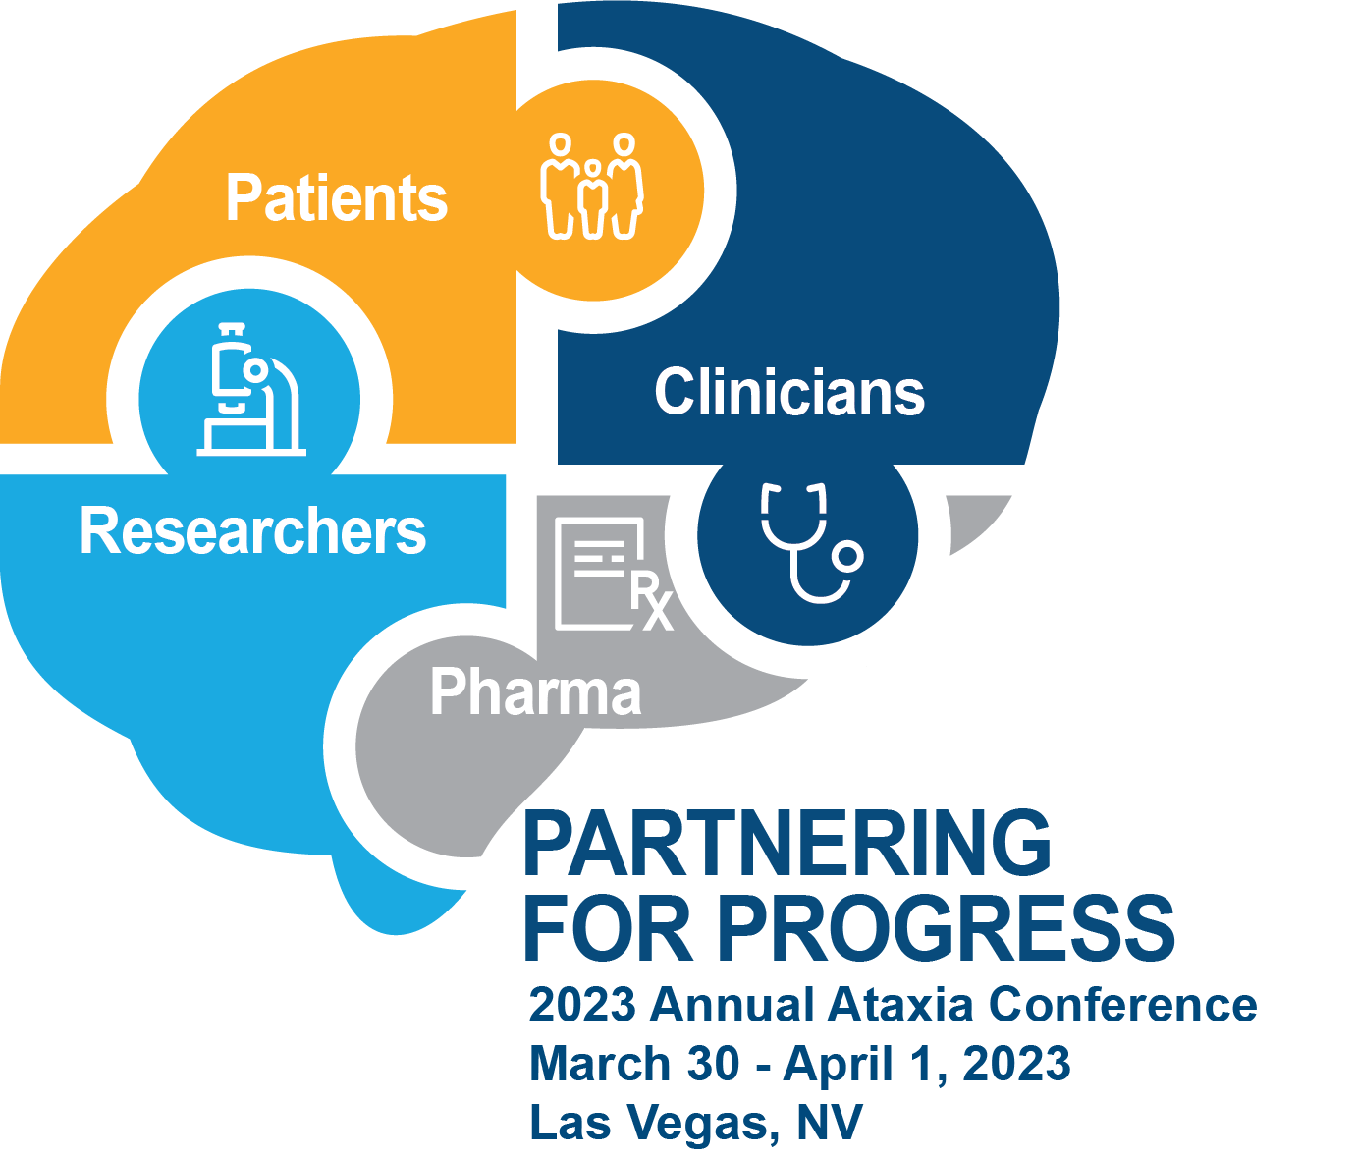
Late Breaking (NAF) News

Slide 2
What can we accomplish with more than 2X revenue and 2X workforce?
Chief Scientific Officer
Regional Development Manager
Clinical Services Manager
Research Services Coordinator
Accountant
Social Media Coordinator
Database Manager
Support Group / Programs Coordinator

Slide 3
In just 5 years, your support has enabled NAF to sponsor research advancements for….
SCA1 SCA2 SCA3 SCA6 SCA7 SCA8 SCA10 SCA12 SCA13 A-T
SCA17 SCA27b SCA28 SCA35 SCA36 SCA41 SCA48 EA2 FXTAS
FRDA PDHD SCAN1 SCAR12 SCAR13 SCAR20 SPAX5 SPG48 MEAK
AOA2 HADDS Gordon-Holmes Syndrome Immune-mediated Ataxias
Mitochondrial Ataxias Christianson Syndrome Marinesco-Sjögren syndrome
Sporadic / Unknown / Cerebellar Ataxias

Slide 4
NAF-funded grants have contributed to…
Creation of multiple 1st animal models of rare ataxias, critical tools for understanding disease and developing treatments
Discovery of new ataxia genes and ataxia types
New clinical scales and biomarkers that are already being used in clinical trials
New potential therapies and drug targets for ataxias
1st in human clinical trials to assess gene silencing therapies for ataxia
Biorepositories of patient blood, CSF, brain and spinal cord tissue, and natural history data that are and will continue to contribute to ataxia research all around the world

Slide 5
Small Research Grants = Huge Impact!
In a recent survey of NAF funded grants:
>$4.1M in New Ataxia Funding from Other Sponsors
(i.e. NIH, other foundations)
$1.8M in NAF Research Funding
Seeded

Slide 6
Small Research Grants = Huge Impact!
“Thank you again for the support -- we have very encouraging results, and this funding helped us collect the preliminary data necessary to partner with (another) Charitable Foundation to work on therapeutic development.
Further, it really helped me transition to a faculty position. NAF has supported me at multiple stages of my postdoc, and I don't think I'd be where I'm at in my career without the support you've given to my work.”

Slide 7
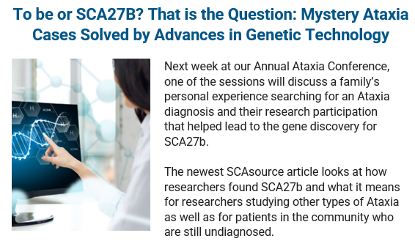
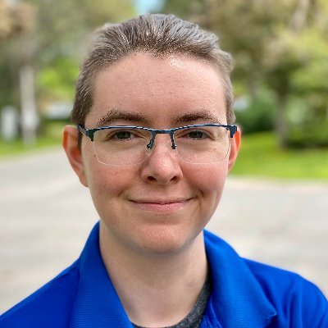
Making Ataxia Research Accessible
Co-founder, Dr. Celeste Suart, will be joining the NAF research team as our 1st Patient Engagement Manager!
Goal: Expand NAF resources about research, clinical care, and drug development across all ataxia types.

Slide 8
Providing Ataxia Information that is Relevant to You and Your Life

Slide 9
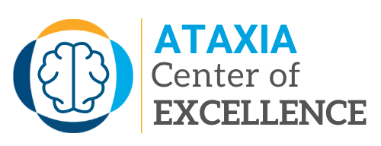
Setting a Higher Bar for Ataxia Clinical Care
No one should have to teach their doctor about their disease!
The NAF Ataxia Centers of Excellence Program will identify the best ataxia clinics in the US and around the world.
First designated centers will be announced in May 2023!

Slide 10
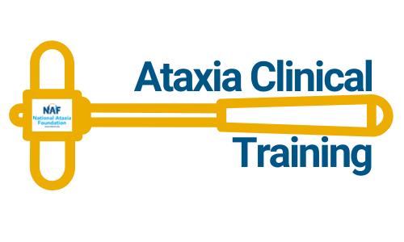
Training the Next Generation of Ataxia Clinical Experts
Our Goal: Train 200 ataxia-specialized neurologists over the next 5 years!
In 2022, NAF launched the Ataxia Clinical Training Program to educate movement disorder neurologists about ataxia.
Over the next 2 days, 35 fellows from 25 institutions will be trained by the world’s leading experts in ataxia diagnosis and treatment.

Slide 11
Increasing Accessibility to Diagnostic Testing for Ataxias
Since its launch in Feb. 2022, NAF has helped sponsor:
>180 virtual genetic counseling appointments
>80 genetic test results for individuals at-risk for SCA1, 2 & 3
97% of survey respondents would recommend to a family member
NAF will continue to work hard to try to make genetic testing affordable & accessible to everyone.
Notes:
Overall, genetic counseling and testing costs have decreased significantly.
~$200 Virtual Genetic Counseling Appt.
~$300 Single Gene Test
~$700-1500 Ataxia Gene Panel

Slide 12
Amplifying the Patient Voice
Increased interactions and meetings with the FDA
Development of new government-funded initiatives and funding sources dedicated to ataxia research and drug Development
Formalized partnerships between NAF and industry leaders in ataxia drug development
Completion of many patient panel discussions and advisory boards so that drug companies can learn from the real experts of these diseases.
Thank you to all of you who have contributed your precious time, energy, $$$ and expertise to help drive ataxia research forward!
Notes:
Dawn Bir, Chief Commercial Officer, Reata to

