Slide 1
#1 Goal of NAF Grant Funding Program:
Diverse Scientists in Ataxia Pre-Doctoral Award
Young Investigators Award
Research Seed Money Grants
Post-doctoral
Fellowship Award
Pioneer SCA3/MJD Translational Research Award
2
$35k/yr
Support research that will lead to effective therapies for all ataxias.
3
$35k/yr
4
$50k/yr
7
$50k/yr
2
$100k/yr
Notes:
Remove names, add # of grants
Total amount spent

Slide 2
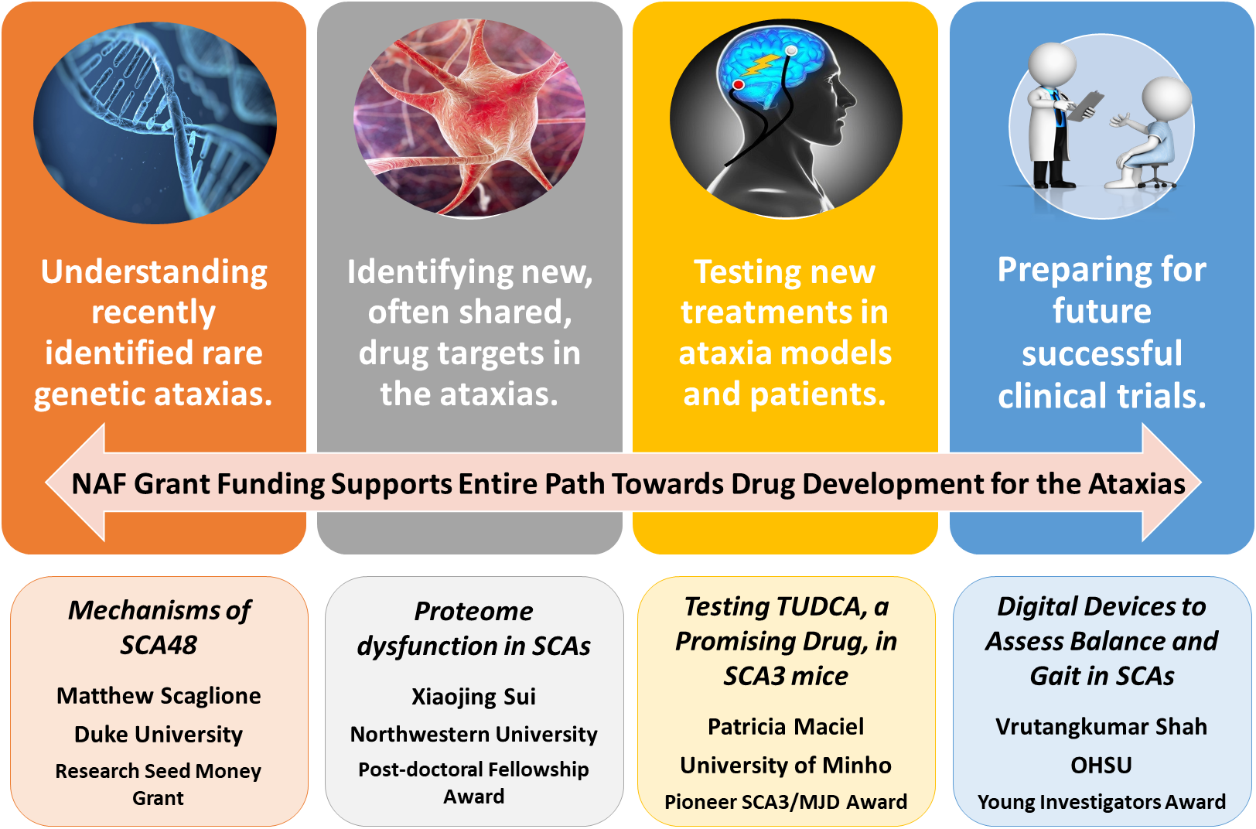

Slide 3
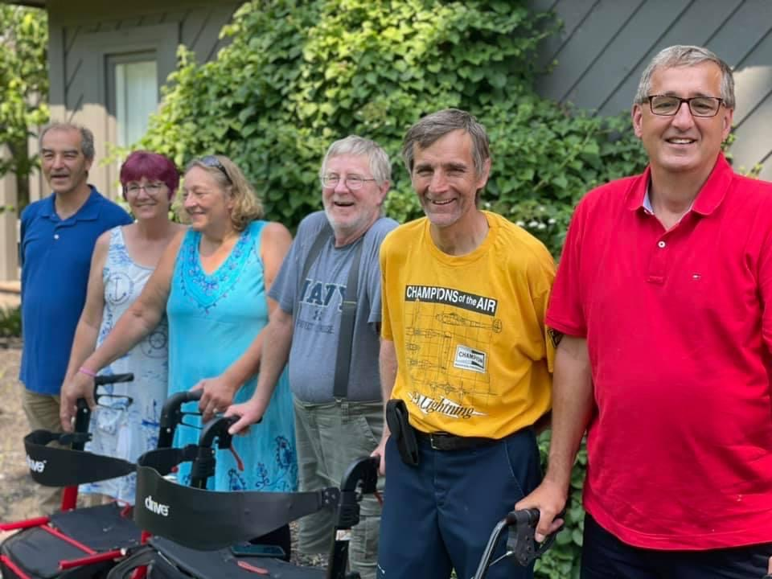
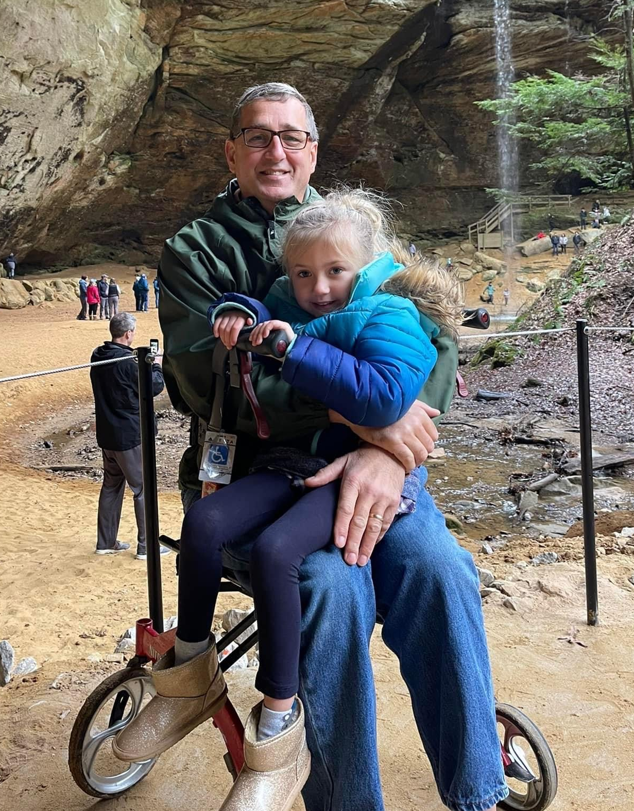
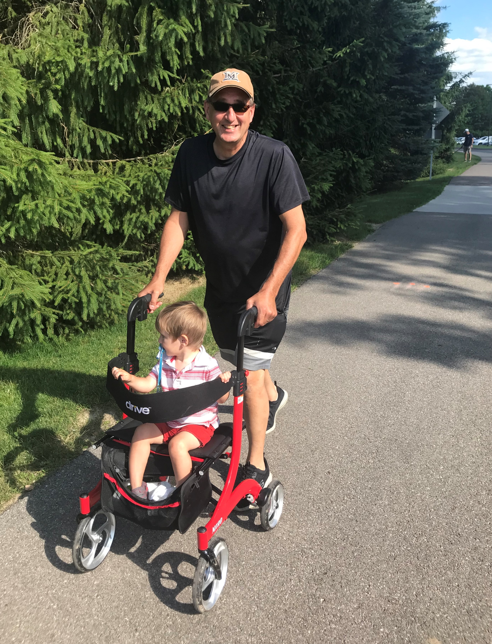
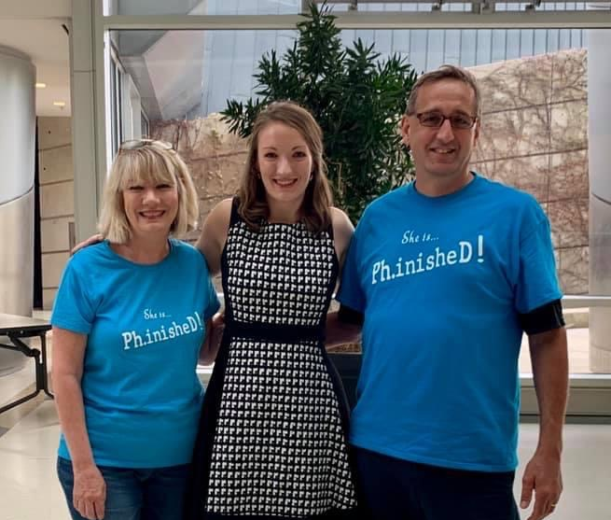
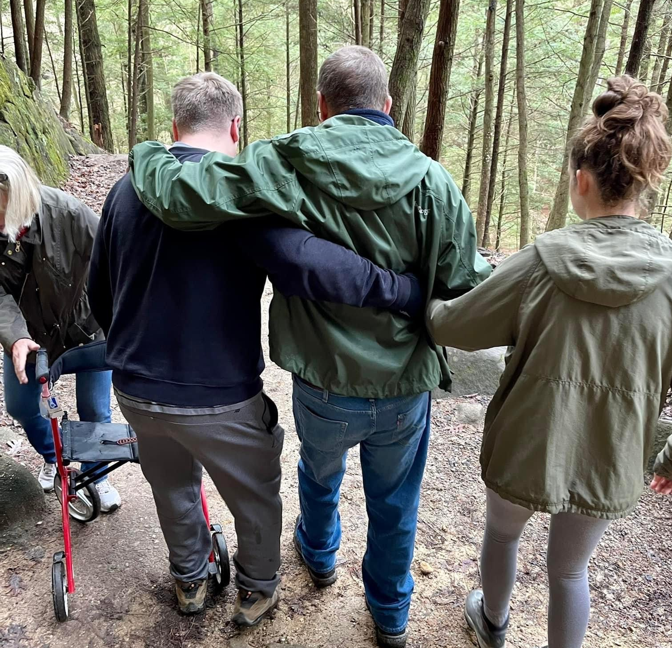

Slide 4
Clinical Trial Readiness & You
Participate in Ataxia Natural History Studies
Learn what it means to be “clinical trial ready”
Let drug companies know we are here and ready for trials

