Slide 1


Ataxia- family planning
Matt Bower
Genetic counselor
University of Minnesota Health
A Virtual Event
March 17-19, 2022

Slide 2



DISCLAIMER
The information provided by speakers in any presentation made as part of the 2022 NAF Annual Ataxia Conference is for informational use only.
Products or series mentioned during these presentations does not imply endorsement by NAF
NAF encourages all attendees to consult with their primary care provider, neurologist, or other healthcare provider about any advice, exercise, therapies, medication, treatment, nutritional supplement, or regimen that may have been mentioned as part of any presentation.
2022 AAC
A Virtual Event
March 17-19

Slide 3
PRESENTER DISCLOSURES
Matt Bower
No relationships to disclose or list
Other than…..
I have been tasked with covering the topic in 12 minutes or less- which means this will be a quick overview!
2022 AAC
A Virtual Event
March 17-19

Slide 4
Roadmap
What is my diagnosis?
What are my options?
What is the risk?
What is the best choice for me?
2022 AAC
A Virtual Event
March 17-19

Slide 5
Step 1- what is my diagnosis?
For most reproductive options, it is critical to have genetic confirmation of diagnosis.
  Is the type of ataxia known in my family?
  If the type of ataxia is not known, what test should I do?
  If I am young and asymptomatic, do I want to have predictive testing?
2022 AAC
A Virtual Event
March 17-19

Slide 6
Step 2- what is the risk?
Once we know the type of ataxia, we can accurately predict the risk
Dominant
Recessive
?
?
Other factors:
Can my partner have carrier testing? (for recessive conditions)
Is this a condition with anticipation? (younger onset if repeat expands)
2022 AAC
A Virtual Event
March 17-19

Slide 7
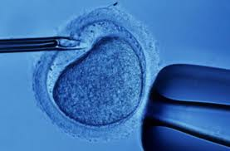
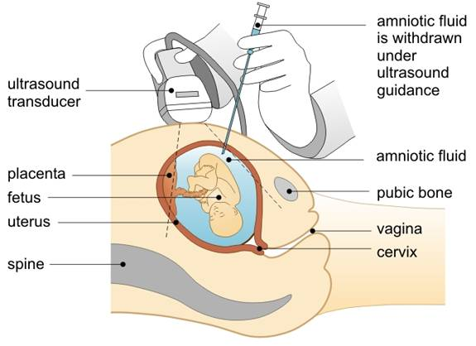
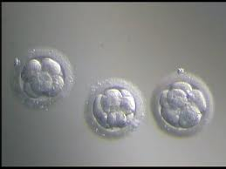
Children but no testing
No children
Donor egg/sperm
Adoption
Step 3- what are my options?
Prenatal testing
Pre-implantation genetic diagnosis
2022 AAC
A Virtual Event
March 17-19

Slide 8
Step 4- what is best for me?
How important is being a biological parent?
How concerned am I about the risk for ataxia in my children?
How will ataxia impact my ability to parent in the future?
Do any of the options raise ethical/moral concerns for me?
2022 AAC
A Virtual Event
March 17-19

Slide 9
How do I travel down this road
Enlist an expert to assist you- often a genetic counselor
Trusted sources
  Spouse, friends, pastor, counselor, other patients

