Slide 1
Pediatric Ataxia
David Lynch, MD PhD

Slide 2
DISCLAIMER
The information provided by speakers in any presentation made as part of the 2021 NAF Annual Ataxia Conference is for informational use only.
NAF encourages all attendees to consult with their primary care provider, neurologist, or other healthcare provider about any advice, exercise, therapies, medication, treatment, nutritional supplement, or regimen that may have been mentioned as part of any presentation.
Products or series mentioned during these presentations does not imply endorsement by the NAF.

Slide 3
PRESENTER DISCLOSURES
David Lynch, MD PhD
The following personal financial relationships with commercial interests relevant to this presentation existed during the past 12 months:
Dr. Lynch receives grant support from the NIH, MDA, FARA, Reata pharmaceutical, Retrotope, PTC Therapeutics and Audentes Therapeutics.

Slide 4
Friedreich ataxia –Neurology, Genetics, and Neuroscience
David Lynch

Slide 5
Friedreich Ataxia (FA)
1
Rare, genetic, progressive disease
- Affects 1 in 50,000-100,000
- Estimated 4-5K people in US and 15K worldwide
Usual presentation involves neurological features, which are 100% penetrant; FA is a multi-system disease
Genotypic and phenotypic heterogeneity
- Childhood onset, most common, is associated with relatively rapid progression
Onset usually at 5-15 y
By late teens to early 20’s most are wheelchair-bound and require assistance with ADLs
Late onset (diagnosed after age 25) is associated with slower progression and overall milder phenotype

Slide 6
Clinical Features
2
Neurological-Classical perspective (neuronal death)
Loss of large sensory neurons - proprioception
Loss of balance and coordination
Loss of reflexes
Loss of spinocerebellar tracts
Loss of balance and coordination
Loss of motor tracts
Loss of dentate nucleus of the cerebellum
Dysarthria (slurred speech), modest eye movement abnormalities
Loss of vision, hearing
Subclinical myopathy
Relatively sparing of cerebellar cortex, cerebral cortex
Relatively normal cognition
Loss of relatively few neurons, modest number of axonal tracts--MRI is often normal in early disease

Slide 7
FA – A Multisystem Disorder
3
Cardiac:
Hypertrophic cardiomyopathy, progressive and severe, and early morbidity and mortality
Clinically significant arrhythmias
Atrial/ SVT
Endocrine: Diabetes –10-20%; >65% insulin resistance
Skeletal abnormalities:
Scoliosis - corrective surgery (25% of pts)
Pes cavus
Fatigue: Nearly all patients experience significant fatigue that impacts quality of life

Slide 8
FA – Management. The past/present
4
No treatment to stop disease progression
Ongoing clinical trials of small molecules targeting down-stream consequences of frataxin deficiency
Annual evaluation & supportive treatment
Echocardiogram, EKG
Elevated glucose
Scoliosis screening (especially 7-18 y)
Vision and hearing screen
PT/OT/Speech

Slide 9
8
Genetic basis of Friedreich ataxia: The FXN gene
(GAA)100-1500
Non-FA genes: <30 triplets
FA genes: 100 – 1500 triplets

Slide 10
9
Genetic basis of Friedreich ataxia: The FXN gene
(GAA)100-1500
G130V
I154F
L106X
96% = (GAA)exp + (GAA)exp
4% = (GAA)exp + LOF mutation
Mutational homogeneity
Everyone has at least one (GAA)exp
except one recently ID pt in Turkey

Slide 11
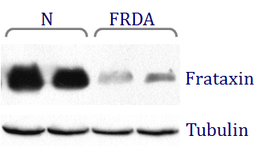
10
FXN transcriptional deficiency: Loss of function
qRT-PCR
Frataxin deficiency
All have some frataxin
No aberrant frataxin
Carriers with ~50% are asymptomatic
Patients with point mutations identical to GAA x 2 pts

Slide 12
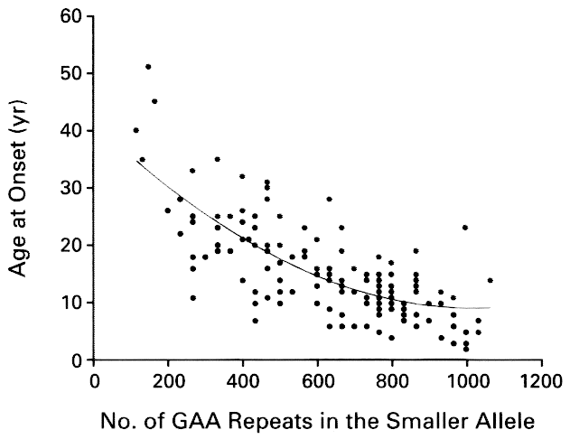
GAA Repeat Size and Age of Onset, Durr et al., NEJM, 1996
GAA repeat expansion sizes correlate with measures of disease severity
GAA repeat expansions decrease, but do not eliminate, frataxin expression
This curve for 1997 looks the same now.
3 Reasons for discrepancies:
Somatic variability
Modifiers
Ascertainment bias

Slide 13
FRDA- The present What we have learned
Measures
Biomarkers
Natural history data
Way to find patients with specific
features
Funding
Patient advocacy organization
Pharmaceutical company support
Tools:
Registry
Natural history study

Slide 14
Lessons learned- the present
Human disease takes place over a longer period of time
(chronic vs acute/subacute disease)
Think of FA as chronic metabolic disease
Antioxidant concepts too simplistic
Need to re-activate endogenous antioxidant systems--omaveloxolone

Slide 15
mFARS Improved Over Time

Slide 17
FA in the COVID era
National mortality rate around 2%
Probably about the same in our FA program
Higher for individuals with FA and DM, bad cardiomyopathy, bad scoliosis.
Vaccination as soon as available
All presently available vaccines OK for FA
Research continuing

Slide 18
Summary-The present and future
49
FA is multi-system disease caused by a decreased expression of a single gene. Disease diagnosis and treatment preferably would begin in pediatric patients (<14 yrs).
Natural history databases and disease severity score systems available
Meaningful treatment could be to one or multiple target tissues/organ systems.
Clinical research infrastructure established globally
Omaveloxalone, gene therapy, protein replacement as upcoming therapies
Each new finding leads to more questions

