Slide 1
The Process of Drug Development
Liana S. Rosenthal, MD, PhD
Melissa Wolfe beiner, MD

Slide 2
Agenda
Clinical Trial Overview/the drug development process
Clinical Trial readiness and the challenges inherent to rare disease
How do clinical trials contribute to advancing research in a given disease space
NAF (Patient Advocacy) Role in Accelerating Drug Development and Aligning Regulators, Clinicians, and Industry
NAF and Biohaven
DDC

Slide 3
Basic Science Research/Clinical Research
Basic Science Research
Investigation of a subject to increase knowledge and understanding about it
In the sciences, usually refers to research performed on cells, animals, etc
Knowledge for the sake of knowledge, but can then be translated to other things
Example: An atomic clock that is critical to satellite-based GPS
Clinical Research
Any research that involves humans
Goal is to improve human health or increase understanding of human biology
May be observational vs interventional
Observational: we observe—clinical assessments, blood, spinal fluid, imaging, etc in order to understand more about human biology
Interventional/clinical trial: we determine if our intervention changes an underlying condition

Slide 4
Examples: Observational Studies
Framingham Heart Study
US Census
COVID vaccine monitoring

Slide 5
Examples: Clinical Trials
Every prescription drug or vaccine you have ever taken, was once part of a clinical trial
Antibiotics
Birth control pills
Blood pressure medications
Riluzole, 4-aminopyridine, amantadine, baclofen, etc
COVID 19 vaccines

Slide 6
Clinical Trials and research terms to know
Placebo: A substance or thing with no therapeutic effect
Double blind: The researchers and the patients do not know if they are taking placebo or active medication/intervention
Powered: the ability of a study to detect a difference, if a difference actually exists
Endpoints: an event or outcome that can be measured objectively to determine whether the intervention being studied is beneficial

Slide 7
Overview: Clinical Trial Readiness and Advancing SCA Clinical Trials
Clinical Trial Readiness/Challenges
Natural History Data
READISCA
CRC-SCA
EUROSCA
Clinical Trial Experience
Biomarkers/Quantitative Assessments
Important as indirect measures of disease severity and for predictive purposes
Sensitive and Specific Outcome Assessments
Notes:
Clinical readiness: what do we need to have in place to conduct a clinical trial
What are the specific challenges we face when studying a rare disease/ what are our specific challenges to SCA
What do we need?
An understanding of the natural clinical course of the disease being studied
Mention heterogeneity
Ways to measure a clinical change in the disease: is it getting worse/better?
Qualitative COA’s
Quantitavie measurements

Slide 8
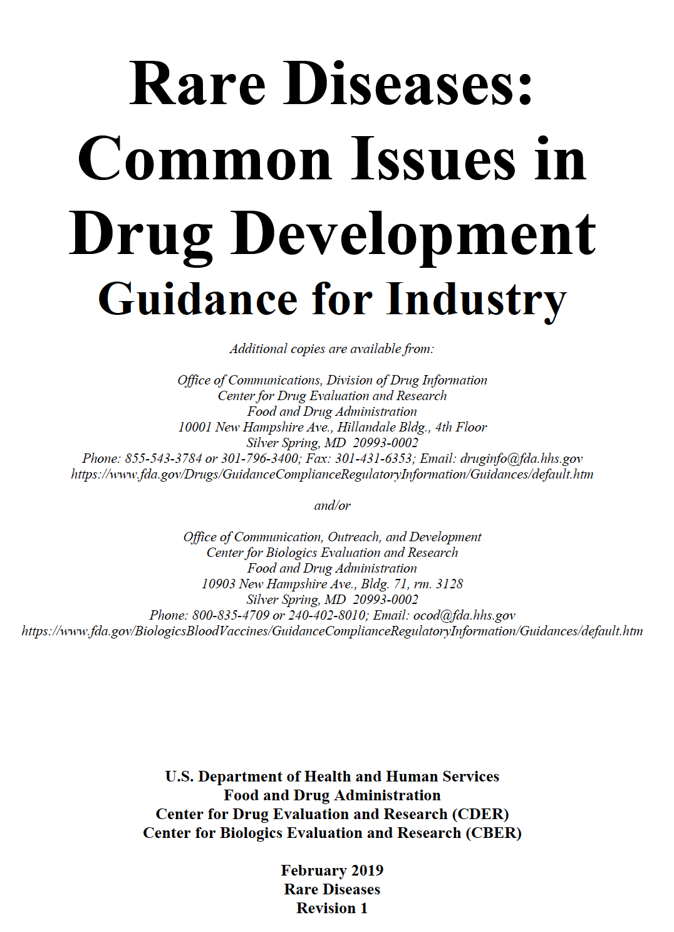
FDA Draft Guidance on Important Elements for Drug Development
Pathophysiology of Disease/Drug Mechanism
Agency Interaction
Evidence of Safety and Efficicacy
Toxicology
Natural History of Disease
READISCA
EuroSCA
CRC-SCA
Drug
Quality Considerations
Outcome Assessments
Patient, Caregiver, Advocacy Group Involvement
Notes:
These are all the obvious things we talked about, but I want to highlight the need for the patient voice and patient advovacy and how the FDA encourages this

Slide 9
Natural History Studies/Observational Studies
Not required by FDA but important to all drug development programs.
Knowledge of natural history of disease helps:
Define disease population and clinical course:
Prognostic enrichment: allows selection of patients more likely to progress and develop disease endpoints
Importance of understanding the epidemiology of SCA across the globe and across the USA (NAF genetic testing initiative)
Define entry criteria and adequate trial duration
Select sensitive and specific outcome assessments
Identify new or validate existing biomarkers
Clinical Research Consortium-Spinocerebellar ataxia
(CRC-SCA)(e.g. natural history study) (CSF collection/Blood draws)
IDEA study
READISCA study (MRI)
Notes:
Just to address the again the importance of non interventional trials as a stepping stone to drug development…why are the natural hx and observational studies so important, other than the obvious reason that they advance the field by accumulating information and knowledge about the given disorder
Importance of understanding the heterogeneity of SCA: at what point in disease are you seeing progression, etc

Slide 10
The Stages of Clinical Trials
Notes:
What is a clinical trial and who conducts it?
Phase 3…need numbers for power
Mandated in vitro/in vivo studies provide
Evidence of safety
Mechanism of action
PK
Drug metabolism
Provides important rationale for:
Dose selection
Dose regimen
Route of administration
Guidance of safety assessments

Slide 11
The Long Process of Drug Development
Drug Discovery
~10,000 Compounds
~4-6
Years
Preclinical Testing
~250 Compounds
~12-15
Years
Clinical Testing
~5 Drugs
~6-7
Years
~1-2
Years
FDA Approval
1 Drug
Notes:
The process we just talked about takes a long time, requires collaboration of researchers across the field, and costs a lot of money
estimated the cost of bringing a new drug from the beginning of the research process to the market at $2.6 billion.
For Phase III Trials alone, it has been estimated that costs can be as high as $40 to $60 million.
The cost of developing a specific drug is dependent on the prevalence of the disease it is intended to treat (how common that disease is in the population) as well as the complexity of the disease. This can affect how long it takes to enroll enough patient volunteers, as well as the general medical costs of taking care of patients in the research trial.

Slide 12
The Value of Clinical Trials in Advancing Research

Slide 13
Why do clinical trials fail?
The drug or intervention do not work
Not enough patients enrolled in the study, so it is not adequately powered
SCA 3 is different from SCA 1 so a SCA 3 drug may not work on SCA 1. A study with both groups needs to be adequately powered.
The endpoint is not objective or ideal

Slide 14
Troriluzole Treated SCA Patients Treated for 1 Year Compared to Matched Ashizawa Natural History Cohort
Post-hoc analysis of patients enrolled in long-term extension of Phase 2b/3 troriluzole SCA trial
Primary efficacy endpoint: change from baseline in the Total SARA Score after 48 weeks
Patients from BHV4157-201 trial versus eligibility criteria matched Ashizawa Natural History cohort:
SCA Genotype
SCA1, SCA2, SCA3, SCA6
Age at baseline
18 to 75 years of age
Gender
SARA Score at baseline
≥ 8 and ≤ 30, and
Initial SARA gait item score ≥ 2
SCA Patients on Troriluzole vs. Natural History Cohort
Least Squares Mean² Change in Total SARA Score (from baseline ± SE)
Difference: -1.41 ± 0.411 (95% confidence interval of -2.22 to -0.60) suggesting therapeutic benefits of troriluzole (p=0.0007)
1. Matched on eligibility criteria
2. ANCOVA model with fixed effects for cohort, sex, & SCA genotype with age and baseline SARA scores as covariates
Troriluzole Study (BHV4157-206) in Spinocerebellar Ataxia (SCA) Achieved Phase 2/3 start in 1Q19
SARA: Scale for the Assessment and Rating of Ataxia
Notes:
This study highlights the importance of
a failed trial: what do we learn from any trial, regardless of its success. (will talk about that more in the next slide)
the natural history studies
the patient voice

Slide 15
Learnings and Next Steps
FDA suggests use of gait, balance and language Items of the SARA
Importance of Variability in SARA Scoring
Rationale for enriched target population (prognostic enrichment)
Natural History Studies
Study data and anecdotal reports
Long-term study design may extinguish placebo effects
Exposure-response relationship suggests use of higher troriluzole dose in subsequent study
Overall study data (extension phase and subset of randomization phase) consistent with potential therapeutic effect

Slide 16
Preparing for BHV4157-206 and future clinical trials
Optimal Trial Design for BHV4157-206
Lessons from 201
Natural History Studies
Optimize primary efficacy assessment
Align with FDA
Notes:
The message here is that, in the rare disease space, it is particularly challenging to optimize the design of a clinical trial and that you need to incorporate…

Slide 17
Clinical trials underway
Anti-sense oligonucleotides (ASO)
DNA --> RNA --> Proteins
ASO’s bind to the RNA and stop it from making the “bad” protein
Coming soon, probably starting with SCA 3

Slide 18
Clinical trials coming soon
Gene therapy trial for SCA 3
Administered to the cerebrospinal fluid, 1 time
Replaces SCA 3 mutated gene with non-mutated gene replacement
Uses viral vector to administer gene (viral vector also used in AstraZenaca COVID vaccine)

Slide 19
Looking to the Future: Advocacy and Drug Development
Clinical Trial Readiness
Patient Identification: NAF online resources and membership; genetic counseling/testing initiative; NAF educational campaign
Regulatory Acceptance
Advocacy at the regulatory level
Post-Approval
Epidemiology
Natural history studies, biospecimen collection/biomarkers; clinical endpoint development
Payers and budget holders have competing priorities

Slide 20
Thank you and questions!

