Slide 1


Ataxia Biomarkers and Why They’re Important
Presented by:
  Dr. Puneet Opal
  Dr. Hayley McLoughlin
A Virtual Event
March 17-19, 2022

Slide 2




DISCLAIMER
The information provided by speakers in any presentation made as part of the 2022 NAF Annual Ataxia Conference is for informational use only.
Products or series mentioned during these presentations does not imply endorsement by NAF
NAF encourages all attendees to consult with their primary care provider, neurologist, or other healthcare provider about any advice, exercise, therapies, medication, treatment, nutritional supplement, or regimen that may have been mentioned as part of any presentation.
2022 AAC
A Virtual Event
March 17-19

Slide 3
PRESENTER DISCLOSURES
Dr. Puneet Opal (Northwestern University)
  Has no conflicts of interest with the material presented in this talk
  Research Support from Biohaven, Royalties from Uptodate
Dr. Hayley McLoughlin (University of Michigan)
  Has no conflicts of interest with the material presented in this talk
  Research Support from Ionis, Biogen, and UniQure.
  Consultant for Lacerta
2022 AAC
A Virtual Event
March 17-19

Slide 4
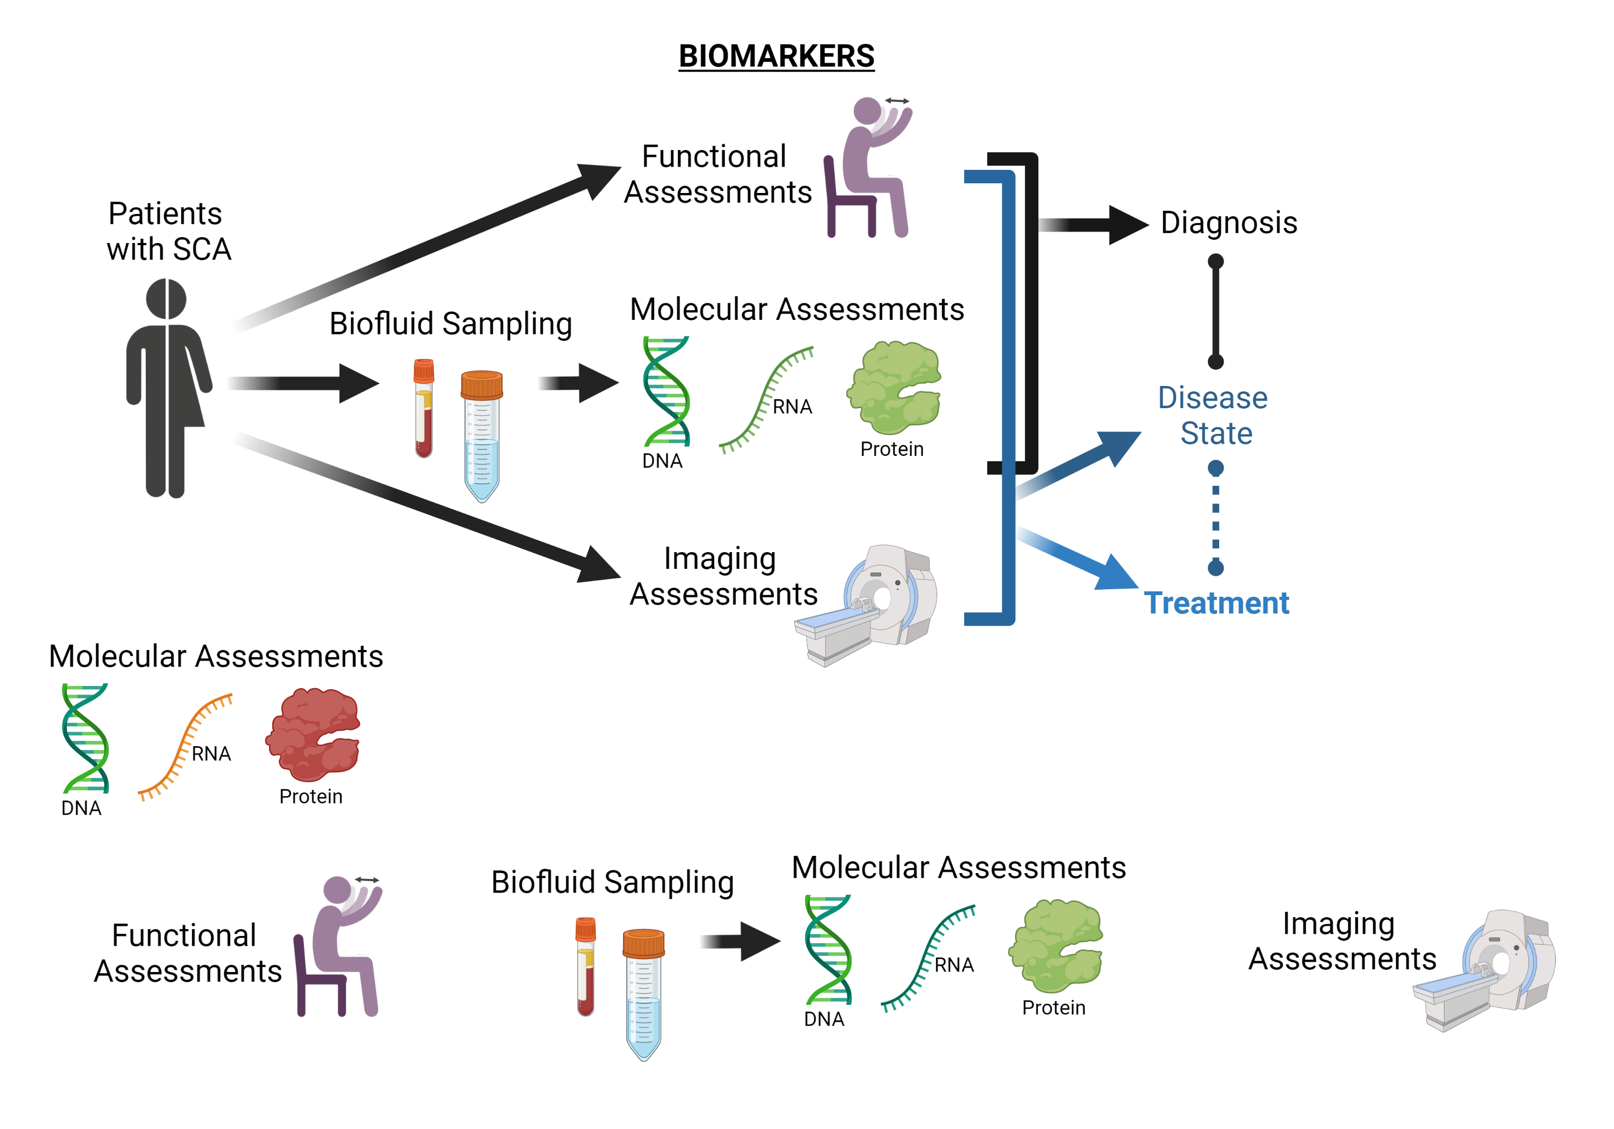
Clinical trial readiness
DNA
CRISPR: Genome Editing
Genes | References
SCA1 | Xia H, et al. Nat Med. 2004; Friedrich J, et al. JCI Insight. 2018.
SCA2 | Scoles DR, et al. Nature. 2017.
SCA3 | Miller VM, et al. PNAS. 2003. Moore LR, et al. Mol Ther Nucleic Acids. 2017. McLoughlin HS, et al. Ann Neurol. 2018
SCA6 | Tsou WL, etal. Neurobiol Dis. 2011.
SCA7 | Niu C, et al. Sci Transl Med. 2018.
Antisense oligonucleotides (ASOs)
RNA
siRNA
Toxic protein
Ion channel
Modifiers;
Neurotrophic factors; etc.

Slide 5
Challenges in SCA Clinical Research
Low SCA disease prevalence
Clinical heterogeneity
Genetic heterogeneity
Lack of objective disease measures
Lack of objective disease measures
This talk will cover how biomarkers can assist in clinical trial readiness
Keys to Clinical Trial Readiness
Clinical disease measures
- User rating scales
- Wearable devices
Biomarkers of disease
- Fluid biomarkers
- Imaging biomarkers
Strategic trial design
- Patient recruitment efforts
- Statistical modeling
Funding support
- Government
- Private
- Non-profit
- Foundation
Well validated pre-clinical data
- In vitro studies
- Animal models
Clinical disease measures
- User rating scales
- Wearable devices
Biomarkers of disease
- Fluid biomarkers
- Imaging biomarkers
Strategic trial design
- Patient recruitment efforts
- Statistical modeling
Brooker et al. Annals of Clinical and Translational Neurology, 2021

Slide 6
Topics covered in this talk
What is a biomarker?
Why are biomarkers so valuable?
What are the different types of biomarkers?
  And how are they being used in SCA research/clinic
How is data/samples collected?
How you can help?
2022 AAC
A Virtual Event
March 17-19

Slide 7
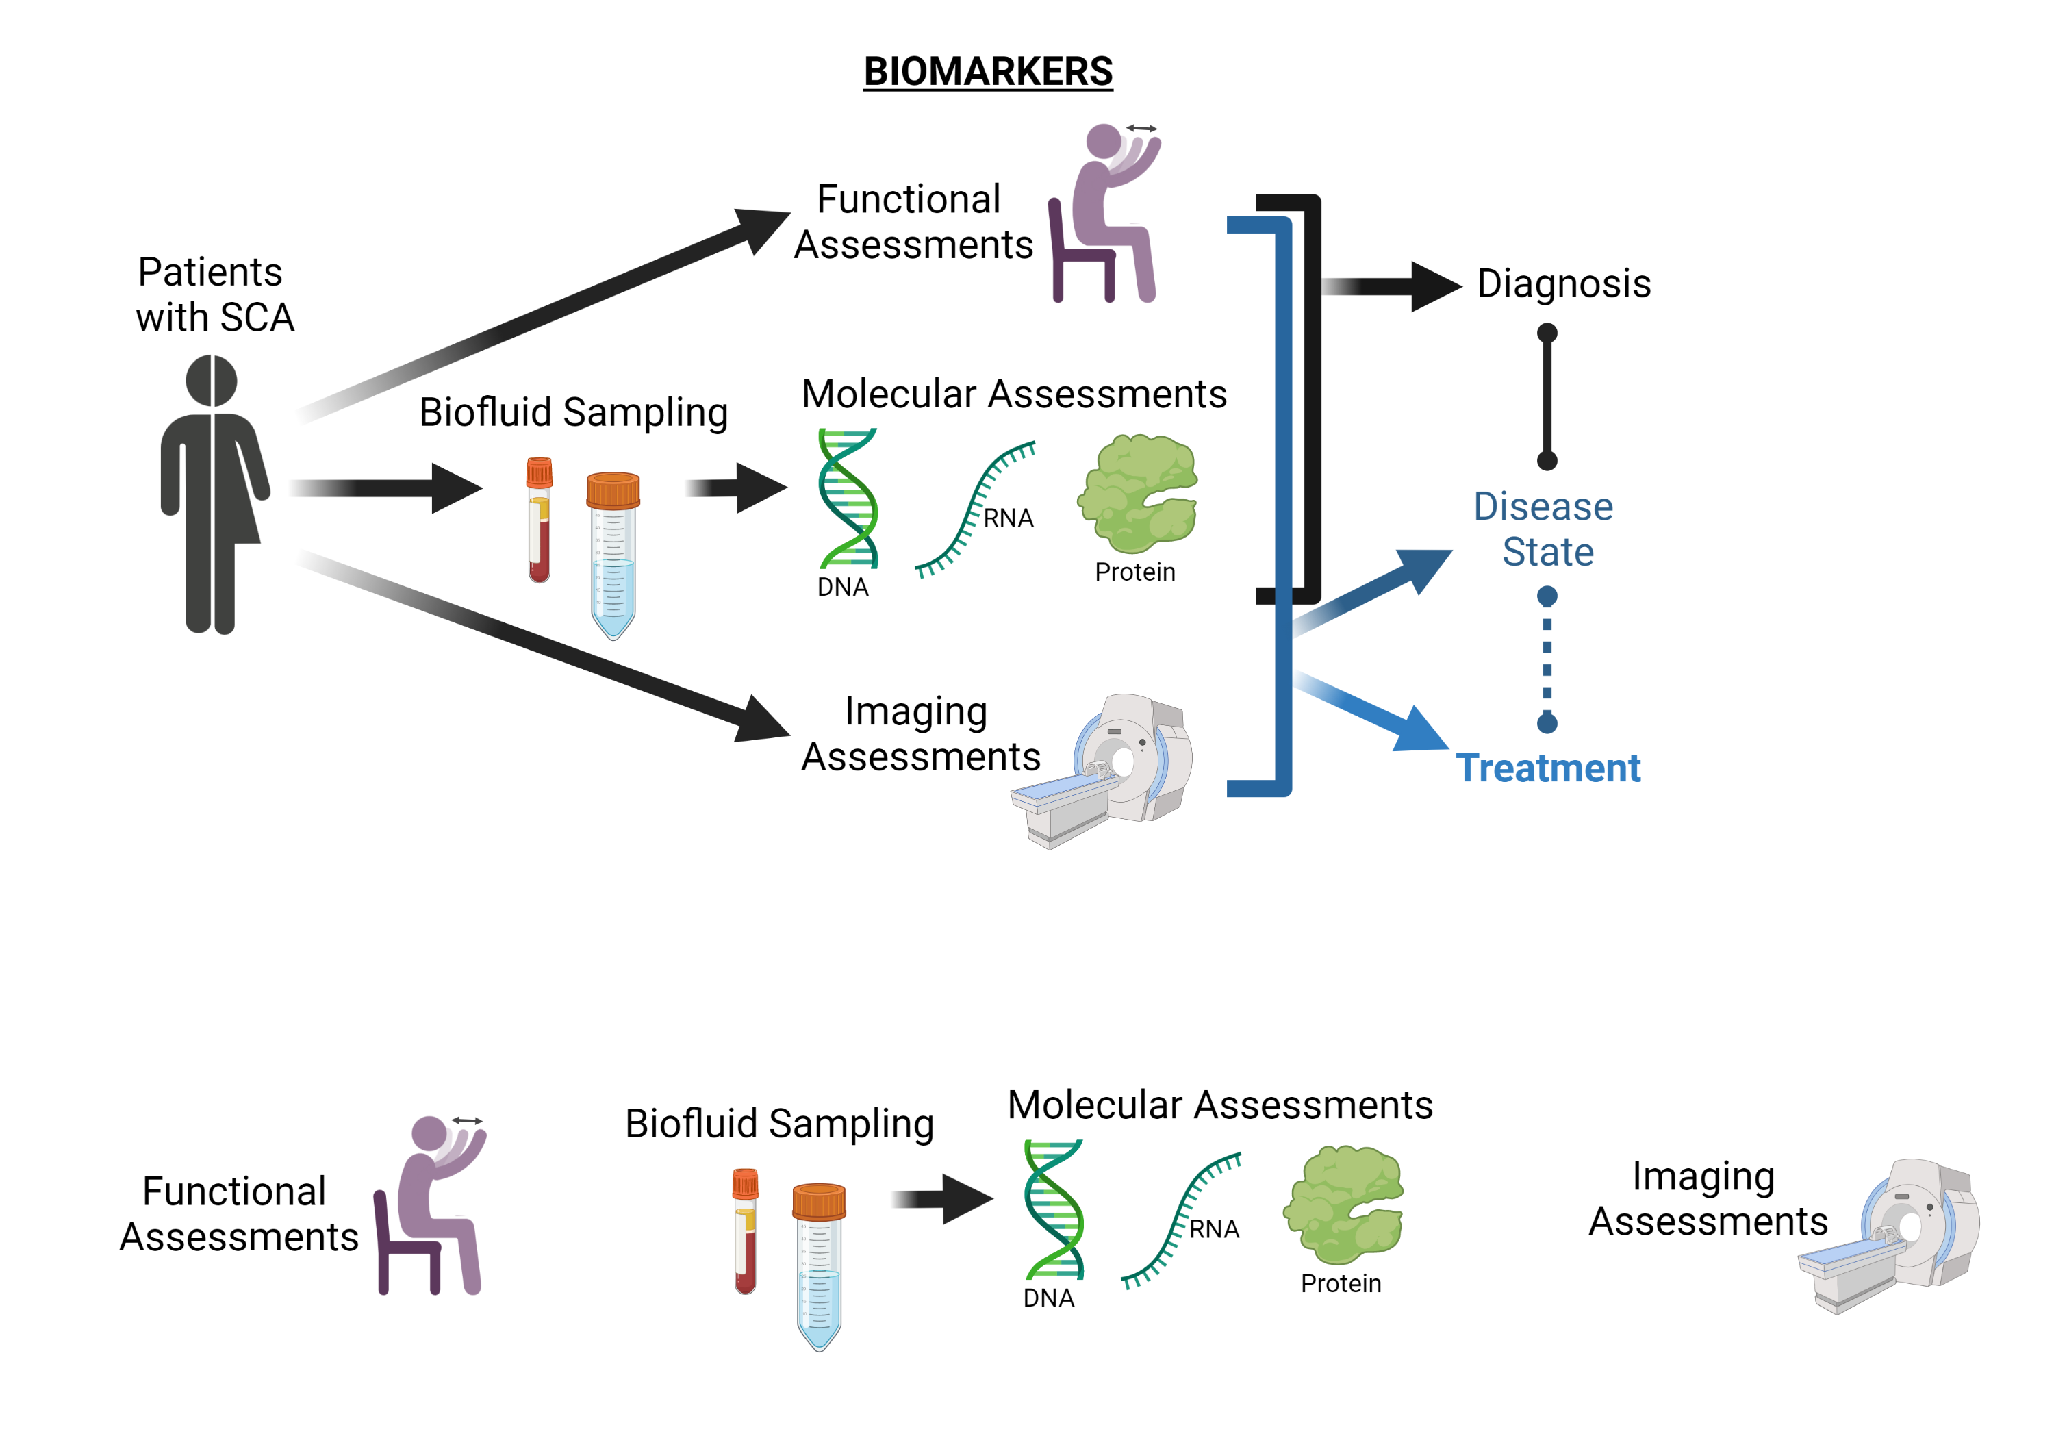
What is a biomarker?
BEST (Biomarkers, EndpointS, and other Tools) Resource (FDA/NIH Biomarker working group):
A defined characteristic that is measured as an indicator of normal biological processes, pathogenic processes or responses to an exposure or intervention.

Slide 8
Why are biomarkers so valuable?
Disease state biomarkers that can indicate when treatment will be most effective for a disease.
Target engagement biomarkers and pharmacodynamic biomarkers that can indicate whether a treatment is engaging with a target and is causing a response. Showing a drug is working or if it is leading to side effects.

Slide 9
What types of Biomarkers are there?

Slide 10
What types of Biomarkers are there?
  Clinical assessments or wearable sensors for daily tracking of movement.

Slide 11
What types of Biomarkers are there?
Ataxia Rating Scales:
SARA
International Cooperative Rating Scale (ICARS)
Non-ataxia Rating Scales:
Cerebellar Cognitive Affective Syndrome Scale (CCAS)
Inventory of non-ataxia signs (INAS)
Composite Cerebellar Functional Severity Score (CCFS)
Timed Tests (T25-FW)
Functional Staging
Patient Global Impression
EQ-5D (generic measure of health status)
Nine-Hole Peg Test
Friedreich’s Ataxia Activities of Daily Living (FA-ADL)
Fatigue Severity Scale (FSS)
Wearable Sensors

Slide 12
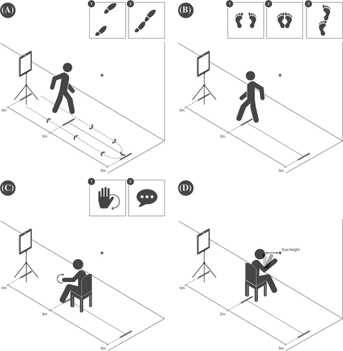
Scale for Assessment and Rating of Ataxia
  Measures motor coordination through 8 tests:
    Gait (0-8 points),
    Stance (0-6 points),
    Sitting (0-4 points)
    Speech disturbance (0-6 points)
    Finger chase (0-4 points)
    Nose-finger test (0-4 points)
    Fast alternating hand movement (0-4 points)
    Heel-shin slide (0-4 points)
  Ranges from 0 (no ataxia) to 40 (most severe ataxia)
Diagram of (A) Gait, (B) Stance, (C) Fast-alternating hand movements, and (D) Nose-finger test (Grobe‐Einsler et al., 2021).

Slide 13
SARA utility in clinical studies
Six studies with 1215 SCA patients enrolled between 2005 and 2016 were finally selected.
Annual pooled SARA score increase:
Two-arm interventional trials of 1-year duration to detect a 50% reduction in disease progression (80% power and a level of 5%) would require:
Diallo et al 2021 JNeuro

Slide 14
Instrumented Data Exchange for Ataxia Study (IDEA)
This research study is testing body-worn sensors to measure movement during simple tests of coordination, in order to evaluate the progression and severity of ataxia.
ClinicalTrials.gov Identifier: NCT04268147
Currently recruiting
  SCA1, SCA2, SCA3, SCA6, FA
  Age-matched healthy controls

Slide 15
Wearable sensor for assessment of gait impairment in SCA
Gait variability (toe out angle, double support) were the most discriminative feature in individuals with manifest SCA relative to health controls
  These measures also correlated with disease severity as measured by SARA.
  163 people with SCA (SCA1=18, SCA2=85, SCA3=23, SCA6=37)
  96 age-matched Healthy controls.
Gait variability also distinguished premanifest from manifested ataxic patients!
  42 prodromal SCA (SCA1=3; SCA2=4; SCA3=4; and SCA6=31)
Future work with an independent cohort is needed to investigate if these findings would generalize.
Shah et al 2021 Movement Disorders

Slide 16
These functional ataxia assessments, like SARA, are limited to only patients with ataxia symptoms…
What biomarker assessments distinguish SCA patients prior to ataxia onset of disease and correlate with disease progression?

Slide 17
What types of Biomarkers are there?
  Clinical assessments or wearable sensors for daily tracking of movement.
  Imaging biomarkers — detection of brain size and metabolite changes in a noninvasive way.

Slide 18
What types of Biomarkers are there?
Ataxia Rating Scales:
SARA
International Cooperative Rating Scale (ICARS)
Non-ataxia Rating Scales:
Cerebellar Cognitive Affective Syndrome Scale (CCAS)
Inventory of non-ataxia signs (INAS)
Composite Cerebellar Functional Severity Score (CCFS)
Timed Tests (T25-FW)
Functional Staging
Patient Global Impression
EQ-5D (generic measure of health status)
Nine-Hole Peg Test
Friedreich’s Ataxia Activities of Daily Living (FA-ADL)
Fatigue Severity Scale (FSS)
Wearable Sensors
MRI/DTI (gray and white matter brain volume changes)
MRS (metabolite changes)
Specific tracer imaging modalities
  PET (position emission tomography)
  SPECT (single-photon emission computed tomography)

Slide 19
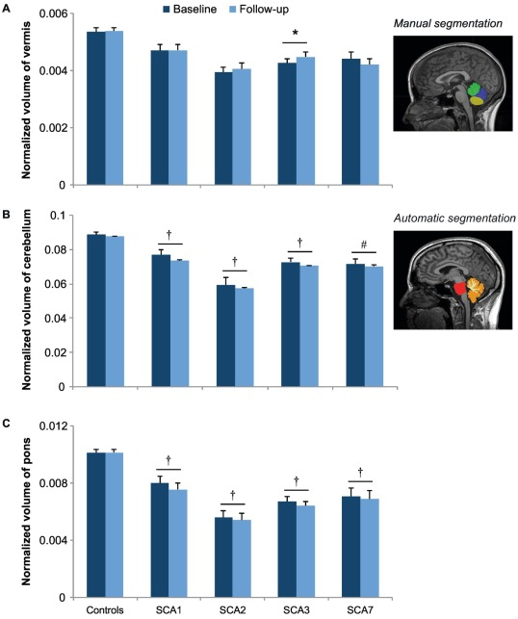
Magnetic Resonance Imaging (MRI)
24 month
MRI= scanners use strong magnetic fields to generate pictures of the organs in a body.
“Mounting evidence indicates that the underlying cellular changes consistent with SCA start years before clinical onset and irreversible neurodegenerative damage detectable by conventional MRI.” -ReadiSCA website
* p < 0.05, #p ≤ 0.01, and †p ≤ 0.001 represent significant differences adjusted for age and corrected with Bonferroni correction.
Adanyeguh et al 2018

Slide 20
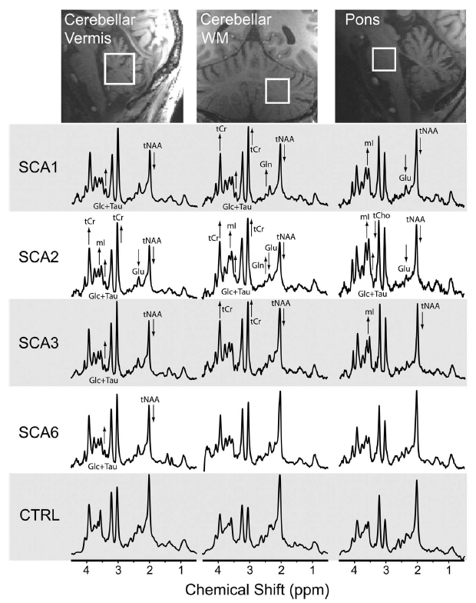
MRS (metabolites) assessment in humans
Neurochemical abnormalities are detectable in individuals before manifest disease, which may allow
premanifest enrollment in future SCA trials.
Levels of neuronal (tNAA) and glial (tCho) markers significantly correlated with SARA and Activities of Daily Living score in subjects with SCA.
Joers et al 2018 ANA

Slide 21
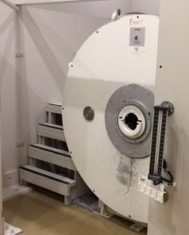
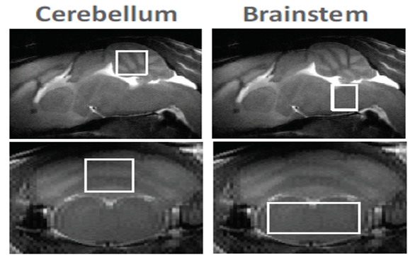
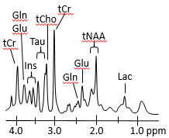
MRS (metabolites) assessment in mice
NINDS R21 Specific Aim 1: Use ¹H-MRS to identify neurochemical signatures of disease state in a progressive SCA3 mouse model and evaluate the response of MRS biomarkers to anti­-ATXN3 ASO gene silencing.
###
#
*
Acquisition of MRI and MRS at 9.4 T. A) A horizontal 9.4 T-31 cm magnet (Agilent) and a quadrature surface coil (not pictured) are used for MR acquisitions. B) The MRS voxel for either the cerebellum or brainstem is placed on fast spin-echo MR images. C) A typical spectrum acquired from the cerebellum for quantification of neurochemicals. D) example of ASO treatment effects on Cerebellar tNAA levels in SCA3 mice.
collaboration with Gulin Oz UMN; McLoughlin et al. (in prep)

Slide 22
What types of Biomarkers are there?
  Clinical assessments or wearable sensors for daily tracking of movement.
  Imaging biomarkers — detection of brain size and metabolite changes in a noninvasive way.
  Molecular biomarkers — these include any type of molecule that can be obtained from biofluids or tissue samples, including:
    DNA
    RNAs
    Proteins

Slide 23
What types of Biomarkers are there?
SARA
Cerebellar Cognitive Affective/Schmahmann Syndrome Scale (CCAS)
INAS
Composite Cerebellar Functional Severity Score (CCFS)
Timed Tests (T25-FW)
Functional Staging
Patient Global Impression
EQ-5D
PHQ9
Friedreich’s Ataxia Activities of Daily Living (FA-ADL)
Fatigue Severity Scale (FSS)
Wearable Sensors
MRI/DTI
MRS
Specific tracer imaging modalities
  PET
  SPECT
Blood
  Plasma
  Serum
  Cells
CSF
Urine
DNA
  Genetic diagnosis
  SNPs for Genetic Modifiers
RNA
  Expression profiling
  Small RNAs
Protein
  Proteomic analysis (Mass Spec)
  Candidate proteomics
    ELISA
    SIMOA

Slide 24
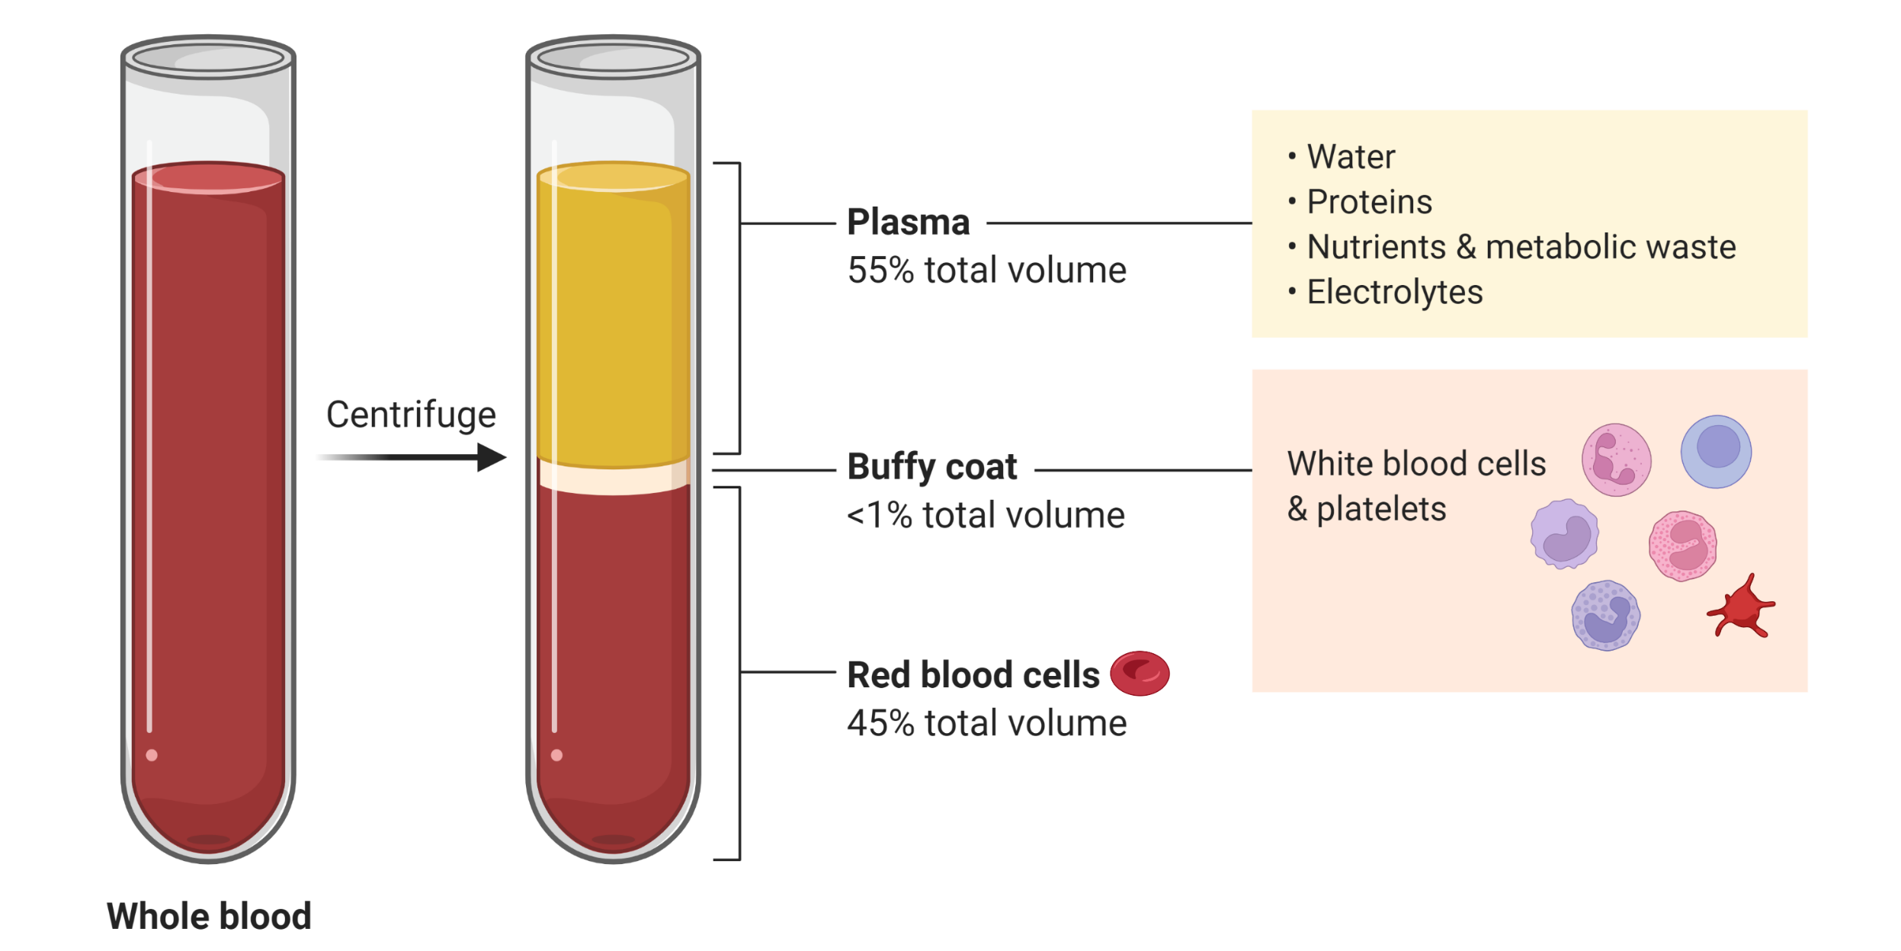
Biofluid collection
Blood Draw

Slide 25
Biofluid collection
Cerebrospinal fluid (CSF) surrounds the brain and spinal cord.

Slide 26
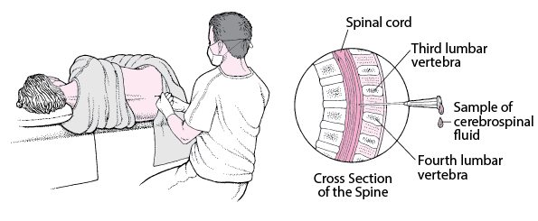
Lumbar Puncture for CSF collection
John E Greenlee: Merck’s manual Professional Version

Slide 27
Goals of fluid biomarkers
Target engagement for clinical trials
Surrogate markers for disease onset, severity and progression –this is important for clinical trials but may also help to gain insights into pathogenic mechanisms
Define inclusion criteria/stratification for clinical trials
Other: genetic modifiers/novel pathways (basic science)—inspire new treatments

Slide 28
Target Engagement example:
Identifying mutant Ataxin-3 in Plasma and CSF of SCA3 Patients
Prudencio et al., (2020): Toward allele-specific targeting therapy and pharmacodynamic marker for spinocerebellar ataxia type 3” Sci. Tran. Med.

Slide 29
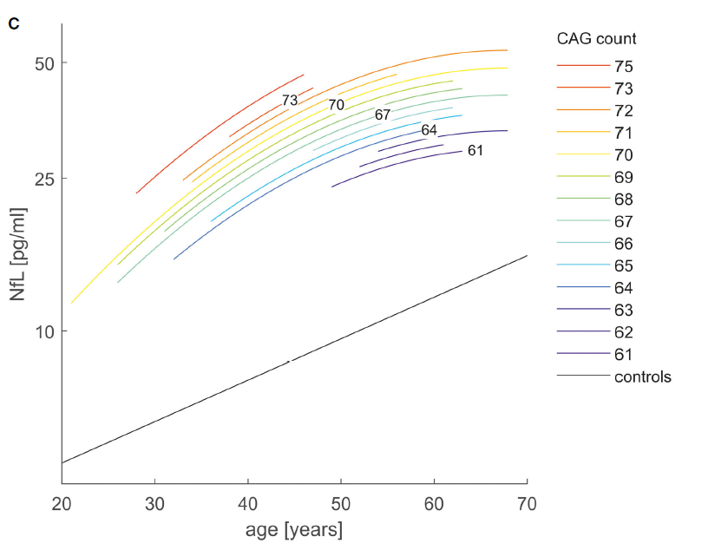
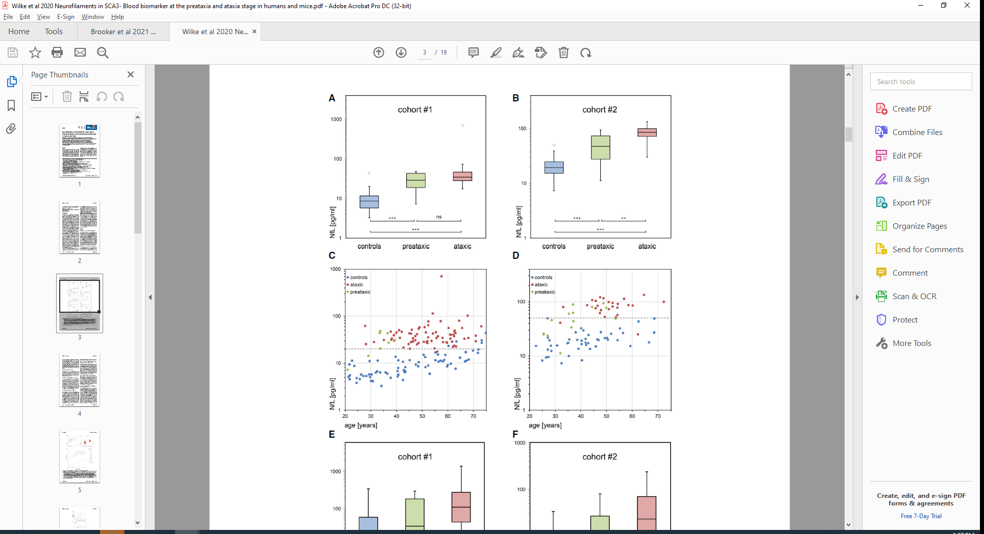
Example of a Surrogate markers: Neuronal health – NFL
Emerging as one of the most promising biomarkers in neurodegenerative syndrome
It is a high abundance neuronal protein that can be detected in the blood
Wilke et al 2020 EMBO Mol Med

Slide 30
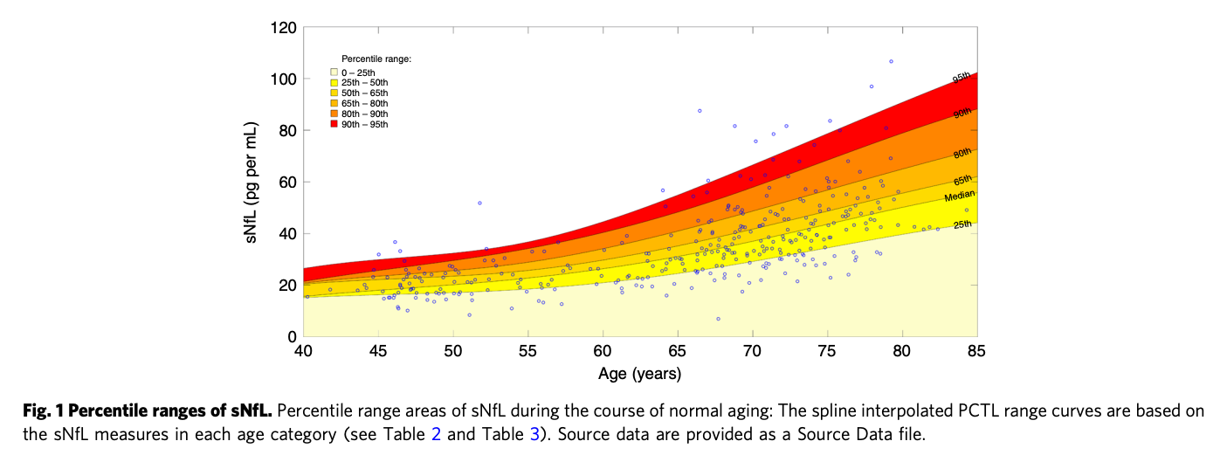
Confounding effect of aging on NFL in serum
Serum neurofilament light levels in normal aging—335 individuals in a cohort study; mean follow up 5.9 years (SIMOA study; Khalil et al. Nature Communications 2020)
NFL in serum shows age related increase—but this increase is non linear
Yearly median increase 0.9% in 40-50; then 2.7% age 50-60; age 60 years 4.3% --after which slope relatively stable thereafter

Slide 31



SCA Patient Cohorts
UMich
BioSCA3
Clinicaltrials.gov ID: NCT03885167
CRC-SCA
https://ataxia.org/
https://readisca.org/
RiSCA
ESMI
At risk
SCA3
http://www.ataxia-study-group.net/html/studies/risca?asgsid=4893cdc97f968ff47e83c4f885d6eefe
http://www.ataxia-study-group.net/html/studies/esmi
http://www.eurosca.org/

Slide 32
Advantage to keeping the ataxias separate
Ataxias progress at different rates (SCA 1 fastest, SCA2 and 3 intermediate, SCA6 slowest (Jacobi et al., Lancet Neurology, 2015)
It is likely that the biomarkers will also follow different trajectories
Might be too ambitious to study all the ataxias without identifiable funding mechanisms in place
It is likely that clinical trials will focus on each ataxia individually

Slide 33
Topics covered in this talk
What is a biomarker?
Why are biomarkers so valuable?
What are the different types of biomarkers?
  And how are they being used in SCA research/clinic
How is data/samples collected?
How you can help?
2022 AAC
A Virtual Event
March 17-19

Slide 34
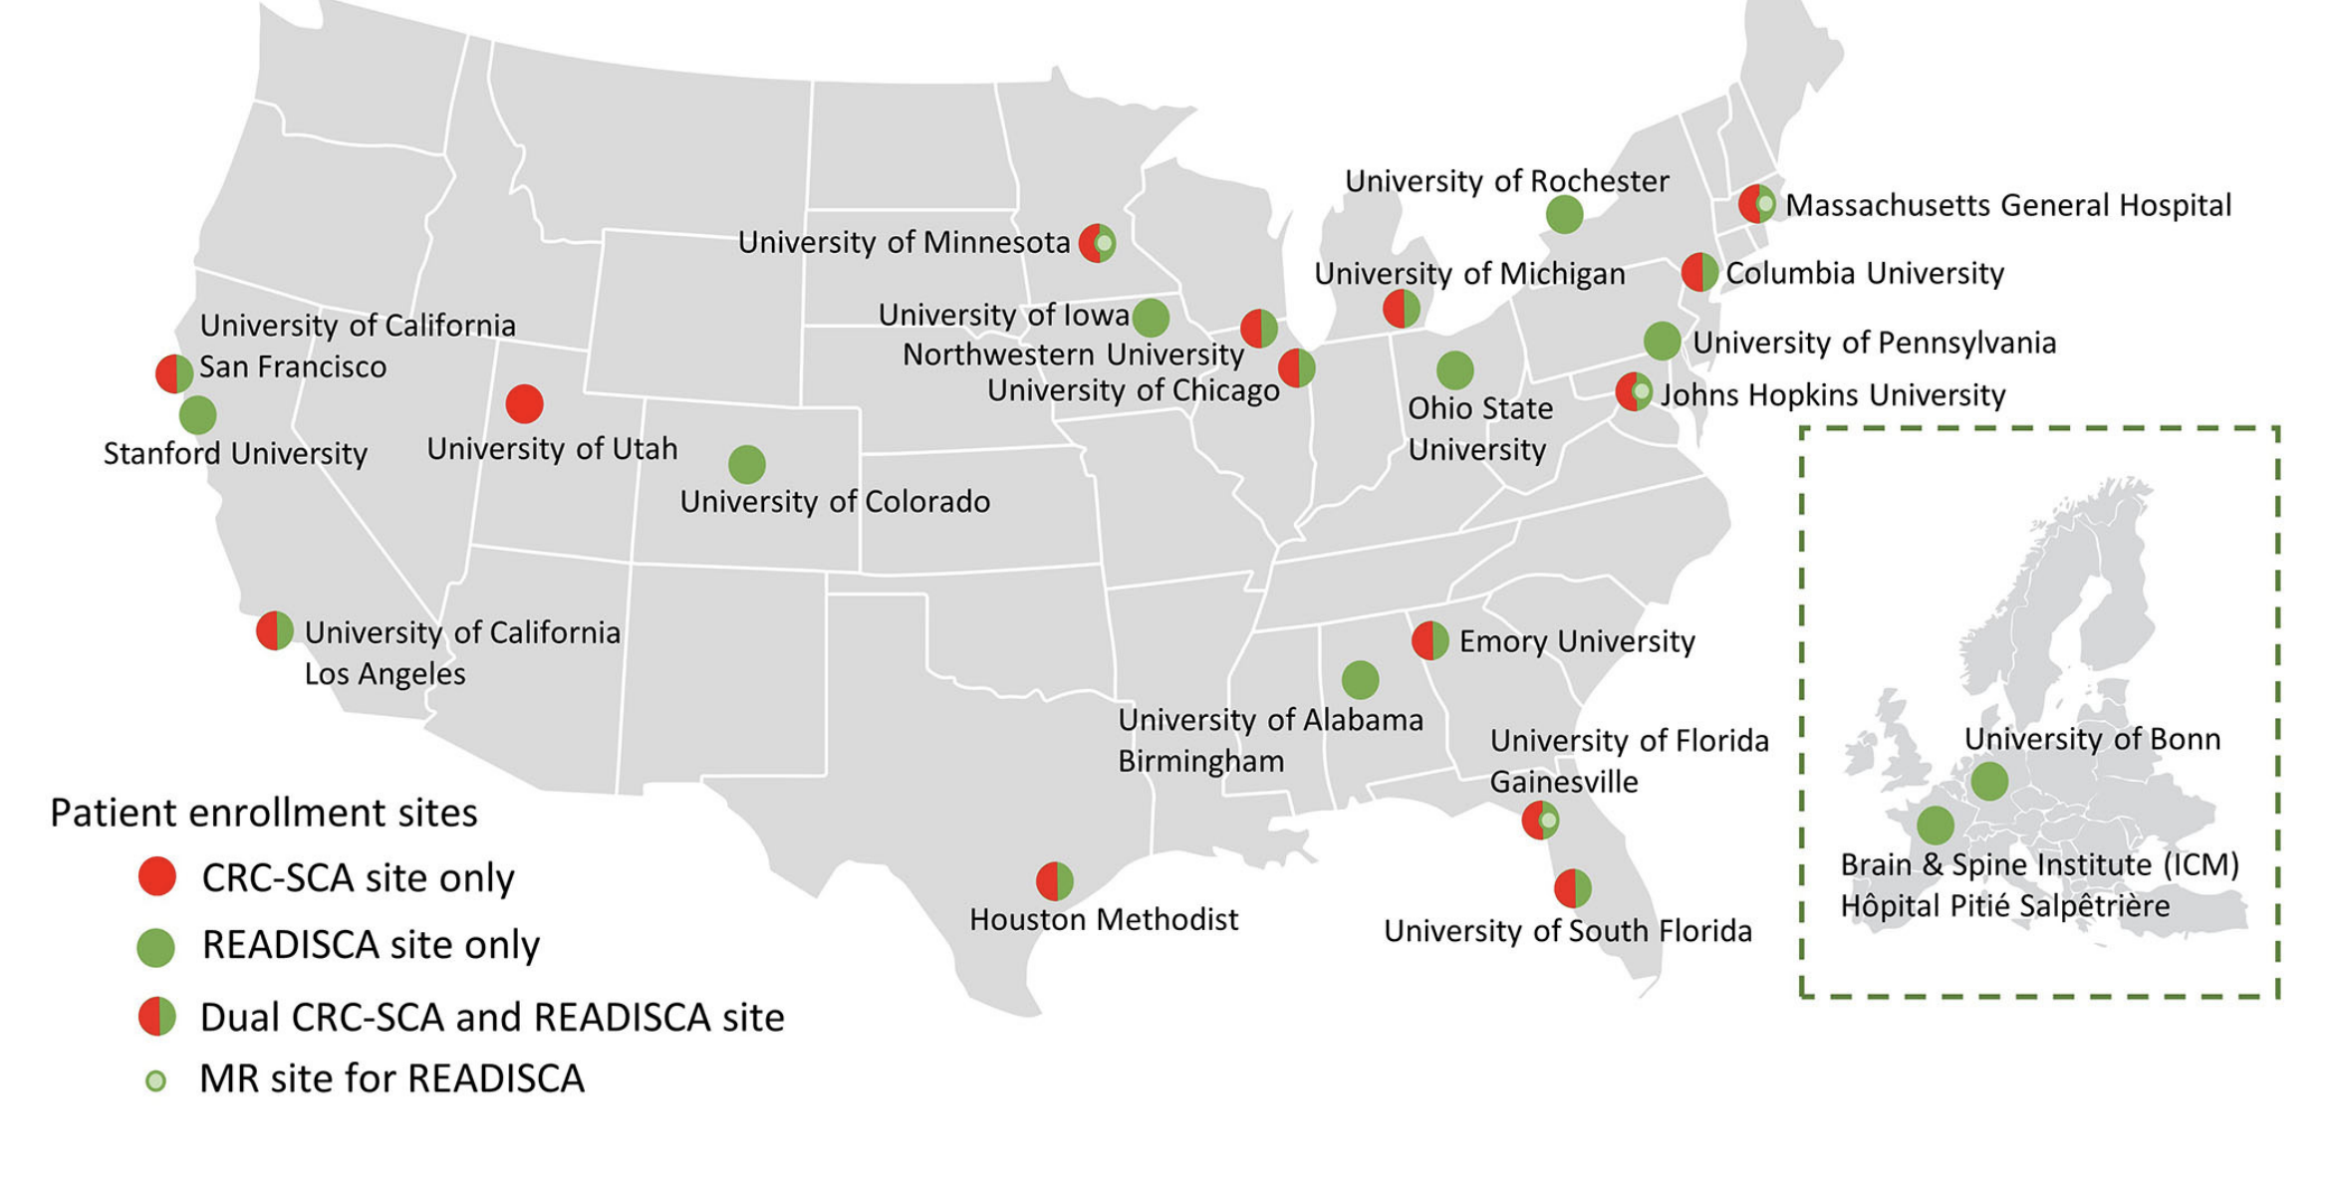
14 Patient Enrollment Sites
Lin et al., Frontiers in Neurology 2020

Slide 35
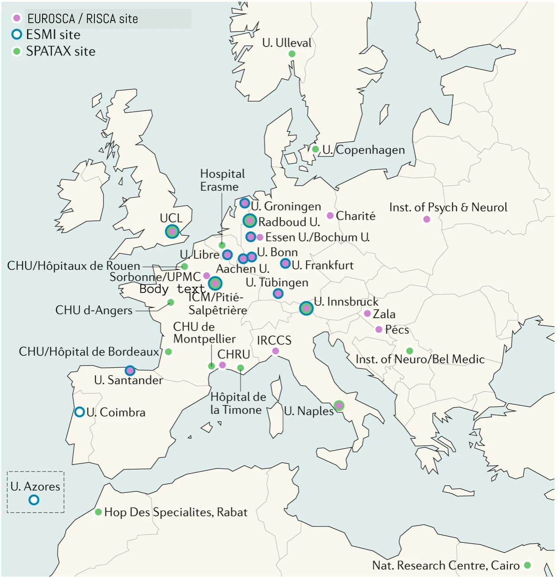
EUROSCA - 17 Centers in 10 Countries
RISCA - 14 Centers in 7 Countries
Modified from Ashizawa et al., Nature Reviews Neurology 2018

Slide 36
Call for Action!
contact NAF or your neurologist to see if you qualify for a research study and donating biosamples.
2022 AAC
A Virtual Event
March 17-19

Slide 37
Thank you and Questions?
2022 AAC
A Virtual Event
March 17-19

