Slide 1
Balance and Fall Prevention in Cerebellar Ataxia
Elizabeth foss OTR/l

Slide 2
Agenda
Prevalence of Falls in Ataxia
Role of the Cerebellum with Balance
Remediation- interventions to restore impairments
Compensation- interventions to offset the problem- live life despite the impairments
Summary of Resources

Slide 3
Ataxia and Falls
In one study, 228 SCA patients were asked how many falls they had in the past year.
  73.6% reported having at least one fall
    74% reporting injury
Another study instructed 113 patients with SCA to record their falls during a one-year diary.
  84.1% reported at least one fall
Notes:
One of the greatest challenges faced by individuals with ataxia is an impairment in balance.
Prevalence above
So, if you have fallen- you are not alone. You are surrounded by a community who truly understands

Slide 4
Why do we fall?
Changes to the Cerebellum
Altered Integration of Sensory Systems
Delayed Balance Recovery Strategies
Muscle Weakness
Fear of Falling
Notes:
Let’s start with why we fall by looking at the components that contribute to this prevalence.

Slide 5
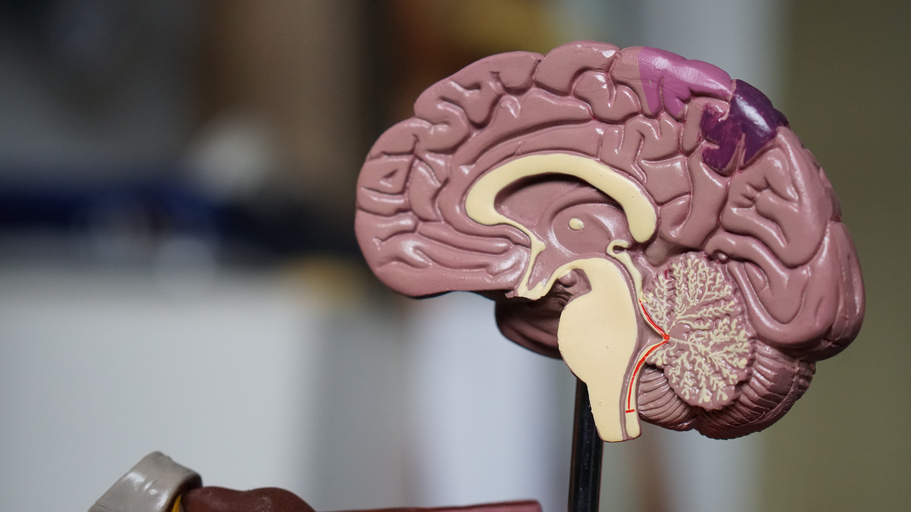



Main Roles of the Cerebellum
Motor planning- planning and initiating movements
Balance
Equilibrium
Posture
Notes:
Start with the cerebellum
Cerebrum- large in front... cerebellum in back …. Latin for little brain.

Slide 6

Cerebellum and Motor Planning
Plans and Initiates our Movements
Error Based Learning
Notes:
Reaching-
Limb send signals to the brain to tell it where it is in space
Brain- is that where it is supposed to be?
Sends motor signal to correct errors

Slide 7

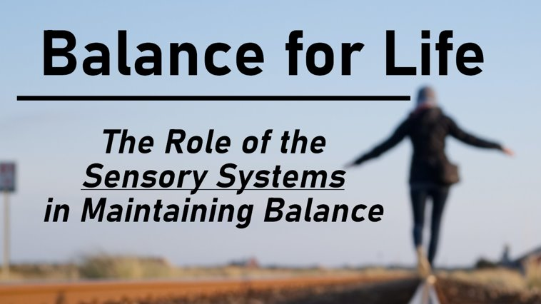
Cerebellum and Balance
  Three Balance Sensory Systems
    Visual, Somatosensory, Vestibular
    Cerebellum- Organizer & Responder
YouTube: "Little Steps, Big Gains"
Notes:
Components of Balance
- Sensory Systems
- Balance Strategies
- Muscle Weakness
- Fear of falling

Slide 8
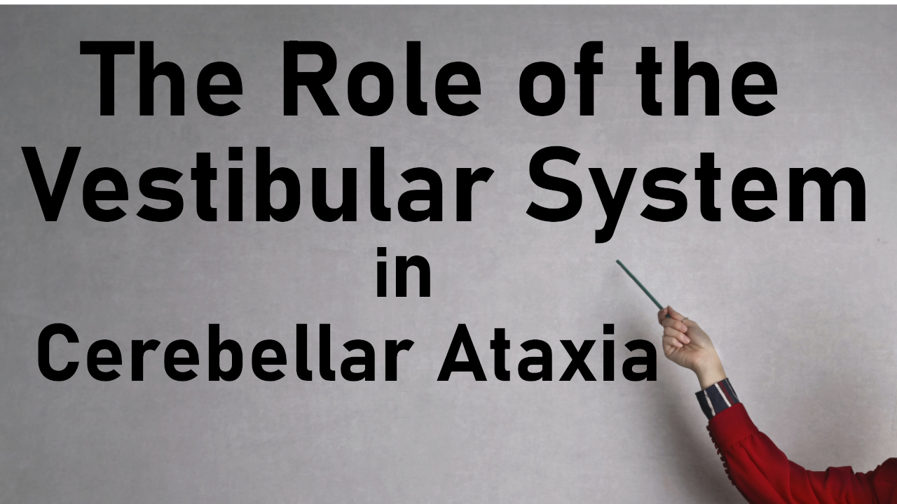
Cerebellum & Equilibrium and Posture
Centrally mediates all incoming vestibular input
YouTube: "Little Steps, Big Gains"

Slide 9
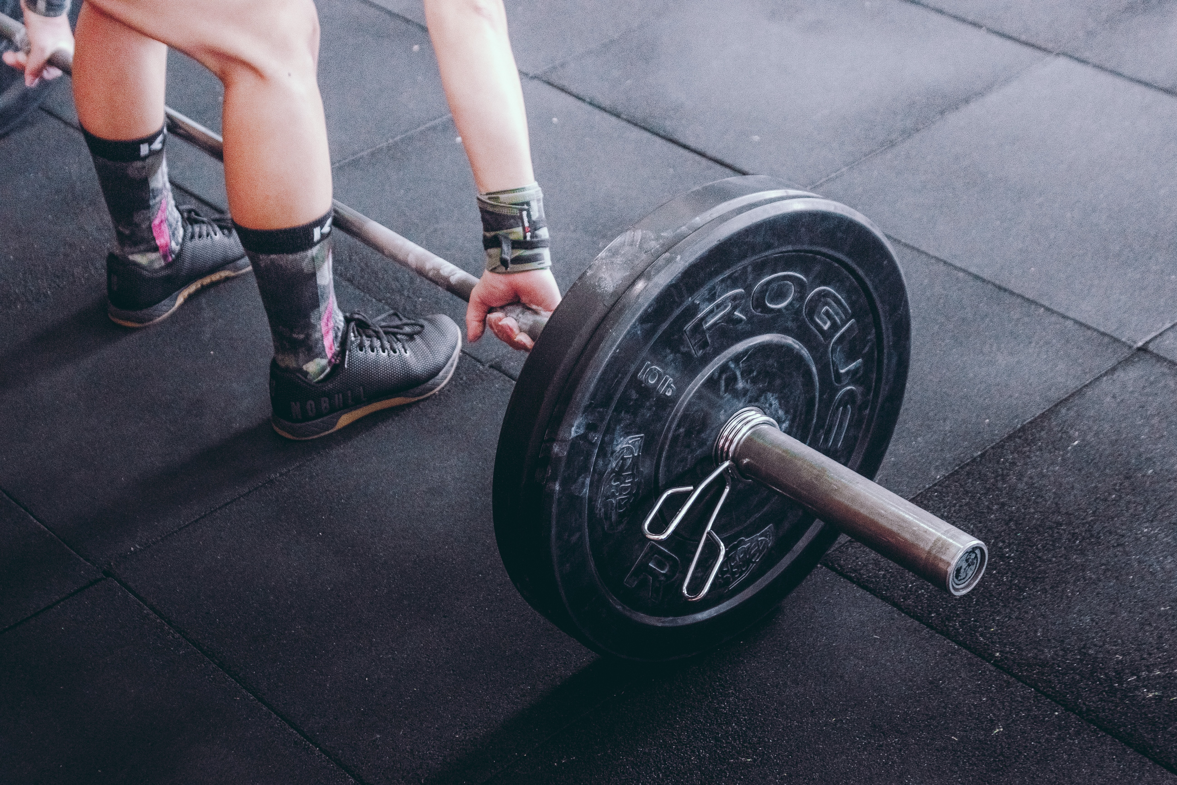
Ataxia and Muscle Weakness
Types of muscle fibers-
  Type I- Endurance
  Type II – Power
Lose type II muscle fibers faster!
  Kick in for balance retrieval, going from sit-to-stand, etc

Slide 10
Fear of Falling!
Fear of Falling
Increased Risk for
Falling
Less Physical Activity
Increased
Weakness and Unsteadiness
Notes:
Vicious Cycle

Slide 11
Ataxia and Falls
So what can we do about this prevalence?
Remediation- interventions to restore impairments
Compensation- interventions to offset the problem- strategies to live life despite balance impairments
Notes:
Spent 12 minutes talking about compensatory strategies in "ataxia hacks"
Therefore this presentation will spend the majority of time on remedial strategies.

Slide 12
Remediation
What can we do to "fix" the problem?

Slide 13
Categories of Ataxia
Acquired- Caused by an external factor that results in damage to the brain
  Some examples include: stroke, brain injury, cancer
Inherited- Caused by an internal factor with a genetic component that results in a degeneration of the brain.
  Many types- however many unknown types as well

Slide 14
Can Exercise improve balance in
Acquired Ataxia?

Slide 15
YES!!!
Exercise CAN help Acquired Ataxia
Neuroplasticity
  Brains ability to grow new neural networks through growth and reorganization
  Create new connections!

Slide 16
Exercise and Acquired Ataxias
  "Functional recovery after rehabilitation for cerebellar stroke"
  Kelly PJ, Stein J, Shafqat S, Eskey C, Doherty D, Chang Y, Kurina A, Furie KL. Functional recovery after rehabilitation for cerebellar stroke. Stroke. 2001 Feb;32(2):530-4. doi: 10.1161/01.str.32.2.530. PMID: 11157193.
"Substantial improvement of mean FIM score frequently occurs after rehabilitation after cerebellar infarction"
Notes:
Strong evidence for neuroplasticity with stroke

Slide 17
Can Exercise improve balance in
Progressive and Degenerative Ataxia?

Slide 18

Dr llg, Doris Brutz and Colleagues
Notes:
16 progressive ataxias- found gains!
One of many studies I will show you

Slide 19
YES!!!
Exercise CAN help Progressive & Degenerative Ataxia
Neuroplasticity
  Brains ability to grow new neural networks through growth and reorganization
  Create new connections!

Slide 20
Exercise and Progressive, Degenerative Ataxias
"Intensive coordinative training improves motor performance in degenerative cerebellar disease"
  Ilg W, Synofzik M, Brötz D, Burkard S, Giese MA, Schöls L. Intensive coordinative training improves motor performance in degenerative cerebellar disease. Neurology. 2009 Dec 1;73(22):1823-30. doi: 10.1212/WNL.0b013e3181c33adf. Epub 2009 Oct 28. PMID: 19864636.
"In patients with cerebellar ataxia, coordinative training improves motor performance and reduces ataxia symptoms, enabling them to achieve personally meaningful goals in everyday life."

Slide 21
Evidence Based Exercise Modalities for Ataxia
  Physical/Occupational Therapy
  Balance Training
  Core Stability Training
  Coordination Training
  Exergames
  Dance
  Cycling
  Swimming
  Balance Based Torso Weighting
  Whole Body Vibration

Slide 22
Physical/Occupational Therapy
& Cerebellar Ataxia

Slide 23
Physical/Occupational Therapy
Systematic Review of nine studies
"All studies reported positive effects of physiotherapy over a range of outcomes measured, in particular balance, gait and function"
"Effectiveness of physiotherapy for adults with cerebellar dysfunction: a systematic review"
Martin C, Tan D, Bragge P, Bialocerkowski A. Effectiveness of physiotherapy for adults with cerebellar dysfunction: a systematic review. Clinical Rehabilitation. 2009;23(1):15-26. doi:10.1177/0269215508097853

Slide 24
Physical/Occupational Therapy
"This work is particularly EXCITING because it shows that individuals with cerebellar damage CAN learn to improve their movements.
"A new avenue for improving motor skills and functional performance in a population of individuals PREVIOUSLY thought to have little chance for motor recovery."
6 supplemental studies in resources section

Slide 25
PT/OT Limitations
Only 11% of therapists felt they had the expertise to treat ataxia patients.
Nearly 20% of patients changed therapists because they felt they did not receive appropriate guidance
"Treatment Options in Degenerative Cerebellar Ataxia: A Systematic Review"
  Sarva H, Shanker VL. Treatment Options in Degenerative Cerebellar Ataxia: A Systematic Review. Mov Disord Clin Pract. 2014;1(4):291-298. Published 2014 Jun 12. doi:10.1002/mdc3.12057
Notes:
Why didn't I find improvements?

Slide 26
PT/OT Limitations
Lack of clinical training/education
Lack of focus on balance/coordination training
  Too much focus on strength training
Underchallenging exercises
  Exercises NEED to be challenging!
Lack of carry over outside of the clinic
  Need receive and DO homework
Notes:
Why didn't I find improvements?

Slide 27
Vestibular Rehabilitation
& Cerebellar Ataxia

Slide 28
Vestibular Rehabilitation
Reduce Dizziness
Reduce Falls
3 supplemental studies in resources section
YouTube: "Little Steps, Big Gains"
Notes:
3 Studies below – improving cerebellums ability to organize sensory information

Slide 29
Balance Training
& Cerebellar Ataxia

Slide 30
Ataxia and Balance Training
Proprioceptive Loading Exercise
Sensory – Motor Adaptation
Improving Balance Strategies
YouTube: "Little Steps, Big Gains"
Notes:
In Evidence below... learn to improve their postural stability.

Slide 31
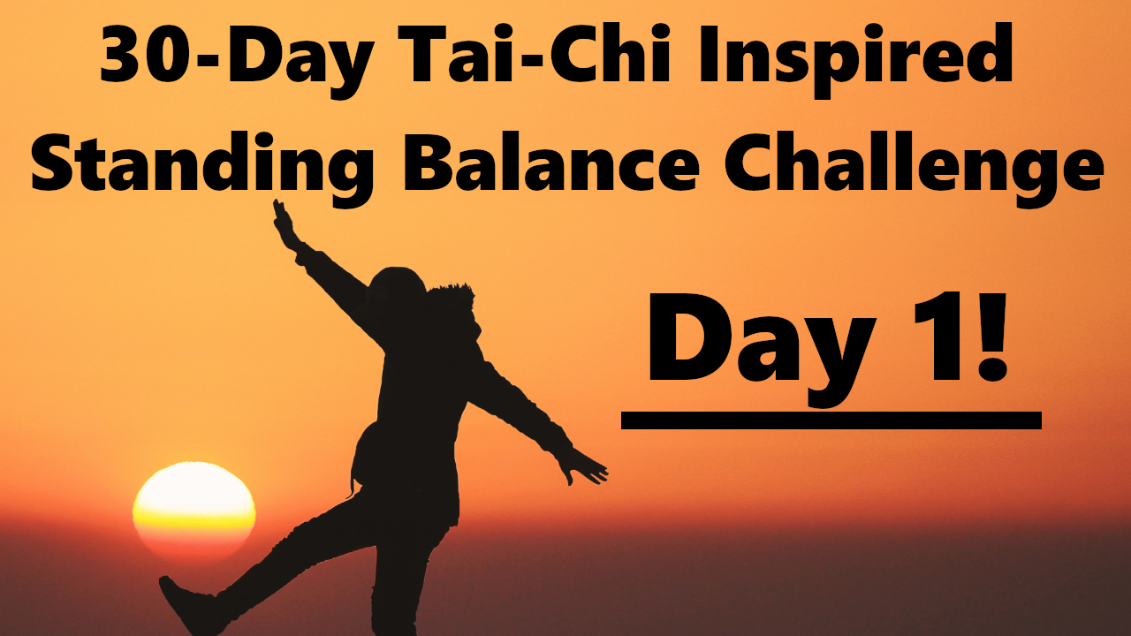
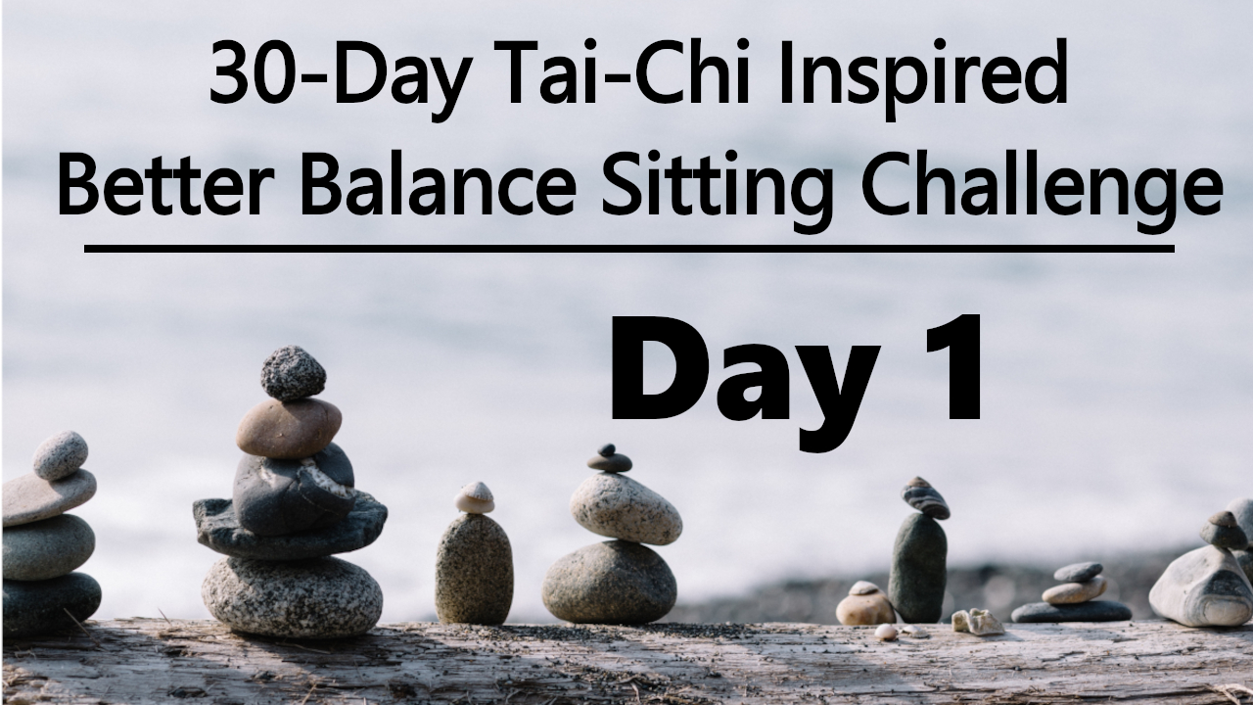
Ataxia and Balance Training
Ataxia- Reduced Trunk Position Sense
  Proprioceptive Based Exercises
Slow vs fast movements to Improve Body Awareness
  Tai-Chi
  Yoga
  Pilates
YouTube: "Little Steps, Big Gains"
Notes:
In Evidence below... learn to improve their postural stability.

Slide 32
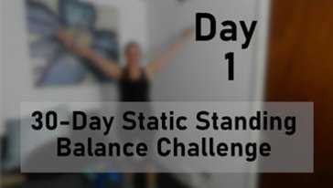
Ataxia and Balance Training
Sensory-Motor Adaptations
  Improve Brains ability to integrate incoming sensory information
  Balance Pads/Eyes Closed/Head Turns/Positional Changes
  Balance Based Torso Weighting
YouTube: "Little Steps, Big Gains"

Slide 33

Ataxia and Balance Training
Improve Balance Recovery Strategies
  Ankles!!!
    Calf Raises
  Hips
  Stepping Strategies
YouTube: "Little Steps, Big Gains"

Slide 34
Core Stability Training
& Cerebellar Ataxia

Slide 35
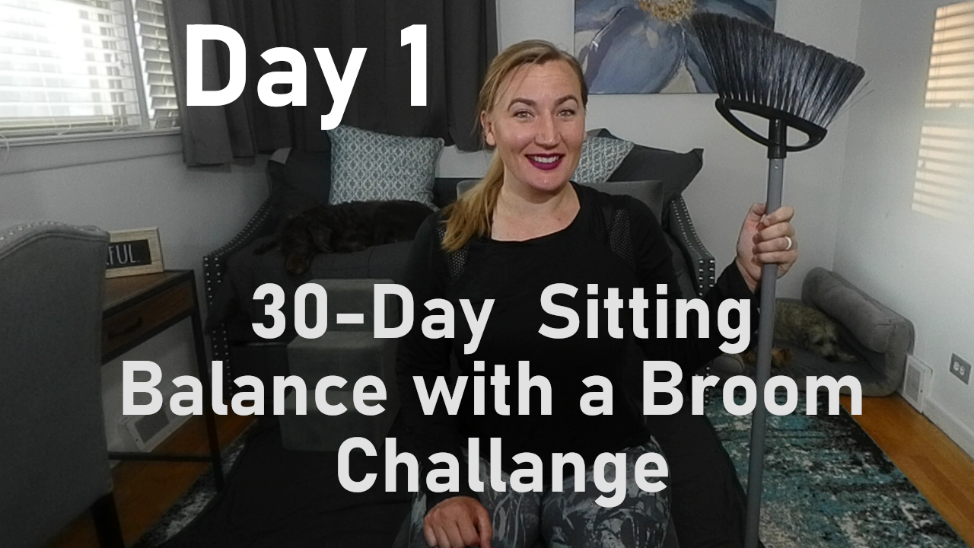
Core stability training
Ataxia- Lack of Core Stability during Gait
Modalities?
  Yoga
  Pilates
  Nordic Walking
YouTube: "Little Steps, Big Gains"

Slide 36
  6- week Home Exercise Program with Static and Dynamic Balance rather than direct gait training
  "Improvement in locomotor performance in people with cerebellar ataxia was observable after a six-week home balance exercise program."
"A Home Balance Exercise Program Improves Walking in People with Cerebellar Ataxia"
  Keller JL, Bastian AJ. A home balance exercise program improves walking in people with cerebellar ataxia. Neurorehabil Neural Repair. 2014;28(8):770-778. doi:10.1177/1545968314522350

Slide 37
Core Stability Training
"Core stability training can be included as an adjunct to conventional balance training in improving dynamic balance in patients with progressive degenerative Cerebellar ataxia"
"Core Stability Training with Conventional Balance Training Improves Dynamic Balance in Progressive Degenerative Cerebellar Ataxia"
  TABBASSUM, Khan Neha et al. Core Stability Training with Conventional Balance Training Improves Dynamic Balance in Progressive Degenerative Cerebellar Ataxia. Indian Journal of Physiotherapy & Occupational Therapy-An International Journal, [S.l.], p. 136-140, Dec. 2013. ISSN 0973-5674.

Slide 38
Coordination Training
& Cerebellar Ataxia

Slide 39
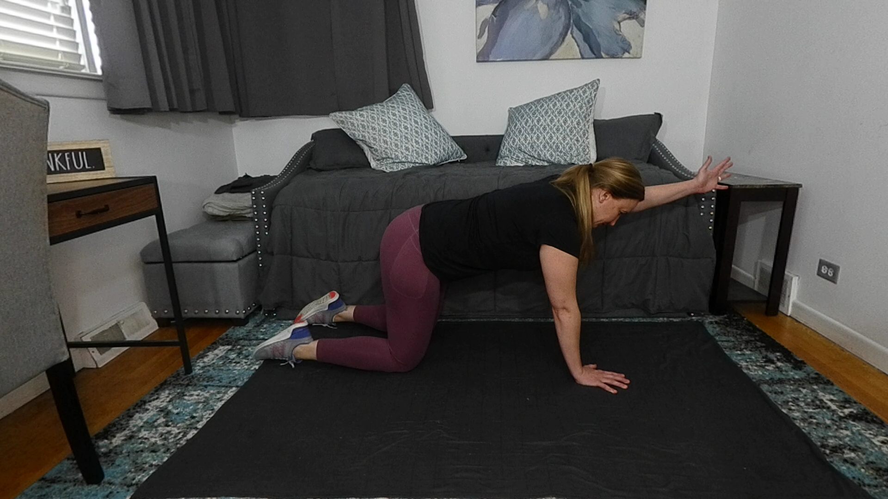
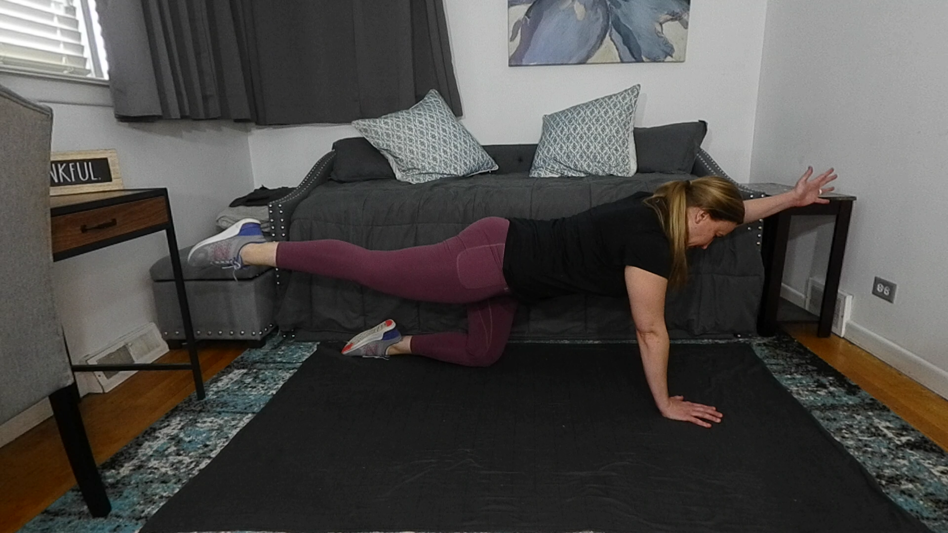
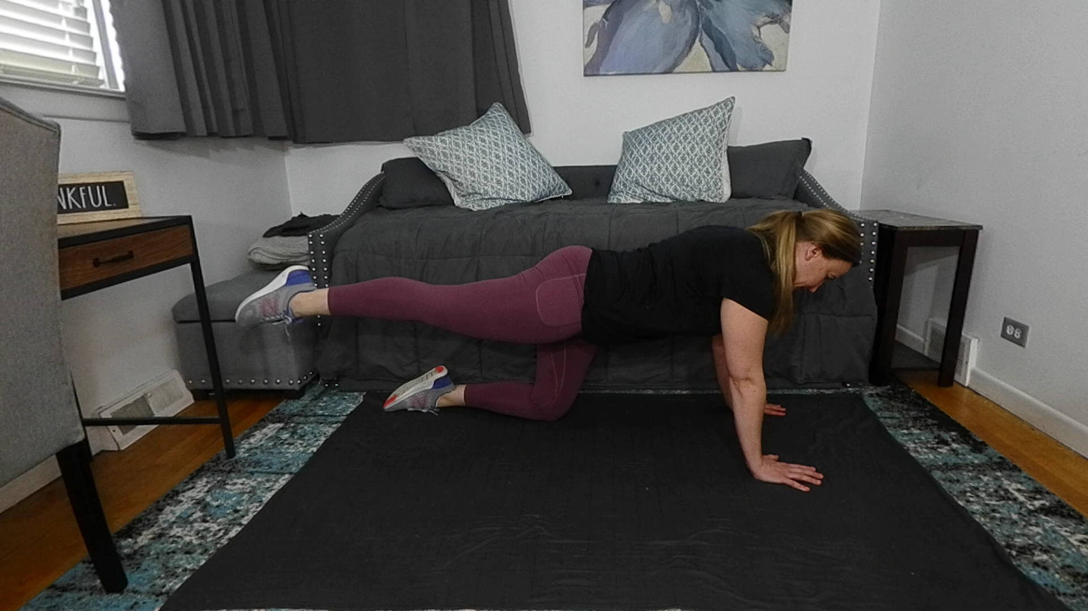
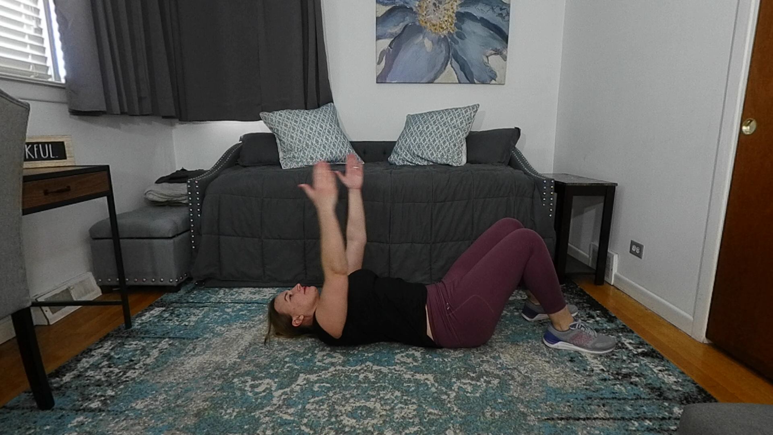
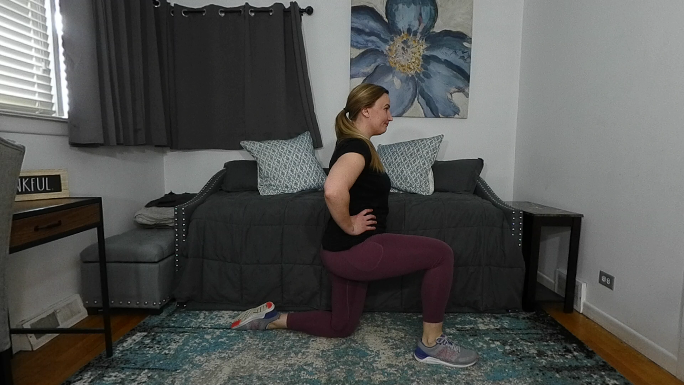
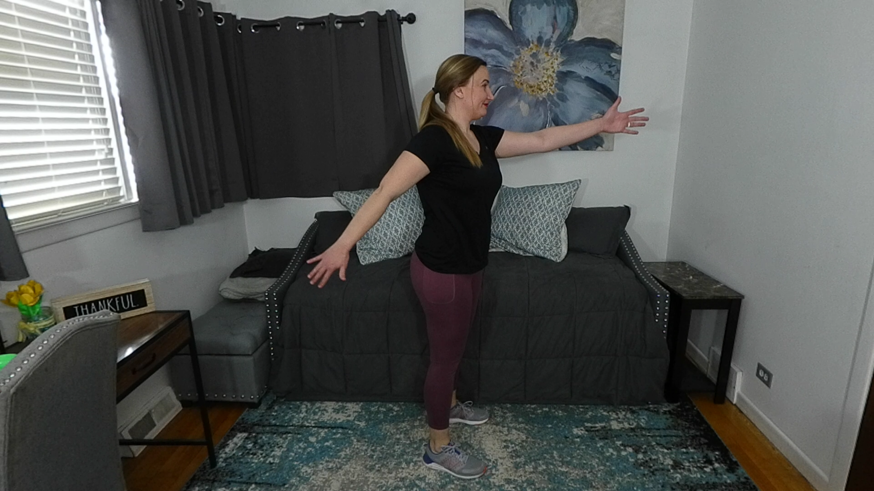
"Intensive coordinative training improves motor performance in degenerative cerebellar disease"

Slide 40
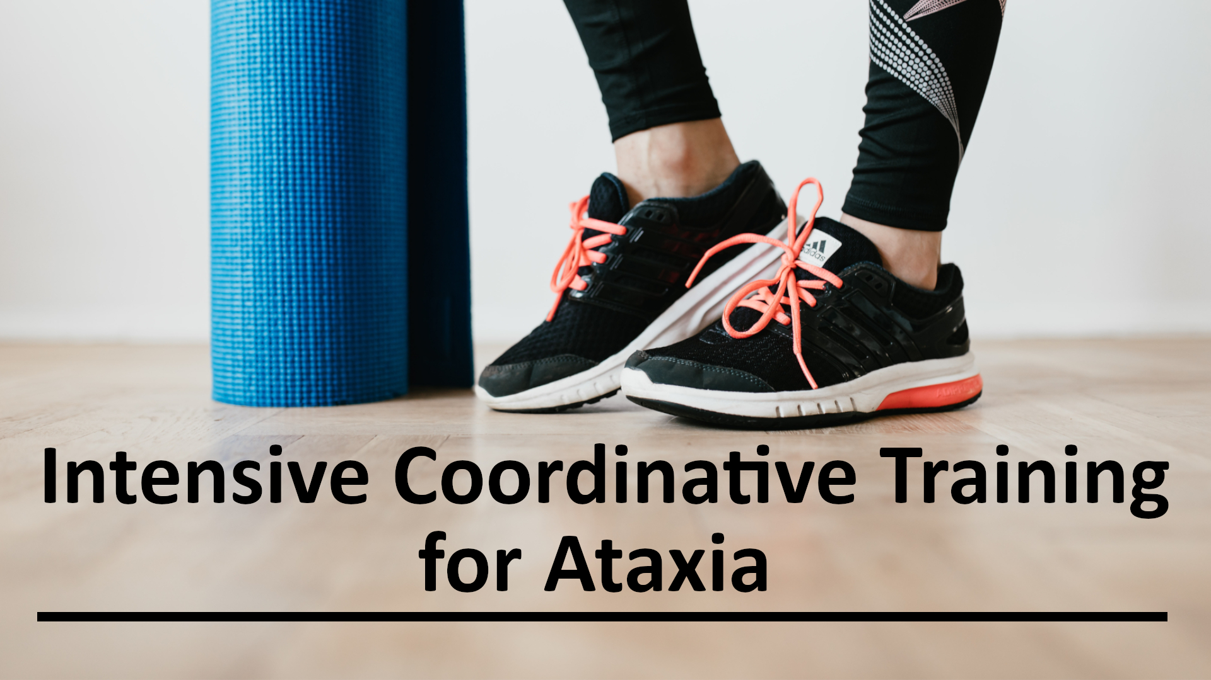
YouTube: "Little Steps, Big Gains"

Slide 41
Coordination Training and Ataxia
  "Proprioceptive loading reduced tremor among cerebellar intention tremor patients."
"Effect of stretching and proprioceptive loading in hand function among patients with cerebellar tremor"
Ravichandran H, Janakiraman B, Sundaram S. Effect of stretching and proprioceptive loading in hand function among patients with cerebellar tremor. Arch Med Health Sci 2016;4:185-8.
Notes:
Talked about above- now what did they do???

Slide 42

Fine Motor Coordination Tasks
+
Wrist Weights
Precisional tapping of objects on a table
Finger-to-Nose tapping
Rapid Alternating Movements
Therapeutic activities- building blocks, buttoning, typing, writing, etc.

Slide 43
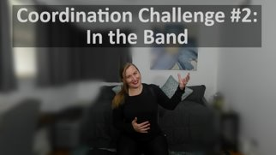
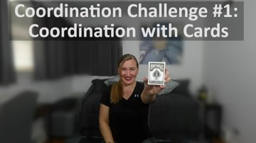
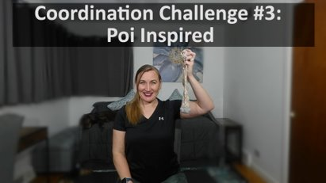
YouTube: "Little Steps, Big Gains"

Slide 44
Exergames
& Cerebellar Ataxia

Slide 45
Intensive Physiotherapy and Exergames
"Motor training in degenerative spinocerebellar disease: ataxia-specific improvements by intensive physiotherapy and exergames"
  Synofzik M, Ilg W. Motor training in degenerative spinocerebellar disease: ataxia-specific improvements by intensive physiotherapy and exergames. Biomed Res Int. 2014;2014:583507. doi: 10.1155/2014/583507. Epub 2014 Apr 27. PMID: 24877117; PMCID: PMC4022207.
Notes:
5 studies show exergames

Slide 46
Intensive Physiotherapy and Exergames
"These studies demonstrate that high-intensity coordinative training might lead to a significant benefit in patients with degenerative ataxia."
"This training might be based either on physiotherapy or on whole-body controlled videogames ("exergames").
The benefit shown in these studies is equal to regaining one or more years of natural disease progression."

Slide 47
Exergame-Based Training
4 Supplemental Studies in References Below:
Significantly decreased ataxia in SCA 3
Even in advanced stages, subjects with degenerative ataxia may benefit from individualized exergame training
Video game-based coordinative training improves ataxia in children with degenerative ataxia
Case of cerebellar ataxia successfully treated by virtual reality-guided rehabilitation

Slide 48
Dance
& Cerebellar Ataxia

Slide 49
Dance-Based Movement Therapy
"Partnered dance could be a suitable alternative physiotherapeutic intervention method for people with severely impaired mobility due to cerebellar dysfunction."
"Effects of dance-based movement therapy on balance, gait, and psychological functions in severe cerebellar ataxia: A case study"
Song YG, Ryu YU, Im SJ, Lee YS, Park JH. Effects of dance-based movement therapy on balance, gait, and psychological functions in severe cerebellar ataxia: A case study. Physiother Theory Pract. 2019 Aug;35(8):756-763. doi: 10.1080/09593985.2018.1457119. Epub 2018 Mar 30. PMID: 29601222.

Slide 50
Dance
Zumba
Line Dancing
Latin Dancing
YouTube- Dance Workouts

Slide 51
Dance-Based Movement Therapy
"Dance Improves Motor, Cognitive, and Social Skills in Children With Developmental Cerebellar Anomalies"
  Bégel V, Bachrach A, Dalla Bella S, Laroche J, Clément S, Riquet A, Dellacherie D. Dance Improves Motor, Cognitive, and Social Skills in Children With Developmental Cerebellar Anomalies. Cerebellum. 2021 Jun 24. doi: 10.1007/s12311-021-01291-2. Epub ahead of print. PMID: 34169400.
The training led to improvements in Sensorimotor synchronization (SMS) balance, and executive functioning (cognitive flexibility), as well as in social skills (social cognition)

Slide 52
Cycling
& Cerebellar Ataxia

Slide 53
Cycling
A 4-week cycling regimen can normalize the modulation of reciprocal inhibition and functional performance in individuals with SCA.
These findings are applicable to the coordination training of patients.
"Cycling regimen induces spinal circuitry plasticity and improves leg muscle coordination in individuals with spinocerebellar ataxia"
Chang YJ, Chou CC, Huang WT, Lu CS, Wong AM, Hsu MJ. Cycling regimen induces spinal circuitry plasticity and improves leg muscle coordination in individuals with spinocerebellar ataxia. Arch Phys Med Rehabil. 2015 Jun;96(6):1006-13. doi: 10.1016/j.apmr.2015.01.021. Epub 2015 Feb 7. PMID: 25668777.

Slide 54
Treadmill Training

Slide 55
Treadmill training- Caution
Rehabilitation of postural and gait in patients with acute cerebellar stroke
  Treadmill training did not show significant effects.
Better option?
Wrist weights or Theraband
  Nordic Walking
    Total Body Form of Walking

Slide 56
Swimming
& Cerebellar Ataxia

Slide 57
Swimming and Cerebellar Ataxia
"Safe, and viable alternative to gait training in patients with cerebellar ataxia because the risk of falls is eliminated and less strength and strength-endurance may be needed"
Incorporate water AND land exercises

Slide 58
Balance-Based Torso Weighting
Whole Body Vibration

Slide 59
Balance-based Torso-Weighting
  Strategic weighting improved standing stability
  Has potential for improving stability and response to challenging sensory conditions in this population.
Whole Body Vibration
  Can improve of all components of postural control in patients with ataxia.

Slide 60
Evidence Based Exercise Modalities for Ataxia
  Physical/Occupational Therapy
  Balance Training
  Core Stability Training
  Coordination Training
  Exergames
  Dance
  Cycling
  Swimming
  Balance Based Torso Weighting
  Whole Body Vibration

Slide 61
Compensation
What can we do to "offset" the problem?
Notes:
While we can improve balance- we NEED to adapt our environment live life despite the problem:

Slide 62
Compensatory Strategies
Assisted Devices
Adapted Equipment
Activity Modifications
Notes:
Difference between walker dependent and walker smart

Slide 63
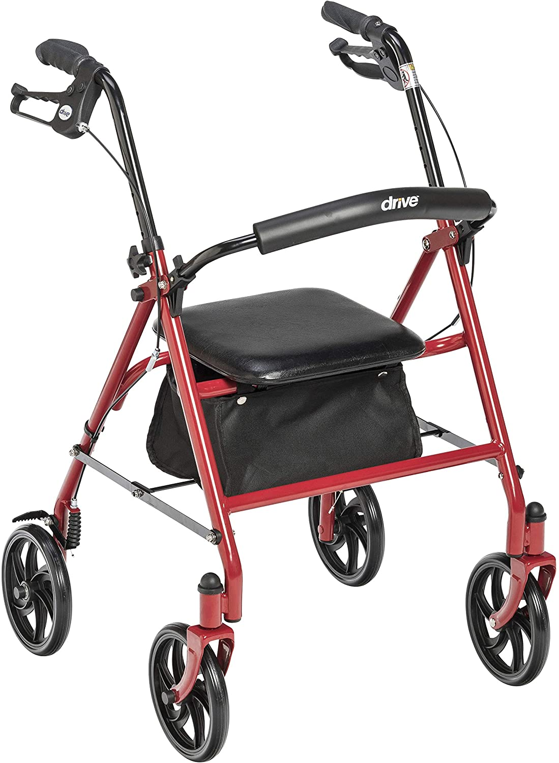
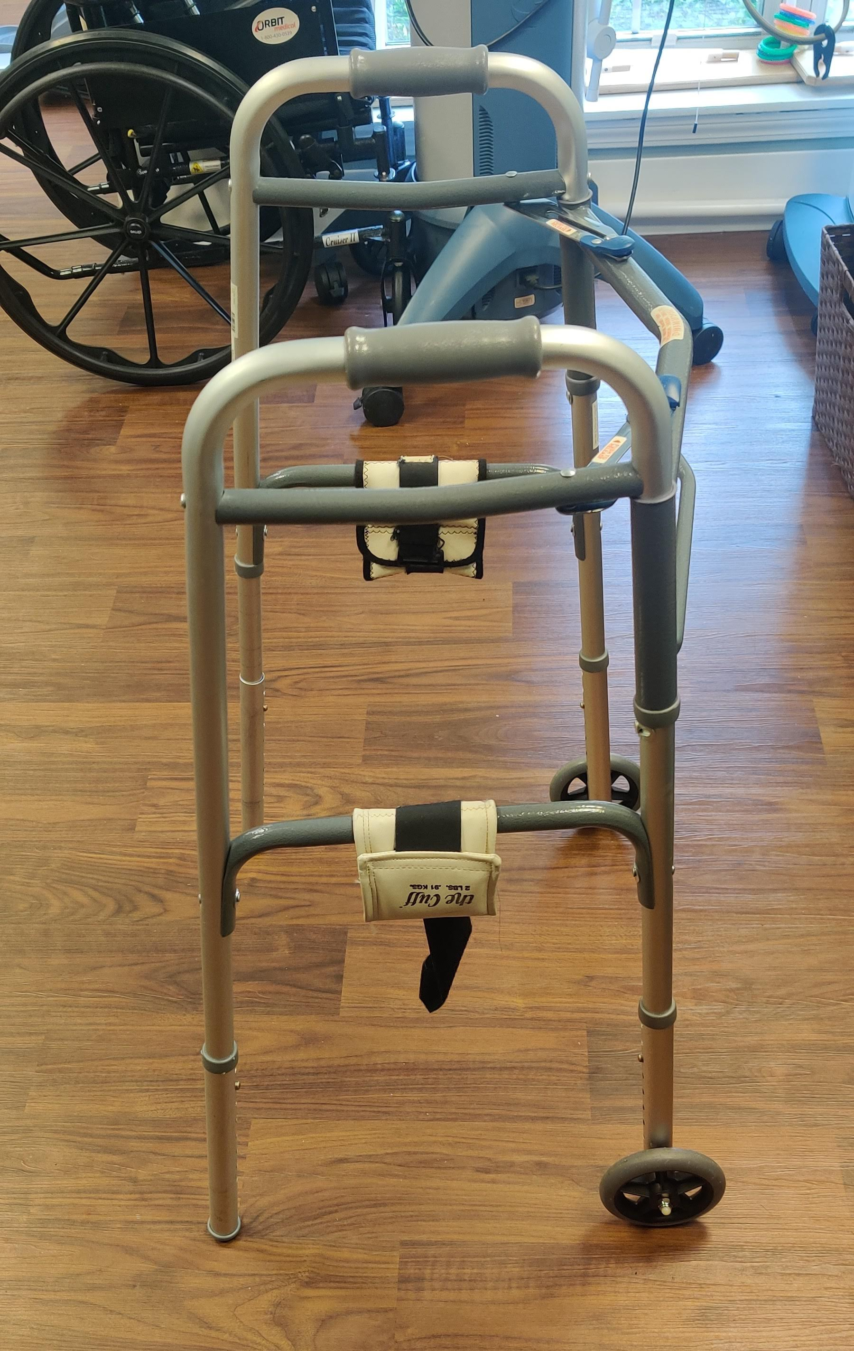
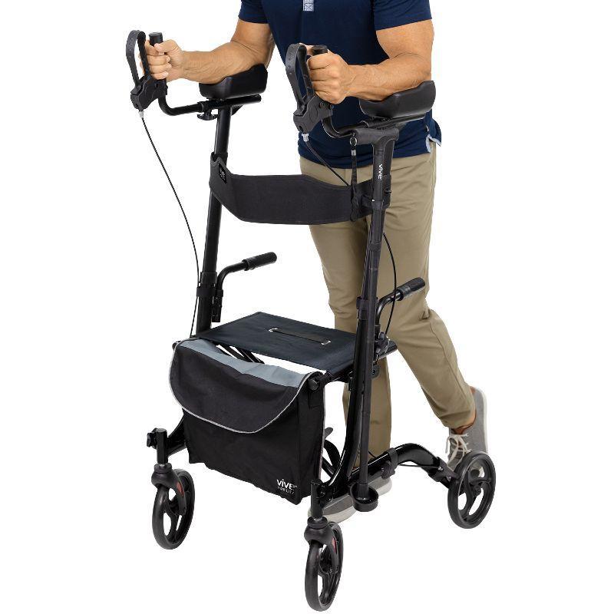
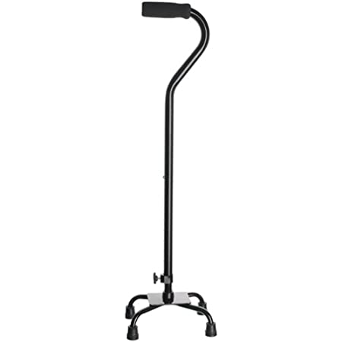
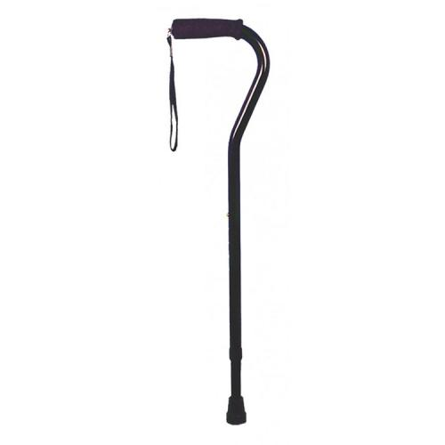
Assisted Devices
PT Referral
Add Weight

Slide 64
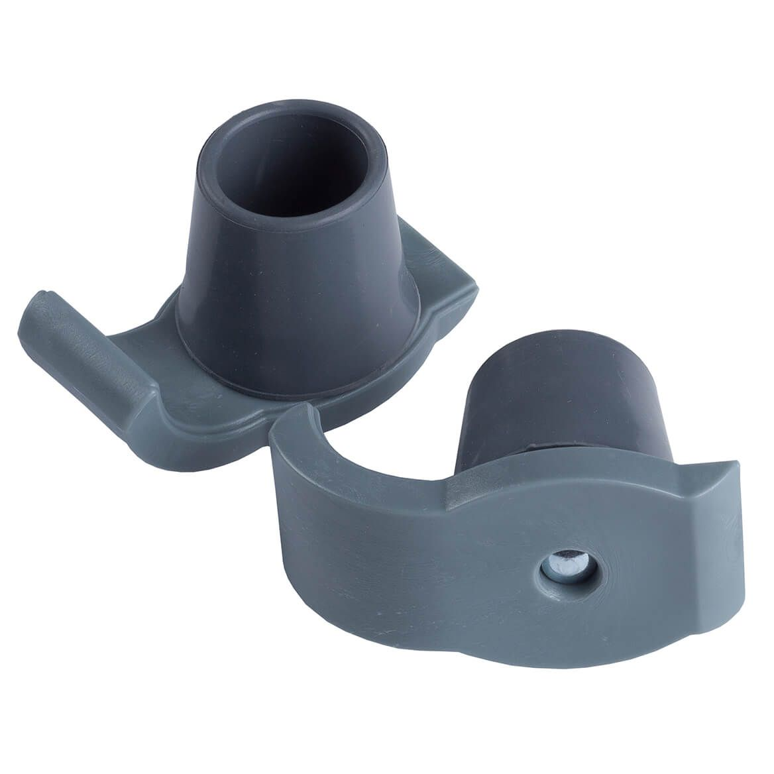
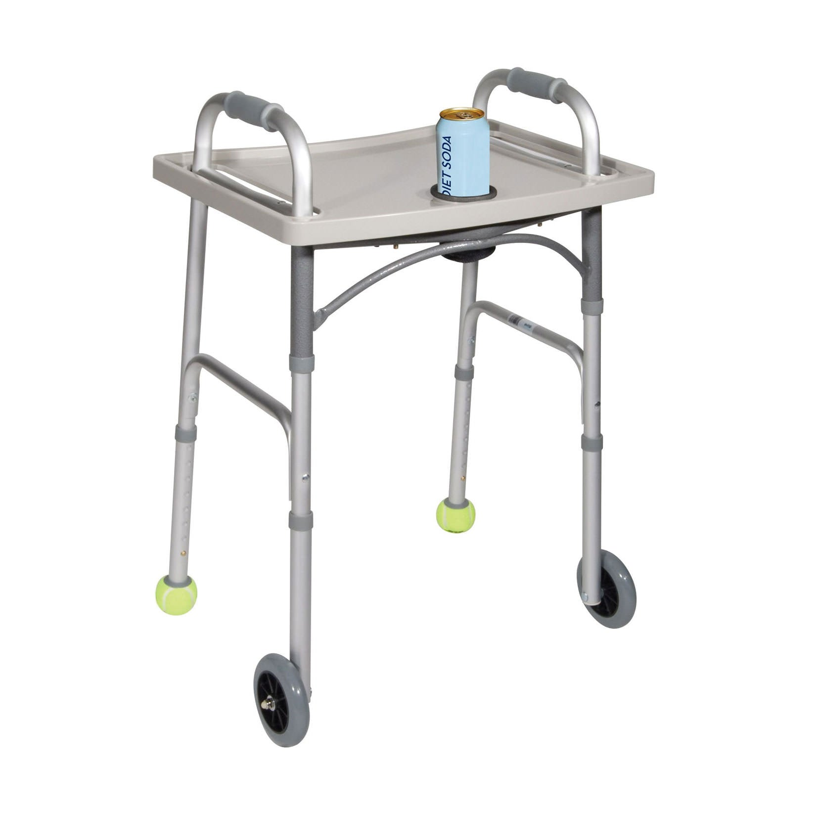
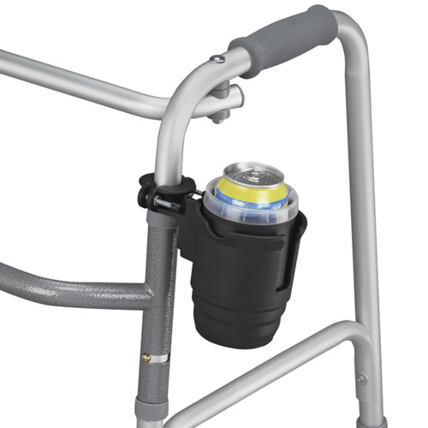
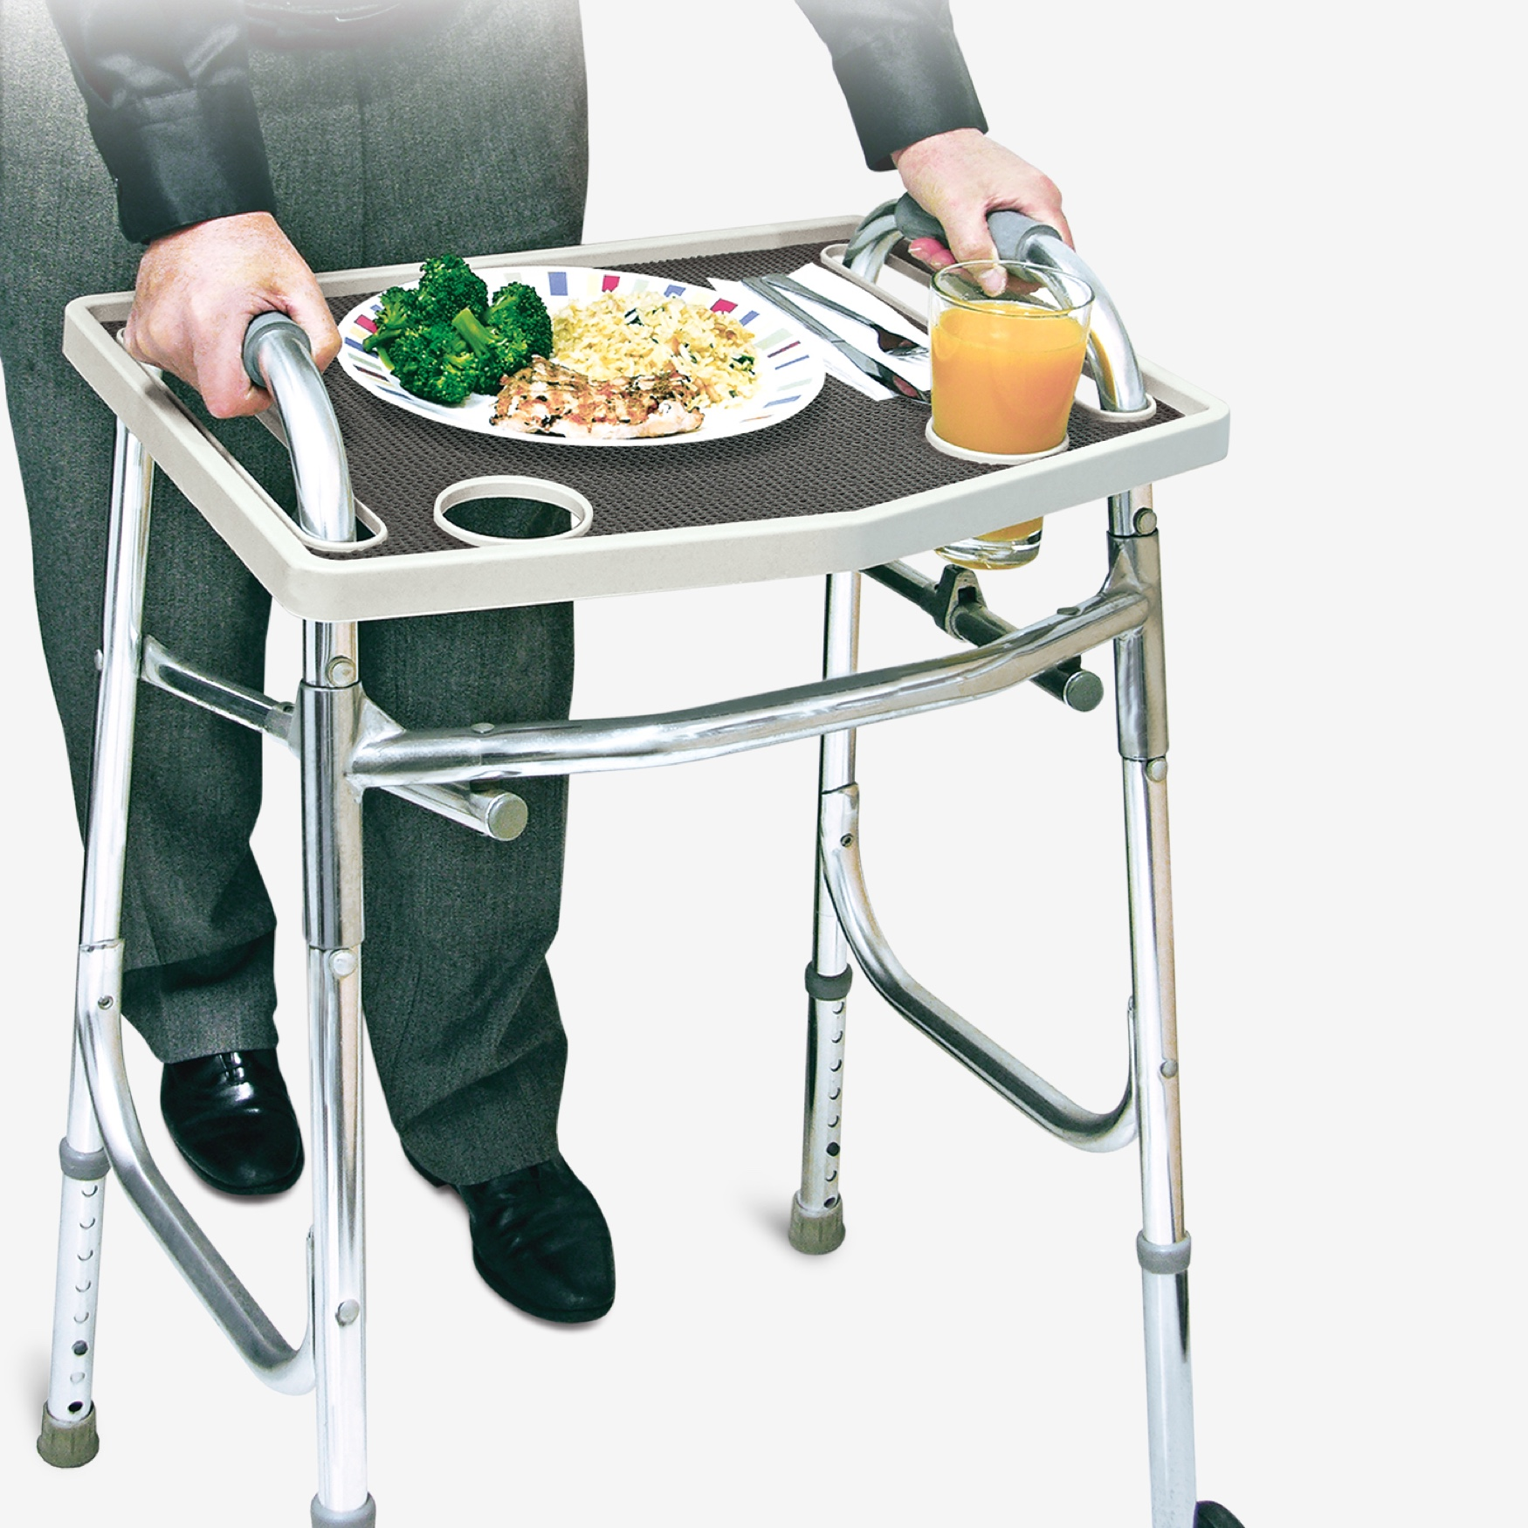
Walker Accessories
Non-Slip
Grip Mat
Cup Holders
Walker Glides
Walker Tray

Slide 65
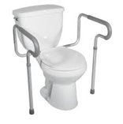
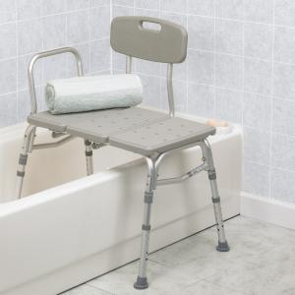
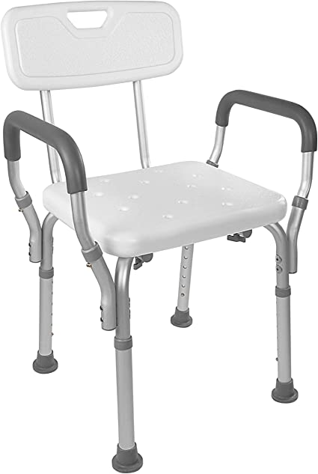
Adapted Equipment
Shower Chair
Toilet Safety Frame
Bathtub Transfer Bench

Slide 66
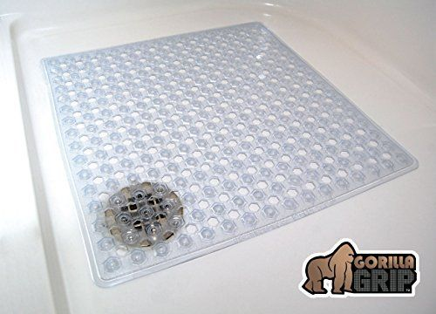
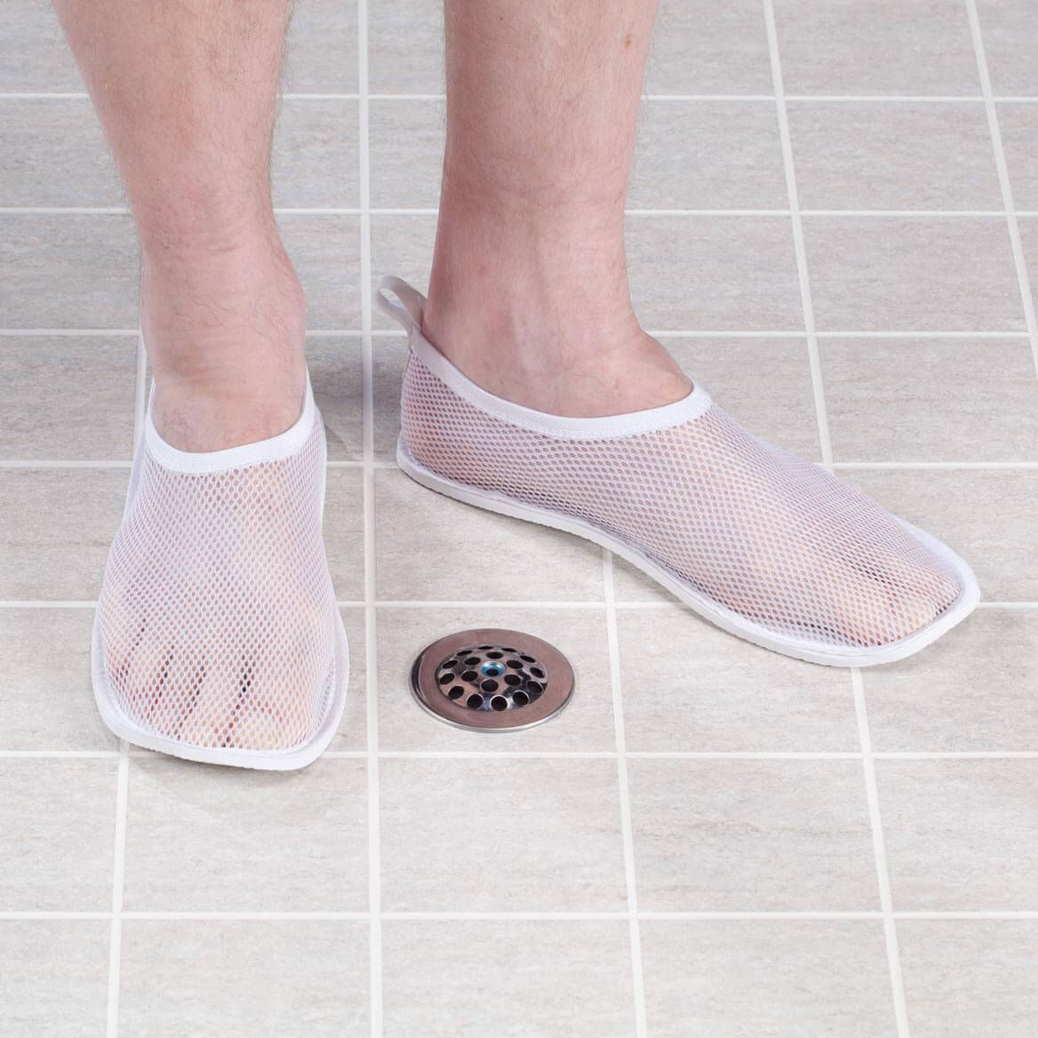
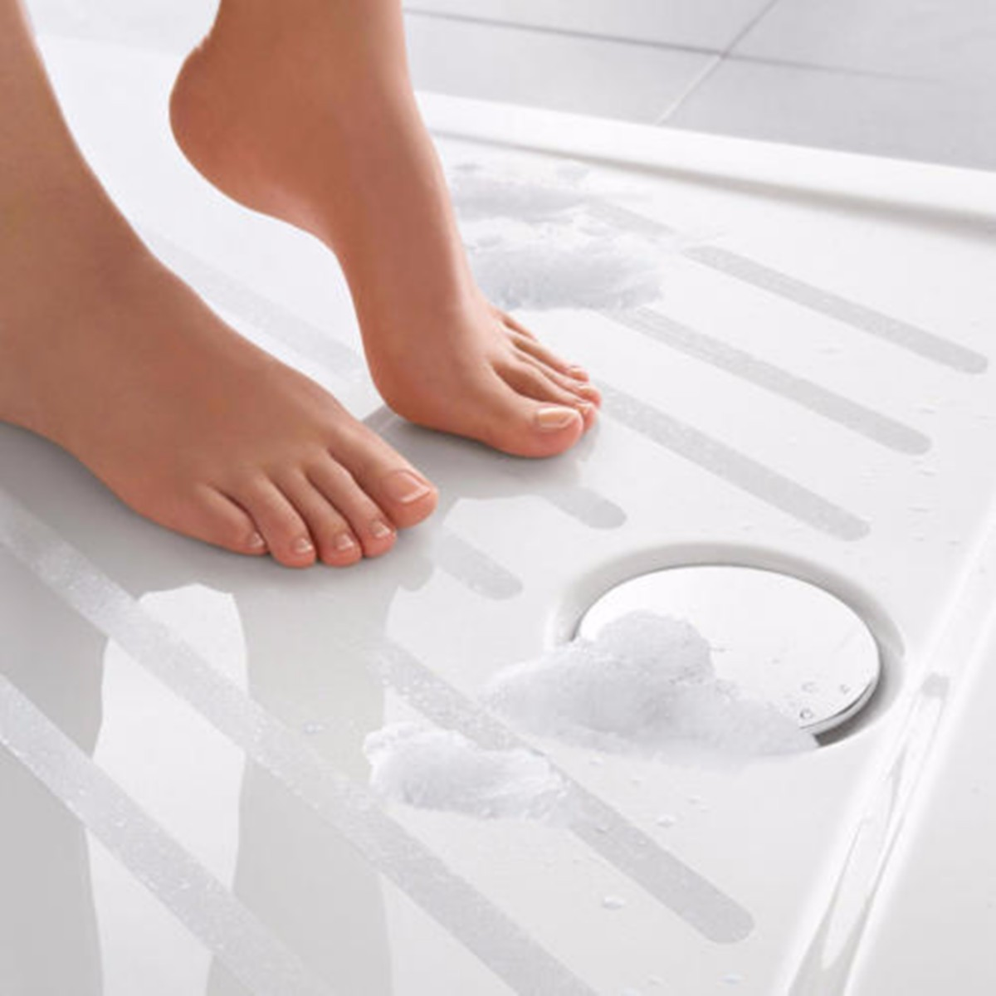
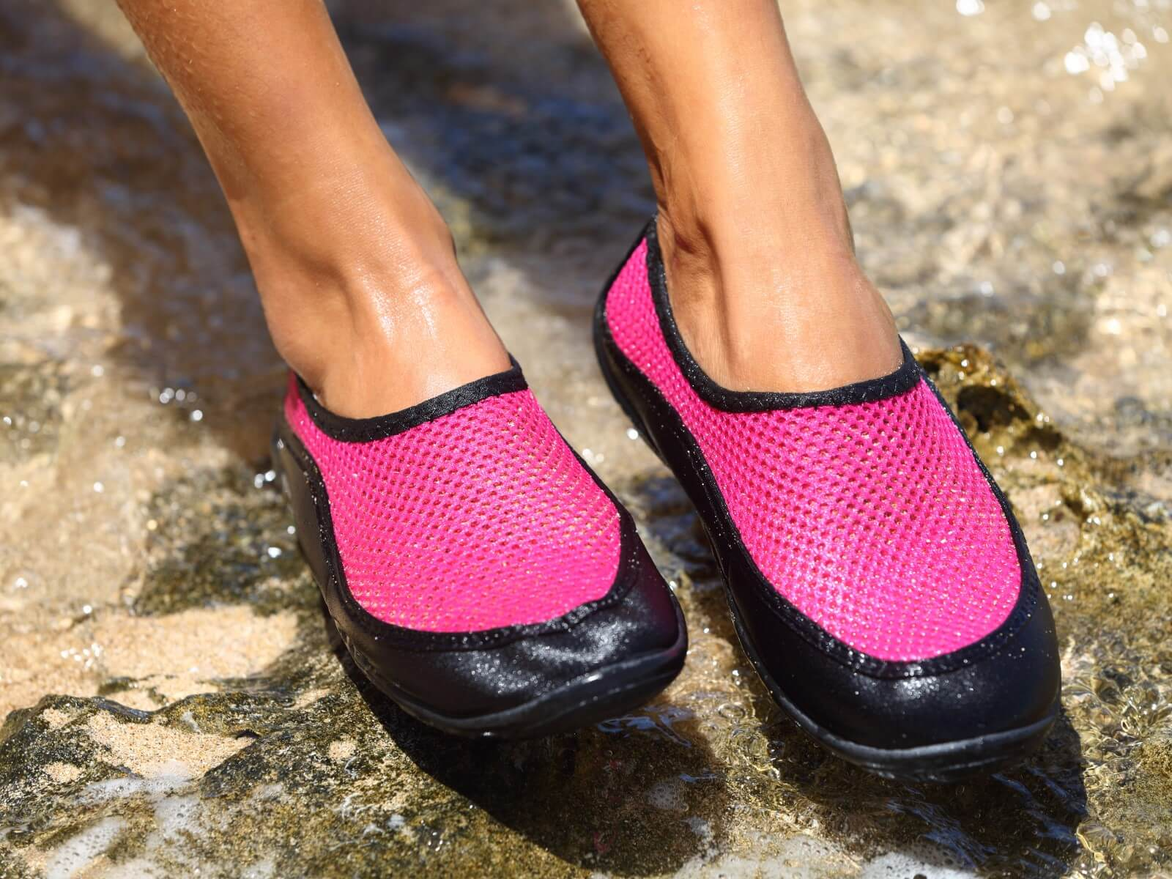
Bathing
Gorilla Grip
Shower or Water
Shoes
Non-Slip Shower Strips

Slide 67
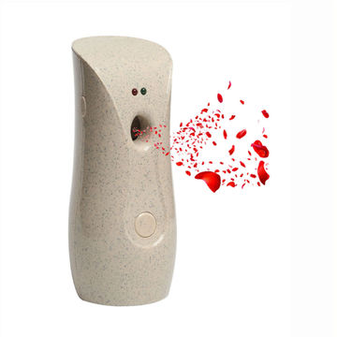
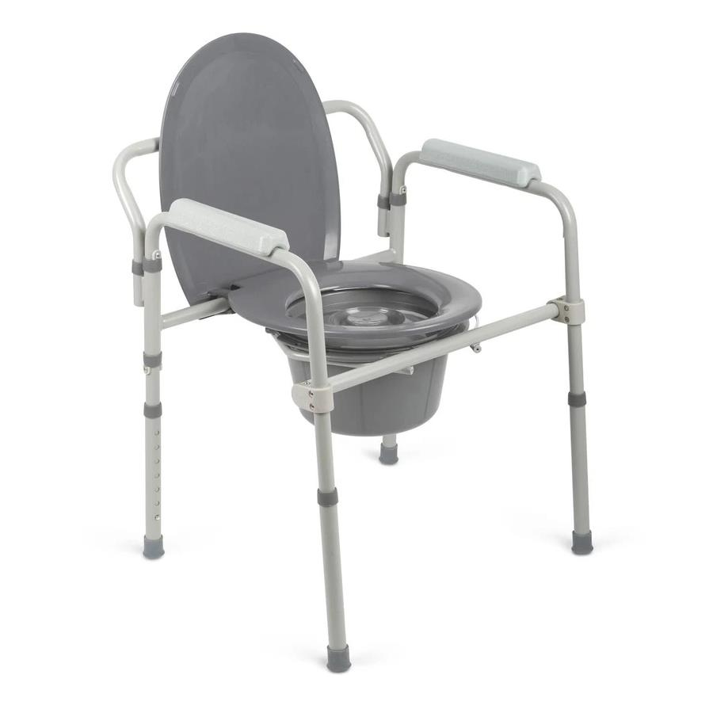
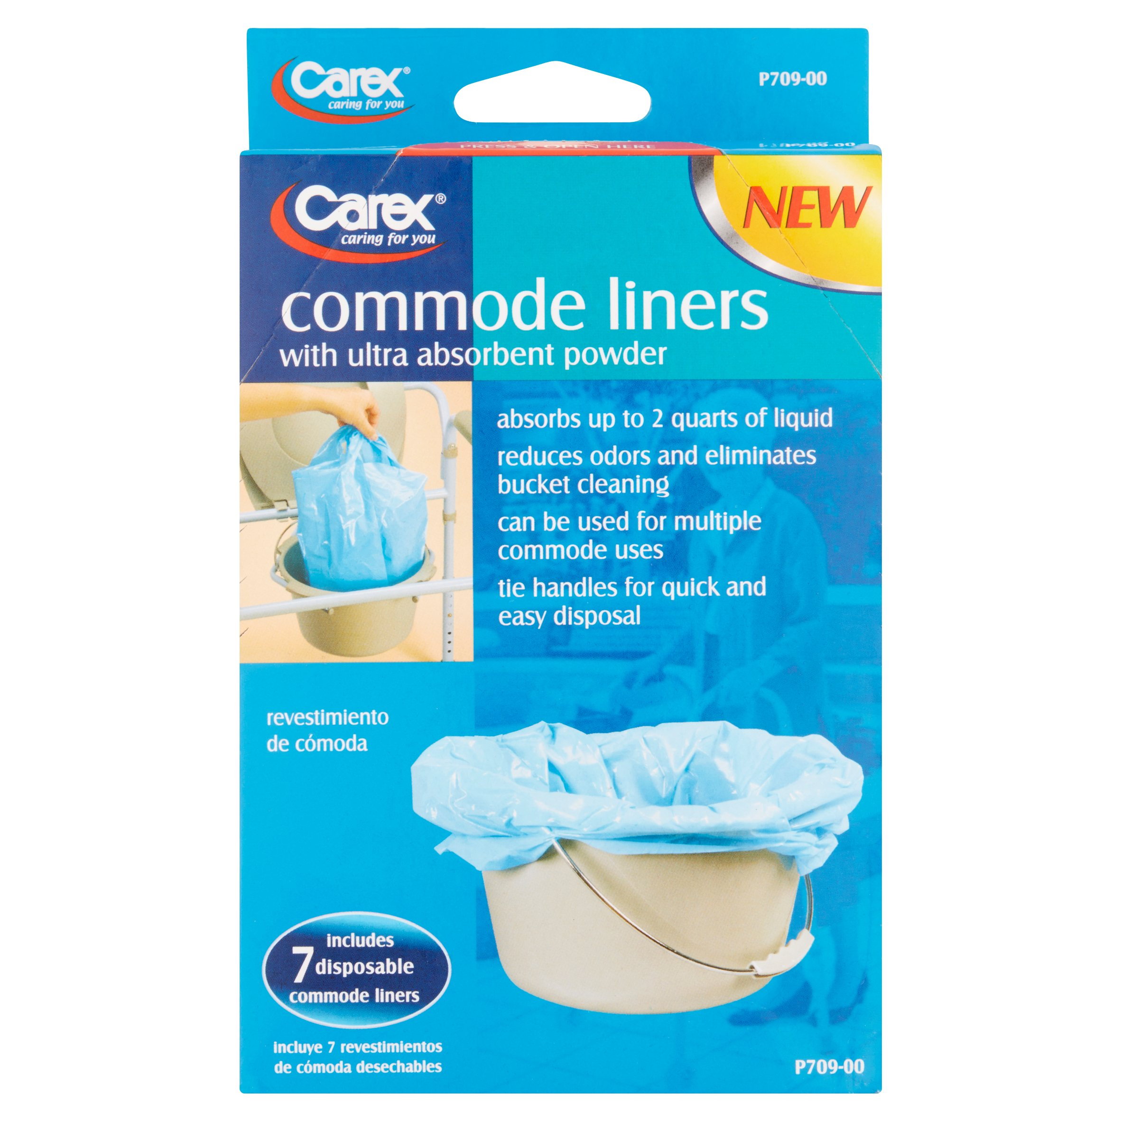
Toileting
Automatic
Air Freshener
Bedside Commode

Slide 68
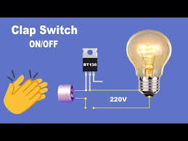
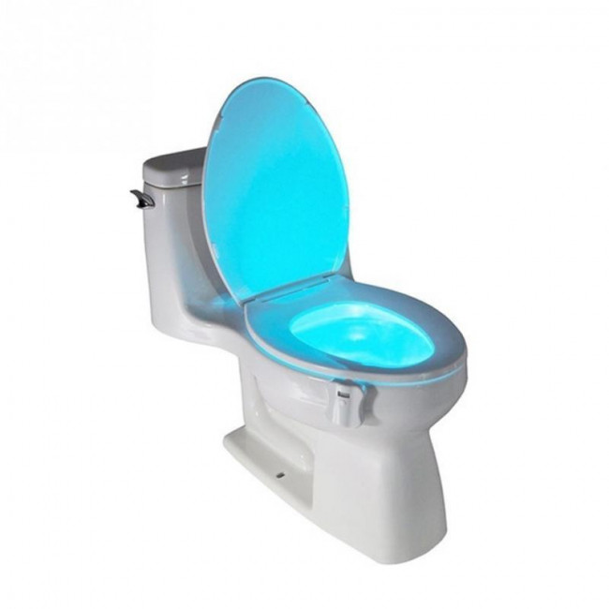
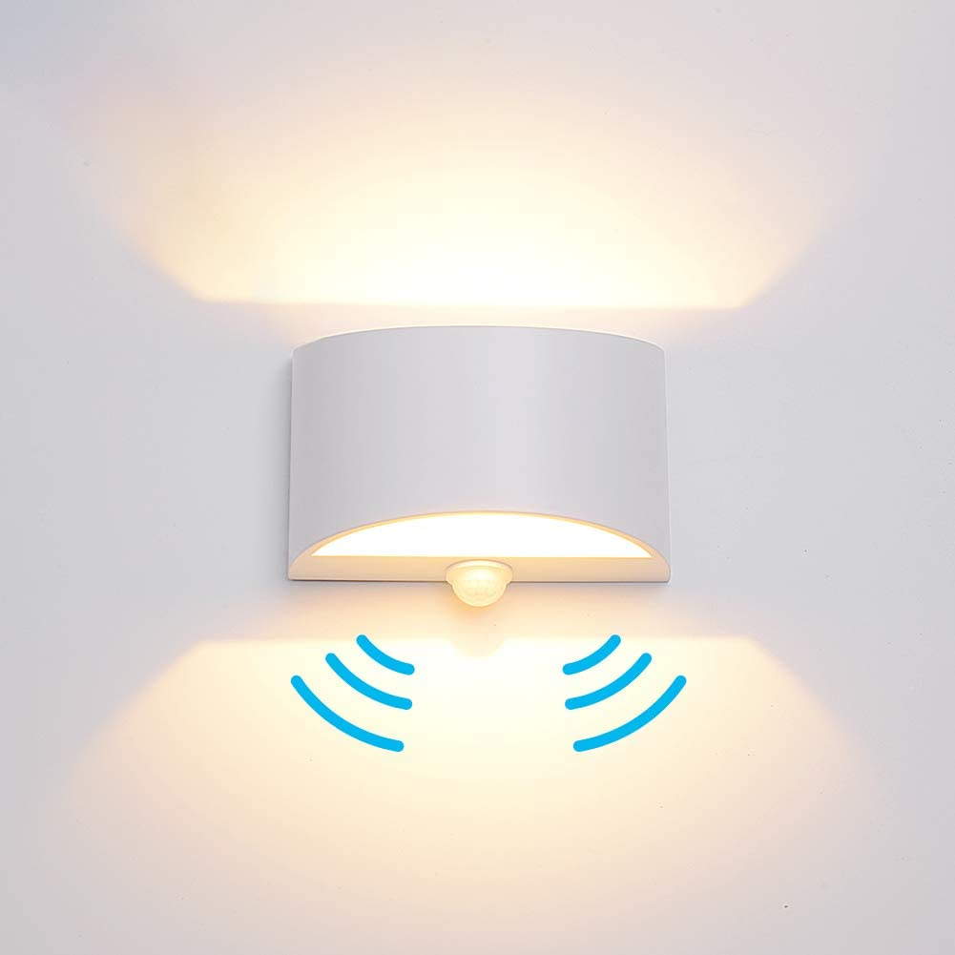

Night Time Lighting
    Timers
    Clapper Lights
    Voice Activated
    Motion Sensored
    Strip Lighting
    Toilet-Bowl Light

Slide 69
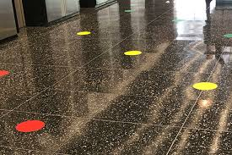
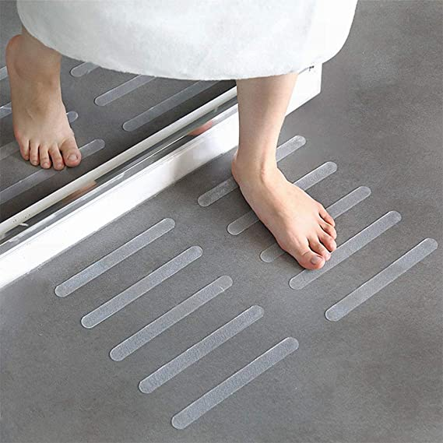
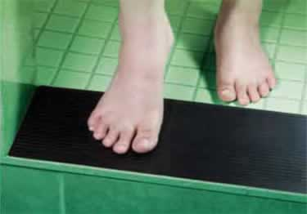
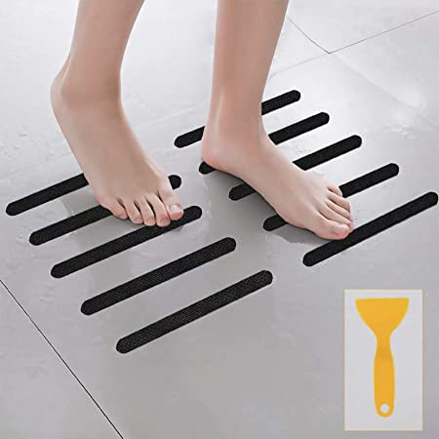
Safety
Freezing- Floor Targets
Non-Slip Floor Adhesives
Remove Clutter

Slide 70

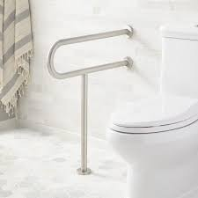
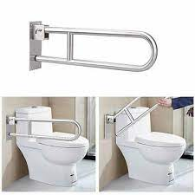
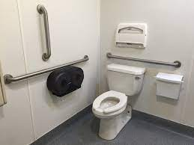
Safety
Grip Strips
Grab bars
Flip up Grab Bars

Slide 71
Resources

Slide 72
Resources
YouTube "Little Steps, Big Gains"
  30-Day Sitting Tai-Chi Inspired Standing Balance Challenge
  30-Day Standing Tai-Chi Inspired Standing Balance Challenge
  30-Day Combination Band and Balance Challenge
  30-Day Sitting Balance with a Broom Challenge
  30-Day Static Standing Balance Challenge

Slide 73
Resources
YouTube "Little Steps, Big Gains"
  "Let's Talk Balance"
  "Let's Talk Posture for Mobility and Balance"
  "Balance for Life- Balance Strategies"
  "Balance for Life- The Role of the Sensory Systems in Maintaining Balance"
  "Balance for Life- The Role of the Somatosensory System"
  "Balance for Life- The Role of the Vestibular System in Balance"
  "Balance for Life- The Role of the Vestibular System in Cerebellar Ataxia"

Slide 74
Resources
YouTube "Little Steps, Big Gains"
  "Intensive Coordinative Training for Ataxia"
  "Ataxia- what we need to know and who we need to listen to"
  "Let's Talk Urinary Incontinence"
  "Let's Talk Bowel Incontinence"
  "Let's Talk Ataxia"

Slide 75
Resources
YouTube "Little Steps, Big Gains"
  "Tips for Tremors in Life"
  "Tips for Tremors with Eating"
  "Tips for Compression Stocking, Socks, and Shoes"
  "How to make a Pant Clip using Chip Clips"
  "How to use a Foot Funnel Shoe Assist"
  "Compression Stockings- The Inside Out and Scoop Methods"
  "Navigate Shower Thresholds. The Double Shower Chair Method"
  Marked 4 Glory YouTube- Season 1, Episode 18- Elizabeth Foss

Slide 76
The Evidence

Slide 77
Exercise and Progressive Degenerative Ataxias
"Long-term effects of coordinative training in degenerative cerebellar disease"
  Ilg W, Brötz D, Burkard S, Giese MA, Schöls L, Synofzik M. Long-term effects of coordinative training in degenerative cerebellar disease. Mov Disord. 2010 Oct 15;25(13):2239-46. doi: 10.1002/mds.23222. PMID: 20737551.
"Despite gradual decline of motor performance and gradual increase of ataxia symptoms due to progression of disease after 1 year, improvements in motor performance and achievements in activities of daily life persisted."
Thus, also in patients with degenerative cerebellar disease, continuous coordinative training leads to long-term improvements, which translate to real world function."

Slide 78
Physical/Occupational Therapy
"Can rehabilitation help ataxia?"
  Morton SM, Bastian AJ. Can rehabilitation help ataxia? Neurology. 2009 Dec 1;73(22):1818-9. doi: 10.1212/WNL.0b013e3181c33b21. Epub 2009 Oct 28. PMID: 19864635.
"This work is particularly exciting because it shows that individuals with cerebellar damage can learn to improve their movements. Despite continuing disease progression, these subjects were able to benefit from a specific training program targeting balance and gait impairments."
"This result suggests a new avenue for improving motor skills and functional performance in a population of individuals previously thought to have little chance for motor recovery."

Slide 79
Physical/Occupational Therapy
"Rehabilitation for Individuals With Genetic Degenerative Ataxia: A Systematic Review"
  Milne SC, Corben LA, Georgiou-Karistianis N, Delatycki MB, Yiu EM. Rehabilitation for Individuals With Genetic Degenerative Ataxia: A Systematic Review. Neurorehabil Neural Repair. 2017 Jul;31(7):609-622. doi: 10.1177/1545968317712469. Epub 2017 Jun 9. PMID: 28595509.
"There is consistent evidence that rehabilitation improves function, mobility, ataxia, and balance in genetic degenerative ataxia."

Slide 80
Physical/Occupational Therapy
"Neurorehabilitation for spinocerebellar degeneration"
Miyai I. [Neurorehabilitation for spinocerebellar degeneration]. Rinsho Shinkeigaku. 2013;53(11):931-3. Japanese. doi: 10.5692/clinicalneurol.53.931. PMID: 24291837.
"Recent clinical trials from Germany and Japan have demonstrated that comprehensive intensive rehabilitation focusing on balance function have immediate and lasting effect up to 1 year on ataxia and gait disorder in patients with spinocerebellar degeneration"

Slide 81
"Physical Therapy for Cerebellar Ataxia"
  Matsugi, Akiyoshi. (2017). Physical Therapy for Cerebellar Ataxia. 10.5772/67649.
  Intensive physical therapy more than 1 hour per day for at least 4 weeks, focused on balance, gait, and strength training in hospital and home for patients with degenerative cerebellar ataxia can improve ataxia, gait ability, and activity of daily living.
"Cerebellar ataxia rehabilitation trial in degenerative cerebellar diseases"
  Miyai I, Ito M, Hattori N, Mihara M, Hatakenaka M, Yagura H, Sobue G, Nishizawa M; Cerebellar Ataxia Rehabilitation Trialists Collaboration. Cerebellar ataxia rehabilitation trial in degenerative cerebellar diseases. Neurorehabil Neural Repair. 2012 Jun;26(5):515-22. doi: 10.1177/1545968311425918. Epub 2011 Dec 2. PMID: 22140200.
"The immediate group showed significantly greater functional gains in ataxia, gait speed, and ADLs than the control group."

Slide 82
Vestibular Rehabilitation
"Gaze Stabilization Exercises to Decrease Fall Rate in Person with Hereditary Cerebellar Atrophy: A Case Study"
  Interim Healthcare, Rochester, MN Sara DeMars, PT, DPT, NCS
"Effects of gaze stability exercises along with proprioception training to improve balance in cerebellar ataxia"
  Chaitali Gandhi, Jimshad TU, Anil T John International Journal of Physical Education, Sports and Health 2015; 2 (1):248-251
  Results suggest that Gaze stability exercise along with proprioception training was more effective in improving balance than proprioception training alone in patients cerebellar ataxia
"Cerebellar signatures of vestibulo-ocular reflex motor learning"
  Blazquez PM, Hirata Y, Heiney SA, Green AM, Highstein SM. Cerebellar signatures of vestibulo-ocular reflex motor learning. J Neurosci. 2003 Oct 29;23(30):9742-51. doi: 10.1523/JNEUROSCI.23-30-09742.2003. PMID: 14586001; PMCID: PMC6740887.

Slide 83
Ataxia and Balance Training
"Rehabilitation of Balance in Two Patients With Cerebellar Dysfunction"
  Kathleen M Gill-Body, Rita A Popat, Stephen W Parker, David E Krebs, Rehabilitation of Balance in Two Patients With Cerebellar Dysfunction, Physical Therapy, Volume 77, Issue 5, 1 May 1997, Pages 534–552, https://doi.org/10.1093/ptj/77.5.534
This case report describes two individualized treatment programs and documents functional improvements in two patients with different etiologies, durations, and clinical presentations of cerebellar dysfunction.
The outcomes suggest that patients with cerebellar lesions, acute or chronic, may be able to learn to improve their postural stability.

Slide 84
"A Home Balance Exercise Program Improves Walking in People with Cerebellar Ataxia"
  Keller JL, Bastian AJ. A home balance exercise program improves walking in people with cerebellar ataxia. Neurorehabil Neural Repair. 2014;28(8):770-778. doi:10.1177/1545968314522350
  6- week Home Exercise Program with Static and Dynamic Balance rather than direct gait training
  "Improvement in locomotor performance in people with cerebellar ataxia was observable after a six-week home balance exercise program. The exercise program must be designed to provide a significant challenge to the person's balance."

Slide 85
Ataxia and Coordination Training
Effect of stretching and proprioceptive loading in hand function among patients with cerebellar tremor
Ravichandran H, Janakiraman B, Sundaram S. Effect of stretching and proprioceptive loading in hand function among patients with cerebellar tremor. Arch Med Health Sci 2016;4:185-8
"Thus, we concluded that proprioceptive loading reduced tremor among cerebellar intention tremor patients.
This study proved that proprioceptive loading is effective in cerebellar tremor. The demerits are small sample size and need for long-term follow-up."

Slide 86
Intensive Physiotherapy and Exergames
"Motor training in degenerative spinocerebellar disease: ataxia-specific improvements by intensive physiotherapy and exergames"
  Synofzik M, Ilg W. Motor training in degenerative spinocerebellar disease: ataxia-specific improvements by intensive physiotherapy and exergames. Biomed Res Int. 2014;2014:583507. doi: 10.1155/2014/583507. Epub 2014 Apr 27. PMID: 24877117; PMCID: PMC4022207.
  These studies demonstrate that high-intensity coordinative training might lead to a significant benefit in patients with degenerative ataxia.
  This training might be based either on physiotherapy or on whole-body controlled videogames ("exergames"). The benefit shown in these studies is equal to regaining one or more years of natural disease progression.

Slide 87
Game-Based Training
"A randomized controlled pilot trial of game-based training in individuals with spinocerebellar ataxia type 3"
  Wang, RY., Huang, FY., Soong, BW. et al. A randomized controlled pilot trial of game-based training in individuals with spinocerebellar ataxia type 3. Sci Rep 8, 7816 (2018). https://doi.org/10.1038/s41598-018-26109-w
Our results suggested that the exergaming training program significantly decreased ataxia.
These results support implementation of exergaming training for people with SCA3.

Slide 88
Individualized exergame training
"Individualized exergame training improves postural control in advanced degenerative spinocerebellar ataxia: A rater-blinded, intra-individually controlled trial"
  Schatton C, Synofzik M, Fleszar Z, Giese MA, Schöls L, Ilg W. Individualized exergame training improves postural control in advanced degenerative spinocerebellar ataxia: A rater-blinded, intra-individually controlled trial. Parkinsonism Relat Disord. 2017 Jun;39:80-84. doi: 10.1016/j.parkreldis.2017.03.016. Epub 2017 Mar 28. PMID: 28365204.
This study provides first evidence that, even in advanced stages, subjects with degenerative ataxia may benefit from individualized training, with effects translating into daily living and improving underlying control mechanisms.

Slide 89
Video game-based coordinative training
"Video game-based coordinative training improves ataxia in children with degenerative ataxia"
  Ilg W, Schatton C, Schicks J, Giese MA, Schöls L, Synofzik M. Video game-based coordinative training improves ataxia in children with degenerative ataxia. Neurology. 2012 Nov 13;79(20):2056-60. doi: 10.1212/WNL.0b013e3182749e67. Epub 2012 Oct 31. PMID: 23115212.
Despite progressive cerebellar degeneration, children are able to improve motor performance by intensive coordination training.
Directed training of whole-body controlled video games might present a highly motivational, cost-efficient, and home-based rehabilitation strategy to train dynamic balance and interaction with dynamic environments in a large variety of young-onset neurologic conditions.

Slide 90
Virtual reality-guided rehabilitation
"Case of cerebellar ataxia successfully treated by virtual reality-guided rehabilitation"
  Takimoto K, Omon K, Murakawa Y, et al Case of cerebellar ataxia successfully treated by virtual reality-guided rehabilitation BMJ Case Reports CP 2021;14:e242287.
  40 year old male s/p right cerebellar and brainstem infarction
  3 weeks conventional physical therapy
  Discharged- initiated virtual reality-guided balance training
    Significant improvements in balance, confidence and returned to work as standup forklift driver

Slide 91
Treadmill training- Caution
"Functional recovery and rehabilitation of postural impairment and gait ataxia in patients with acute cerebellar stroke"
  Bultmann U, Pierscianek D, Gizewski ER, Schoch B, Fritsche N, Timmann D, Maschke M, Frings M. Functional recovery and rehabilitation of postural impairment and gait ataxia in patients with acute cerebellar stroke. Gait Posture. 2014;39(1):563-9. doi: 10.1016/j.gaitpost.2013.09.011. Epub 2013 Sep 24. PMID: 24119775.
  Treadmill training did not show significant effects.

Slide 92
Swimming and Cerebellar Ataxia
"Swimming with Cerebellar Ataxia"
  Yang CY, Kuo SH. Swimming with Cerebellar Ataxia. PM R. 2021;13(4):425-426. doi:10.1002/pmrj.12431
  From the rehabilitation perspective, swimming can be explored as a safe, and viable alternative to gait training in patients with cerebellar ataxia because the risk of falls is eliminated and less strength and strength-endurance may be needed.

Slide 93
Balance-based Torso-Weighting
"Changes in standing stability with balance-based torso-weighting with cerebellar ataxia: A pilot study"
  Widener GL, Conley N, Whiteford S, Gee J, Harrell A, Gibson-Horn C, Block V, Allen DD. Changes in standing stability with balance-based torso-weighting with cerebellar ataxia: A pilot study. Physiother Res Int. 2020 Jan;25(1):e1814. doi: 10.1002/pri.1814. Epub 2019 Nov 20. PMID: 31749254; PMCID: PMC7050535.
  Strategic weighting improved standing stability but not movement speed in people with ataxia.
  BBTW has potential for improving stability and response to challenging sensory conditions in this population.

Slide 94
Ataxia and Whole Body Vibration
"The Effect of Whole Body Vibration on Postural Control of Ataxic Patients: a Randomized Controlled Cross-Over Study"
  Ayvat E, Kılınç M, Ayvat F, Onursal Kılınç Ö, Aksu Yıldırım S. The Effect of Whole Body Vibration on Postural Control of Ataxic Patients: a Randomized Controlled Cross-Over Study. Cerebellum. 2021 Aug;20(4):533-541. doi: 10.1007/s12311-021-01233-y. Epub 2021 Jan 21. PMID: 33475935.
  "This study demonstrated that exercise programs supported by WBV can play an important role in the improvement of all components of postural control in patients with ataxia."

Slide 95
"A wearable proprioceptive stabilizer for rehabilitation of limb and gait ataxia in hereditary cerebellar ataxias: a pilot open-labeled study"
  Leonardi L, Aceto MG, Marcotulli C, Arcuria G, Serrao M, Pierelli F, Paone P, Filla A, Roca A, Casali C. A wearable proprioceptive stabilizer for rehabilitation of limb and gait ataxia in hereditary cerebellar ataxias: a pilot open-labeled study. Neurol Sci. 2017 Mar;38(3):459-463. doi: 10.1007/s10072-016-2800-x. Epub 2016 Dec 31. PMID: 28039539.
"Focal mechanical vibration exerted by a wearable proprioceptive stabilizer might improve limb and gait ataxia in patients affected by hereditary cerebellar ataxias."

Slide 96
References
"Decreasing fall risk in spinocerebellar ataxia"
  Santos de Oliveira LA, Martins CP, Horsczaruk CH, et al. Decreasing fall risk in spinocerebellar ataxia. J Phys Ther Sci. 2015;27(4):1223-1225. doi:10.1589/jpts.27.1223
"The relationship between trunk position sense and postural control in ataxic individuals"
  Özge Onursal Kılınç, Ender Ayvat, Fatma Ayvat, Gülşah Sütçü, Muhammed Kılınç, Songül Aksoy, Sibel Aksu Yıldırım, The relationship between trunk position sense and postural control in ataxic individuals, Gait & Posture, Volume 68, 2019, Pages 258-263

Slide 97
Agenda
Prevalence of Falls in Ataxia
Role of the Cerebellum with Balance
Remediation- interventions to restore impairments
Compensation- interventions to offset the problem- live life despite the impairments
Summary of Resources

Slide 98
Thank you!

