Slide 1




Ataxia, Assistive Technology, and Swallowing
Carolyn Buchanan, M.A., CCC-SLP, ATP, CBIS
Todd R. Fix, M.A., CCC-SLP, CBIS
A Virtual Event
March 17-19, 2022

Slide 2



DISCLAIMER
The information provided by speakers in any presentation made as part of the 2022 NAF Annual Ataxia Conference is for informational use only.
Products or series mentioned during these presentations does not imply endorsement by NAF
NAF encourages all attendees to consult with their primary care provider, neurologist, or other healthcare provider about any advice, exercise, therapies, medication, treatment, nutritional supplement, or regimen that may have been mentioned as part of any presentation.
2022 AAC
A Virtual Event
March 17-19

Slide 3
PRESENTER DISCLOSURES
Carolyn Buchanan and Todd R. Fix
No relationships to disclose or list
2022 AAC
A Virtual Event
March 17-19

Slide 4
What is Assistive Technology?
“For people without disabilities, technology makes things easier. For people with disabilities, technology makes things possible.”
PIAT web site (www.temple.edu/inst_disabilities/piat)
2022 AAC
A Virtual Event
March 17-19

Slide 5

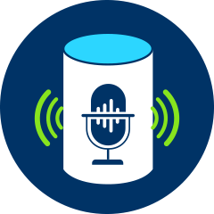
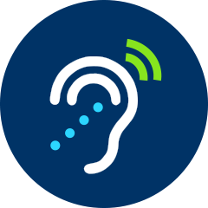
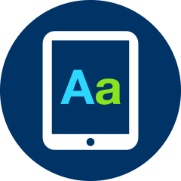


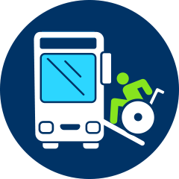


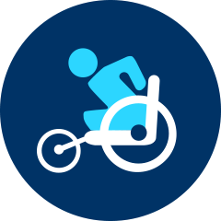
What is Assistive Technology?
AT Device
Any item, piece of equipment of product system whether acquired commercially off-the-shelf, modified,
or customized that is used to increase or improve functional capabilities of individuals with disabilities.
AT Service
Any Service that directly assists an individual with a disability in the selection, acquisition, or use of an assistive technology device.
VISION
COMPUTERS AND RELATED PERIPHERALS
MOBILITY, SEATING, AND POSITIONING
SPEECH COMMUNICATION
HEARING
2022 AAC
A Virtual Event
March 17-19
COMPUTER ACCESS
VEHICLE MODIFICATION AND TRANSPORTATION
DAILY
LIVING
ENVIRONMENTAL ADAPTATIONS
RECREATION, SPORTS
AND LEISURE

Slide 6
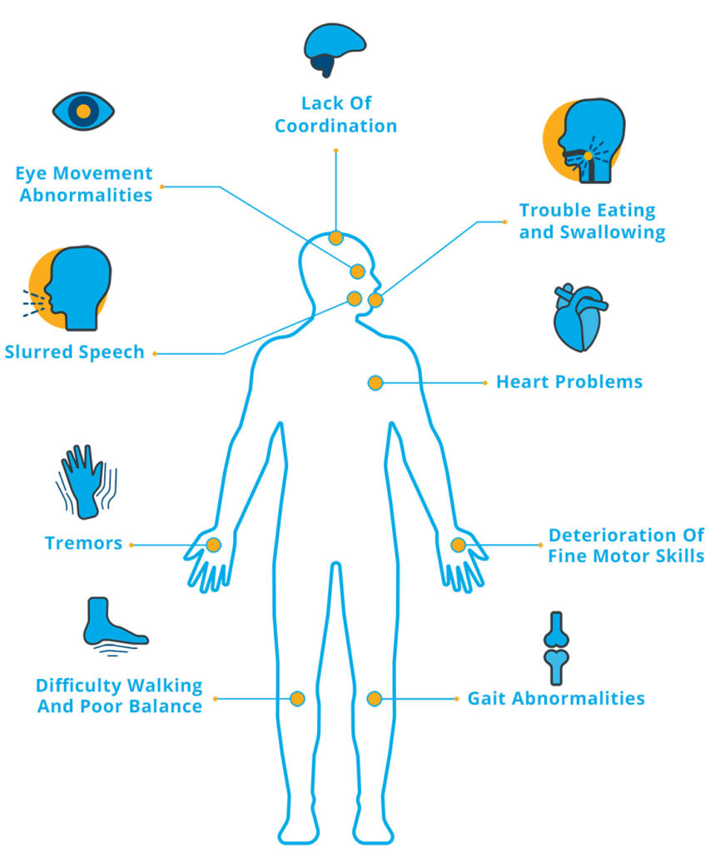
Assistive Technology and Ataxia
Ataxia has great variability in presentation
  Severity
  Age of onset
  Presentation
  Co-morbidities
Assistive technology recommendations will vary based on symptoms, environment, and use
2022 AAC
A Virtual Event
March 17-19
Image from the National Ataxia Foundation

Slide 7
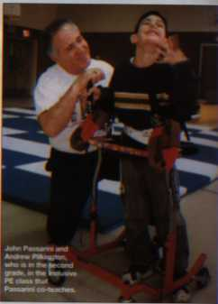
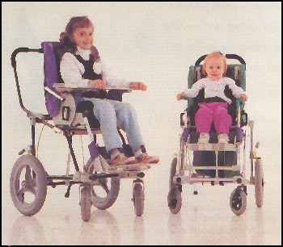
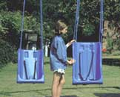
Mobility & Positioning
Wheelchairs
Standers
Walkers/Canes
Alternative positioning
Photos from Sunrise Medical
2022 AAC
A Virtual Event
March 17-19
Photo from Exceptional Parent magazine, Sept. 2000

Slide 8
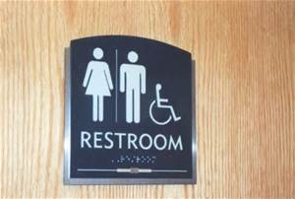
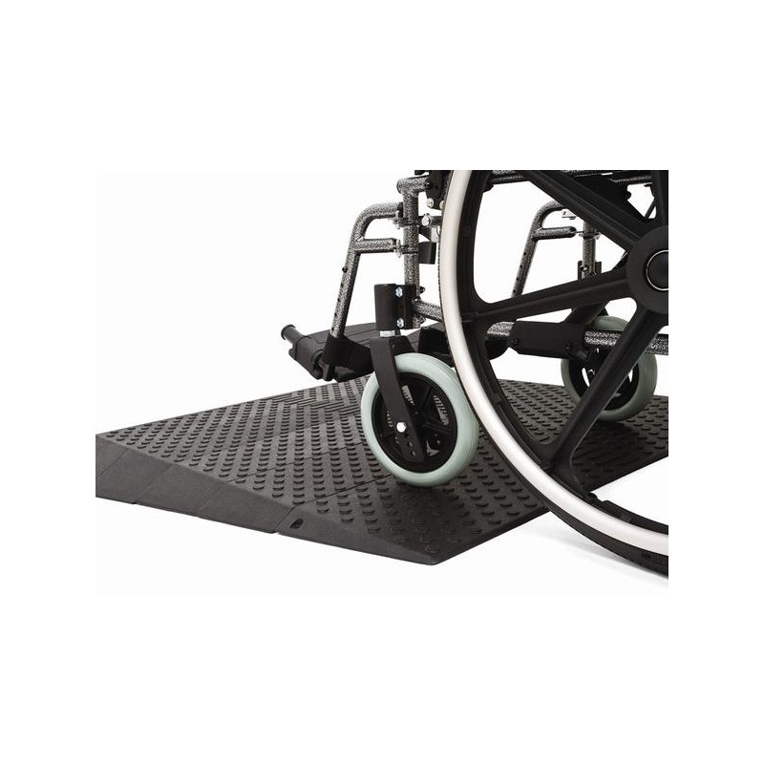
Architectural Adaptations
Citizens have a right to a physically accessible environment
PL 101-336- Americans with Disabilities Act
Modifications include:
  Ramps
  Braille signs
  Elevators
  Accessible restrooms
  Automated transportation announcements
  Accessible public transportation
2022 AAC
A Virtual Event
March 17-19

Slide 9
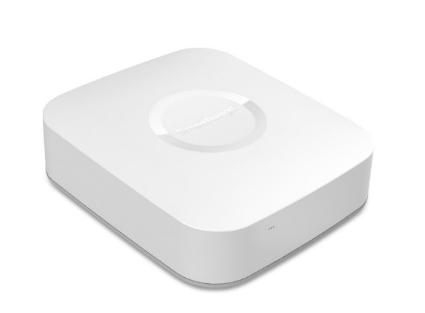
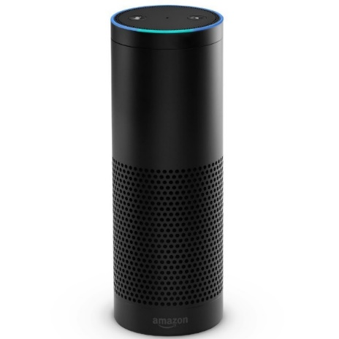
Home Automation
Automation can be used to increase independence through controlling a number of elements in homes:
  Thermostats for heating and air conditioning
  Security cameras and locks
  Lighting
  Home appliances
Samsung Smartthings Hub
2022 AAC
A Virtual Event
March 17-19
Amazon Echo

Slide 10
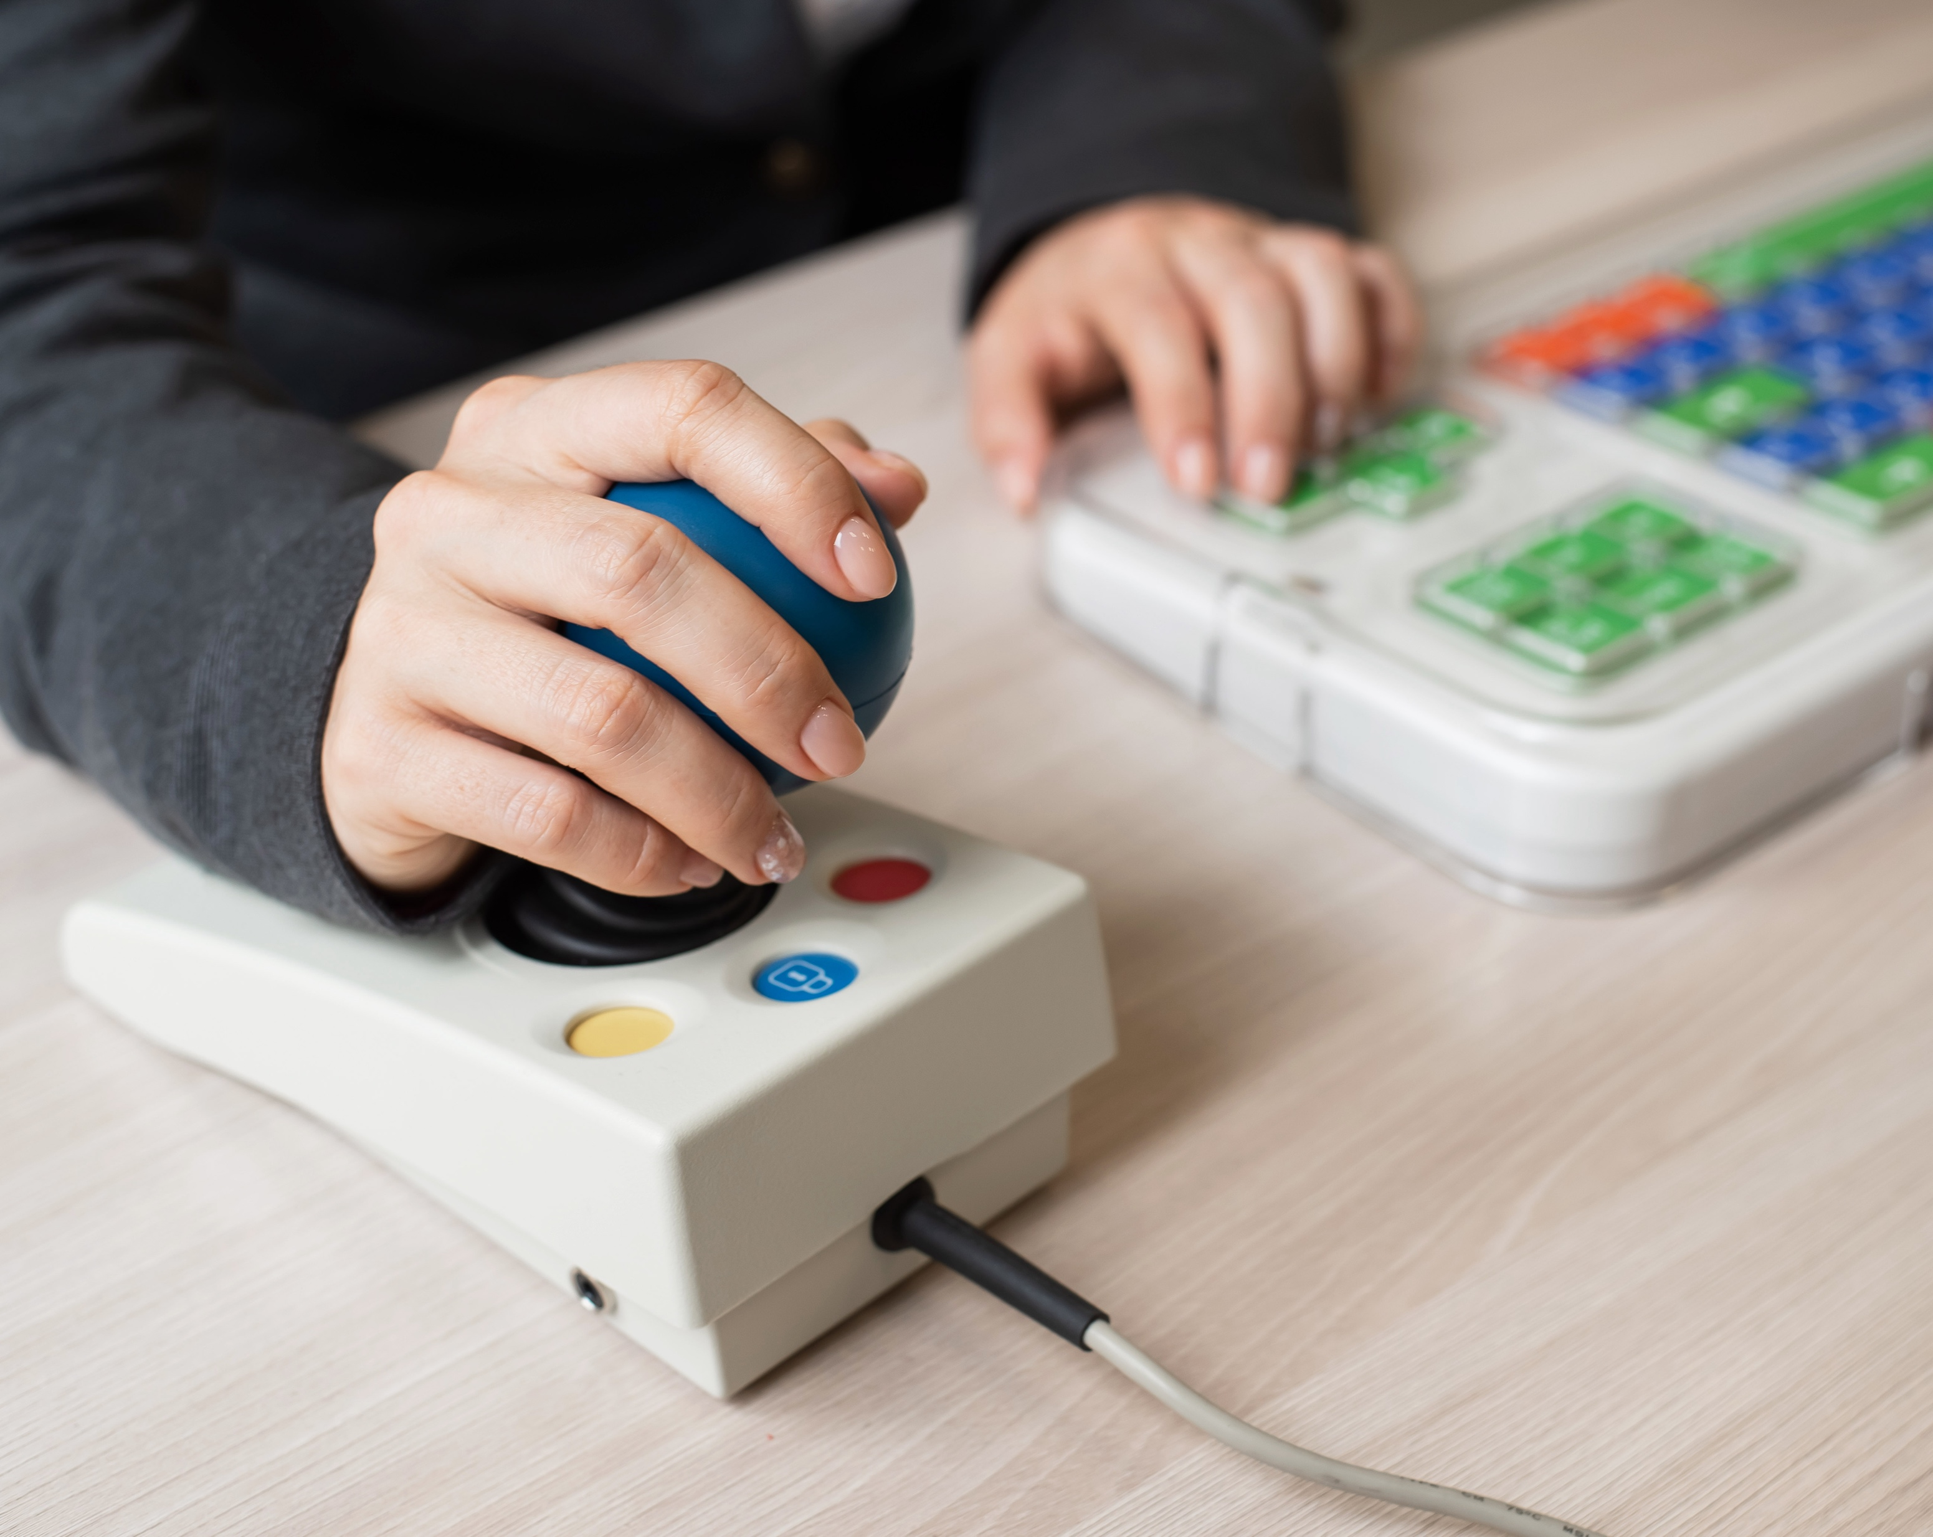
Computers & Technology
Alternative Computer Access
  Alternative keyboards
  On Screen Keyboards accessed via Touch, Switch, Eye gaze or Head Pointing
Accessible educational software
  Many popular applications are not universally accessible to individuals with disabilities.
  Educators should consider access issues when selecting software.
2022 AAC
A Virtual Event
March 17-19

Slide 11
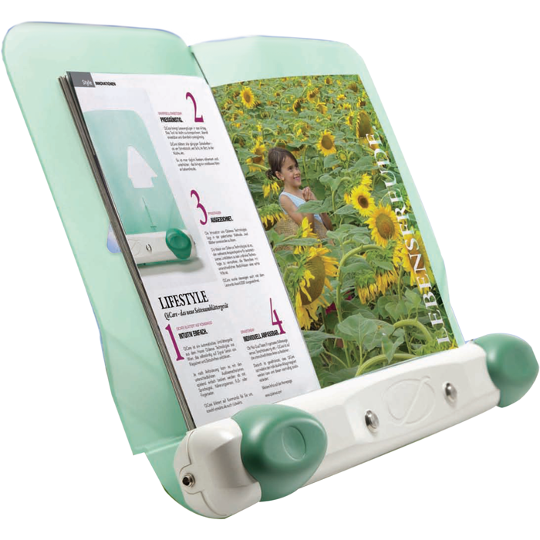
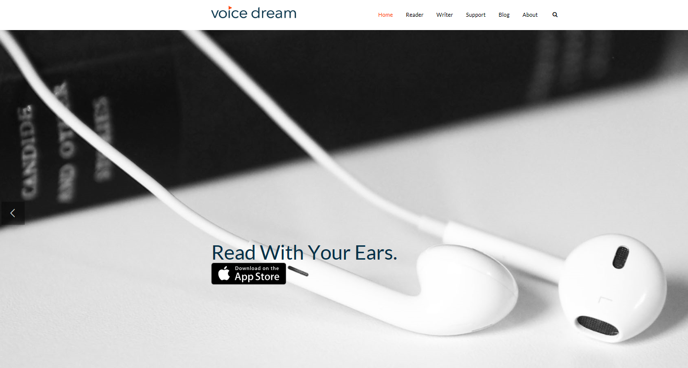



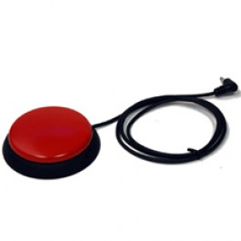
Adaptive Software
  Speech-to-Text
  Text-to-speech word processors
  Screen magnifier
  Screen reader
Adaptive tools
  Pen & paintbrush holders
  Page turners
  Captioned video
2022 AAC
A Virtual Event
March 17-19

Slide 12
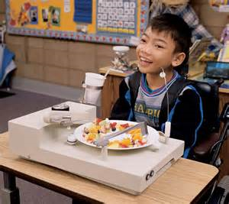
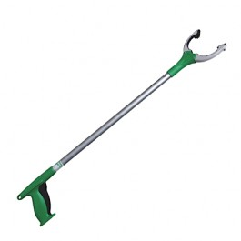
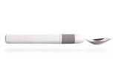
Activities of Daily Living
Self-feeder
  Photo from Winsford Feeder®
Computerized Utensils
  Photo from Liftware
Reacher
  Photo from Enablemart
2022 AAC
A Virtual Event
March 17-19

Slide 13
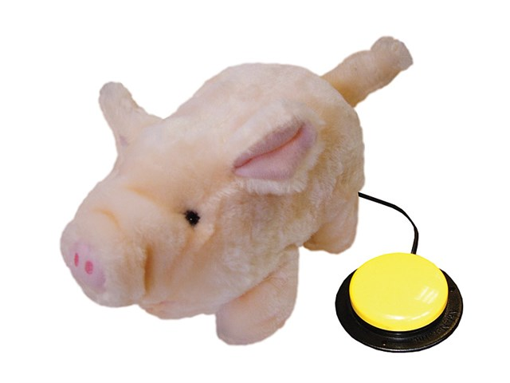
Switch Adapted Toys
A toy that has been modified so that a person with physical disabilities can operate it
Increases ability to independently play
Allows for a variety of switches to accommodate a range of physical limitations
2022 AAC
A Virtual Event
March 17-19

Slide 14
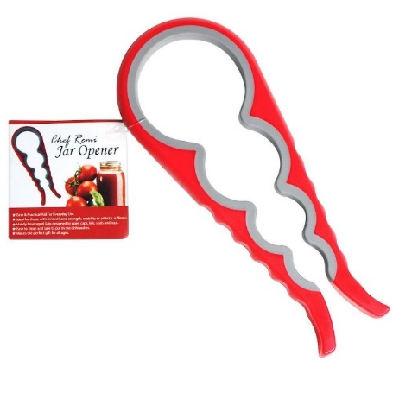
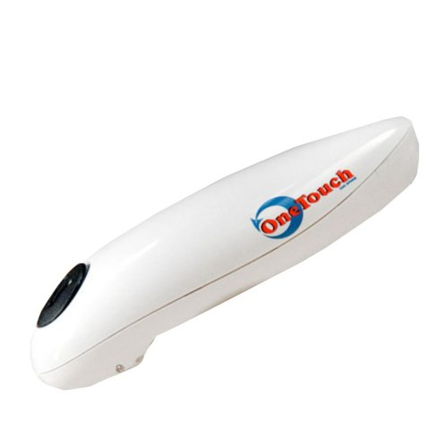
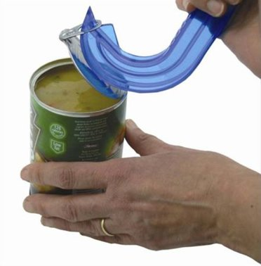
Activities of Daily Living
Items to assist with tasks impacted by decreased strength or muscle endurance:
Easy Safe Ring Pull Can Opener
One Touch Can Opener
Chef Remi Jar Opener
2022 AAC
A Virtual Event
March 17-19

Slide 15
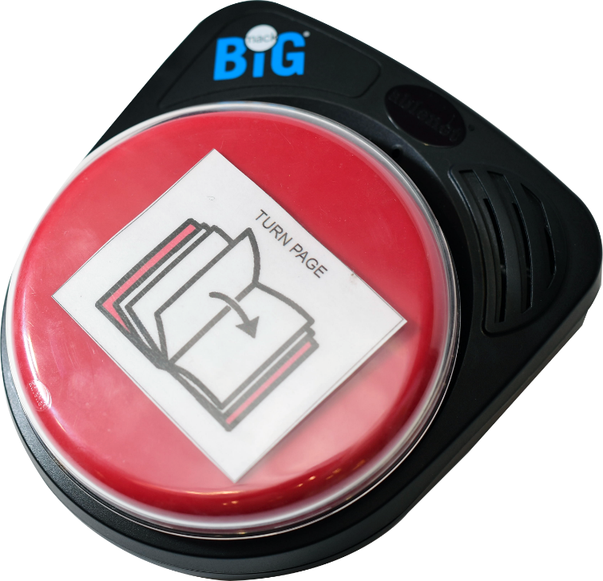

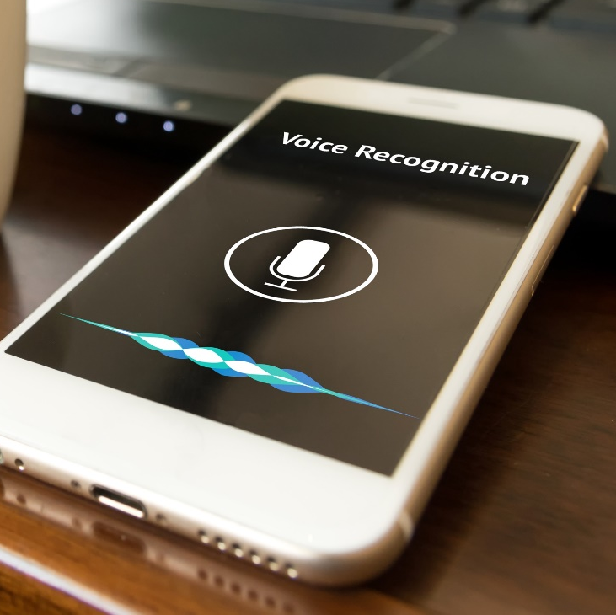
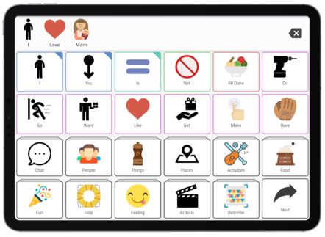

Augmentative and Alternative Communication (AAC)
“AAC incorporates the individual’s full communication abilities and may include any existing speech or vocalizations, gestures, manual signs, and aided communication.”
-National Joint Committee for the Communication Needs of Persons with Severe Disabilities
2022 AAC
A Virtual Event
March 17-19

Slide 16
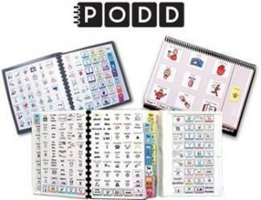
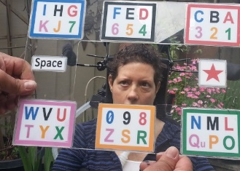
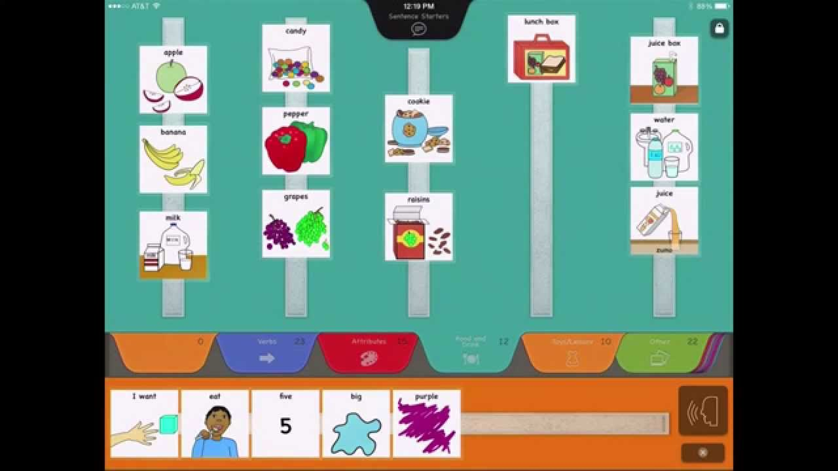
Low-Tech Communication Systems
2022 AAC
A Virtual Event
March 17-19

Slide 17
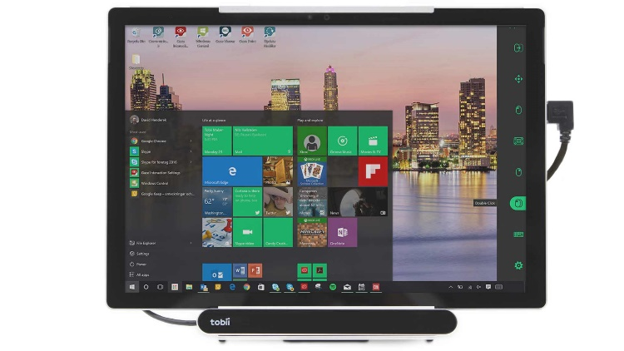
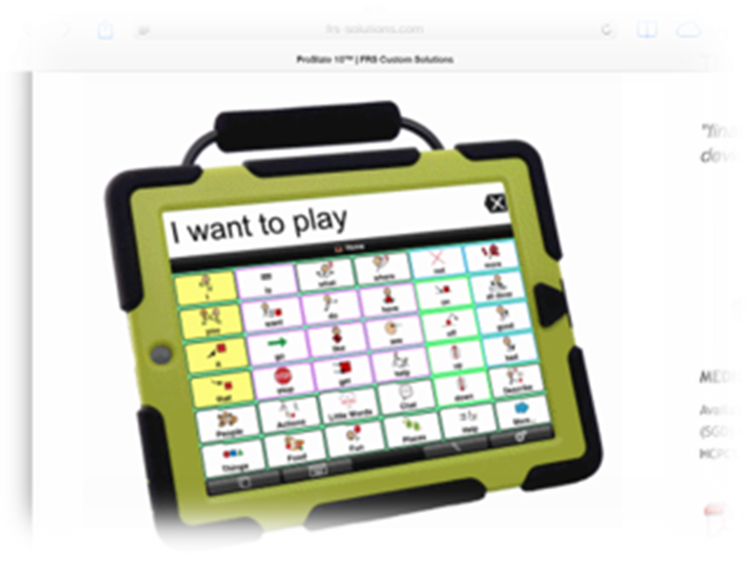
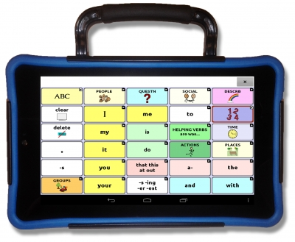
Speech Generating Devices (SGDs)
iPad & iPad Mini
Android Tablets (some AAC Apps available)
Dedicated Tablet Devices
Nova Chat 5, 8 & 10 (an Android Device)
Accent 800, 1000, 1400
Dynavox I-110
Lingraphica Touch Talk & Mini Talk
2022 AAC
A Virtual Event
March 17-19

Slide 18


Where Do I Go for Help with Assistive Technology?
For clinical services including assessments:
Speech-language pathologists
Physical Therapists
Occupational Therapists
For State Tech Act Services:
Every state and U.S. territory has a state tech act program
Services include demonstrations, loans, information & assistance, and trainings
All services are free
2022 AAC
A Virtual Event
March 17-19

Slide 19
Difficulty Swallowing and Ataxia
Each year 1 in 25 people in the US experience difficulty swallowing
Occurs more often in adults with neurological disorders
Impacts quality of life
May impact nutrition and hydration
May impact respiratory/lung health
While difficulty swallowing is seen in people with individuals that have ataxia, it remains mild to moderate
2022 AAC
A Virtual Event
March 17-19

Slide 20
Dysphagia
Difficulty swallowing is called dysphagia (dis-fay-juh).
2022 AAC
A Virtual Event
March 17-19

Slide 21
Symptoms of Dysphagia
drooling
food or liquid remaining in the mouth after the swallow;
inability to maintain lip closure, leading to food and/or liquids leaking from the oral cavity;
food and/or liquids leaking from the nasal cavity;
complaints of food "sticking";
complaints of pain when swallowing;
wet or gurgly sounding voice during or after eating or drinking;
coughing during or right after eating or drinking;
difficulty coordinating breathing and swallowing;
recurring aspiration pneumonia/respiratory infection and/or fever;
extra effort or time needed to chew or swallow;
changes in eating habits—specifically, avoidance of certain foods/drinks; and
weight loss or dehydration from not being able to eat enough.
2022 AAC
A Virtual Event
March 17-19

Slide 22
Help is Available!
Primary Care Providers
Neurology Care Providers
Ear, Nose, and Throat specialists
Speech and Language Pathologists
Dieticians
Other therapists of physical activities (e.g., physical and occupational therapists)
2022 AAC
A Virtual Event
March 17-19

Slide 23
Swallowing Tests
A primary care or specialty provider may send you to a speech – language pathologist that specializes in treating dysphagia.
The tests for swallowing may include eating and drinking foods while the clinician observes.
May be done in a clinic, with x-ray, or a scope
Results of swallowing tests give the clinician information on how to best treat dysphagia
2022 AAC
A Virtual Event
March 17-19

Slide 24
Swallowing Treatments
Speech – language pathologists work together with doctors and nurses to customize a treatment plan
Treatments may include posture changes while eating/drinking, adaptive tools to use during eating and drinking, exercise programs for the mouth and throat, and medications
It is recommended that people with ataxia and difficulty swallowing seek out speech – language pathologists that specialize in treating people with movement disorders
2022 AAC
A Virtual Event
March 17-19

Slide 25
Swallowing References
American Speech-Language-Hearing Association. (n.d.). Adult dysphagia. American Speech-Language-Hearing Association. Retrieved February 4, 2022, from https://www.asha.org/practice-portal/clinical-topics/adult-dysphagia/
Bhattacharyya, N. (2014). The prevalence of dysphagia among adults in the United States. Otolaryngology–Head and Neck Surgery, 151, 765–769
Keage, Delatycki, M. B., Gupta, I., Corben, L. A., & Vogel, A. P. (2017). Dysphagia in Friedreich Ataxia. Dysphagia, 32(5), 626–635. https://doi.org/10.1007/s00455-017-9804-4
Nagaya, Kachi, T., Yamada, T., & Sumi, Y. (2004). Videofluorographic observations on swallowing in patients with dysphagia due to neurodegenerative diseases. In Nagoya Journal of Medical Science (Vol. 67, Issues 1-2, pp. 17–23). Nagoya University School of Medicine.
Swan, Speyer, R., Heijnen, B. J., Wagg, B., & Cordier, R. (2015). Living with oropharyngeal dysphagia: effects of bolus modification on health-related quality of life—a systematic review. Quality of Life Research, 24(10), 2447–2456. https://doi.org/10.1007/s11136-015-0990-y
Rönnefarth, Hanisch, N., Brandt, A. U., Mähler, A., Endres, M., Paul, F., & Doss, S. (2020). Dysphagia Affecting Quality of Life in Cerebellar Ataxia—a Large Survey. Cerebellum (London, England), 19(3), 437–445. https://doi.org/10.1007/s12311-020-01122-w
Vogel, Fendel, L., Paige Brubacher, K., Chan, V., & Maule, R. (2015). Dysphagia in spinocerebellar ataxia and multiple system atrophy-cerebellar. Speech, Language and Hearing, 18(1), 39–43. https://doi.org/10.1179/2050572814Y.0000000047
2022 AAC
A Virtual Event
March 17-19

