Slide 1



Mobility Devices
Jennifer Keller, PT, MS
Kennedy Krieger Institute
Johns Hopkins
Physical Medicine and Rehabilitation
Jennifer Millar, MSPT
Johns Hopkins
Ataxia Center
Physical Medicine and Rehabilitation

Slide 2



DISCLAIMER
The information provided by speakers in any presentation made as part of the 2023 NAF Annual Ataxia Conference is for informational use only.
NAF encourages all attendees to consult with their primary care provider, neurologist, or other healthcare provider about any advice, exercise, therapies, medication, treatment, nutritional supplement, or regimen that may have been mentioned as part of any presentation.
2023 Annual Ataxia Conference
March 30 – April 1, 2023
Planet Hollywood
Las Vegas, NV
Products or series mentioned during these presentations does not imply endorsement by NAF

Slide 3
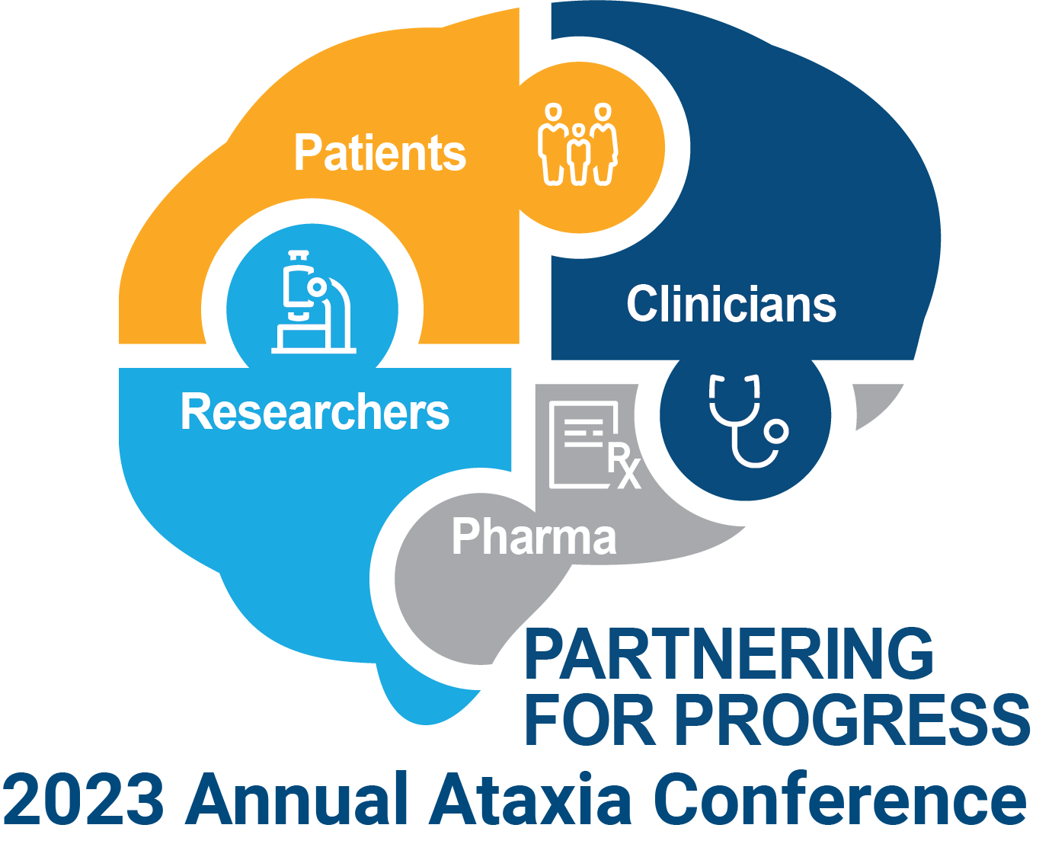
PRESENTER DISCLOSURES
Jennifer Keller, MS, PT
Jennifer Millar, MSPT
The following personal financial relationships with commercial interests' relevant to this presentation existed during the past 12 months:
No relationships to disclose or list
Products mentioned during these presentations are for example purposes and do not imply endorsement by NAF or the presenters

Slide 4
Learning Objectives
Discuss common impairments
Discuss compensatory strategies:
  Safe mobility strategies
  Mobility devices
    Orthoses
    Walkers
    Wheelchairs
  Adaptive equipment
  Safety considerations

Slide 5
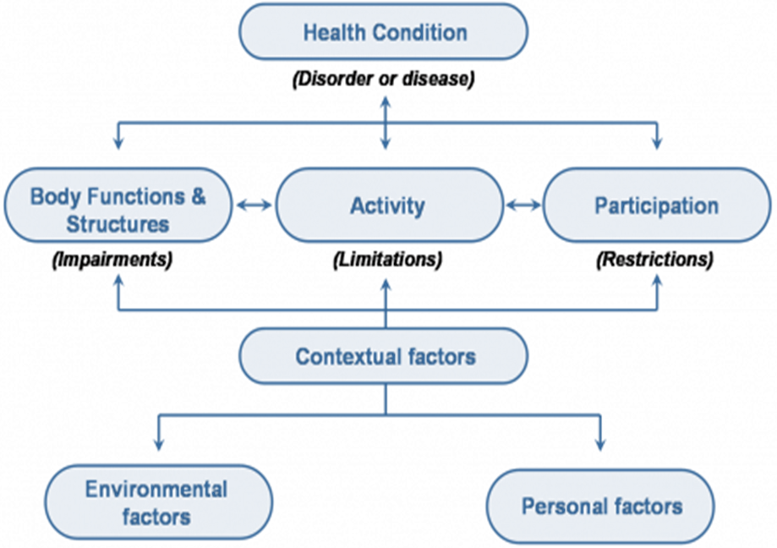
International Classification of Functioning (ICF)
Impairments
  Limb Movement
    Dysmetria
    Dyssynergia
    Tremor
  Speech
    Dysphagia
    Dysarthria
  Ocular motor
  Sensory
  Non-motor symptoms
    Working memory, fatigue
Limitations
  Walking safely in home or community.
  Transfers.
  Walking and turning without falling.
  Blurry or bouncy vision, reading ability.
Restrictions
  Working
  Playing with kids or grandkids.
  Maintaining a clean house.
A care model used by the rehab/medical team aimed to optimize patients’ participation in life:
Progressive or Non-progressive
Ataxia

Slide 6
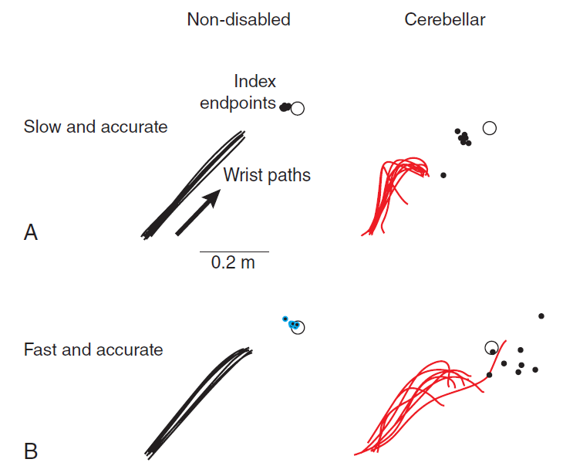
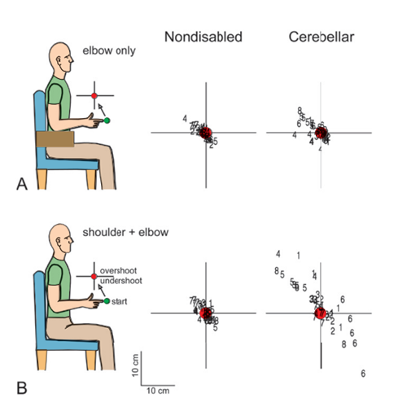
Movement impairments
Dysmetria:
Impaired ability to properly scale a movement
Dyssynergia:
Impaired ability to simultaneously coordinate movement from multiple joints
Figures from Morton SM, Keller JL, Bastian AJ; Umphred's Neurological Rehabilitation
7th Edition 2019, Ch19, Movement Dysfunction Associated with Cerebellar Damage
eBook ISBN: 9780323641944

Slide 7
COMPENSATORY STRATEGIES
General strategies for safe navigation
Mobility and transfer tips

Slide 8
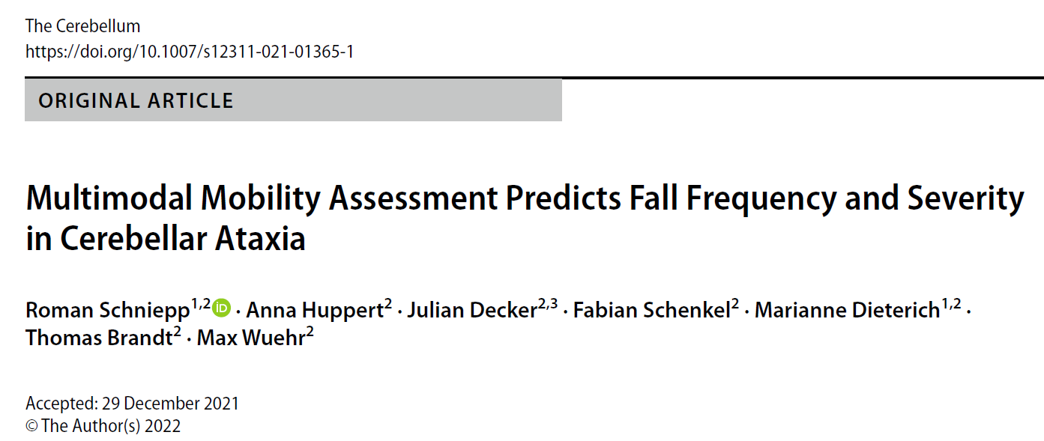
Patients’ fall status and frequency could be reliably predicted (78% and 81% accuracy, respectively), primarily based on falls history.
Fall history reliably informs of individuals’ general fall risk in cerebellar ataxia.
Clinical scoring and instrument-based mobility measures provide further in-depth information on the risk of recurrent and injurious falling.

Slide 9
Safe mobility strategies

Slide 10

Compensatory strategies
Move slowly
Simplify movements
  Make sure you’re stable before taking a step.
Do one thing at a time
  Avoid multi-tasking.
    Often cognition helps motor function.
Give yourself permission to accept help.

Slide 11
Mobility and Transfer Tips

Slide 12
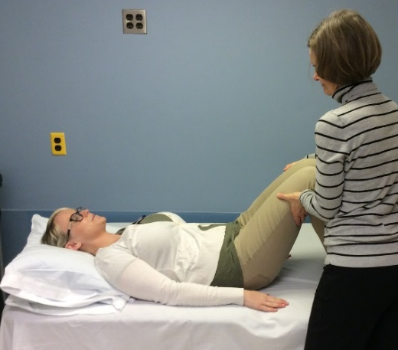
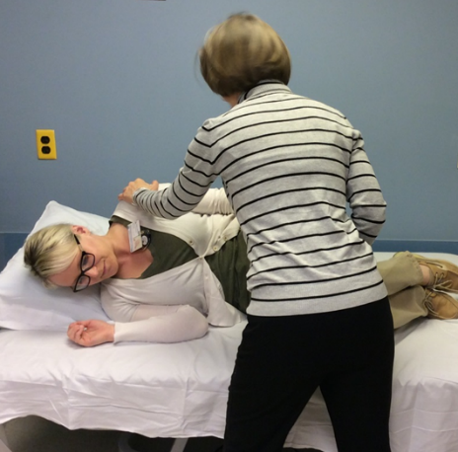
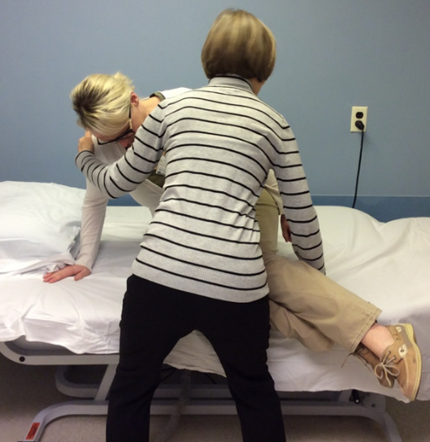
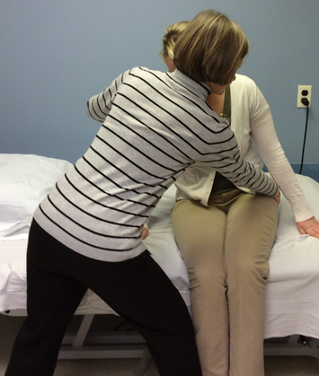
ASSISTED BED MOBILITY
Step 1
Step 2
Step 3
Step 4

Slide 13
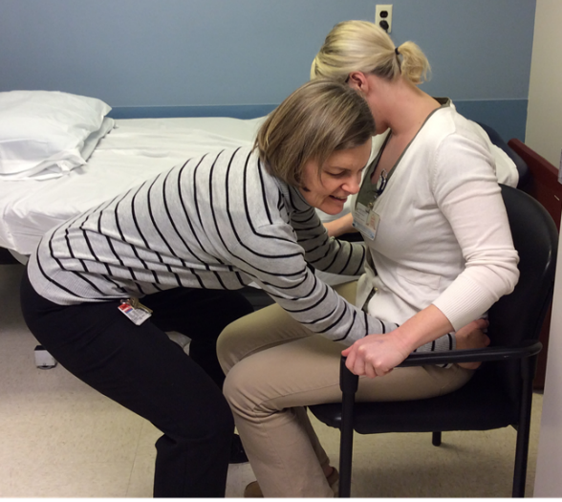
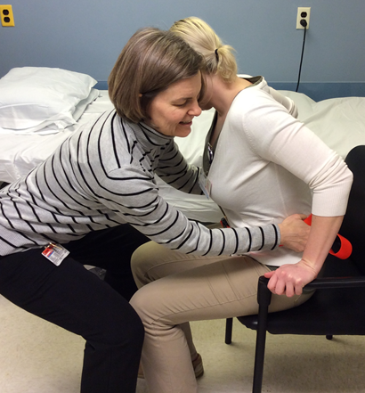
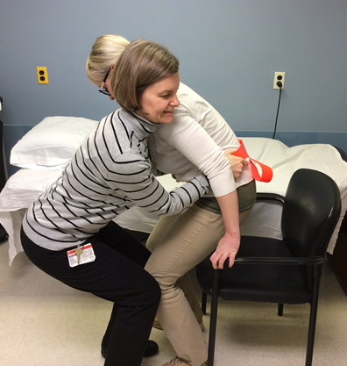
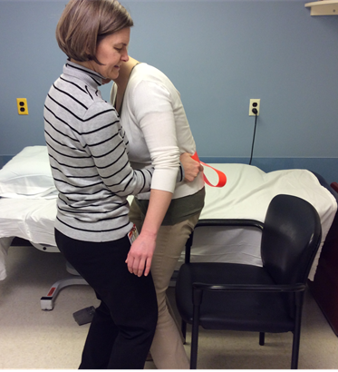
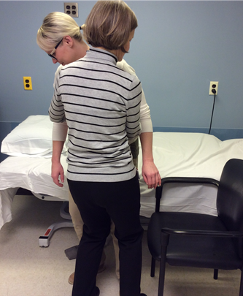
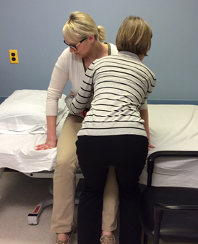
ASSISTED STAND PIVOT TRANSFERS
Step 1
Step 2
Step 3
Step 4
Step 5
Step 6

Slide 14
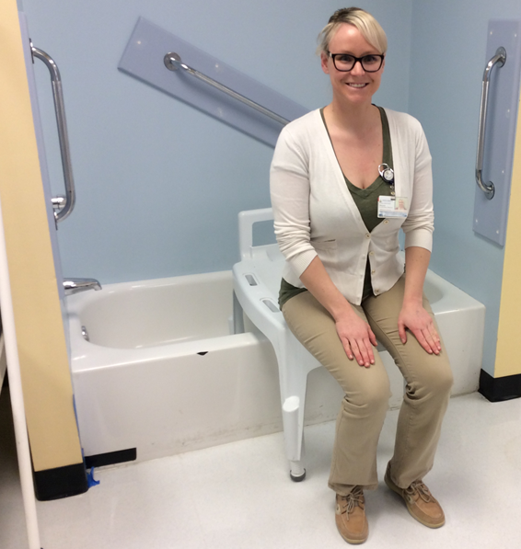
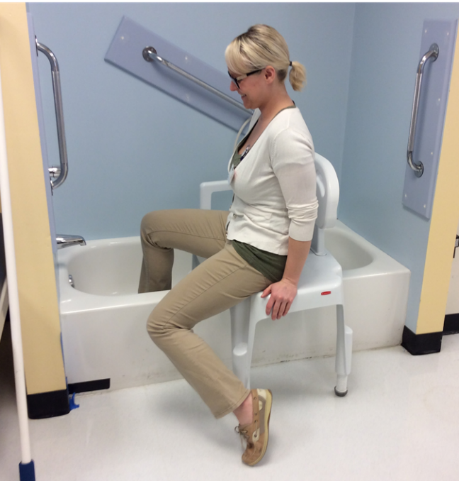
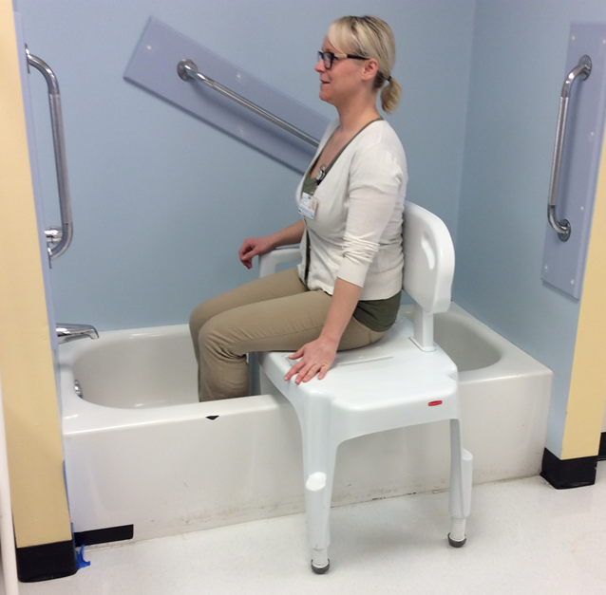
TUB TRANSFERS
Step 1
Step 2
Step 3

Slide 15
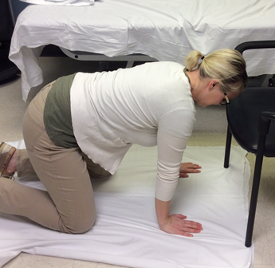
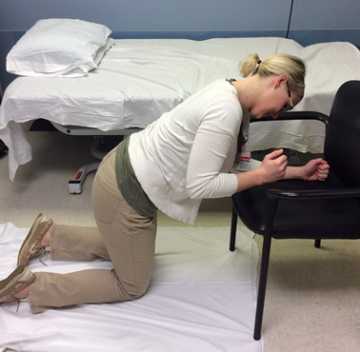
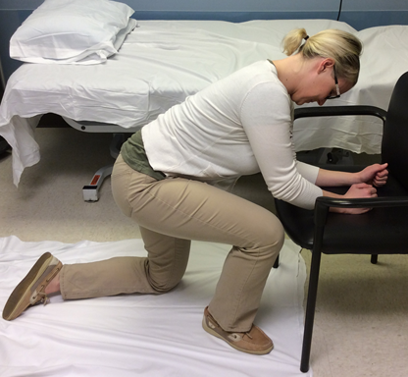
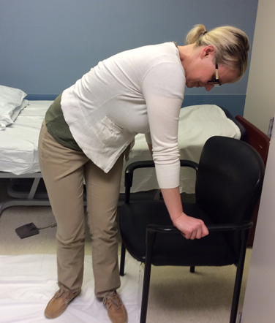
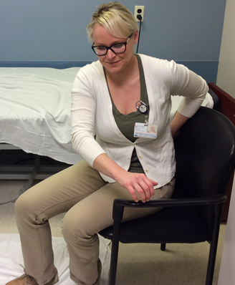
TRANSFERS FROM FLOOR
Step 1
Step 2
Step 3
Step 4
Step 5

Slide 16
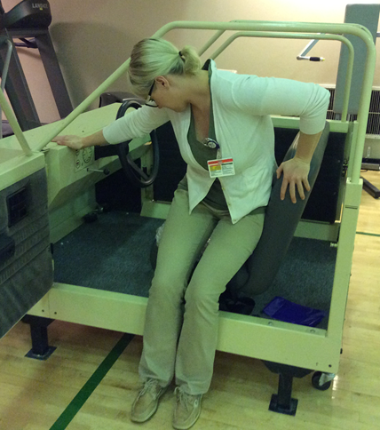
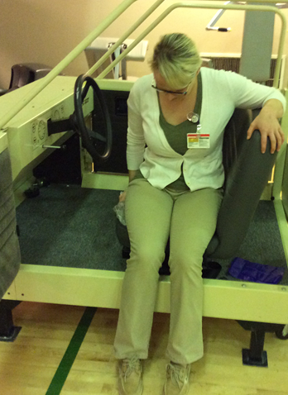
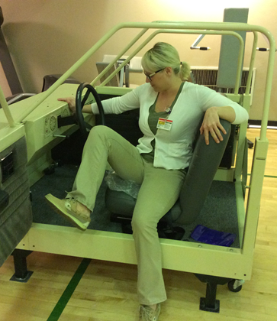
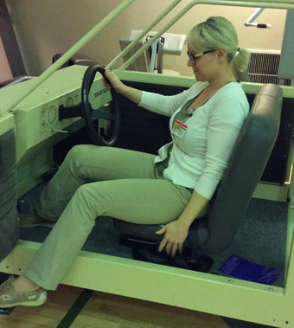
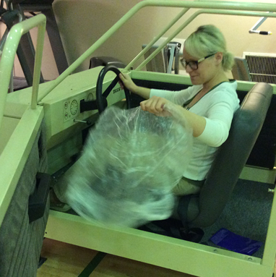
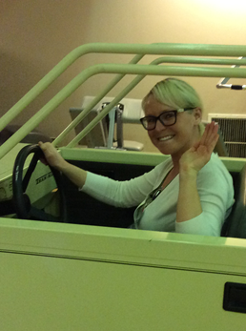
TRANSFERS IN AND OUT OF CAR
Step 1
Step 2
Step 3
Step 4
Step 5
Step 6

Slide 17
Mobility and Adaptive Devices
*The following products mentioned does not imply endorsement by NAF or the speakers.

Slide 18
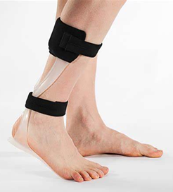
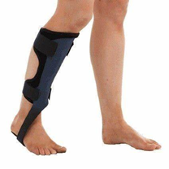
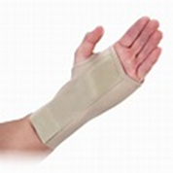
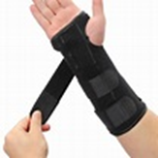
Devices to help simplify movement
Ankle Foot Orthoses (AFOs)
Wrist splints
These devices minimize degrees of freedom at a single joint.
(not commonly recommended)

Slide 19
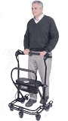
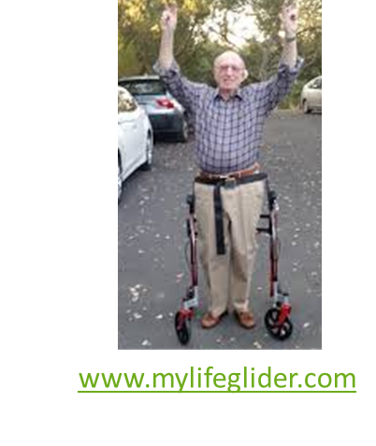
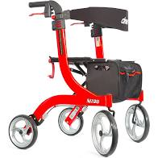
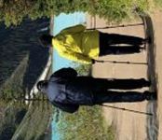

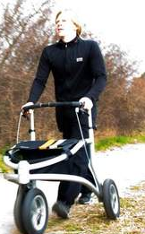
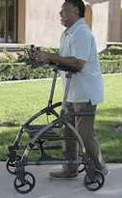
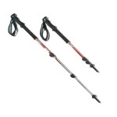
Mobility device examples
  Adaptive equipment.
  Assistive devices.
  Home modifications.
www.ustep.com
Drive Nitro
Rollator Walker
*Do work with a therapist to determine an appropriate walking device that's right for you.
** Do consider demo’ing the available devices at your local medical supply store that are NA in the therapy clinic.
https://www.trionic.us/
https://tryupwalker.com/

Slide 20
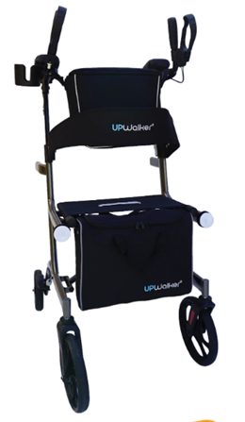
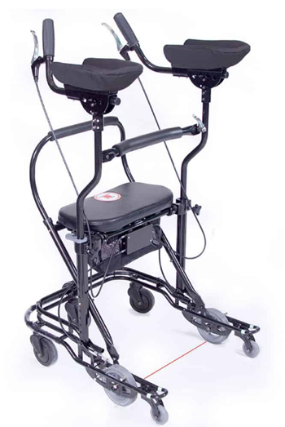
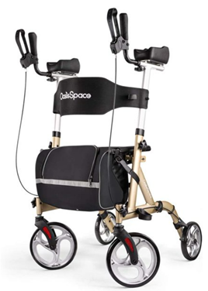
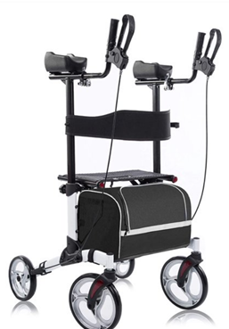
Upright/Platform walker examples
Platform U-Step
www.ustep.com
Oasis space Armrest Walker
Upwalker.com
Beyour Walker
$250
Option for pneumatic tires
$695
Accessory options
$834.00 – $1,063.00
Heavy duty
$150-$190

Slide 21
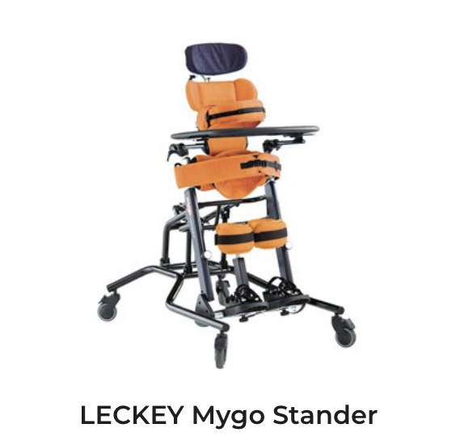
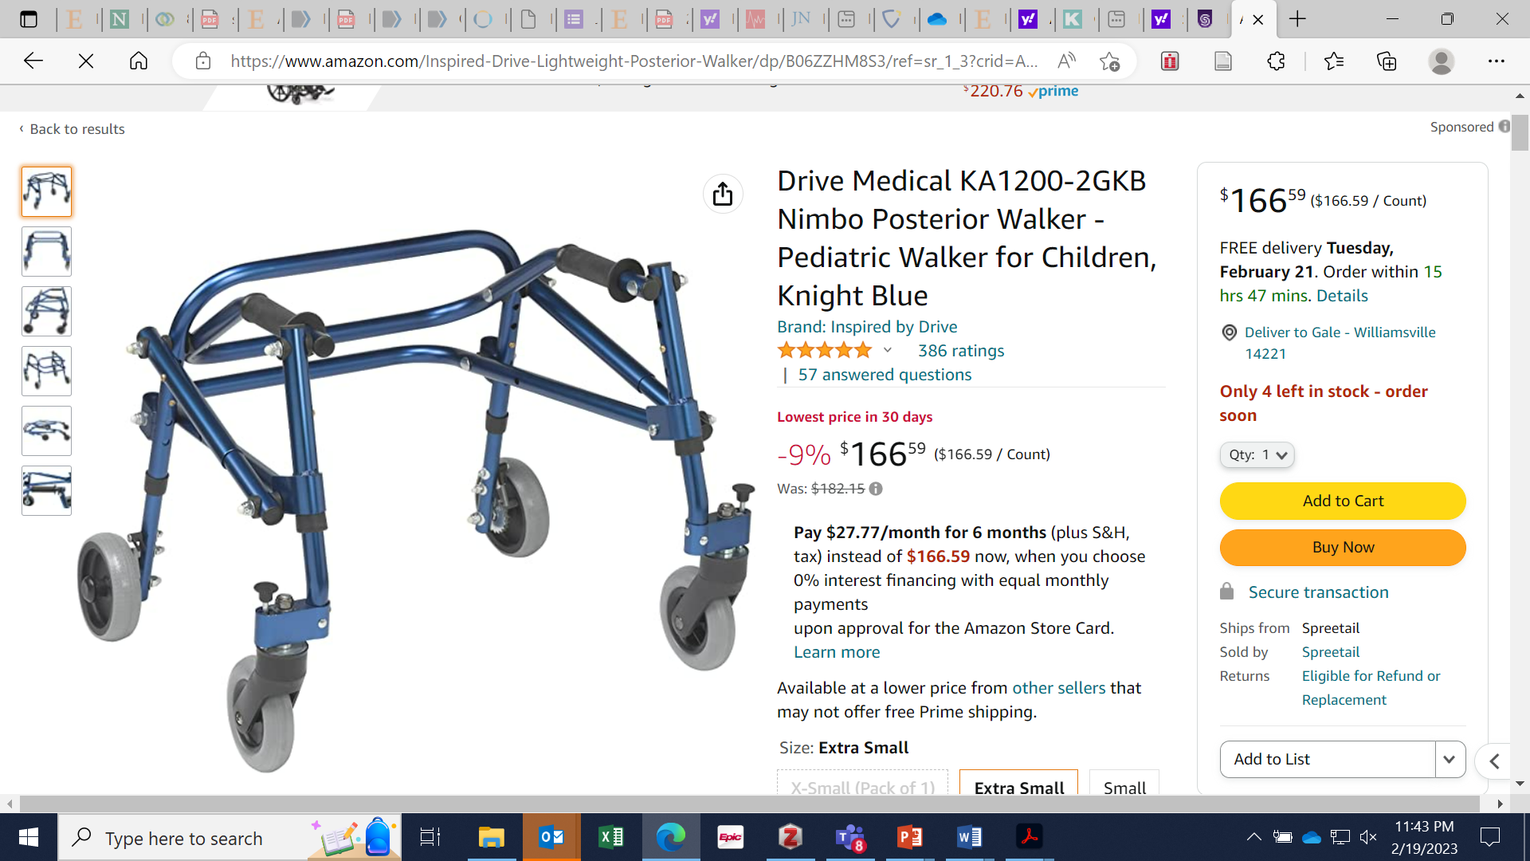
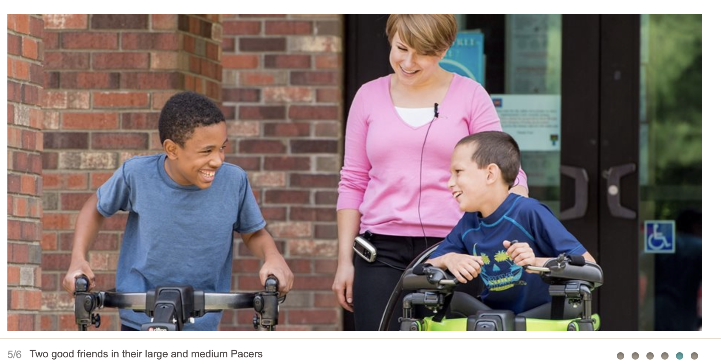
Examples of mobility devices for children
Posterior walkers
Gait trainers
  Crocodile walker
  Kaye walker
  Klip walker
Standers
www.rifton.com

Slide 22
Wheelchairs
Manual options
Power options
Lightweight vs heavy duty
Foldable vs Rigid
Ergonomic
Positioning
  Tilt and space
Transport/travel chairs
Foldable vs Rigid
Lightweight vs heavy duty
Ergonomic
Positioning
  Tilt in space
  Stand assist

Slide 23
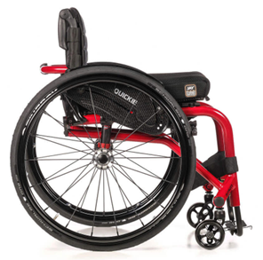
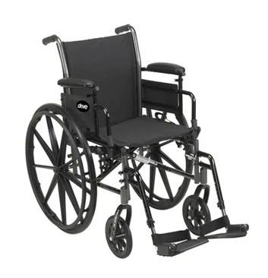
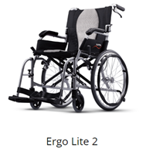
Manual Wheelchair Examples
Ergonomic Rigid
Basic Manual
Foldable
Lightweight Ergonomic, Foldable
Quickie Nitrum
www.quickie-wheelchairs.com
DRIVE MEDICAL (Model No. K3)
Cruiser III
$235
www.drivemedical.com
www.karmamedical.com

Slide 24



Power Wheelchair Examples
Lightweight Foldable Electric Wheelchair - EZ Lite Cruiser ®
https://www.ezlitecruiser.com
$2,600
www.pridemobility.com
www.quantumrehab.com

Slide 25
Wheelchair accessories
Cushion options:
  Eggcrate
  Wedge
  Gel
  Foam
  Air (Roho)
Back supports:
  Sling
  Solid (Foam vs Gel)
Leg rests:
  Elevating
  Swing away
  Heel loops
Holders for:
  Cups
  Cell phone
  Walker or canes
  Backpacks
    adaptive-packs (jansport.com)

Slide 26
Steps for obtaining a wheelchair
Often insurance companies follow Medicare guidelines.
(each insurance is a little different)
Requirements for manual/power mobility:
  A PT/OT wheelchair evaluation (usually with a vendor present).
  A face-to-face appointment with your doctor:
    The face-to-face appointment should reflect the need for manual/power mobility.
    MD documentation must also indicate that you are unable to functionally use any other assistive device safely in the home.
    If the medical record indicates that you are walking in the home, a manual or power wheelchair will likely be denied.
  Wheelchair vendors take care of obtaining all the required documentation and communicating with the doctor’s office regarding what documents are needed.

Slide 27

Scooters
Options:
  3 or 4 wheeled
  Foldable vs Heavy Duty
  Travel vs general mobility
Often an out-of-pocket cost.
www.pridemobility.com/pride-mobility-scooters/
www.bajamobility.com

Slide 28



Torso weighted vest
Weights strategically placed to address postural control impairments
1/8, 1/4, 1/2 pound increments.
Publications, Presentations, Grants and Research - BalanceWear™ (motiontherapeutics.com)
Cindy Gibson-Horn, PT (Oakland, CA)
info@motiontherapeutics.com

Slide 29

When we know weights don't work:
Use of external limb weights to control acceleration/ inertial forces has been proven ineffective in people with degenerative cerebellar ataxias.
Use of limb weights for strength training is fine!
Zimmet AM, Cowan NJ, Bastian AJ. Patients with Cerebellar Ataxia Do Not Benefit from Limb Weights. Cerebellum. 2019;18(1):128-136. doi:10.1007/s12311-018-0962-1

Slide 30
Safe Environment Considerations

Slide 31




Make your home a safe environment…
Consider installing handrails or grab bars.
Choose a chair you know you'll be able to get out of!
  Adaptive equipment.
  Assistive devices.
  Home modifications.
Assess for fall hazards
  Remove area rugs
  Clear power cords
  Use night lights

Slide 32



Adaptive equipment for the home
Bed Rails
Couch grab bars

Slide 33






Adaptive equipment for the kitchen
Weighted utensils
No spill cups
Food chopper
Dycem

Slide 34





Adaptive equipment for the bathroom
Tub Transfer Bench
Grab bars (portable or mounted)
Electric toothbrush
Toilet frame

Slide 35



Home Technology
Make your life easier….
Motion Sensor Lighting
Smart Lighting:
Controlled by phone, Alexa Echo Dot or
Google home system
Let a remote vacuum help conserve your energy!
Phillips Hue System:
https://www2.meethue.com/

Slide 36




Establish a fall safety plan…
Apple Watch
How to transfer from the floor:

Slide 37
Questions?

Slide 38
Break Time...
Let's Move!

Slide 39

Hand to opposite knee tap
Sit at edge of chair
Hold both hands up overhead.
March in place.
  Then, tap your hand to your opposite knee.
Progression:
  Look at your hand as you reach across your body to tap your opposite knee.

Slide 40

Side to side reach
Sit at the edge of your chair with your arms out to the side.
Look at one hand.
Next, lean your body to the side while maintaining your gaze on your hand.
Hold 5 seconds.
Return to center.
Switch.

Slide 41

Row the Boat
Sit at the edge of your chair.
Lean your body back with your hands in front. Avoid touching the back of the chair.
Then lean your body forward, with your hands back, head up.
Repeat.

Slide 42

V-Sit
Sit at the edge of your chair.
Cross your arms.
Lean back without touching the back rest and hover your feet off the ground.
Try to remain balanced and hold 10 seconds.

Slide 43
Rehabilitation Strategies
Jennifer Keller, PT, MS
Kennedy Krieger Institute
Johns Hopkins - Department of
Physical Medicine and Rehabilitation
Jennifer Millar, MSPT
Johns Hopkins Ataxia Center
Johns Hopkins - Department of
Physical Medicine and Rehabilitation

Slide 44
Learning objectives
Discuss theories of the role of the cerebellum and motor control
Discuss current ataxia rehab evidence in the literature
Discuss motor learning theories in ataxia
Provide examples of exercises
Discuss alternative exercises including Tai Chi
Discuss goal setting
Discuss the role of physical therapy and rehabilitation

Slide 45

Motor control theories
Motor behaviors can occur along a continuum of control, ranging from feedback to feedforward.
Feedback control, involves modification of the ongoing movement using information from your vision, vestibular, sensory systems.
Allows for accuracy and error correction (a slow process).
Feedforward movements are made without the online use of sensory feedback evolving during the action.
Requires an internal model for accuracy (a fast process).
Both these strategies are likely utilized for optimal motor control.
Seidler RD, Noll DC, Thiers G. Feedforward and feedback processes in motor control. NeuroImage. 2004;22(4):1775-1783. doi:10.1016/j.neuroimage.2004.05.003

Slide 46
Motor control:
Feedforward motor control: In theory, the brain uses an internal model to predict the consequences of motor commands before sensory feedback arrives.
Time-delayed sensory feedback can then be used to correct for the unexpected (e.g., external perturbations).
You do utilize both types of motor control mechanisms in every-day movement with the help of your cerebellum.
Zimmet A et al DOI: 10.7554/eLife.53246

Slide 47
Motor Learning
Cerebellar dependent motor learning is driven by errors directly occurring during the movement, i.e., feedforward motor learning.
Example of a "sensory prediction error" during a reaching task:
“How far am I from where I predicted I would be?”
Example of a type of feedback error for motor learning:
  “How far am I from the target.”
Morton SM, Keller JL, Bastian AJ; Umphred's Neurological Rehabilitation​
7th Edition 2019, Ch19, Movement Dysfunction Associated with Cerebellar Damage​
eBook ISBN: 9780323641944

Slide 48
Role of the cerebellum
Coordination center for movement
Timing of movement
Motor control
Adaptation of movement and motor learning
Morton SM, Keller JL, Bastian AJ; Umphred's Neurological Rehabilitation
7th Edition 2019, Ch19, Movement Dysfunction Associated with Cerebellar Damage
eBook ISBN: 9780323641944

Slide 49




Motor Learning
Reinforcement
Step by step
Mass practice
Error-based

Slide 50
Type of movement disorder –
Important for guiding treatment
Think of a car having trouble starting, and maintaining speed
  Parkinson’s Disease
  Multi System Atrophy-P
  Supranuclear palsy (PSP)
Think of a car drive having trouble driving straight, or driving too fast.
  Cerebellar ataxia
  Multi System Atrophy-C
“High amplitude, BIG, movement”
External cueing to help jump start a dimmed “internal go” signal.
Balance training
“Slow and soft” movement
“Quality, not quantity”
Balance training

Slide 51
Evidence in the Literature
Efficacy of Exercise and Rehabilitation in Ataxia

Slide 52

Results:
15/17 studies revealed
  significant improvements in at least 1 outcome measure:
  Ataxia symptoms
  Balance
  Function
  Gait
1010 studies identified
Treatments:
Balance and coordinative training
Multi D inpatient rehab
Cycling regime
Balance training with feedback
Treadmill training
17 studies reviewed
292 subjects
148 autosomal dominant
85 autosomal recessive
27 idiopathic ataxia
28 sporadic adult onset ataxia
Conclusion:
Consistent evidence that rehabilitation improves function, mobility, ataxia, and balance in
genetic degenerative ataxia.

Slide 53


Subjects:
  Cerebellar ataxia = 10
  Sensory ataxia = 6
Frequency/intensity
  4 week program:
    Lab/clinic: 3 days/week (1 hour)
    Home: 1 hour/day
    10 hours/week training total
Exercises/training:
  Standing balance
  Dynamic balance
  Whole body coordination
  Reactive training
  Tasks challenged all sensory input systems required for motor learning (visual, vestibular, somatosensory)
Ilg, et al 2009, DOI: 10.1212/WNL.0b013e3181c33adf

Slide 54


DOI: 10.1212/WNL.0b013e3181c33adf
Results:
C=Cerebellar ataxia
A= Afferent (sensory) ataxia
Cerebellar ataxia subjects showed improvements in walking speed,
variability of steps, body sway, dynamic balance to a level of significance(*)
after 4 weeks of training and maintained those improvements.
People with sensory ataxias did not improve gait and balance to a level of significance.

Slide 55

6 week home exercise program study for people with cerebellar dysfunction
14 participants performed balance training in sitting and standing.
Dosage: 3-5 times/week for 20 min x 6 weeks.
Intensity:
Patients were told to aim for a level 7-8/10 challenge meaning 70-80% level of balance difficulty, 0%=Feeling stable; 100% =falling.
Those who challenged themselves more, despite exercising less frequently, showed greater change in walking speed.
Those who exercised more often, yet didn’t challenge themselves, did not improve as much.
Keller and Bastian 2014, DOI: 10.1177/1545968314522350

Slide 56

Participants who rated the balance exercises more challenging demonstrated higher improvements in walking speed.
Training: Balance tasks (sitting or standing).
Outcomes: Walking measures.
Minimum balance training frequency
*with significant change in gait measures:
20 minutes, 4 times per week.
….at an intensity level that was challenging,
yet do-able/safe.
Keller and Bastian, 2014: DOI: 10.1177/1545968314522350

Slide 57

Results:
  Home balance training can improve walking speed.
  Amount of improvement correlated with intensity/self-perceived level of challenge.
Intensity matters!
Why?

Slide 58


Motor Learning
Improvements may be explained by reinforcement feedback motor learning.
Motor exploration is required. (Thierren, 2016)
• Examples:
-Learning to swing
-Learning to play shuffleboard
•Future research:
-Motor learning preferences
Adaptation is impaired…

Slide 59

Aerobic training:
Columbia University
Intervention: Stationary biking
Frequency: 5 days per week for 4 weeks
Intensity: > 60-65 rpms
Duration: > 30 minutes
Results: SARA scores improved 2.1 points

Slide 60

Aerobic training:
Single-center, assessor-blinded, randomized controlled trial (Columbia University)
Subjects: A variety of cerebellar ataxia patients, including MSA-C
Aerobic training (n=19) 30 min (at target heart rate), 5x/week x 6 months
Balance training (n=17) 30 min, 6 tasks, 5 min each, 5x/week x 6 mo (challenging)
Results: Improvements in SARA total scores among both groups:
  Aerobic group: Improvement of 1.9 SARA points (SD 1.62)
  Balance group: Improvement of 0.6 SARA points (SD 1.34)
    SARA balance subscores improved more in balance group

Slide 61
Relationships of ocular motor symptoms, eye/head coordination, and activity in ataxia
Report of oscillopsia in ataxia patients correlates with activity, not vestibular ocular reflex gain
Millar, Schubert, 2021 J. Vestibular Research doi:10.3233/VES-210106

Slide 62
Individuals with ataxia reporting oscillopsia (bouncy vision with head movement) have symptoms comparable to those of bilateral vestibulopathy.
Oscillopsia Functional Index (OFI) scores:
(mean ± 1 standard deviation)
Ataxia (68.4± 28.7) (red line)
Bilateral vestibulopathy (65.9 ± 7.7) (green)
Healthy controls (12.0 ± 1.6) (blue line)
OFI BVH and healthy control data per Anson et al, 2018.
*The higher symptoms of oscillopsia, the slower the walking speed. (r=-0.56, p<0.05)
Millar, Schubert, 2021 J. Vestibular Research DOI:10.3233/VES-210106
Notes:
Mean and 1 SD of Oscillopsia Functional Index (OFI) scores in cerebellar ataxia (solid line) are similar to those reported in bilateral vestibular hypofunction (dashed line).

Slide 63

Eye/head coordination (vestibular ocular reflex gains) is impaired in ataxia patients versus healthy controls:
The Box and whiskers plot indicate a range of VOR gain values of all 6 semicircular canal (SCC) planes.
White boxes = 40 healthy controls.
Gray boxes = 19 ataxia patients.
Left (L), Right (R) Horizontal (H)
Anterior (A) Posterior(P) canal planes
*Interestingly, eye/head coordination results were not correlated with severity of symptoms of blurry/bouncy vision.
Millar, Schubert, 2021 J. Vestibular Research DOI:10.3233/VES-210106

Slide 64

Oscillopsia (bouncy vision) symptoms are an issue in cerebellar ataxia
Severity of Dynamic Visual Acuity (DVA) impairment in ataxia was linked mainly to eye/head coordination impairment and only marginally to the degree of ataxia.
Dankova et al 2021 PLOS ONE | https://doi.org/10.1371/journal.pone.0255299

Slide 65

Does lack of vestibular input affect feedforward motor learning?
Subjects: Bilateral vestibular impairment (n= 5), Cerebellar ataxia (n=9), Healthy controls (n=10)
Task: Head inertia was increased with head weight while subjects performed large (75 and 80 deg) horizontal gaze shifts towards briefly flashed targets in darkness.
Results:
  Bilateral vestibular impaired patients could not maintain gaze.
  Cerebellar ataxia patients’ gaze was just short of the target (mean =11.5 degrees).
Relevance:
  Vestibular impaired patients show impaired learning due to impaired gaze control and impaired feedforward motor learning.
  Cerebellar patients show the ability to utilize feedforward mechanisms to decrease gaze stability variability.
  Perhaps gaze stabilization exercises are warranted in individuals with eye-head coordination impairments.
Notes:
Feed forward motor learning: i.e. the ability to choose optimal movement parameters that minimize variability during active movements such as combined eye-head gaze shifts?

Slide 66

Study ongoing…
BMJ Open. 2020;10(12):e040230. Published 2020 Dec 17. doi:10.1136/bmjopen-2020-040230
Proposed methods: Comparing a neuro rehabilitation program to standard activity in individuals with hereditary cerebellar ataxia.
Subjects: 80 individuals with a hereditary cerebellar ataxia
Intervention: 6 weeks of outpatient land and aquatic therapy followed immediately by a 24-week home exercise program supported with PT sessions.

Slide 67



Adjunct Treatments: Help to sustain activity
Tai Chi
https://www.taichihealth.com/
Yoga
Pilates
XBOX Kinect (Ilg, 2012)
  20,000 Leaks
  Light Race
  Table Tennis
Swimming
Notes:
Adjunct treatments ideally involve head turns/dynamic balance challenges for best effect..
Tai Chi/Yoga can help with static balance, yet do not substitute for the exercises involving head movement, focusing on a target (Gaze stability tasks)
Early evidence that virtual reality can help…limited evidence at this time.

Slide 68


Video game–based coordinative training improves ataxia in children with degenerative ataxia
Ilg W, et al Neurology 2012;79:2056–2060

Slide 69



XBOX Kinect
8 weeks of training in kids with early onset ataxia
20,000 Leaks
Light Race
https://www.youtube.com/watch?v=C8I7tzhBeow
https://www.youtube.com/watch?v=u3EIHiKmrks
FUN!
Table Tennis
Ilg, et al 2012
https://www.youtube.com/watch?v=1-I79UwJhd0

Slide 70

Quantitative gait measures improved, including lateral sway and step length variability.
Quantitative improvements correlated with improvements in clinical measures.
* Indicates significant improvement with intervention
Ilg, et al 2012

Slide 71



Children with degenerative ataxia can improve whole-body coordination and dynamic balance by highly motivational intensive coordination training.
Clinical
outcome
measures:
Scale for the Assessment and Rating of Ataxia (SARA)*
Activities Balance Confidence Scale (ABC)
Dynamic Gait Index (DGI)*
* Indicates significant improvement with intervention
Ilg, et al 2012
Notes:
Early-onset degenerative ataxia might be one of the most difficult groups of ataxias to treat due to
its onset during motor development, its progressive nature, and the significant damage also to extracerebellar
systems.

Slide 72
Exercise examples

Slide 73

Seated exercises
4
1
3
5
2

Slide 74


Supine exercises
1
1- Marching with slow, controlled, movements.
2- Lying on half round roller without arm support, with knees apart.
3- Half foam roller progression:
-arm raises
-leg raises
Foam roller size:
36” x 6” x 3”
4
4- Bridges
5- Bridges with heel raises.
6- Bridges with leg raises.
2
5
3
6

Slide 75

Quadruped exercises
1
1- Maintaining a hands and knees position can be a challenging core stability task.
2- Progressions:
-Lifting one arm at a time
-Lifting one leg at a time.
-Lifting one arm and the opposite leg.
2

Slide 76




Standing exercises (in corner for safety)
1- Standing with narrow base of support or feet together:
Progression: closing eyes or turning head slowly.
2- Standing with feet overlapped)
Progression: gradually decreasing the amount of overlap, 1 inch at a time.
3- Step stance:
(standing with one foot on a step or stool)
4- Standing on a compliant surface:
(pillow), feet apart, arms across chest.

Slide 77
Johns Hopkins Ataxia Center
Cerebellar Ataxia Exercises - YouTube

Slide 78
Take time to consider….
What are your Goals?

Slide 79
Communicate with your care team
Tell your therapist: ​
Your Goals​
What activity is most important to YOU​
What you hope to get out of rehabilitation​

Slide 80
How can you be ready to address your goals?
Break down your goals to be smaller goals.​
    Example: Set a goal to increase your walking distance ability by 10%.​
Be okay with modifying your expectations.​
Give yourself permission to do tasks slightly differently.​
​Address personal/safety concerns.​
  Assess/acknowledge risks for falls. ​

Slide 81



Track your activity
Write daily activity in a journal
  Set goals
Utilize a step tracker or activity monitor
iPhone Health app
Fit Bit
Apple Watch

Slide 82





iPhone Health app (Standard in all iPhones)
Phone must be with you!
    Assess what you’re able to do.
    Set a goal of increasing your current walking distance ability by 10%.

Slide 83
Thoughts to Guide Us:
Is a Bout of Intense Rehab Indicated?
What is your functional goal?
What is the impairment(s) constraining function?
Is this impairment(s) within the rehab scope of practice to address?
If yes, is this impairment amenable to change?
Is there a concern about development of secondary complications (musculoskeletal, muscle weakness)?
Do the other functional domains (cognition, language, behavioral) support motor learning?
Is the rehab provider skilled in neuro-rehabilitation?

Slide 84
Key takeaways and future research
Balance and aerobic exercise (plus staying active) in general is beneficial.
  Future research: Efficacy of gaze stabilization or other ocular motor exercises in individuals with blurry/bouncy vision.
Current neuro rehab evidence mostly focuses improving motor functions, yet more studies are also evaluating efficacy of improving non-motor functions.
Targeting individuals’ preferred learning mechanisms is important for best outcomes
  Future research: identification of motor learning preferences among ataxia types (adaptation/error-based learning vs reinforcement feedback vs cognitive).

Slide 85


Making life easier:
Think about what can you change…
- About yourself.
- About the strategy you use.
- About your environment.

Slide 86
Multi-Disciplinary Team
Physical Therapy
  Provide customized home exercise programs, safe mobility strategies, and assistive device recommendations.
Occupational Therapy
  Provide recommendations for safe activities of daily living, adaptive equipment as well as executive function/cognition strategies.
Speech Language Pathology
  Provide recommendations for effective communication, safe swallowing, and executive function/cognition.

Slide 87
Multi-Disciplinary Team
Rehab and neuro psychology
  Provide coping strategies and address possible issues such as anxiety and depression.
Genetic Counseling
  Provide family education and guidance on family planning.
Physiatry
  Provide medical management for bowel, bladder dysfunction as well as other symptoms in conjunction with rehab therapies.

Slide 88


https://aptaapps.apta.org/APTAPTDirectory/FindAPTDirectory.aspx
How to find a neurological specialized physical therapist:
Browser search:
www.apta.org >
Click on: Find a PT

Slide 89
Key considerations:
Keep moving: Evidence in the literature has shown exercise and activity in ataxia IS beneficial!
Implement safe mobility strategies: Think of what makes sense before you move!
Utilize adaptive equipment when necessary.
Consider seeking a neurological specialized therapist for exercise or safe strategies specific for your situation.
Communicate to your therapist the activities most meaningful to you.
Set realistic goals and modify expectations as needed.
Set yourself up for success and prevent falls.
You're not alone on this journey!
THANK YOU!

Slide 90
Acknowledgements
NAF AAC Attendees
National Ataxia Foundation
Conference Organizers
Kennedy Krieger Institute
Johns Hopkins
Ataxia Center
Department of Physical Medicine and Rehabilitation
Questions?

Slide 91
References
Bastian AJ. Learning to predict the future: the cerebellum adapts feedforward movement control. Curr Opin Neurobiol 2006, 16(6): 645-649.
Barbuto S, Martelli D, Omofuma IB, et al. Phase I randomized single-blinded controlled study investigating the potential benefit of aerobic exercise in degenerative cerebellar disease. Clinical Rehabilitation. 2020;34(5):584-594. doi:10.1177/0269215520905073
Barbuto S, Kuo SH, Winterbottom L, et al. Home Aerobic Training for Cerebellar Degenerative Diseases: a Randomized Controlled Trial. Cerebellum. Published online March 18, 2022. doi:10.1007/s12311-022-01394-4
Chang YJ, Chou CC, Huang WT, Lu CS, Wong AM, HsuMJ. Cycling regimen induces spinal circuitry plasticity and improves leg muscle coordination in individuals with spinocerebellar ataxia. Arch Phys Med Rehabil. 2015;96:1006-1013.
De Silva, R., Greenfield, J., Cook, A., Bonney, H., Vallortigara, J., Hunt, B., and Giunti, P. Guidelines on the diagnosis and management of the progressive ataxias. Orphanet Journal of Rare Diseases 2019 (14); 51.
Ilg W, Synofzik M, Brotz D, Burkard S, Giese MA, Schols L. Intensive coordinative training improves motor performance in degenerative cerebellar disease. Neurol 2009; 79 (20):2056-2060. DOI: 10.1212/WNL.0b013e3181c33adf
Keller JL, Bastian AJ. A home balance exercise program improves walking in people with cerebellar ataxia. Neurorehabilitation and Neural Repair. 2014; 28(8): 770-778. DOI: 10.1177/1545968314522350
Milne et al Rehabilitation for Individuals With Genetic Degenerative Ataxia: A Systematic Review Rehabilitation for Individuals With Genetic Degenerative Ataxia: A Systematic Review. Neurorehabilitation and Neural Repair 31(7) 609-629. DOI: 10.1177/1545968317712469
Millar JL, Schubert, Report of oscillopsia in ataxia patients correlates with activity, not vestibular ocular reflex gain, Journal of Vestibular Research, Accepted for publication, November 18, 2021.
Milne SC, Corben LA, Roberts M, et al. Rehabilitation for ataxia study: protocol for a randomised controlled trial of an outpatient and supported home-based physiotherapy programme for people with hereditary cerebellar ataxia. BMJ Open. 2020;10(12):e040230. Published 2020 Dec 17. doi:10.1136/bmjopen-2020-040230
Morton SM, Bastian AJ. Relative contributions of balance and voluntary leg-coordination deficits to cerebellar gait ataxia. J Neurophysiol 2003; 89(4): 1844-1856. 10.1152/jn.00787.2002
Morton SM, Bastian AJ. Cerebellar control of balance and locomotion. Neuroscientist 2004; June (10): 247-59.

Slide 92
References
Miyai, I., Ito, M., Hattori, N., Mihara, M., Hatakenaka, M., Yagura, H., … Nishizawa, M. (2012). Cerebellar Ataxia Rehabilitation Trial in Degenerative Cerebellar Diseases. Neurorehabilitation and Neural Repair, 26(5), 515- 522. https://doi.org/10.1177/1545968311425918
Reoli R, Therrien A, Cherry-Allen K, Keller J, Millar J, Bastian A, Is the dynamic gait index a useful outcome to measure balance and ambulation in patients with cerebellar ataxia?, Gait & Posture, Volume 89, 2021, Pages 200-205, ISSN 0966-6362, https://doi.org/10.1016/j.gaitpost.2021.07.011.
Reoli R, Cherry-Allen K, Therrien A, Keller J, Leech K, Whitt AL, Bastian A. Can the ARAT Be Used to Measure Arm Function in People With Cerebellar Ataxia? Phys Ther. 2021 Feb 4;101(2):pzaa203. doi: 10.1093/ptj/pzaa203. PMID: 33336704; PMCID: PMC7899061.
Schmitz-Hübsch T, du Montcel ST, Baliko L, Berciano J, Boesch S, Depondt C, Giunti P, Globas C, Infante J, Kang JS, et al. Scale for the assessment and rating of ataxia: development of a new clinical scale. Neurology. 2006; 66:1717–1720.
Schmitz-Hübsch T, Tezenas du Montcel S, Baliko L, Boesch S, Bonato S, Fancellu R, Giunti P, Globas C, Kang JS, Kremer B, Mariotti C, Melegh B, Rakowicz M, Rola R, Romano S, Schöls L, Szymanski S, van de Warrenburg BP, Zdzienicka E, Dürr A, Klockgether T. Reliability and validity of the International Cooperative Ataxia Rating Scale: a study in 156 spinocerebellar ataxia patients. Mov Disord. 2006 May;21(5):699-704. doi: 10.1002/mds.20781. PMID: 16450347.
Therrien AS, Wolpert DM, Bastian AJ. Effective reinforcement learning following cerebellar damage requires a balance between exploration and motor noise. Brain 2016, 139(1):101-14. DOI: 10.1093/brain/awv329
Trouillas P, Takayanagi T, Hallett M, Currier RD, Subramony SH, Wessel K, Bryer A, Diener HC, Massaquoi S, Gomez CM, Coutinho P, Ben Hamida M, Campanella G, Filla A, Schut L, Timann D, Honnorat J, Nighoghossian N, Manyam B. International Cooperative Ataxia Rating Scale for pharmacological assessment of the cerebellar syndrome. The Ataxia Neuropharmacology Committee of the World Federation of Neurology. J Neurol Sci. 1997 Feb 12;145(2):205-11. doi: 10.1016/s0022-510x(96)00231-6. PMID: 9094050.
Zimmet AM, Cowan NJ, Bastian AJ. Patients with Cerebellar Ataxia Do Not Benefit from Limb Weights The Cerebellum 2019, 18:128–136. https://doi.org/10.1007/s12311-018-0962-1
Murat Sağlam, Stefan Glasauer, Nadine Lehnen, Vestibular and cerebellar contribution to gaze optimality, Brain, Volume 137, Issue 4, April 2014, Pages 1080–1094, https://doi.org/10.1093/brain/awu006
Sánchez-Tejerina D, Alvarez PF, Laínez E, et al. RFC1 repeat expansions and cerebellar ataxia, neuropathy and vestibular areflexia syndrome: Experience and perspectives from a neuromuscular disorders unit. Journal of the Neurological Sciences. Published online January 28, 2023:120565. doi:10.1016/j.jns.2023.120565

