Slide 1
Ataxia Support Groups Sarah Pilato
A Virtual Event
March 17-19, 2022

Slide 2
DISCLAIMER
The information provided by speakers in any presentation made as part of the 2022 NAF Annual Ataxia Conference is for informational use only.
Products or series mentioned during these presentations does not imply endorsement by NAF
NAF encourages all attendees to consult with their primary care provider, neurologist, or other healthcare provider about any advice, exercise, therapies, medication, treatment, nutritional supplement, or regimen that may have been mentioned as part of any presentation.
2022 AAC
A Virtual Event
March 17-19

Slide 3
PRESENTER DISCLOSURES
Sarah Pilato
The following personal financial relationships with commercial interests' relevant to this presentation existed during the past 12 months:
No relationships to disclose or list
2022 AAC
A Virtual Event
March 17-19
Notes:
I wasn’t sure how else to fill this part out so I just added my name

Slide 4
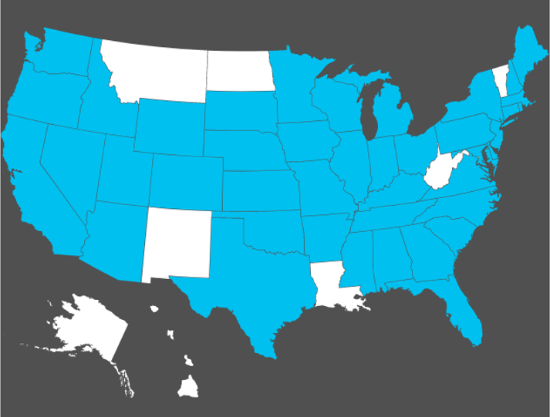
2022 AAC
A Virtual Event
March 17-19
Notes:
Map is a great way to seek out groups that are local to you
Remember to note that some groups have been more or less active than others during the pandemic – people interested in certain groups can reach out to group leaders using provided contact info or to me/others at NAF
Getting involved with a local group can be a great way to find out about things happening near you (events, research opportunities, etc.)

Slide 5
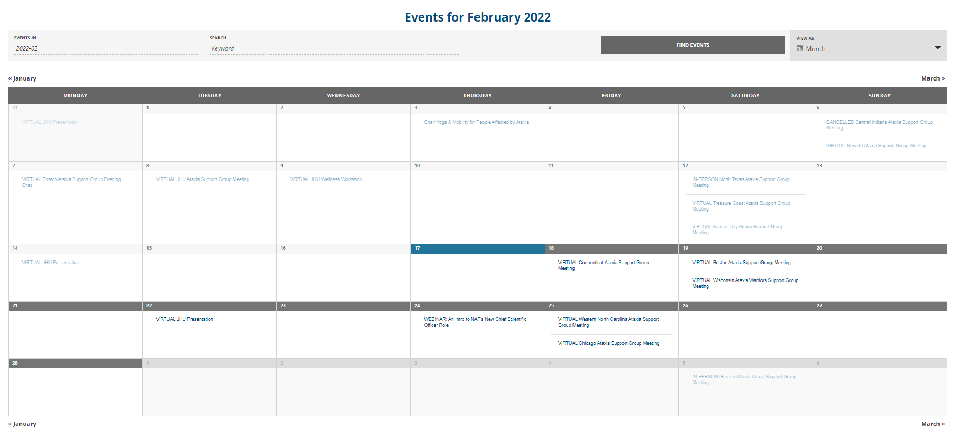
2022 AAC
A Virtual Event
March 17-19
Notes:
Calendar is a great way to seek out groups that fit your schedule rather than your location
Benefits of zoom/virtual meetings – you can join any group you like – they do not have to be your local group
Contact information for support group leaders will be included in the meeting description when clicked on if you need to reach out with questions

Slide 6
International Support Groups
Affiliation Support Groups
Under 30 with Ataxia
Ottawa Support Group
Spouses and Partners of Loved Ones with Ataxia
Global Ataxia Support Group
Parents of Kids with Ataxia
African Americans with Ataxia
U-MATTR: Unbroken- Military Members with Ataxia Talking Team Room
2022 AAC
A Virtual Event
March 17-19
Notes:
Most of these groups (exception of Ottawa) are not location specific and will always meet virtually
These groups and the contact information for their group leaders can be found on the website right below the support group map

Slide 7
2022 AAC
A Virtual Event
March 17-19
Notes:
Transition to talking about the benefits of joining a support group
Explain where this graphic came from – survey sent out to all support group members in Dec. 2021

Slide 8
“It feels great to fit in with a group that understands and supports each other in what we are going through.”
“I love the opportunity to socialize with those who share my experience and the chance to learn from guest speakers and experts in the ataxia field.”
“It’s fun to learn about new developments in ataxia research and to get tips and trick for easier living from other ataxians!”
2022 AAC
A Virtual Event
March 17-19
Notes:
Some anonymously submitted responses from members when asked what they liked about being involved in their group(s)
This is a great snapshot of the benefits to getting involved

Slide 9
What you can expect to see at a support group meeting:
Guest speakers discussing a variety of topics
Sharing and caring time
Social activities (pre- and post- pandemic)
Fundraisers
2022 AAC
A Virtual Event
March 17-19
Notes:
All groups are different! Some will do all of these things, others will only do some of them.
Reaching out to a group leader or just attending a meeting is the best way to find out what the routine of a particular group is like
DISCLAIMER ABOUT SHARING: people will often share tips and tricks, products, therapies, etc. that have worked for them. This is great! But please remember that what works for someone may not work for everyone and may not work for you. Especially when it comes to particular topics (such as exercises, mobility aids, medications, etc.) it is important to consult with your medical team first.

Slide 10
How to find a group that works for you:
Utilize the support group map if you want to find a group local to you
Utilize the calendar if you want to find a group that meets during a day and time convenient for your schedule
Remember that all groups are different! It’s okay to try out a few to find one that you like, or to join multiple to connect with more people!
2022 AAC
A Virtual Event
March 17-19

Slide 11
Interested in starting a new support group near you?
Support groups would not be able to exist without incredibly dedicated members like you to take on the necessary leadership role!
There are a lot of areas that currently have no established support groups as well as existing support groups in need of additional leadership.
Please contact NAF Program Coordinator, Sarah Pilato, to discuss your interest in starting a support group!
2022 AAC
A Virtual Event
March 17-19
Email: sarah@ataxia.org
Phone: (763)553-0093
Notes:
Is this too wordy? What else should I remember to include here?

Slide 12
Additional ways to get involved with NAF
NAF Membership
Advocacy
Webinars
Research Opportunities
2022 AAC
A Virtual Event
March 17-19
Notes:
Should this entire section stay? It was included in the example from last year and I think it’s great information to share but is this adding too much info when the main focus is supposed to be support groups?

Slide 13
NAF Membership
Invitations & Notices:
Live Webinars
Monthly e-news
Generations newsletter
Research Opportunities
Local Support Group Meetings
Community Events
2022 AAC
A Virtual Event
March 17-19

Slide 14
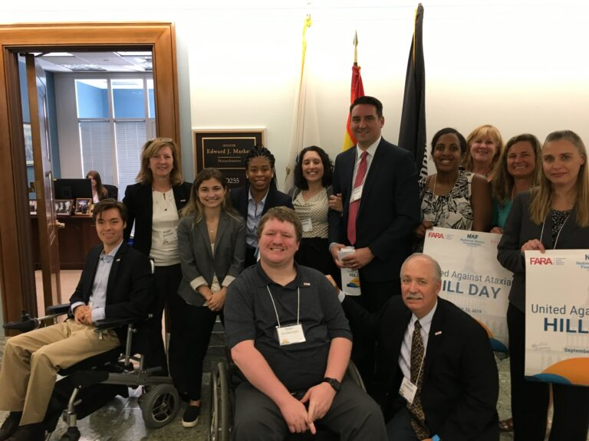
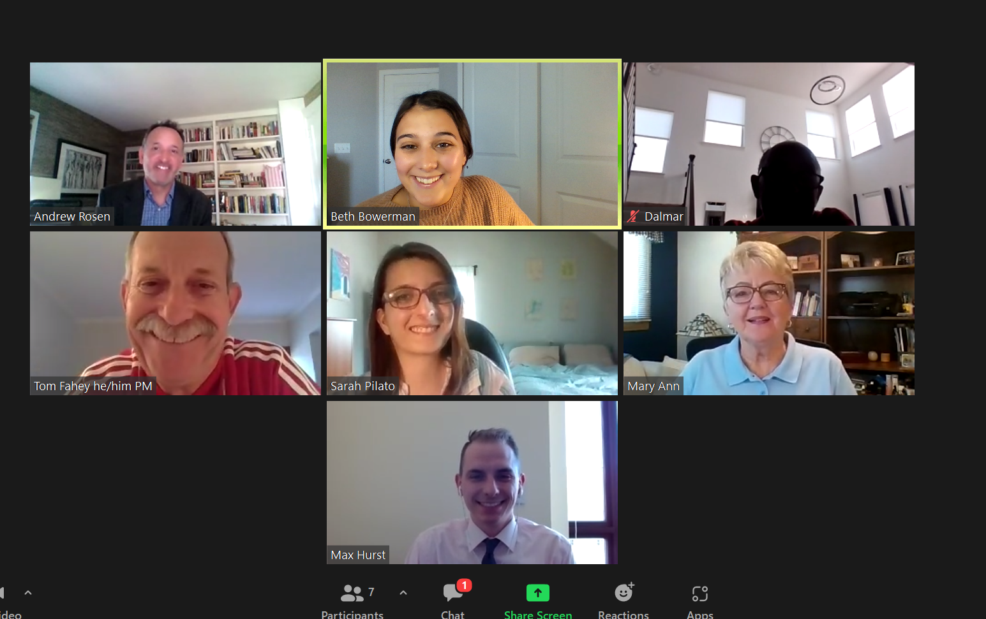
Advocacy
Involvement with advocacy efforts at NAF allows you to share your stories with policy makers, government agencies, and pharmaceutical companies to grow awareness, accelerate drug development, and ensure access to care and treatment services.
2022 AAC
A Virtual Event
March 17-19

Slide 15
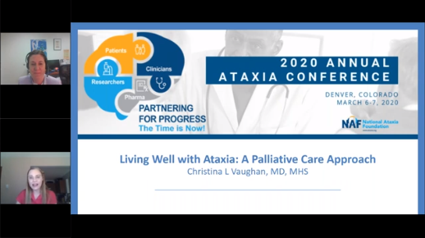
Webinars
NAF hosts webinars on a variety of topics of interest to the Ataxia Community throughout the year.
2022 AAC
A Virtual Event
March 17-19
Living Well with Ataxia: A Palliative Care Approach
Chair Yoga & Mobility for People Affected by Ataxia

Slide 16
Research Opportunities
CoRDS Ataxia Patient Registry
Clinical Trials
Research Studies
Natural History Study
Brain Tissue Donation Program
2022 AAC
A Virtual Event
March 17-19

Slide 17
Thank you for attending the Ataxia Support Groups session!
A Virtual Event
March 17-19, 2022

